Slide 1
Researching Legislative History of Alaska Statutes & Using Library Resources
Oct. 20, 2023

Slide 2
Objectives
Know that the Legislative Reference Library exists.
Identify legislative history materials and where they are found.
Find online resources and guides on how to do legislative history research.
Learn how to do basic legislative history research.

Slide 3
Legislative Reference Library
Terry Miller Bldg. Room 102
Juneau, AK
Hours: 8-5 M-F
Phone: 465-3808
Email: legislative.library@akleg.gov

Slide 4
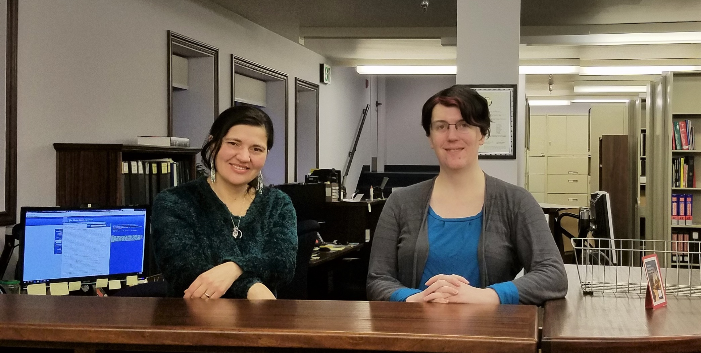
Legislative Library

Slide 5
What we do
Distribute legal materials (Statutes, session laws, etc.)
Maintain a collection to support the work of Leg. Legal, Research, and other staff.
Collect, preserve, and make available the records created by or for the legislature.
Help people with research using the above.

Slide 6
Legislative History Materials
What is meant by “legislative history materials?”
Items created or considered by the legislature in the course of its various official actions.
These items include introduced legislation, journals, committee minutes, bill files, audio/video recordings, subject compilations, reports, etc.

Slide 7
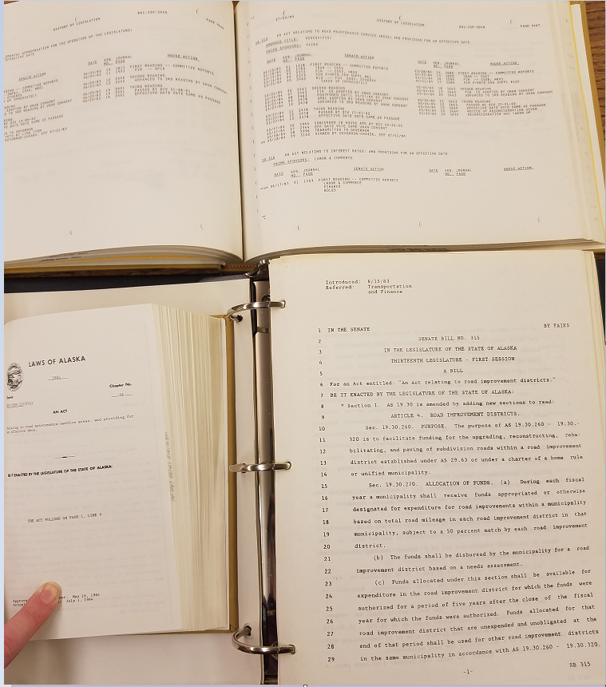
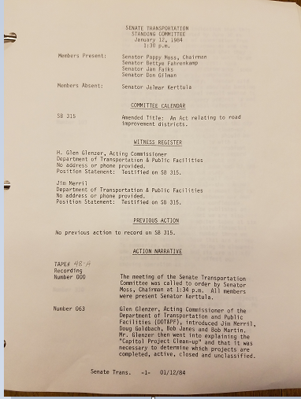
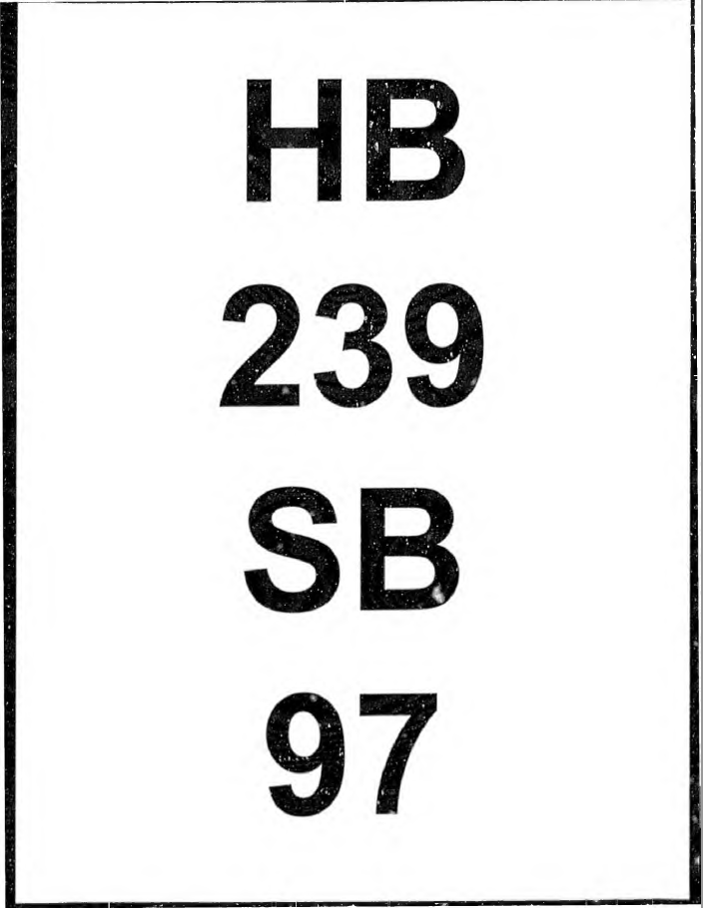
Examples
Counterclockwise from top left: bill history, session law, bill version, committee minutes, and committee bill file cover page

Slide 8
Legislative History Materials
Where can they be found?
Legislative Reference Library
Alaska Law Libraries
University system libraries
Legislative Information Offices
State Library/Archives
Online
Akleg.gov
LexisNexis/Westlaw
Details are complicated, consult the Guide to Legislative History Materials for specifics.

Slide 9
Law/Library Interactions
Generally speaking, the library fields requests for legislative history materials and research from everyone, the Dept. of Law included.
There are some indirect interactions: testimony on legislation, position papers, and the like do end up in our archives.

Slide 10
When requesting materials…
Please be as precise as possible.
There is a huge difference between requesting a complete legislative history of AS 43.55.011, Oil and gas production tax… and focusing on the meaning of “BTU equivalent barrel”, or the enactment and amendments to subsection (k).
This can also keep us from overwhelming you with information.
Please provide deadlines, so we can prioritize.
Being proactive is much better than requesting information the day before a filing deadline.
We recognize both of these are not always feasible.

Slide 11
Additional Training/Interesting Resources
Documents on akleg.gov website:
Guide to Alaska Legislative History Materials
Steps to Using Infobases…
Tips for Researching Alaska Legislative History
Various other items on the “Get Started” and “Publications” pages
Brown, Frederic. Sources of the Alaska and Oregon Codes. 2 UCLA-Alaska Law Review 15 & 87. (Useful for background)
Falk, Susan. Introduction to Researching Alaska Legislative History Materials. Alaska Law Review Vol. 28:2, pgs 279-293
Alaska court system training materials show up in Google searches….

Slide 12
Legislative History Research

Slide 13
Process (Procedural Viewpoint)
Topic -> statute -> session law -> bill -> bill history -> bill versions -> journals -> committee materials -> everything else.
Expect branching at every step.
Repeat until exhausted.
Watch out for complications…

Slide 14
Examples of Complications
Companion legislation contains the pertinent discussion.
Language drawn from other sources (bills, model laws, other states, etc.)
Legislation often develops over multiple legislatures.
Repeal/rewrites.
Leg. History materials may not exist.
Interactions with federal law.
… too many others to fully list.
Notes:
“The difficulties of so-called interpretation arise when the Legislature has had no meaning at all; when the question which is raised on the statute never occurred to it; when what the judges have to do is, not to determine what the Legislature did mean on a point which was present to its mind, but to guess what it would have intended on a point not present to its mind, if the point had been present.” -John Chipman Gray, The Nature and Sources of the Law, 173 (2nd ed. 1972)

Slide 15
Demonstrations of legislative history process
AS 45.25.300 – Unfair practices. (Motor Vehicle Transactions)

Slide 16
Legislative History – AS 45.25.300
Note: actual presentation will switch to using live BASIS at this point. The next slides can be used to follow the rough path of the live demonstration (expect tangents!), or for future reference and consultation.

Slide 17
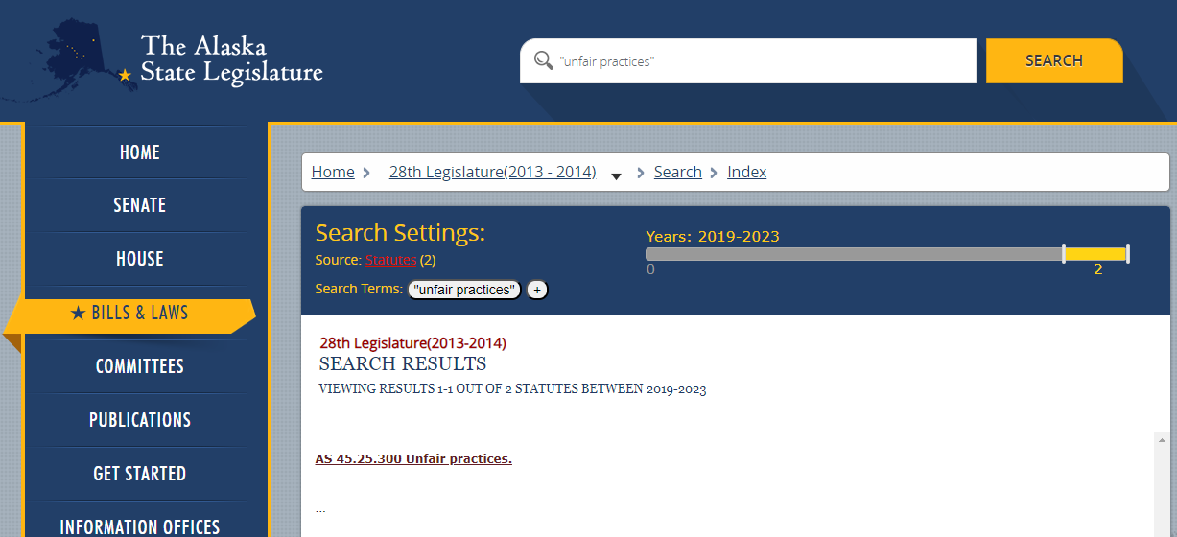
Identifying Statute
Search box terms and enter, source -> statutes, date range -> current legislature, examine results
Notes:
Unfortunately, search function was broken while updating, so this placeholder from a prior training will have to do.

Slide 18
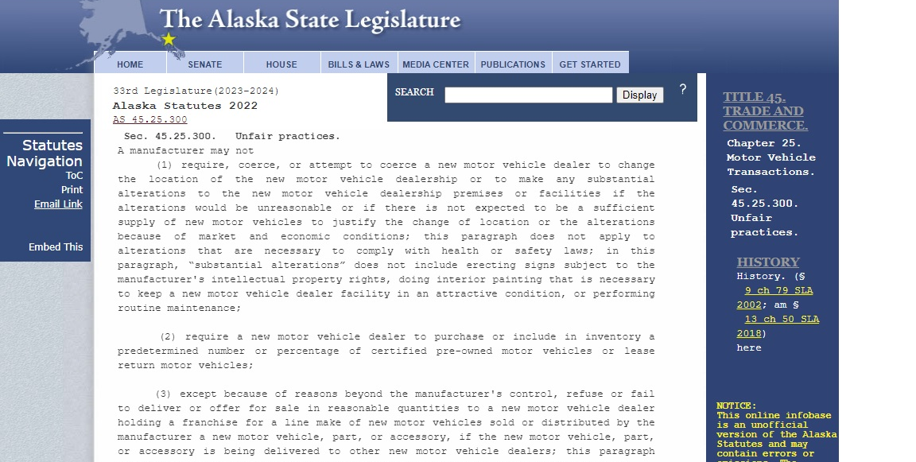
Identifying Session Law…
Typing the statute (AS xx in the search box, and hitting enter, will bring up this page. Note the history line in the right pane.

Slide 19
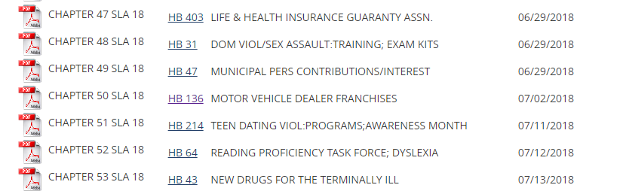
Session Law List (after selecting 2018)
PDF version of the session law, as well as direct link to the BASIS page for the bill.

Slide 20
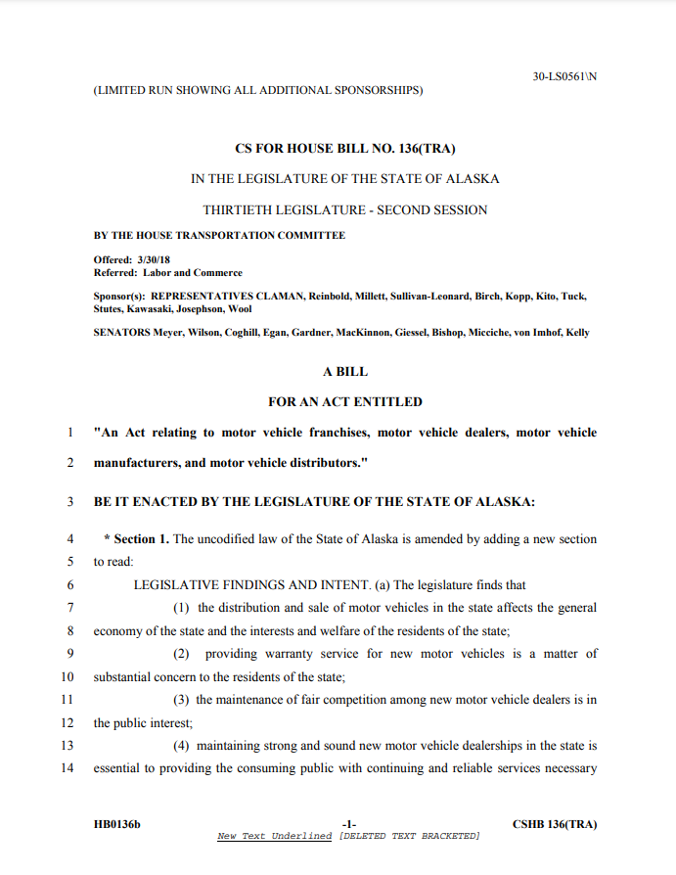
Note: the Session Laws of Alaska will have a slightly different version, with the session law number assigned and all effective date information. See next slide.

Slide 21
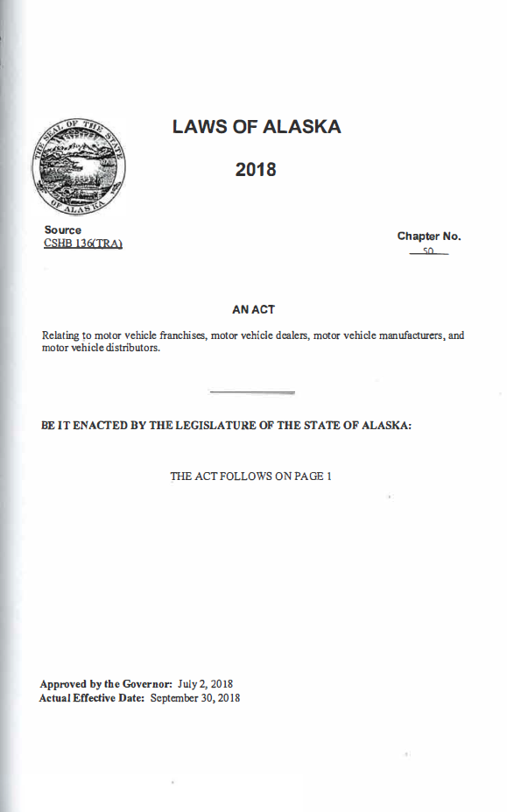
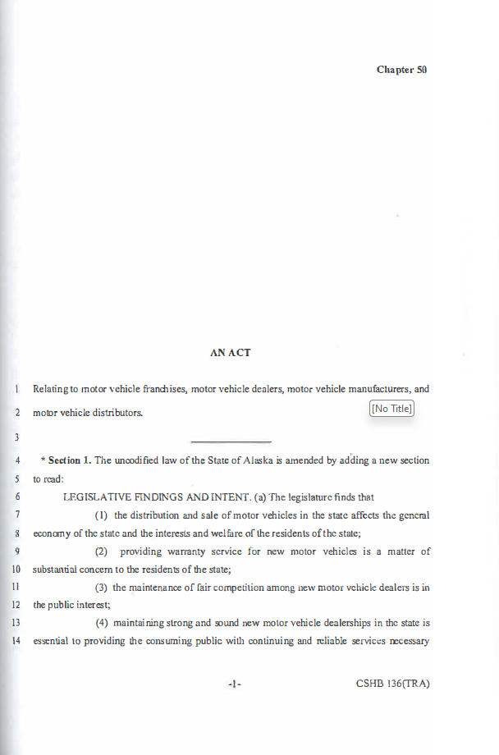

Slide 22
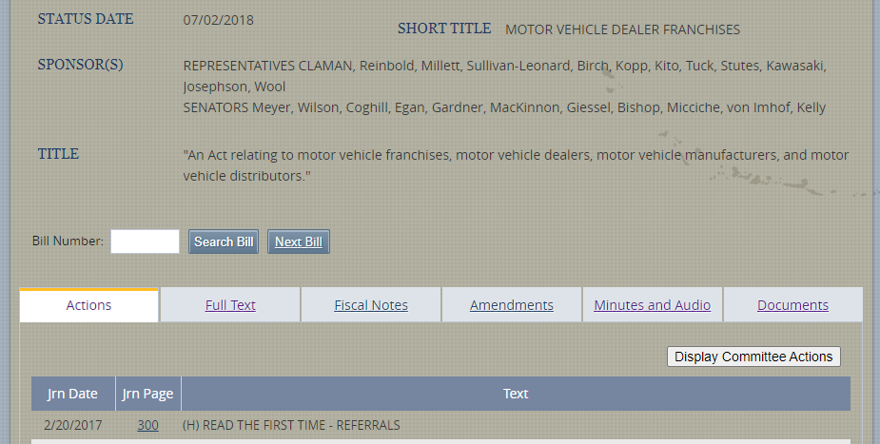
Main BASIS page for HB 136 (2018)
From here, you are able to access the bill history, journal pages, full text of all versions, fiscal notes, floor amendments, committee minutes, audio/video, and uploaded documents. Darker background indicates you are viewing historical data.

Slide 23
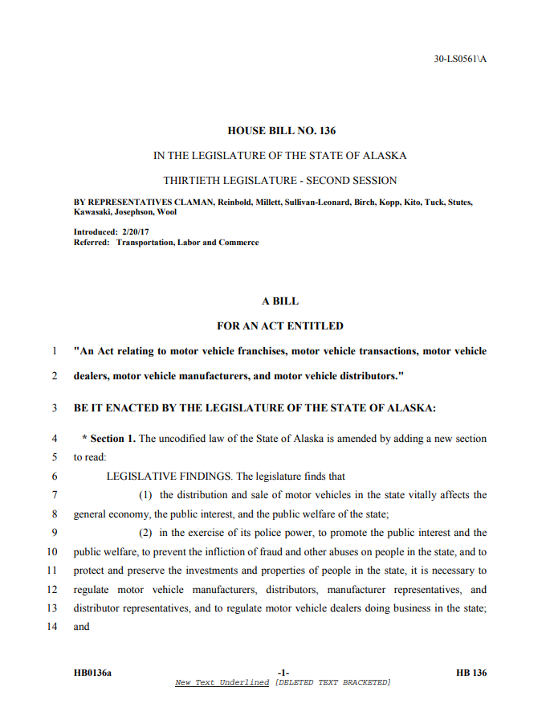
Initial Version

Slide 24
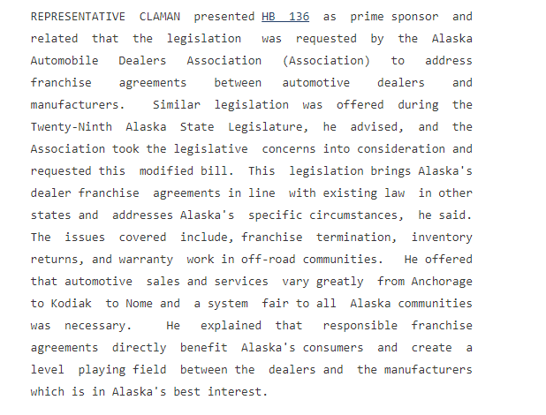
Committee Minutes (HTRA 03/21/2017)
Excerpts…

Slide 25
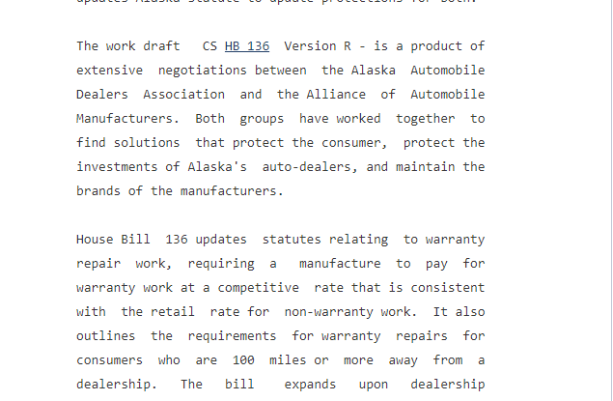
Committee Minutes (HL&C 04/02/2018)
Excerpts…

Slide 26
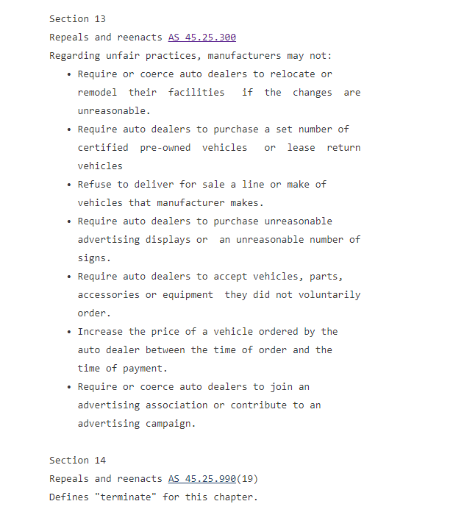

Slide 27
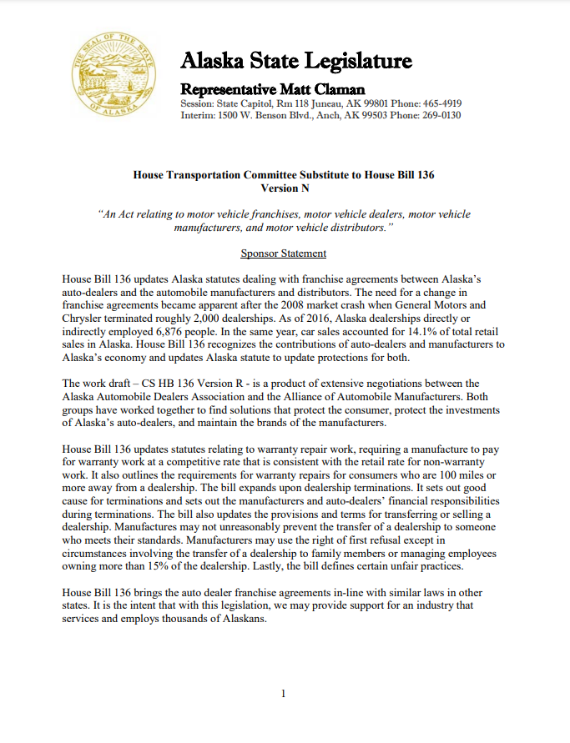
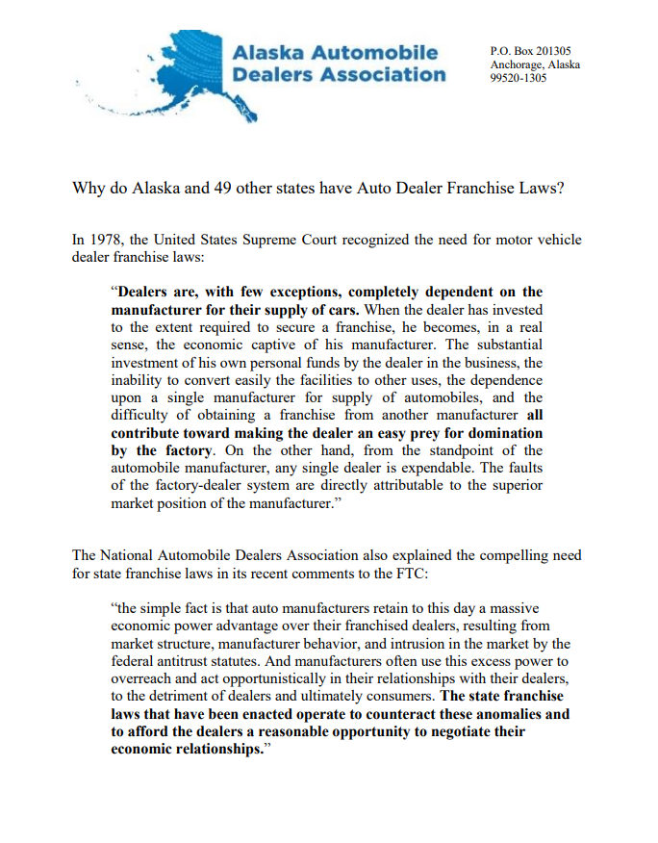
Pages from the House State Affairs Committee bill file for HB 239 (1995).

Slide 28
Demonstrations of legislative history process (Infobases)
AS 45.50.910-945, enacted in 1988.

Slide 29
Legislative History –
Note: Infobases are less user-friendly, and in the interests of time some steps may be skipped.
Hypothetical question: what was the intent behind the Uniform Trade Secrets Act (AS 45.50.910-945)?

Slide 30
Highlights continued
1962 is an important year: the bulk formal revision of the statutes took effect, organizing them into the current title, chapter, section format.
Compiled Laws of Alaska volumes were created in 1913, 1933, and 1949.
Prior to this are the Carter and Charlton codes… and frequent references to Hill’s Annotated Laws of Oregon.

Slide 31
In Closing…
Legislative history research can get complicated. Always feel free to contact the Library for help.
Terry Miller Bldg. Room 102
Juneau, AK
Hours: 8-5 M-F
Phone: 465-3808
Email: legislative.library@akleg.gov

Slide 32
(Reminder about additional guides…)
Documents on akleg.gov website:
Guide to Alaska Legislative History Materials
Steps to Using Infobases…
Tips for Researching Alaska Legislative History
Various other items on the “Get Started” and “Publications” pages
Falk, Susan. Introduction to Researching Alaska Legislative History Materials. Alaska Law Review Vol. 28:2, pgs 279-293

