Slide 1
Researching Legislative History of Alaska Statutes & Using Library Resources
Department of Law Presentation/Training, March 13, 2018

Slide 2
Objectives
Know that the Legislative Reference Library exists.
Identify legislative history materials and where they are found.
Be aware of how the library and the Dept. of Law interact, including how to make everything easier.
Find online resources and guides on how to do legislative history research.
Learn how to do basic legislative history research.

Slide 3
Legislative Reference Library
Terry Miller Bldg. Room 102
Juneau, AK
Hours: 8-5 M-F
Phone: 465-3808
Email: legislative.library@akleg.gov

Slide 4
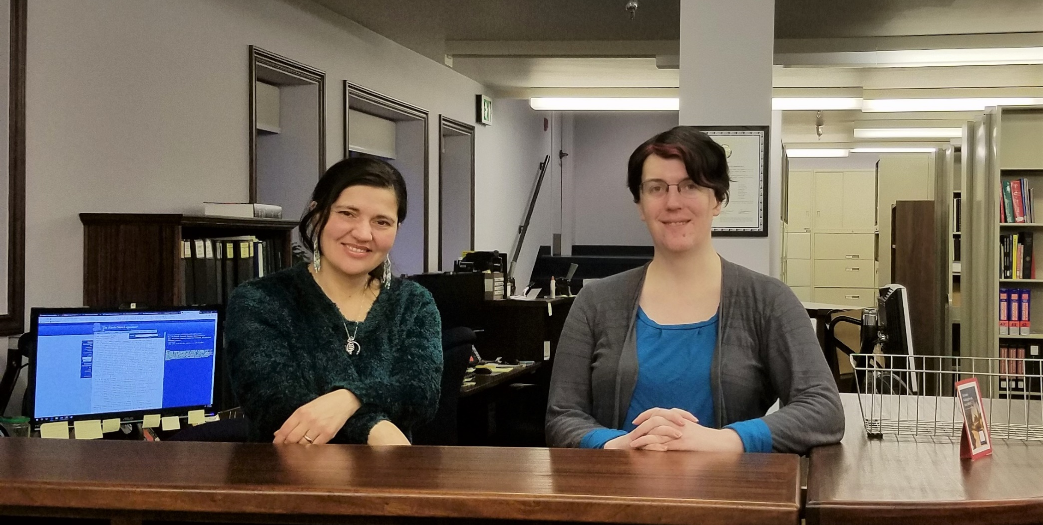
Legislative Library

Slide 5
What we do
Distribute legal materials (Statutes, session laws, etc.)
Maintain a collection to support the work of Leg. Legal, Research, and other staff.
Collect, preserve, and make available the records created by or for the legislature.
Help people with research using all of the above.

Slide 6
Legislative History Materials
What is meant by “legislative history materials?”
  Items created or considered by the legislature in the course of its various official actions.
  These items include introduced legislation, journals, committee minutes, bill files, audio/video recordings, subject compilations, reports, etc.

Slide 7
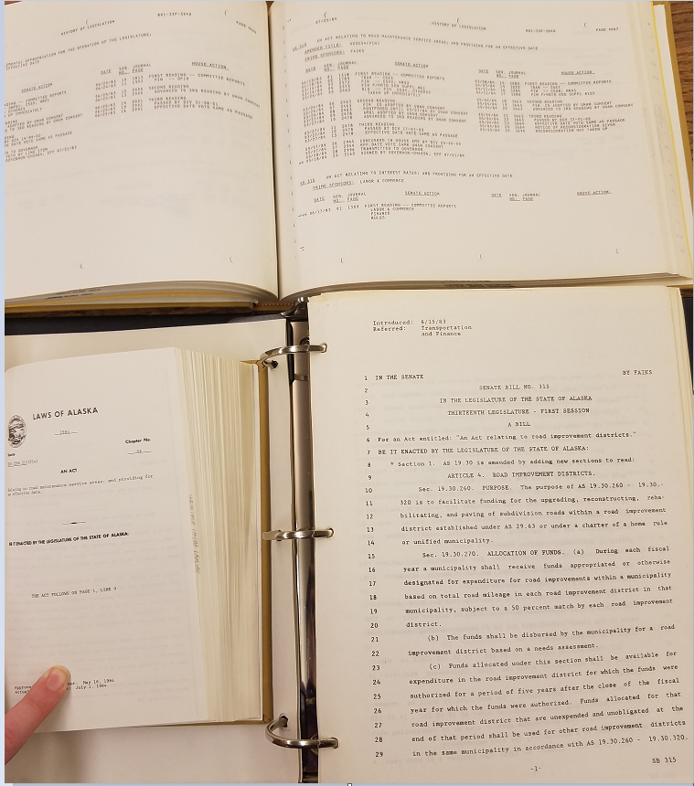
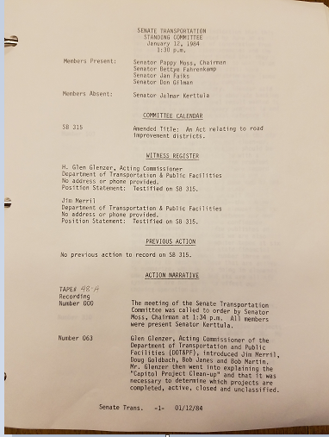
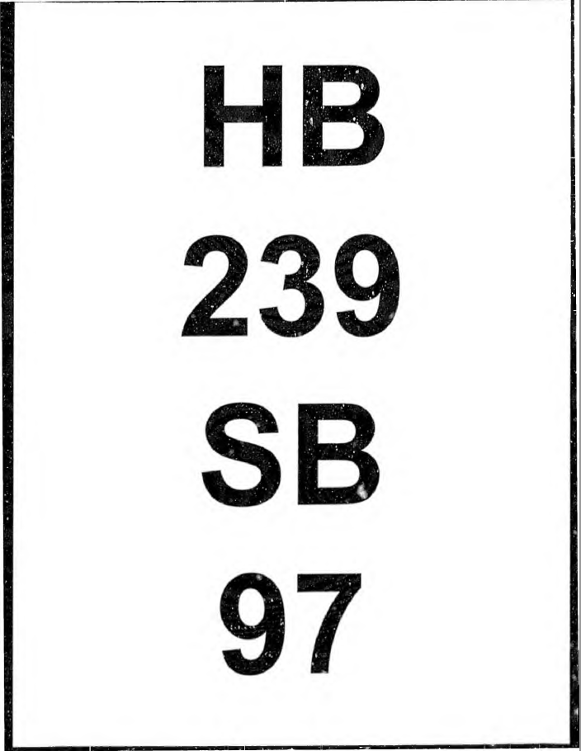
Examples
Counterclockwise from top left: bill history, session law, bill version, committee minutes, and committee bill file cover page

Slide 8
Legislative History Materials
Where can they be found?
  Legislative Reference Library
  Alaska Law Libraries
  University system libraries
  Legislative Information Offices
  State Archives
  Online
    Akleg.gov
    LexisNexis/Westlaw
Details are complicated, consult the Guide to Legislative History Materials for specifics.

Slide 9
Dept. of Law / Library Interactions
Generally speaking, the library fields requests for legislative history materials and research from everyone, the Department of Law included.
There are some indirect interactions: Governor’s Transmittal Letters, Dept. of Law testimony, and bill review files are often valuable sources of information.

Slide 10
When requesting materials…
Please be as precise as possible.
  There is a huge difference between requesting a complete legislative history of AS 43.55.011, Oil and gas production tax… and focusing on the meaning of “BTU equivalent barrel”, or the enactment and amendments to subsection (k).
  This also keeps us from overwhelming you with information.
Please provide deadlines, so we can prioritize.
  Being proactive is much better than requesting information the day before a filing deadline.
We recognize both of these are not always feasible.

Slide 11
Additional Training/Interesting Resources
Documents on akleg.gov website:
  Guide to Alaska Legislative History Materials
  Steps to Using Infobases…
  Tips for Researching Alaska Legislative History
  Various other items on the “Get Started” and “Publications” pages
Brown, Frederic. Sources of the Alaska and Oregon Codes. 2 UCLA-Alaska Law Review 15 & 87. (Useful for background)
Falk, Susan. Introduction to Researching Alaska Legislative History Materials. Alaska Law Review Vol. 28:2, pgs 279-293
Alaska court system training materials show up in Google searches….

Slide 12
Legislative History Research

Slide 13
Process (Procedural Viewpoint)
Topic -> statute -> session law -> bill -> bill history -> bill versions -> journals -> committee materials -> everything else.
  Expect branching at every step.
  Repeat until exhausted.
  Watch out for complications…

Slide 14
Examples of Complications
Companion legislation contains the pertinent discussion.
Language drawn from other sources (bills, model laws, other states, etc.)
Legislation often develops over multiple legislatures.
Repeal/rewrites.
Leg. History materials may not exist.
Interactions with federal law.
… too many others to fully list.
Notes:
“The difficulties of so-called interpretation arise when the Legislature has had no meaning at all; when the question which is raised on the statute never occurred to it; when what the judges have to do is, not to determine what the Legislature did mean on a point which was present to its mind, but to guess what it would have intended on a point not present to its mind, if the point had been present.” -John Chipman Gray, The Nature and Sources of the Law, 173 (2nd ed. 1972)

Slide 15
Demonstrations of legislative history process
State Insect

Slide 16
Legislative History – State Insect
Note: actual presentation will switch to using live BASIS at this point. The next slides can be used to follow the rough path of the live demonstration (expect tangents!), or for future reference and consultation. The presentation will be recorded, so that may be another option.

Slide 17
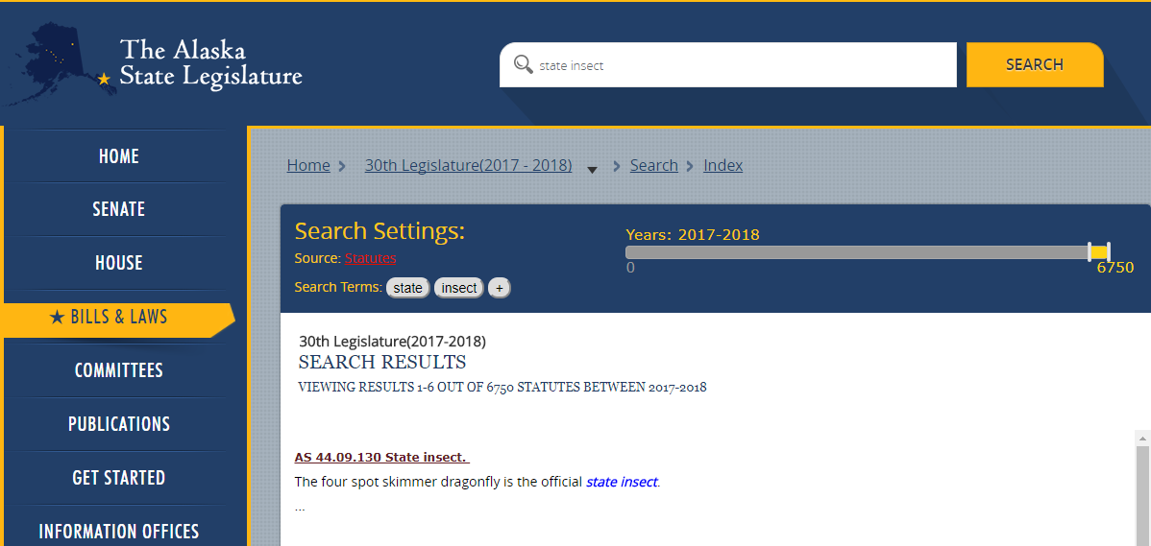
Identifying Statute
Search box terms and enter, source -> statutes, date range -> 2017-2018, examine results

Slide 18
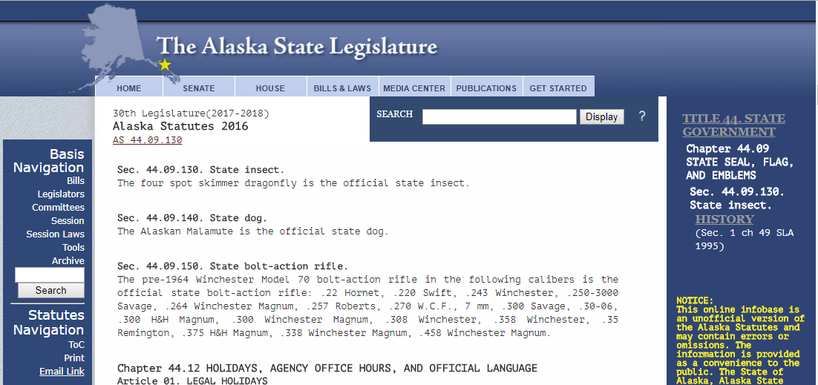
Identifying Session Law…
Typing the statute (AS xx in the search box, and hitting enter, will bring up this page. Note the history line in the right pane.

Slide 19
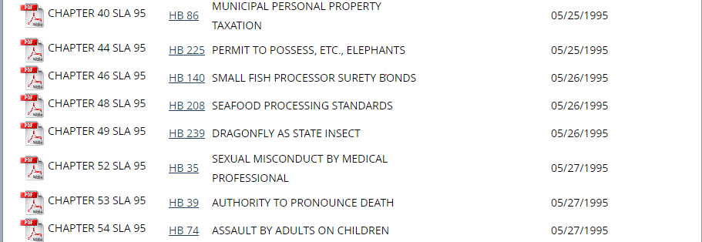
Session Law List (after selecting 1995)
PDF version of the session law, as well as direct link to the BASIS page for the bill.

Slide 20
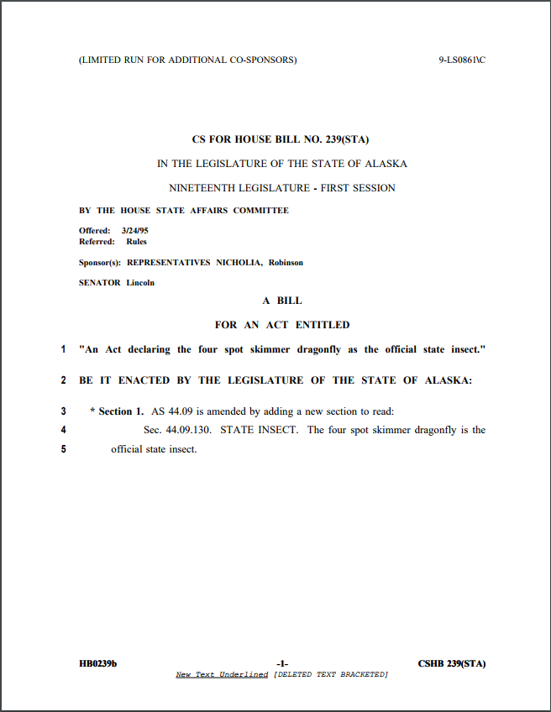
Note: the Session Laws of Alaska will have a slightly different version, with the session law number assigned and all effective date information. See next slide.

Slide 21
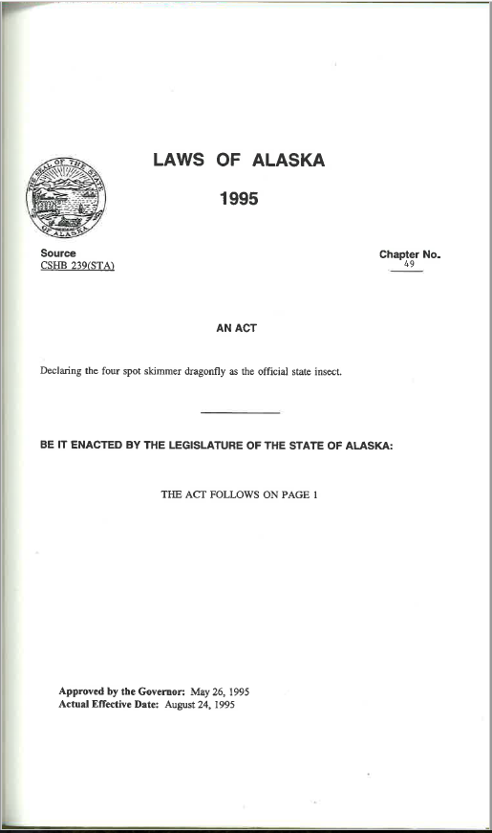
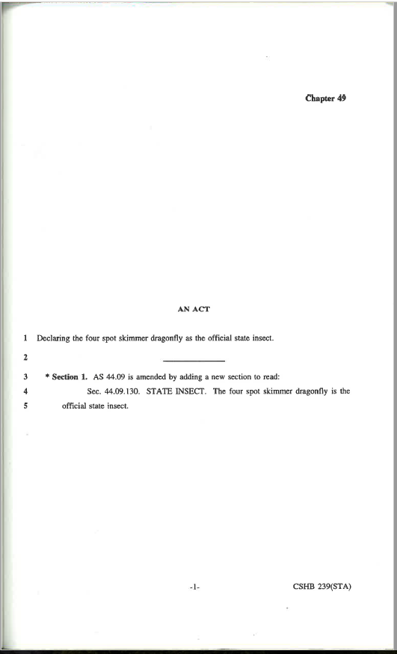

Slide 22
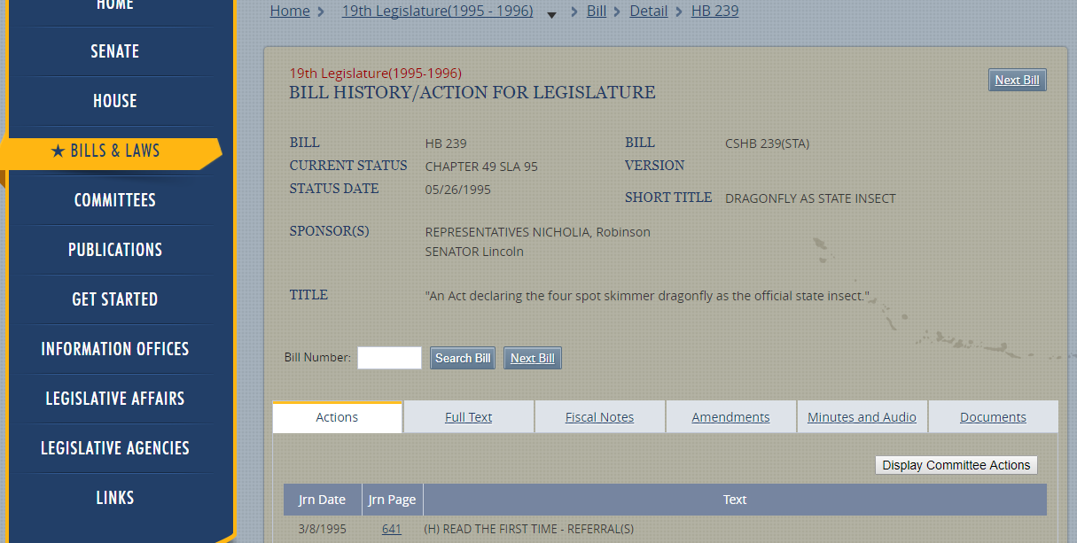
Main BASIS page for HB 239 (1995)
From here, you are able to access the bill history, journal pages, full text of all versions, fiscal notes, floor amendments, committee minutes, audio/video, and uploaded documents. Darker background indicates you are viewing historical data.

Slide 23
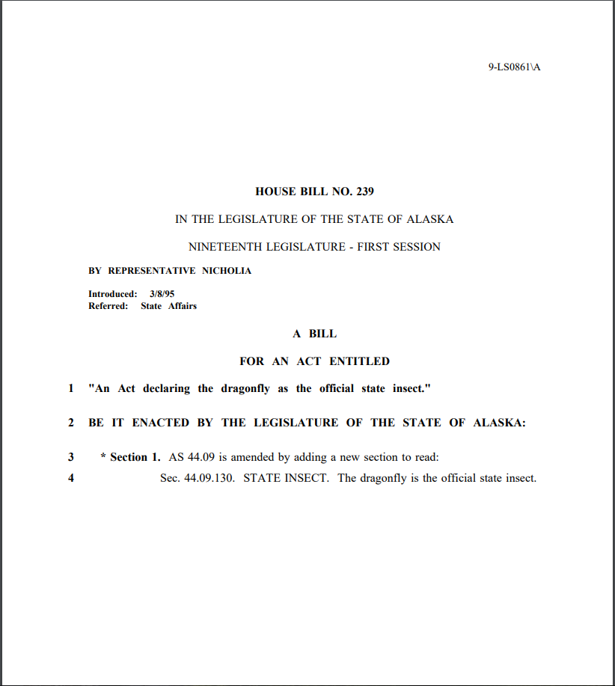
Initial Version

Slide 24
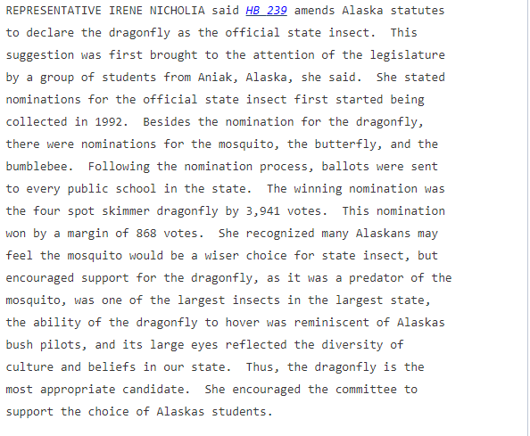
Committee Minutes (HSTA 03/23/1995)
Excerpts…

Slide 25
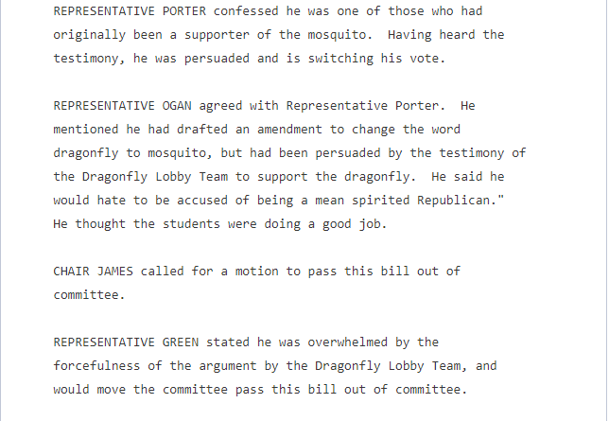
Committee Minutes (HSTA 03/23/1995)
Excerpts…

Slide 26
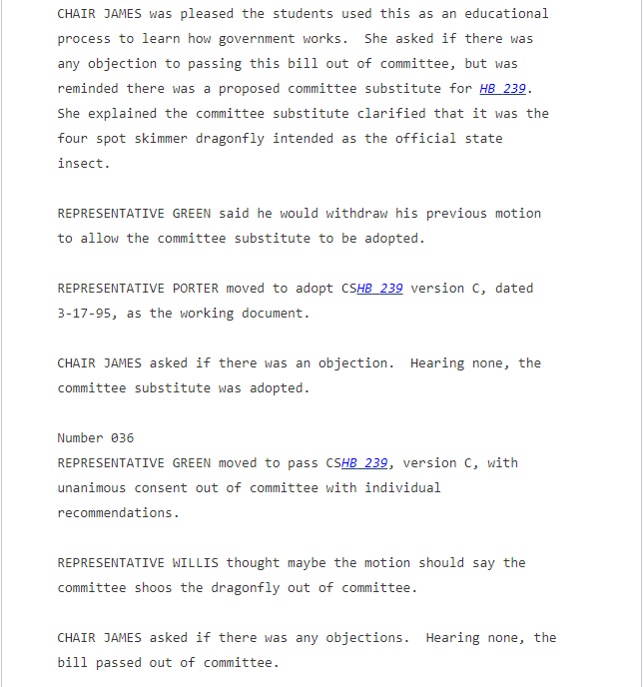

Slide 27
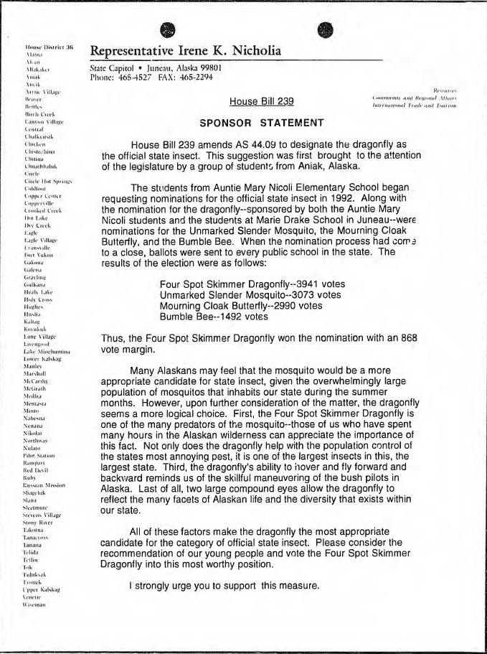
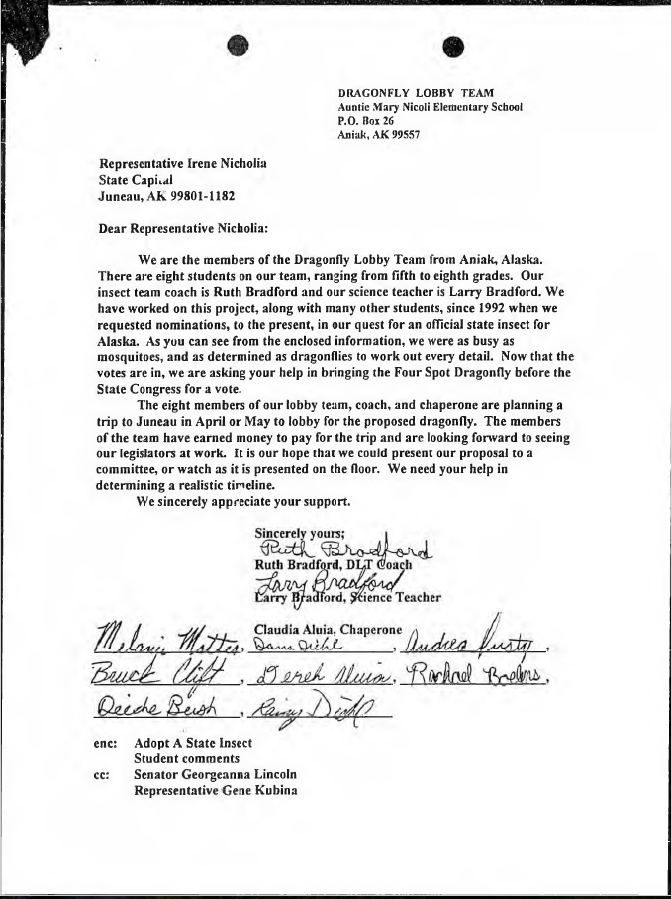
Pages from the House State Affairs Committee bill file for HB 239 (1995).

Slide 28
Demonstrations of legislative history process
Alaska State Defense Force

Slide 29
Legislative History – Alaska State Defense Force
Note: This legislative history is more complicated, and a lot of steps will be skipped or glossed over due to time constraints. Purpose is more to demonstrate some complications and how to deal with them.
Hypothetical question: when was the Alaska State Defense Force created?

Slide 30
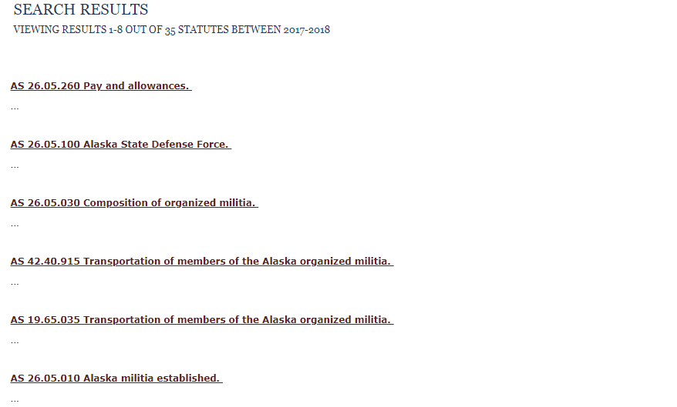
Several statute references to examine, AS 26.05.010, 26.05.030, and 26.05.100 appear most relevant.

Slide 31
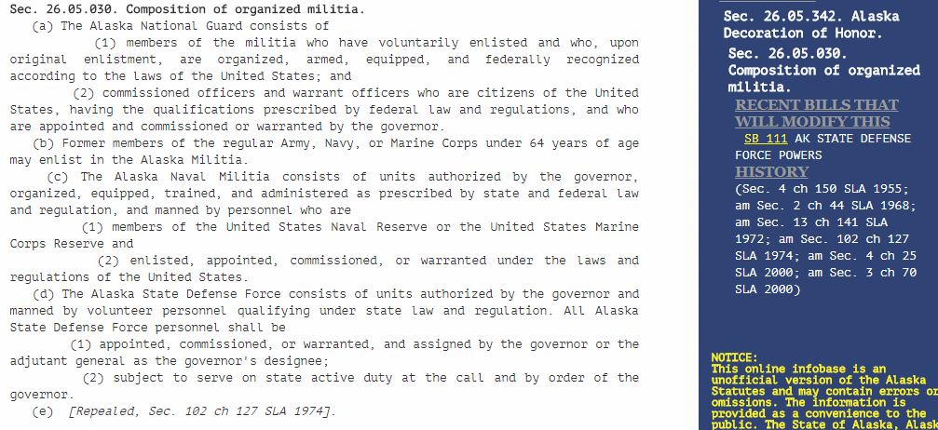
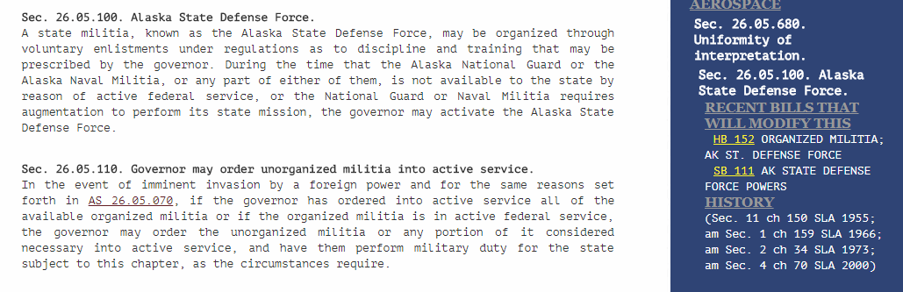

Slide 32
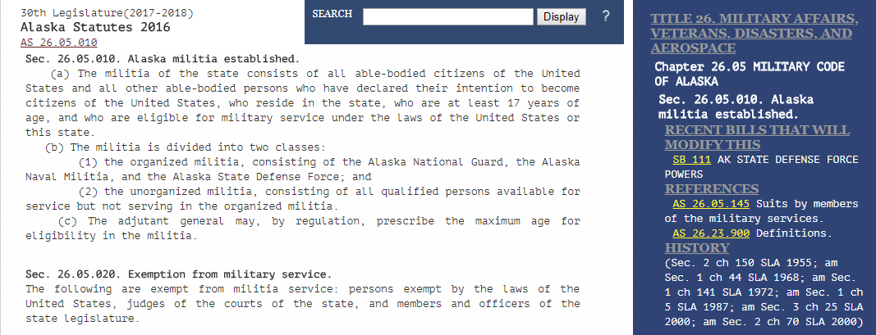
Initial assessment
3 relevant statutes, moderately interesting history lines: 10 session law references.
2 common to all 3 statutes: ch 150 SLA 1955, & ch 70 SLA 2000.
3 common to 2: ch 44 SLA 1968, ch 141 SLA 1972, & ch 25 SLA 2000.

Slide 33
Session Laws
From here, it will be necessary to go through the digital files that accompany this PowerPoint in order to convey how these statutes have changed over time… and explore some of the wonderful complications that arise. (also, assess time and adjust)

Slide 34
Highlights for review post-presentation (State Defense Force)
Materials before 1983, and certain materials (bill files, audio) after 1983, require contacting one of the repositories listed in the Guide.
Multiple session laws acting on the same statute in the same year can cause confusion.
  Also emphasizes how important it is to know exactly what you are looking for: the first session law to change the name, the first to take effect, and the initial formation of what is now the Alaska State Defense Force are three different questions with different answers.
The first entry on the history line may not be the first enacted law.
  In this case, ch 150 SLA 1955 -> ch 120 SLA 1949 -> 1949 ACLA -> 55 Stat 879 (1941).
  Check for repeals, and see if the session law replaces or references prior law on the same topic.

Slide 35
Highlights continued
1962 is an important year: the bulk formal revision of the statutes took effect, organizing them into the current title, chapter, section format.
Compiled Laws of Alaska volumes were created in 1913, 1933, and 1949.
  Prior to this are the Carter and Charlton codes… and frequent references to Hill’s Annotated Laws of Oregon.

Slide 36
In Closing…
Legislative history research can get complicated. Always feel free to contact the Library for help.
Terry Miller Bldg. Room 102
Juneau, AK
Hours: 8-5 M-F
Phone: 465-3808
Email: legislative.library@akleg.gov

Slide 37
(Reminder about additional guides…)
Documents on akleg.gov website:
  Guide to Alaska Legislative History Materials
  Steps to Using Infobases…
  Tips for Researching Alaska Legislative History
  Various other items on the “Get Started” and “Publications” pages
Falk, Susan. Introduction to Researching Alaska Legislative History Materials. Alaska Law Review Vol. 28:2, pgs 279-293

