Slide 1
Gas to Gasoline
via Methanol for Alaska North Slope
House Resources Committee Hearing
January, 25th 2012

Slide 2
Content
Purpose of Presentation
Janus Methanol AG
North Slope Gasoline Project
GigaMethanol® Opportunity
Technologies for Conversion of Natural Gas into Gasoline
Ideas for realising this Project

Slide 3
Purpose of Presentation
To present a solution for the use of North Slope natural gas and viscosity reduction in the Aleyaska pipeline via production of gasoline and injection of the gasoline into the TAPS pipeline to Valdez, as the most economical and safest alternative for the use of Alaska natural gas

Slide 4
Janus Methanol AG
Registered In Switzerland – a methanol and chemicals development and operating company
GigaMethanol B.V. – special purpose company for project development in Mozambique
Janus team consists of highly experienced methanol specialists having developed, financed, built, operated and marketed numerous plants
Chairman – Mr. Deo van Wijk
Janus Methanol AG
GigaMethanol B.V.
100%

Slide 5
Janus Methanol AG
Mr. van Wijk formed Saturn in 1994 – built Titan and Atlas in Trinidad together with BP utilising Lurgi Technology
Janus formed in 2007 – comprising approximately 30 people
Top 10 people have 30+ years’ experience in design and construction of industrial projects each
Worldwide experience comes from BP, Lurgi, Ferrostaal, KTI/Mannesmann and Metallgesellschaft
Strong history of large scale projects

Slide 6
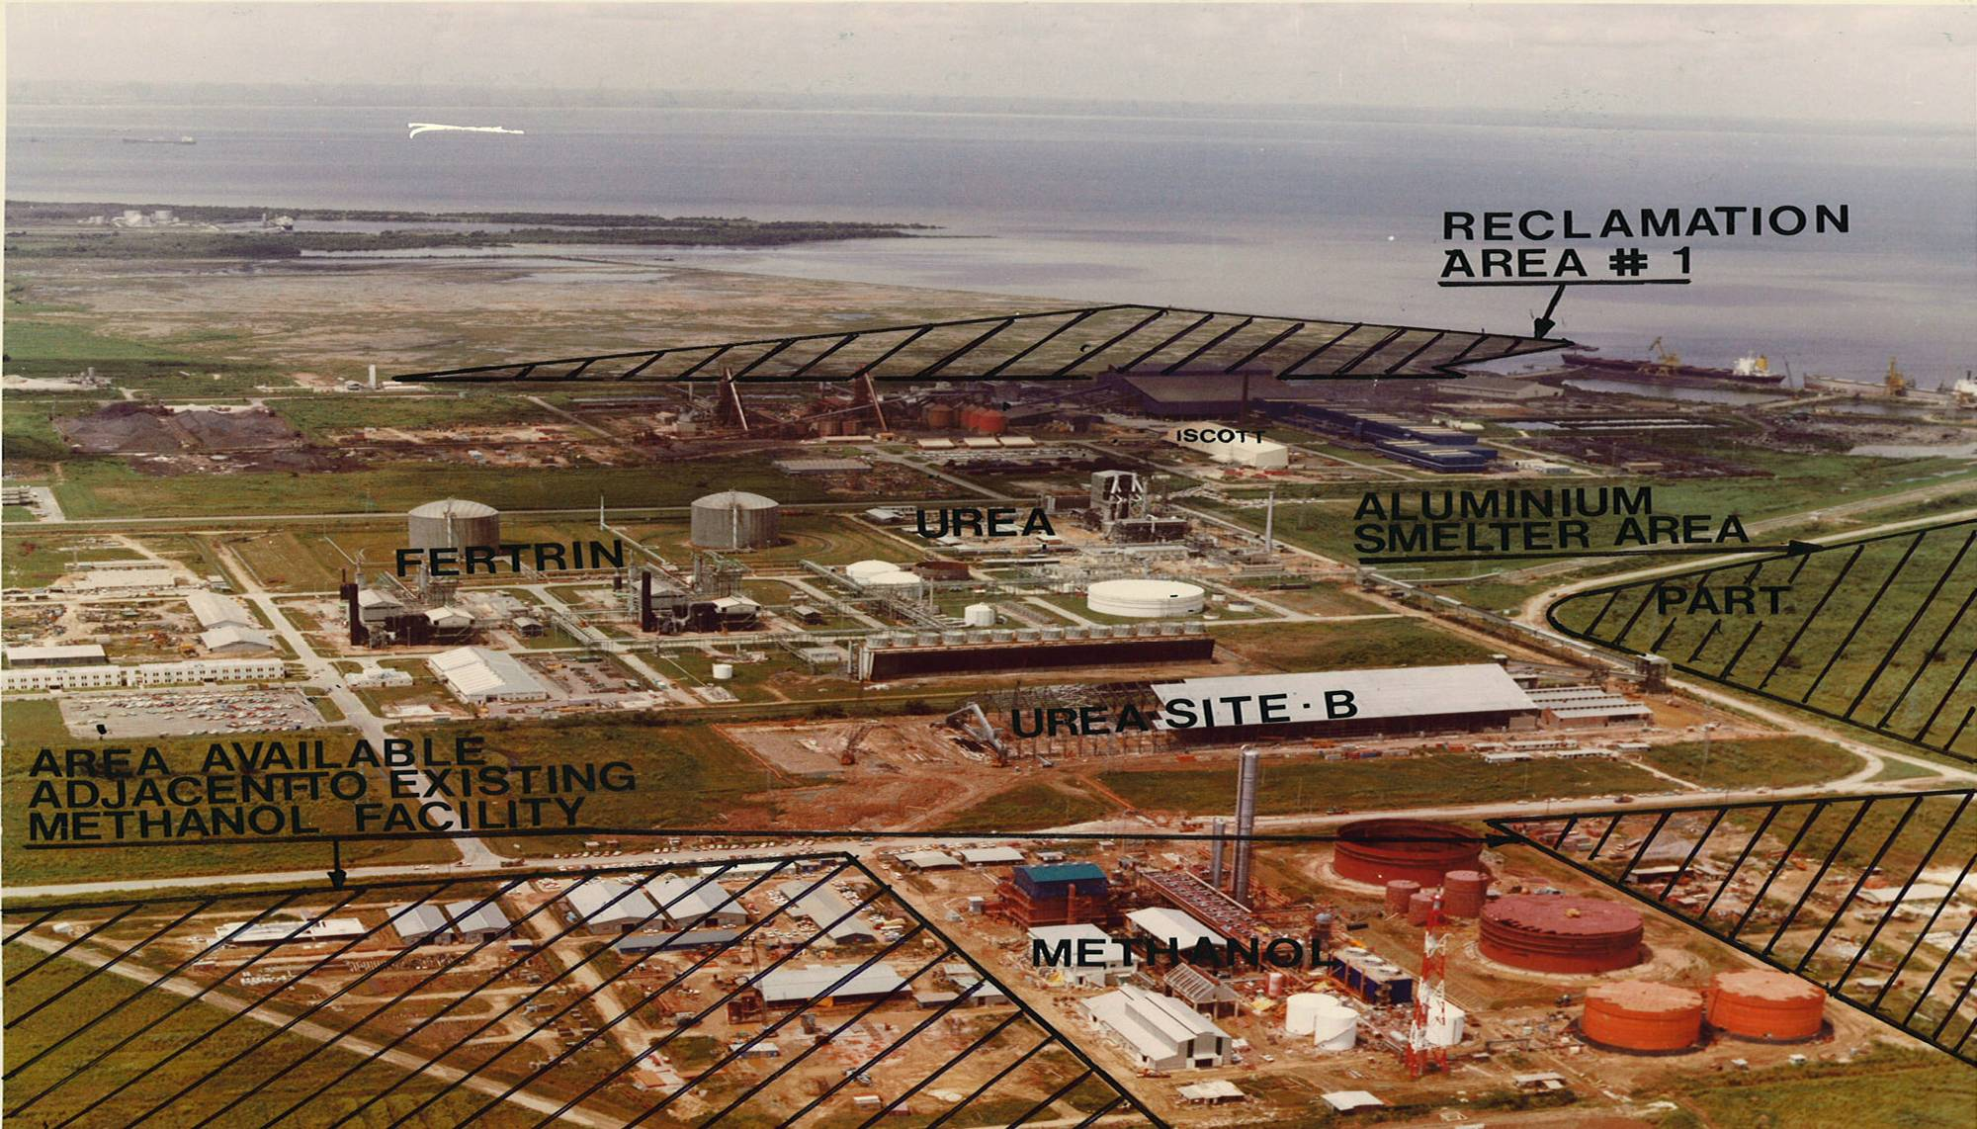
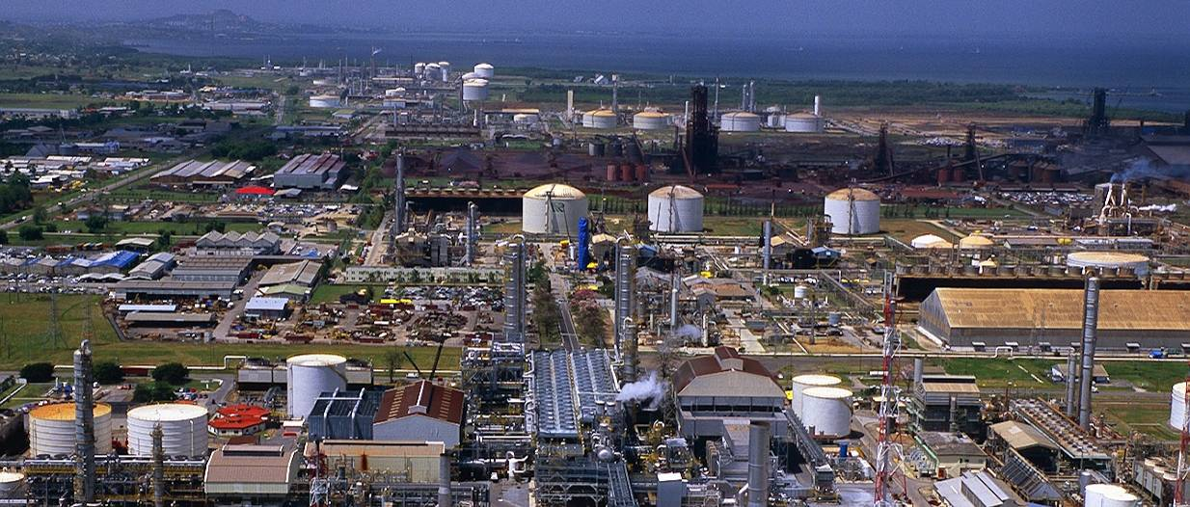
Our Experience in Trinidad &Tobago
Early 1990‘s
2009

Slide 7
North Slope Gasoline Project
Consisting of
2 GigaMethanol® trains producing together 7.0 million (metric)tpy methanol and
2 MTG trains converting the total amount of methanol into ~2.7 million (metric)tpy gasoline (~ 60,000 bbl per day)
2nd train is a 100 percent copy of the first, together with common utilities resulting in expected cost savings of 30 – 40 percent for the 2nd train and overall some 25% versus MegaMethanol® plant size

Slide 8
North Slope Gasoline Project
First phase (2 trains methanol including 2 trains gasoline, all figures below are of order of magnitude)
Investment: ~ 7.7 billion US$
Revenues per year: ~ 3.0 billion US$
Gas consumption: 4.4 tcf over 20 years
Production of methanol: 7.0 million ton per year
Out of 7.0 million ton of methanol
Production of gasoline: 2.66 million ton per year
Production of LPG: 0.35 million ton per year

Slide 9
North Slope Gasoline Project
Utilisation of the Lurgi’s most sophisticated and competitive technology in methanol
Access to ExxonMobil’s MTG technology proven in commercial production
Intended plant would be the worldwide largest methanol complex (~10% of annual global production)
Secured market outlet
A solution for the use of North Slope natural gas and viscosity reduction in the Aleyaska pipeline

Slide 10
GigaMethanol® Technology
10,000 ton methanol per day in a single train configuration based on the ATLAS plant (MegaMethanol® technology) in Trinidad
Utilising Lurgi’s high-pressure ATR-technology with a higher pressure compared to Mega-Methanol® technology
Economy of scale causes a significant reduction in specific investment cost compared to MegaMethanol® plant size

Slide 11
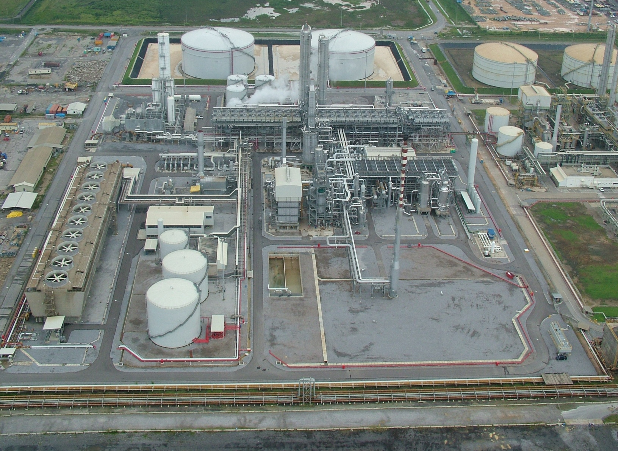
The ATLAS plant - the mother of MegaMethanol®
and the foundation of GigaMethanol
Plant located in Trinidad, one single train, design capacity: 5 000 tpd
In 2008: 360 operational days at 108% of design capacity

Slide 12
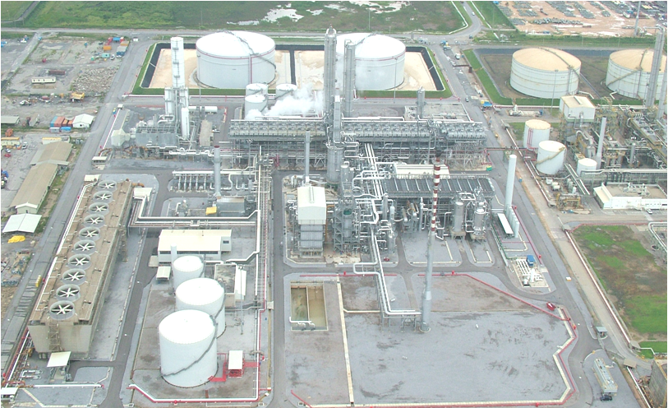
Distillation
Fired Heater
Syngas-compressor
Syngas
generation
Methanol Synthesis
Air cooling
Seawater

Slide 13
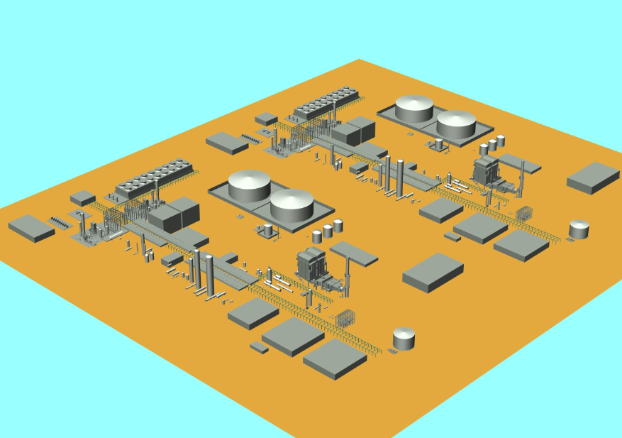
GIGAMETHANOL®
GigaMethanol® (HP ATR)
2 x 10,000 ton methanol per day

Slide 14
Conversion of Syngas into Gasoline
Fischer-Tropsch (FT)
Methanol to Gasoline (MTG)
Conversion of Syngas into Chemicals
Methanol to Propylene (MTP)
Methanol to Olefins (MTO)

Slide 15
Fischer-Tropsch (FT) Technology
Sasol, Shell, Mossgas, built and operate FT plants (latest Shell plant in Qatar costs US$ 24 billion investment for 5 million ton per year gasoline and diesel)
Exxon patented the technology, but never built
All oil companies researched FT technology but never built
Chinese researched and built a FT plant
Oil companies do not like methanol (?)

Slide 16
Methanol to Gasoline (MTG) Technology
Can be licensed from ExxonMobil
Used in New Zealand in the past, improved significantly since that time
In 2009 an optimised plant in Jincheng (China) started successfully and is running well
Chinese plant is reference for all future MTG projects
Train sizes up to 30,000 bpd (1.33 million tpy)

Slide 17
Methanol to Gasoline (MTG) Technology
The catalyst is key to the MTG technology
Janus has an agreement with ExxonMobil that ExxonMobil will license its MTG technology to Janus
Janus has an independent and perhaps exclusive access to a MTG catalyst

Slide 18
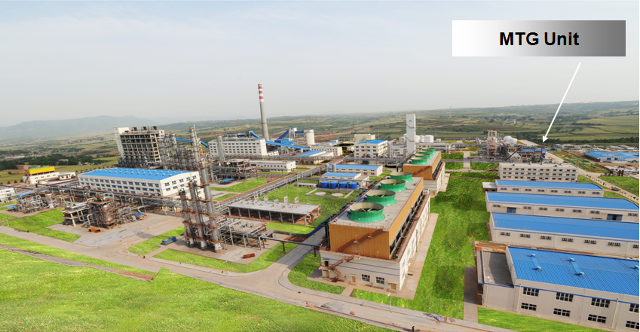
JAM Coal to Gasoline complex with MTG unit

Slide 19
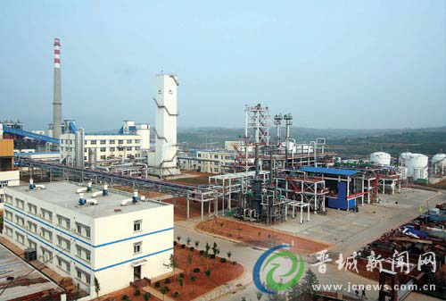

Slide 20
*

Slide 22
Natural Gas
Syngas Production
CO₂ Washing
FT Synthesis
Hydrogenation
Product Separation
* Diesel *Gasoline
* Naphtha * etc.
Syngas Production
MeOH Synthesis
Distillation
MTG Synthesis
* Gasoline * LPG
Natural Gas
Product S e
Fischer Tropsch Route
Methanol to Gasoline Route

Slide 23
*
* Public source

Slide 24
Advantages of MTG technology over Fischer-Tropsch
Low technical risk
Project simplicity
Higher carbon efficiency
Lower specific investment cost
No further upgrading of products necessary, such as hydrogenation of waxes
Advantages of FT over MTG technology
Production of Diesel
References
*

Slide 25
Alaska North Slope Project Potential
Declining flow of crude oil in TAPS pipeline, by 5-6% per year, is already a problem
water accumulation
increased corrosion
ice formation
wax deposits
viscosity issues
Availability of natural gas at North Slope

Slide 26
Alaska North Slope Project Potential
A perfect opportunity for
RNG (reformulated natural gas) gasoline
and then transporting the gasoline with the oil in the pipeline to Valdez and/or to the refineries

Slide 27
Ideas for realising this Project
Can be a partnership between ExxonMobil, PhilipsConoco, BP, Alyeska, State of Alaska and Janus
Janus proposes to do paid study in one or two phases (depending on scope and available budget)

Slide 28
Thank you
very much!

