Slide 1
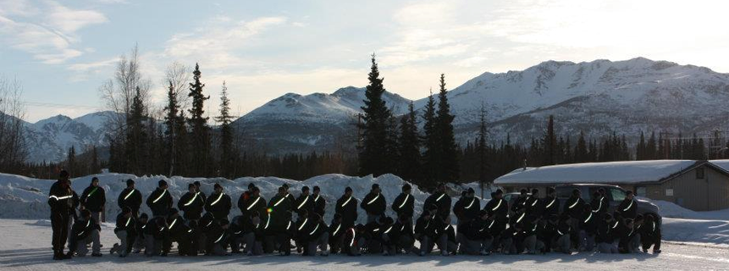
Alaska Military Youth Academy Youth ChalleNGe Program Overview
Senate Finance Subcommittee for the Department of Education and Early Development
10 September, 2013

Slide 2
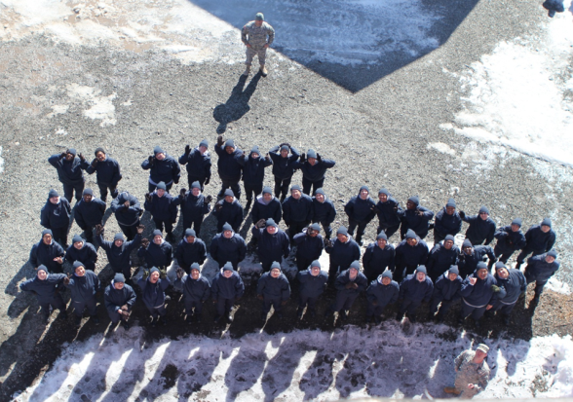
What is the Alaska Military Youth Academy?
Military style alternative program for 16 -18 year olds “at-risk” of not completing secondary education
Two-phased quasi-military school
5 ½ months residential
12 month post residential
Accredited Special Purpose School
AMYA established 1994
Accredited since 1997; good till 2018
HB180 legislation (signed 11 Jul 2013)
AMYA to be permanent component of DMVA
Effective January 1, 2014
HS Diploma/GED available
Authorized by Title 32 USC 509
DOD program
Administered through the National Guard
DODI 1025.8 of 20 Mar 2002
Federal and State Partnership
75/25% basic funding agreement
SOA funds at higher level
Unlikely to see higher federal support

Slide 3
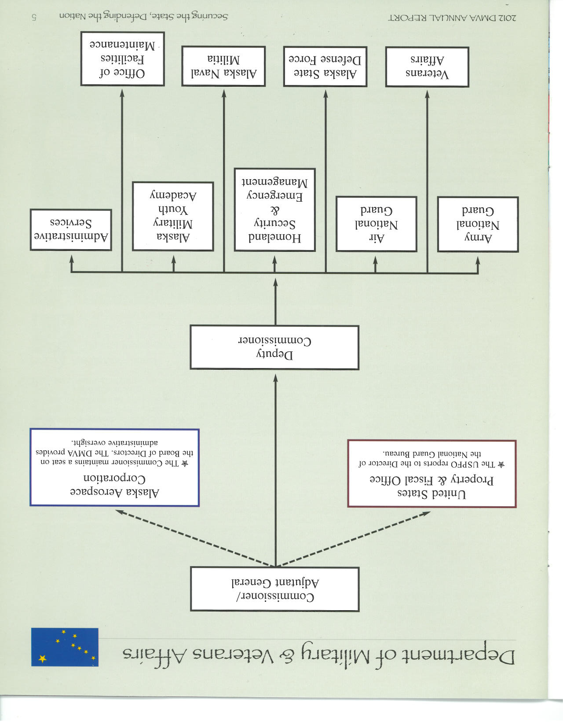
AMYA in DMVA
Mission: To help intervene in and reclaim the lives of Alaska’s at-risk youth and produce graduates with the values, skills, education and self-discipline to succeed as adults.

Slide 4
AMYA Organization & Support Overview & General Info
HQ
Admissions & Records (RPM)
Recruiting
Placement
Academics
Support Services
Medical
Cadre
Mentoring
Nursing Staff
Counseling
1st Plt
2nd Plt
Dining Facility
3rd Plt
Two 5 ½ month classes per year
Travel & residential
April- August
October-February
24/7 facility & staff
-Recruiting Station in Fairbanks & Dimond Center in Anchorage
-Supply, Procurement, IT, Budget, Construction, Maintenance, Pubic Relations, Admin assistance provided by DMVA & SOA

Slide 5
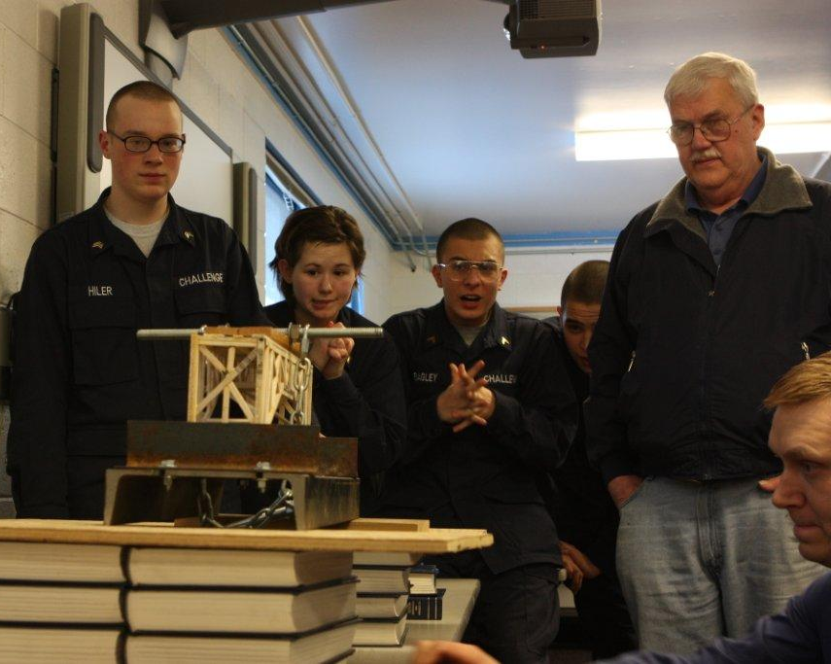
ChalleNGe model
Residential: 5 ½ month redirection phase
8 Core Components
Academic Excellence
Physical Fitness
Job Skills
Service to Community
Health and Hygiene
Responsible Citizenship
Leadership/Followership
Life Coping Skills
Post-residential: 12 month contact/support phase

Slide 6
AMYA General Information
Tot AMYA Graduates: 4,106
Tot AMYA HS Dipl/GEDs: 2,833
3-yr Avg TABE Increase: 1.26

Slide 8
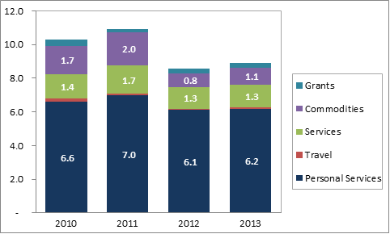
Costs over time
Notes:
6,195,470.13 PERSONALSERVICES
59,164.88 TRAVEL
1,338,372.49 SERVICES
1,053,414.47 COMMODITIES
244,536.80 GRANTS/BENEFITS
17,402.96 CAPITALOUTLAY

Slide 9
Personal Services Cost ($6.2M) Breakdown

Slide 10
Services Cost ($1.3M) Breakdown

Slide 11
Commodities Cost ($1.1M) Breakdown
Notes:
Business
Books & education
Office Equipment & Furn
IT Equipment
Household/Inst.
Food
Clothing/Uniforms
Cleaning
Supplies

Slide 12
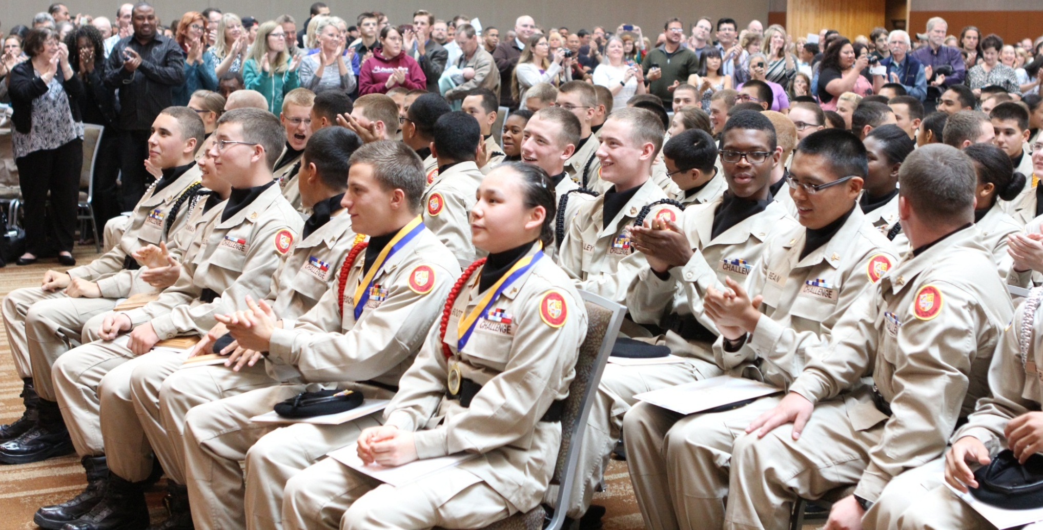
Questions?

