Slide 1
House HSS Committee Overview
Valerie Davidson | Commissioner
Dr. Jay Butler | Chief Medical Officer & Division Director
JANUARY 22, 2015

Slide 2
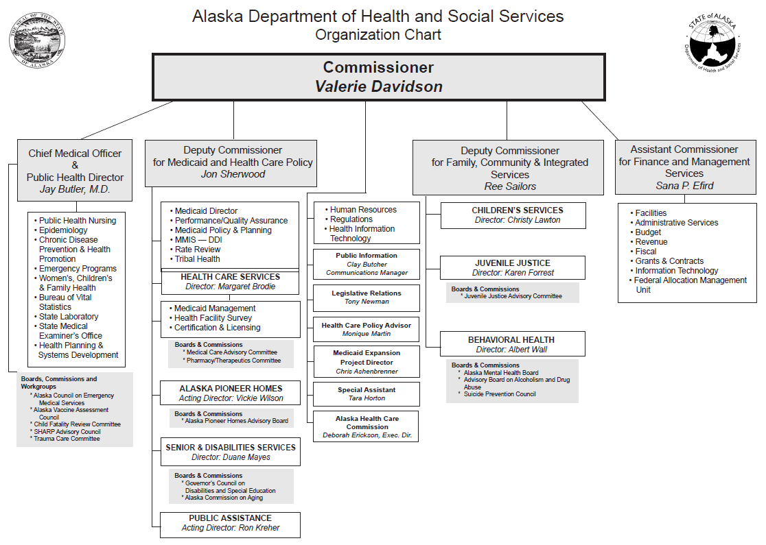

Slide 3
Executive Leadership
Commissioner | Valerie Davidson
Chief Medical Officer/Director | Dr. Jay Butler
Deputy Commissioner | Jon Sherwood
Medicaid and Health Care Policy
Deputy Commissioner | Ree Sailors
Family, Community & Integrated Services
Assistant Commissioner | Sana Efird
Finance and Management Services

Slide 4
Executive Leadership
Health Care Policy Advisor | Monique Martin
Medicaid Expansion Project Director | Chris Ashenbrenner
Legislative Liaison | Tony Newman
Special Assistant | Tara Horton

Slide 5
Health & Social Services
Alaska Pioneer Homes | Vickie Wilson (Acting Director)
Provide the highest quality of life in a safe home environment for older Alaskans and Veterans.
Behavioral Health | Al Wall (Director)
Manage an integrated and comprehensive behavioral health system based on sound policy, effective practices and partnerships.
Office of Children’s Services | Christy Lawton (Director)
Prevent and respond to child maltreatment in order to ensure safe children and strong families.
Health Care Services | Margaret Brodie (Director)
Manage health care coverage for Alaskans in need.

Slide 6
Health & Social Services
Division of Juvenile Justice | Karen Forrest (Director)
Hold juvenile offenders accountable for their behavior, promote the safety and restoration of victims and communities, and assist offenders and their families in developing skills to prevent crime.
Division of Public Assistance | Ron Kreher (Acting Director)
Provide self-sufficiency and provide for basic living expenses to Alaskans in need.
Division of Public Health | Dr. Jay Butler (CMO/Director)
Protect and promote the health of Alaskans.
Senior and Disabilities Services | Duane Mayes (Director)
Promote the independence of Alaskan seniors and persons with physical and developmental disabilities.

Slide 7
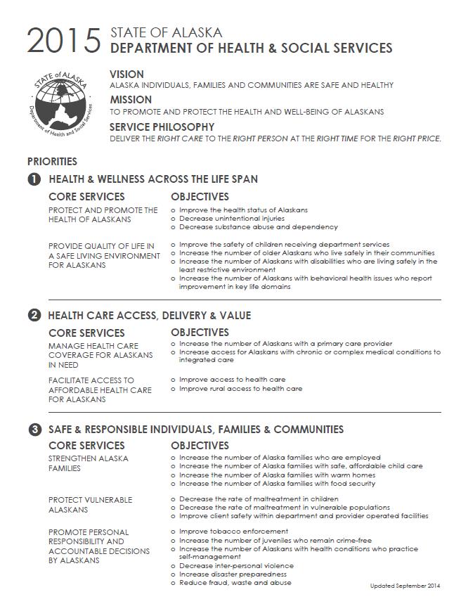

Slide 8
Areas of primary focus (4) (2015 and beyond)
1. Access to health care for Alaskans
Medicaid Expansion: investing in the health of Alaskans
System Improvements: enrolling individuals and paying providers
Medicaid Reform: develop an Alaska plan

Slide 9
Areas of primary focus (4) (2015 and beyond)
2. Child welfare | keeping our children safe
Maximizing relationships and resources to improve outcomes for Alaska’s children
2400+ children in out-of-home placements

Slide 10
Areas of primary focus (4) (2015 and beyond)
3. Tribal and Federal Partnerships
Enhancing partnerships to address health and child welfare issues
Removing barriers that impede our collective efforts

Slide 11
Areas of primary focus (4) (2015 and beyond)
4. Improving the health status of Alaskans (cont.)
Prevent and control complications of obesity
Reduce tobacco use
Reduce abuse of alcohol and other drugs
Prevent and improve management of injuries
Improve immunization coverage among pre-school aged children
Prevent and control infectious diseases
Prevent infant deaths
Implement Healthy Alaskans 2020 action plan

Slide 12
Looking to the future Governor Walker’s 2014 – HSS Transition Report
Five Recommendations
(Department will explore further in coming months)
Medicaid Expansion and Maximize Federal Revenue
Administrative Improvements (ie. Eligibility and Payment systems)
Behavioral Health Policy Improvement and Enforcement
Health Care Cost and Affordability
Safety Net Service Delivery (ie. Children at Risk, Community Access Hospitals, Disproportionate Share Hospitals, Long Term Care)

