Slide 1
Department of Administration Overview
Presented by
Commissioner Sheldon Fisher
House State Affairs Committee

Slide 2
Organization
Department of
Administration
Special Assistant
Commissioner
Megan Collie
Sheldon Fisher
CIO
Legislative Liaison
Deputy
Executive Secretary
Deputy
Minta Montalbo
Commissioner
Chad Medel
Commissioner
Leslie Ridle
Ryan Colgan
Enterprise
Division of
Division of
Division of Risk
Technology Services
Division of Finance
Division of General
Shared Services
Retirement and
Administrative
Management
Jim Steele
Scot Arehart
Services
Kevin Brooks
Benefits
Services
Scott Jordan
Ajay Desai
Cheri Lowenstein
Division of Personnel
Division of Motor
and Labor Relations
Vehicles
Kate Sheehan
Marla Thompson
Alaska Public
Violent Crimes
Alaska Public Offices
Office of Public
Broadcasting
Compensation Board
Internal SOA Services
Commission
Advocacy
Commission
Kate Hudson
Heather Hebdon
Rick Allen
External Public Services
Office of
Alaska Oil and Gas
Public Defender
Administrative
Conservation
Agency
Hearings
Commission
Boards and Commissions
Quinlan Steiner
Kathleen Frederick
Cathy Foerster

Slide 3
DOA Budget - UGF
FY2018 Governor
UGF | $69,036.1
DGF | $30,462.3
FEDERAL | $3,622.9
OTHER | $233,332.3
TOTAL | $336,453.6
$47,620.8 OPA &PDA
$ 6,765.1 SATS & ALMR
$ 5,425.2 Finance Statewide Accounting & Payroll Systems
$ 3,496.1 Public TV & Radio
$ 2,553.2 Internal Rate Subsidies
$ 321.4 Personnel Payroll & Classifications
$ 481.4 Non-Public Building Fund Facilities
$ 2,372.9 Miscellaneous

Slide 4
Department Priorities
Cost Containment, Efficiency, Smarter Government
Shared Services: streamline services and consolidate multiple back office functions by standing up a Shared Services Organization.
Statewide IT: streamline and consolidate IT through a Shared Service model.
Retirement and Benefits: drive efficiency in Division of Retirement and Benefits by modernizing IT and optimizing business functions.
Health Care Reform: Stabilize employee health plan and address long-term health strategy.
Put the AlaskaCare employee plan on a solid financial footing
Complete the Health Care Authority feasibility study
Create roadmap to drive statewide health care reform
Statewide Leases: optimize state’s footprint and leverage volume to reduce costs.
Statewide Workforce: Create and implement a model for improved employee effectiveness. Negotiate consistent, flexible contracts with statewide labor unions.

Slide 5
Shared Services: Government Efficiencies
Streamline services and consolidating operations.
Better, Faster, Cheaper.

Slide 6
Shared Services Overview
Current organizational structure is decentralized; increased budget and staff requirements with reduced focus on mission critical topics. Future structure represents a reduced demand on budget and staff while increasing agency focus on mission critical topics.
Decentralized
Shared Services
Benefits
Procurement
Continuous Improvement
Savings 10% in FY18 and 30% in FY19. 50% long term reductions.
Increased quality and service delivery.
Increased speed delivery.
Increased client satisfaction.
Finance
Facilities
Maintenance
Finance
Facilities
Maintenance
Agency
Shared Services
Human Resources
Operations & Technology
Human Resources
Operations & Technology
Major Lines
of Business
Procurement
Agency Focus
Agency
Major Lines
of Business
Better, Faster, Cheaper.

Slide 7
SSOA Roadmap – Pilots and initial waves are definitive
Nov-16
Dec-16
Jan-17
Feb-17
Mar-17
Apr-17
May-17
Jun-17
Jul-17
10/31
11/7
11/14
11/21
11/28
12/5
12/12
12/19
12/26
1/2
1/9
1/16
1/23
1/30
2/6
2/13
2/20
2/27
3/6
3/13
3/20
3/27
4/3
4/10
4/17
4/24
5/1
5/8
5/15
5/22
5/29
6/5
6/12
6/19
6/26
7/3
7/10
7/17
7/24
7/31
Travel & Expense Pilot
Administration Pilot
Travel & Expense Wave 1
Administration
Labor & Workforce Development
Revenue
Travel & Expense Wave 2
Commerce
Public Safety
Natural Resources
Corrections
Travel & Expense Wave 3
Law
Education
Transportation & PF
Environmental Conservation
Travel & Expense Wave 4
Collections Pilot
Fish & Game
Military & Veteran Affairs
Health & Social Services
Governor’s Office
Department of Revenue - PFD
Collections Wave 1
Department of Law
Collections Wave 2
Department #2
Department #3
Department #4
Collections Wave 3
Department #5
Department #6
Department #7
Collections Wave 4
Department #8
Department #9
Department #10
Accounts Payable Pilot
Department of Administration
Department of Commerce
Accounts Payable Wave 1
Corrections
Natural Resources
Transportation & PF
Accounts Payable Wave 2
Department of Labor
Department #7
Department #8
Wave 3
Department #9
Department #10
Department #11
Centralized Mail & Print Services
Procurement Consolidation
Vendor Rebate
eCatalog Deploy
P-Card Rebate
Facilities Maintenance – Juneau Pilot
CMMS Software Consolidation
Procurement / Contract Consolidation
Service Level Agreements
Staff & Equipment Moves
10/31
11/7
11/14
11/21
11/28
12/5
12/12
12/19
12/26
1/2
1/9
1/16
1/23
1/30
2/6
2/13
2/20
2/27
3/6
3/13
3/20
3/27
4/3
4/10
4/17
4/24
5/1
5/8
5/15
5/22
5/29
6/5
6/12
6/19
6/26
7/3
7/10
7/17
7/24
7/31
NB: Potential onboarding schedule will be confirmed with each department.

Slide 8
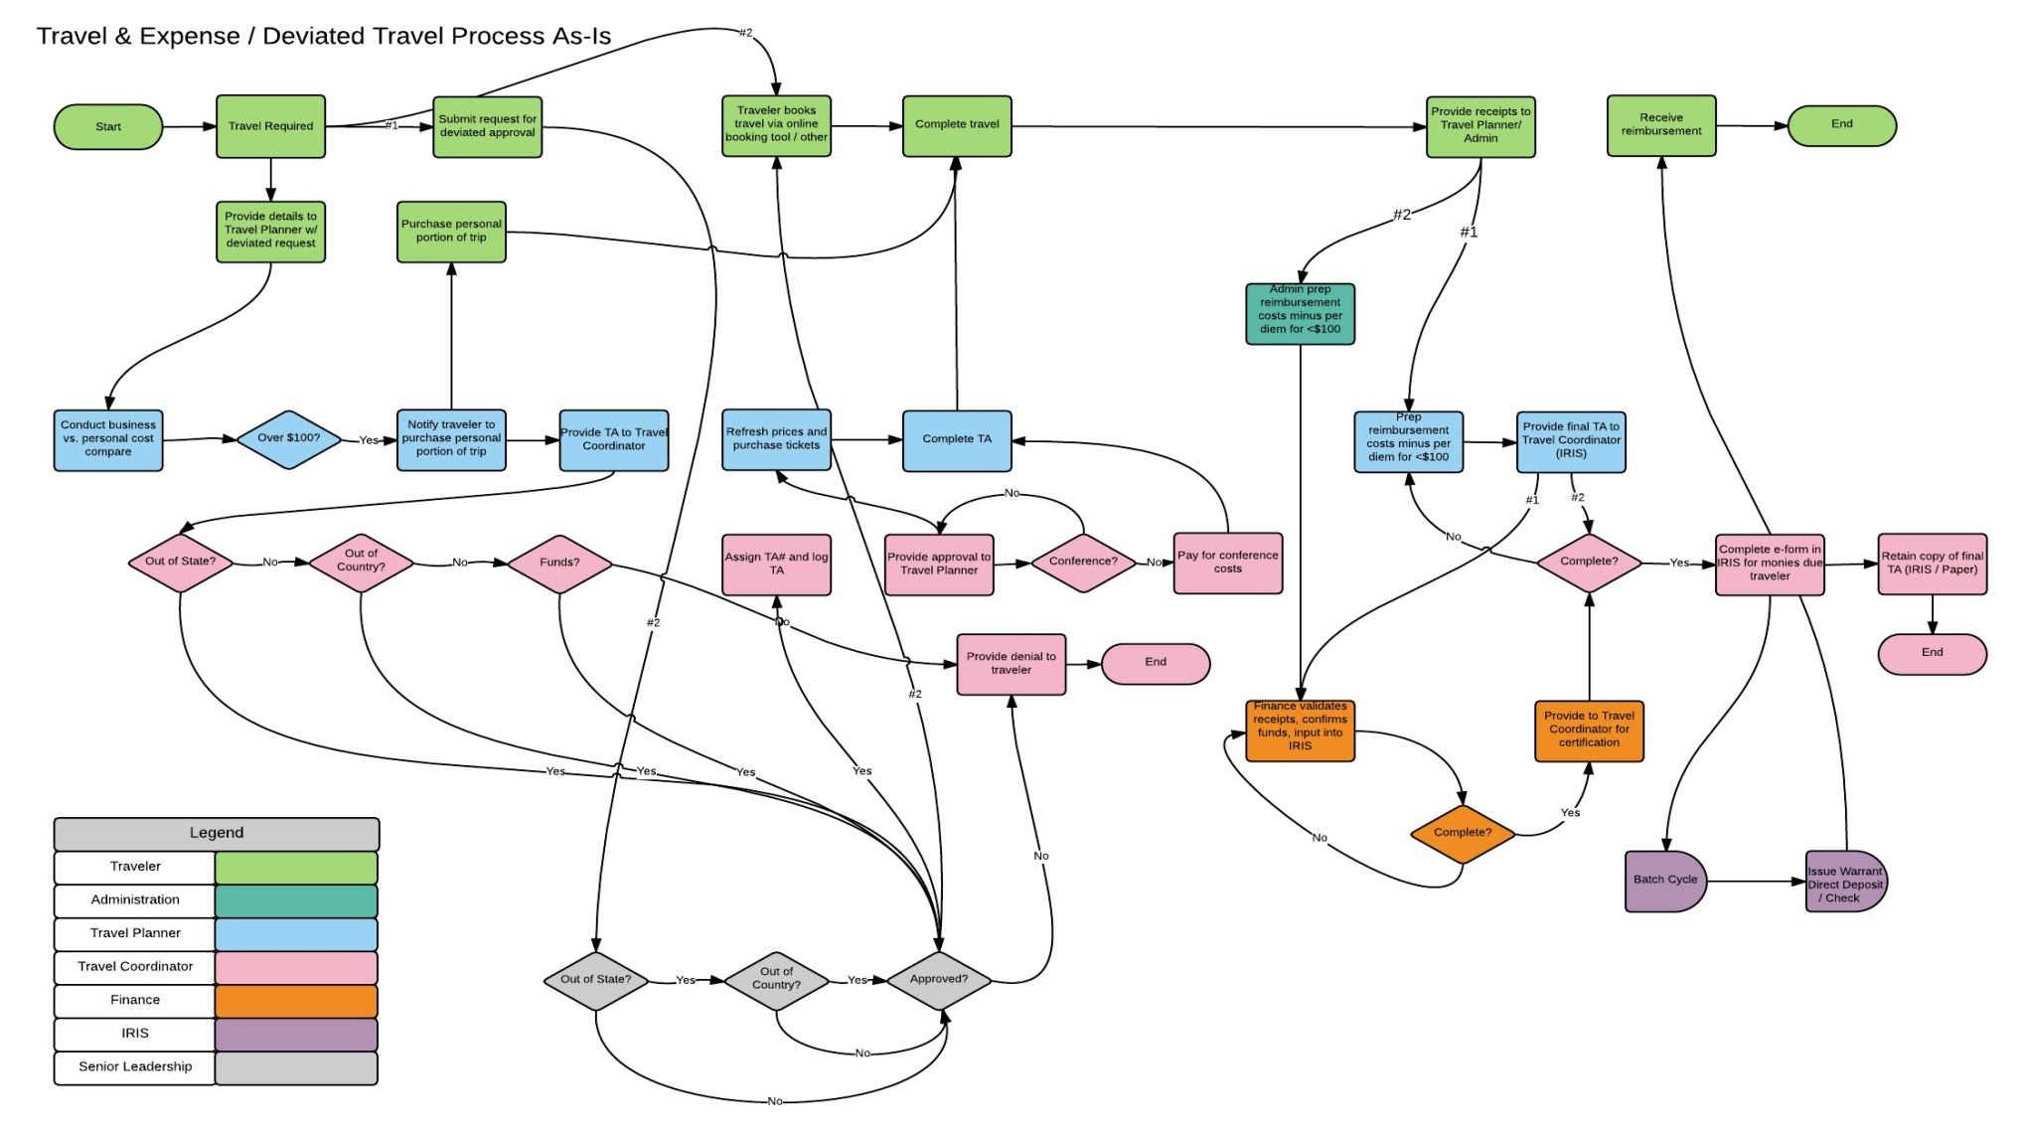
As-Is Process Mapping
Travel & Expense / Deviated Travel Process
Better, Faster, Cheaper.
January 26, 2017

Slide 9
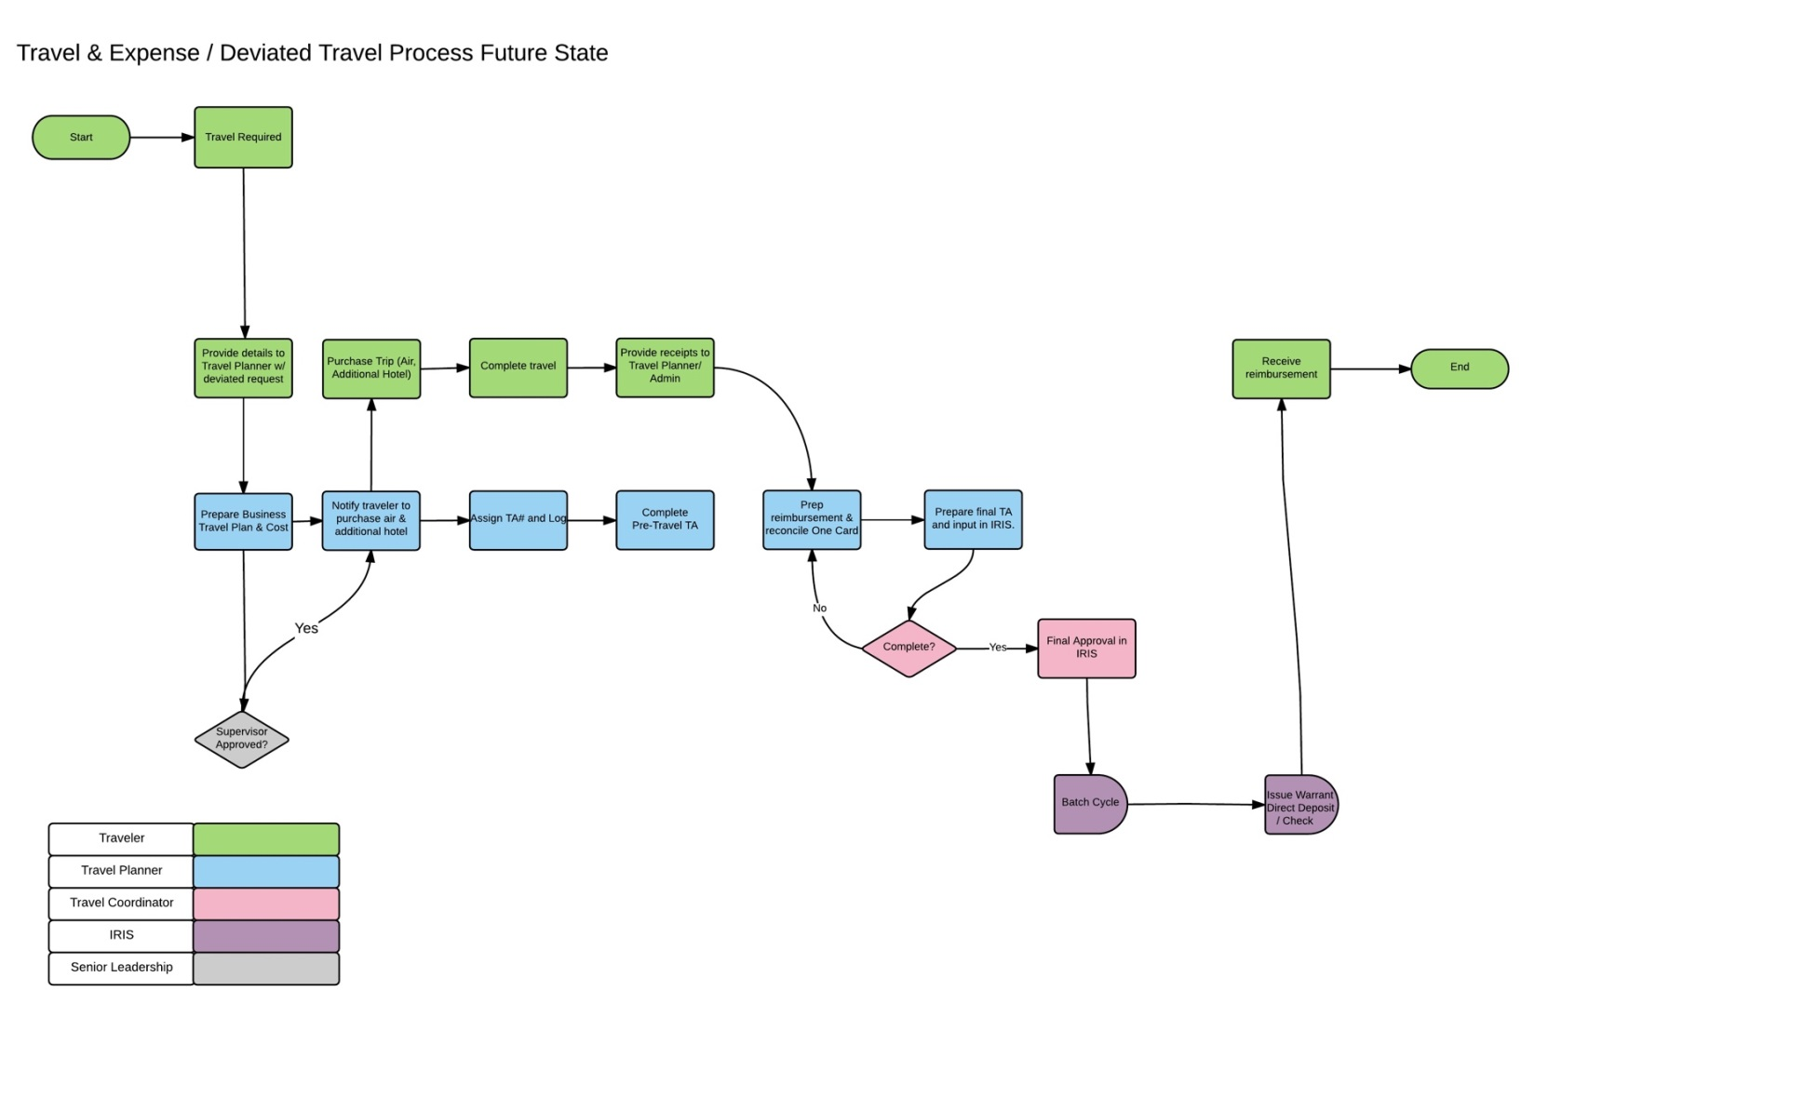
To-Be Process Mapping
Travel & Expense / Deviated Travel Process
Better, Faster, Cheaper.
January 26, 2017

Slide 10
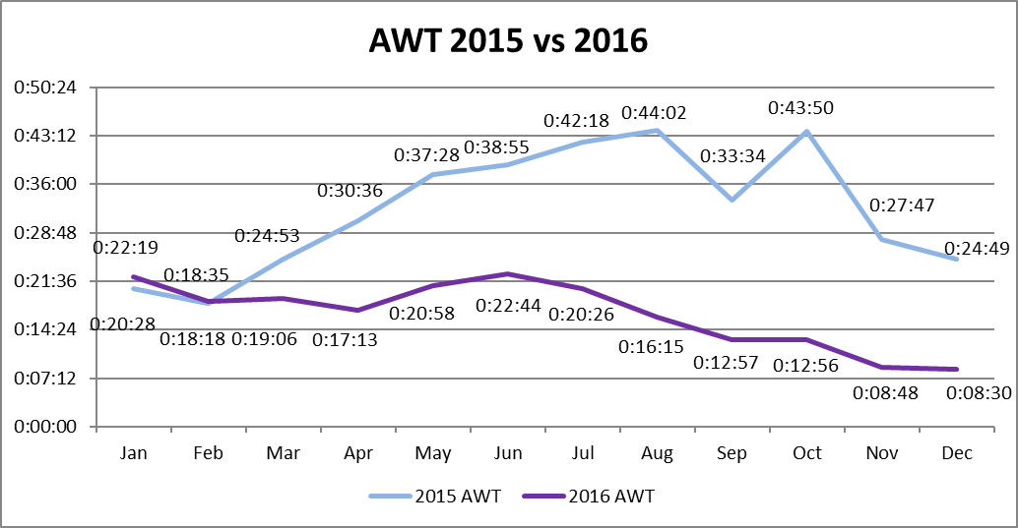
Process Improvement: DMV – Average Weight Time
Better, Faster, Cheaper.

Slide 11
Shared Services: IT Transformation
Streamline services and consolidating operations.

Slide 12
Recommendations
1. Intelligent Integration
Central to the State’s efforts to gain efficiency in the delivery of IT services in the most cost-effective manner, is the concept to distinguish between “Commodity Services” and “Line-of-Business Services.”
2. Organizational Structure
A trade-off central to the governance recommendation attempts to balance the efficiency benefits of “Integration” with the accountability advantages of allowing Department-centric decision-making. The guiding principle that frames the recommendation intends to balance these potentially competing requirements.
3. Governance: Strategic Guidance & Oversight
The Oversight function will be accountable to implement strategies for measuring the OIT’s performance. This Oversight structure ensures that all stakeholders’ interests are taken into account and that processes provide measurable results while achieving the goals of the enterprise.

Slide 13
Organizational Vision:
Governor
Strategic Governance Committee
Director OMB
(IV&V Function)
Strong CIO
Department Technical Officers report to CIO on a solid line basis.
Dept. Technical Officers
DTOs report to Department leadership on a dotted line basis.
Physically located in the department.
Receive day-to-day direction from department leadership.
Annual reviews largely written by Department leadership.
Department
of Administration
CIO
Department
Leadership
Department
Leadership
SSOA Director
Department
Technical Officer
(DTO)
DTO
ETS
Notes:
Why report to OMB?

Slide 14
Health Care Reform
Strengthening the financial stability of our state employee health plan. Addressing the long-term health care needs in Alaska.

Slide 15
Cost of State Employee Health Care
Employer Cost of Health Insurance
AlaskaCare Employee Plan
Self-insured plan
Aetna is the medical Third-Party Administrator (TPA)
Moda is the dental TPA
16,350 total covered lives (active employees & dependents)
6,350 employees
9,800 dependents
Approx. $137.5 million in employer contributions for AlaskaCare
Includes $7.5 million in supplemental funding
Additional $13.8 million paid by employees
Union Trusts
AlaskaCare
State employee health insurance costs have increased by more than $100 million, almost 200%, from 2005 to 2015

Slide 16
AlaskaCare: Challenges & Solutions
Fiscal Challenges
Addressing Fiscal Challenges
Employee plan costs are exceeding revenues
This is due to a combination of factors:
A spike in utilization following layoff notices
Reduction of employees, reducing employer contributions
Emergence of double-digit pharmacy growth
Health care cost growing faster than anticipated
Using reserves to cover the difference is not sustainable
Health care cost increases are pressuring plans across the state and nation
DOA is addressing these challenges through significant plan changes to AlaskaCare in 2017
Four tools available:
Increase employee contributions
Increased deductible & coinsurance
Increased employee share of premiums to approx. 20% in 2018
Implement plan design changes
Three-tier pharmacy benefits
Facility steerage in Anchorage & outside of Alaska
Allow employees to opt-out of coverage
Eliminate Premium plan
Reduce cost of service
Renegotiate pharmacy contracts
Improve facility discounts
Increase employer contributions
Employer contribution rate increased to $1,555

Slide 17
Health Care Authority Study
Last session’s SB 74 Medicare Reform directed DOA to conduct a study evaluating the feasibility of a Health Care Authority due by June, 2017.
Study looks at public employees in all bargaining groups, school districts, political subdivisions, the University, and other public entities providing health care benefits.
Goal is to see if there are opportunities to create savings through greater efficiencies.
Study will be completed in phases:
Phase 1: evaluates opportunities for savings through consolidated purchasing strategies.
Phase 2: evaluates opportunities for savings through coordinated plan administration.
Data collection process complete, surveys sent to all entities, in analysis phase.
More information available at https://alaskahcastudy.com/

Slide 18
State Workforce
Alaska’s employees are the backbone of essential public services.

Slide 19
Negotiation Principles
1. Cash + Benefits will be fair to both the State and the Employee
Recognized need to flatten the growth in cash compensation.
2. Work Rules will be efficient
We will negotiate work rules that maximize efficiency and minimize friction in getting the work done.
Preserve or restore management rights
3. Employees will be held accountable and we will reward our best
employees
Targeted and Measurable Performance Expectations
Pay for performance would be ideal, but difficult in current environment.

Slide 20
Recap of Last Year: ASEA, LTC, SU, CEA
1. Cash + Benefits will be fair to both the State and the Employee
0% COLAs
New Employee Contributions to Health Care
Flat Contributions to Health Trusts
Furloughs or Furlough Equivalents
2. Work Rules will be efficient
Negotiated contract consistencies to allow more efficient support operations
3. Employees will be held accountable and we will reward our best
employees
Working toward the creation of a Labor Management Committee to develop strategies to improve performance review process.

Slide 21
Questions?
For more information on Department of Administration services, priorities, or other issues, please contact:
Minta Montalbo, Legislative Liaison
minta.Montalbo@Alaska.gov
465-2200

