Slide 1
Alaska Department of Transportation & Public Facilities
Navigating, Preparing, Delivering, Improving
Commissioner Marc Luiken
26 Jan 2016

Slide 2
Purpose
Present to HTRA a briefing that addresses:
“what changes were made between FY15 to FY16 and what changes are planned for FY17”

Slide 3
Overview
Our dedicated people
How we are Navigating: $34.6M reduction in operating budget – FY 15- FY16
How we are Preparing: To do our part and absorb more reductions – FY17
How we are Delivering: A year of successes
How we are Improving:
Executive TEAM Guiding Principles and Decision-making
One DOT&PF: Results Based Alignment (RBA) and Everyday Lean

Slide 4
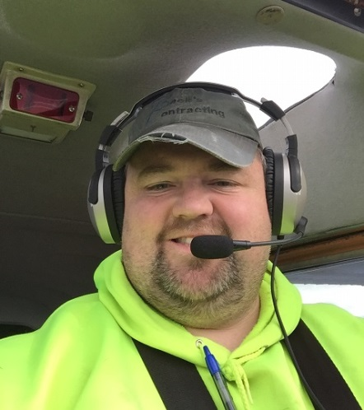
Our DOT&PF People: Alaskans Serving Alaskans
Jed Struempler, Anchorage Station Foreman
Who he is: Born and raised in Anchorage; played high school football for Service; started in construction and heavy equipment on the lap of his father - helping his dad hen Boniface Parkway was expanding from a two-lane to a four-lane road; DOT&PF as an equipment operator when he was 20 years old; -today, he is a Foreman at the Anchorage station. He’s married to a high school principal and has two children.
What Jed does: Day starts at 6 a.m checking with the night shift on the conditions of the roads, and then he and his team get to work. Being a foreman means that you’re leading a crew in the field, rolling up your sleeves to get the work done. He knows firsthand what’s working and what’s not.
Much of the winter is focused on snow and ice removal, the job encompasses more than that. There’s more work than his crew can complete in any given day. Guardrail & fences get hit & damaged, high winds require removing fallen trees from roadways, sidewalks & trails, patching and paving are often in the middle of a summer night to aid in traffic control. There is a long needs list to remove vegetation that could interfere with a driver’s ability to see the road ahead or damage the pavement or guardrail.
Notes:
Jed Struempler, Anchorage Station Foreman
Who he is: Jed’s got a big personality and a long history in Alaska. Born and raised in Anchorage, Jed played high school football for Service. He went Outside after graduation to play collegiate ball and eventually returned to Alaska to finish his education. He attended the Kenai Peninsula Fire Sciences program and became a certified firefighter and EMT. But Jed had a trade he had developed early on in life that eventually led him to a career at DOT&PF. Jed started in construction and heavy equipment on the lap of his father. One of his earliest memories was helping his dad on the job site when Boniface Parkway was expanding from a two-lane to a four-lane road.
While working construction in the summer, friends encouraged him to apply at DOT&PF. What started as a temporary three-month position became a full time position. He joined DOT&PF as an equipment operator when he was 20 years old.
Today, he is a Foreman at the Anchorage DOT&PF station. He’s married to a high school principal and has two children.
What Jed does: A typical day starts at 6 a.m. H e checks in with the night shift on the conditions of the roads, and then he and his team get to work. Being a foreman means that you’re leading a crew in the field, rolling up your sleeves to get the work done. He knows firsthand what’s working and what’s not.
While much of the winter is focused on snow and ice removal, the job encompasses a lot more than that. There is always more work than his crew can complete in any given day. Guardrail and fences get hit and damaged, high winds require removing fallen trees from roadways, sidewalks and trails, and patching and paving are often in the middle of a summer night to aid in traffic control. And there is always vegetation control—there is a long needs list to remove vegetation that could interfere with a driver’s ability to see the road ahead or damage the pavement or guardrail.
Jed helps accomplish DOT&PF’s mission:
Jed keeps Alaska moving through service and infrastructure by keeping Alaska’s roads open for Alaskans to travel. From removing snow during the winter, to patching and paving in the summer, Jed keeps highways in good working order. He and his crew repair guardrail and fences, which preserves our investment and increases safety to the traveling public.
Jed reflects the department’s core values:
Jed is a hard worker and a leader within his crew. He rolls up his sleeves and gets the work done. Jed quite literally preserves Alaska’s infrastructure and keeps Alaska’s roads open for the public.

Slide 5
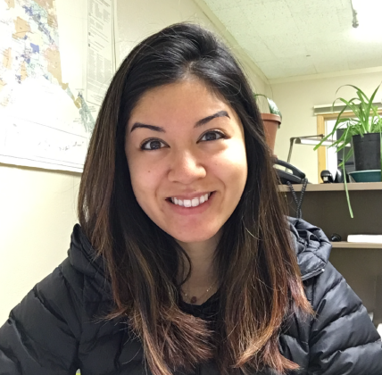
Our DOT&PF People: Alaskans Serving Alaskans
Vanessa Musich
Engineering Assistant III/Project Engineer
Vanessa was raised in Homer. After receiving a Bachelor of Science in Mechanical Engineering from the University of Notre Dame, she relocated back to Alaska with her husband and her dog.
In Nome, she enjoys cooking, hiking, fishing, berry-picking and yoga.
Four years with DOT&PF in May
In the Construction section of Northern Region, Vanessa helps administer projects for Western Alaska. Projects she has worked on include airports and a new bridge. This summer, she will be the project engineer for the Shishmaref Airport Resurfacing.
Rural Alaska depends on safe and functional infrastructure, especially airports, for access and transportation of goods. Through her work, Vanessa helps make sure Western Alaska has that infrastructure.
Vanessa exemplifies the core values of DOT&PF in her ability to assist or lead depending on the department’s need. She is hardworking, smart, encouraging and thoughtful, and she works well with everyone. Her success is in part due to her open, respectful communication, which makes her a valuable member of the entire DOT&PF family.

Slide 6
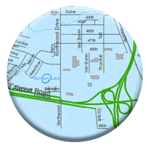
How DOT&PF Navigated the FY2016 $34.6M Reduction
TOTAL
BUDGET
multiple years
single year
CAPITAL
BUDGET
OPERATING
BUDGET
H&A-$15.3M UGF; 29 PCNs
AMHS-$11.1M UGF; 32 PCNs
Capital Budget – A plan for the distribution of state financial resources for items which have an anticipated life that exceeds one year and which usually costs at least $25,000.*
Capital Improvement Project (CIP) – A project listed in the capital budget.*
Strict rules and regulations prohibit spending capital $s on routine maintenance and general operating budget activities.
*Alaska Legislative Budget Handbook, November 2014
Support Services-$8.2M UGF reductions and fund source changes; 34 PCNs
Operating Budget – A plan for the yearly distribution of state resources to cover the ongoing operations of state programs.*
Notes:
28 filled PCNs were eliminated.
$8.2 M is fund source changes and UGF reductions includes facilities - eliminated total of 34 positions
H&A reductions $15.3 17 PFT, 10 PPT, 2 NP
FY 16 Capital Budget
FY16 Reductions
Support Service Reductions $ 7.9M UGF
eliminated 34 positions Total personal services
Highways and Aviation $15.3
eliminated 17 PFT, 10 PPT, 2 NP
Alaska Marine Highway System 32 $11.1M UGF
Fund source changes

Slide 7
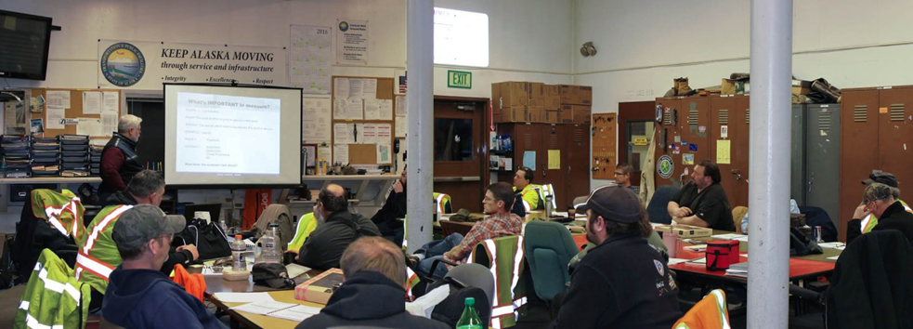
Preparing for FY2017
Results Based Budgeting/Alignment (RBB/RBA): Ensuring we pursue our mission and only our mission—alignment; ensuring we are efficient and effective with the resources we’re given—measure
Core Services:
Operate Alaska's transportation infrastructure
Maintain Alaska's transportation infrastructure
Expand Alaska's transportation infrastructure
Operate Alaska Marine transportation services
Organizational focus shifting from activities and budget to outcomes and results
Notes:
Centralizing planning functions in Division of Program Development

Slide 8
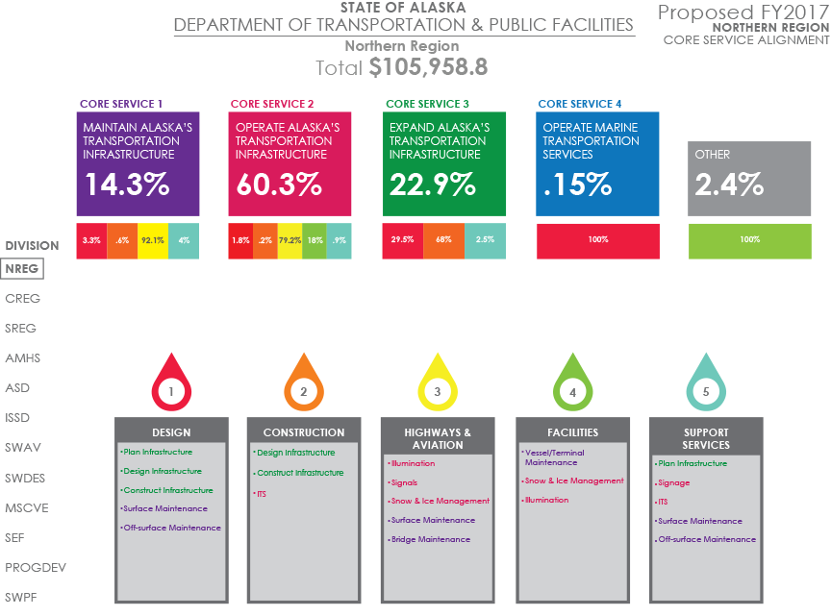

Slide 9
Unrestricted General Fund (UGF) Broken out by Appropriation Further Broken out by Personal Services & Support Lines
Total UGF: $231,307.9

Slide 10
DOT&PF Unrestricted General Fund by RDU FY2010-FY2017 Governor’s Proposed

Slide 11
FY2017 Proposed Reductions
Highways & Aviation RDU-Maintenance and Operations
- $6,509.9 UGF and position reduction (21 PFT, 9 PPT)
Service reduction will be felt on lower priority roads
Reduce equipment fleet
Reduce commodities purchases for summer and winter supplies
Decrease in roadway maintenance, vegetation control, guardrail repairs
Six maintenance stations will close (Seward, Chitina, Central, Birch Lake, O’Brien Creek, Northway)
Thompson Pass station open seasonally (winter)
Identification of previous operating costs that are eligible for federal funding (striping)
Reduction of law enforcement officer coverage at Part 139 airports
Reductions to maintenance agreements on state assets
Alaska Marine Highway System RDU
-$5,392.0 UGF
-6,461.0 AMHS Funds
Position reduction (5 PPT, 9 NP)
Operating plan reduction from 354 to 309 320 week of service
Three vessels are not scheduled to operate (Taku, Chenega, Fairweather)
Multiple week gaps in service
5 weeks – Northern Panhandle
6 weeks – Prince William Sound
7 weeks – Southwest Route
Administration & Support RDU
Positions (2 PFT)
-$1,385.1 UGF Agency-wide unallocated reduction
Design & Construction RDU
Positions (1 PPT, 5 NP)
Notes:
Positions (PCNs) - The department eliminated 52 PCNs (23 PFT; 15 PPT; 14 NP)
58% Highways & Aviation Staff (Equipment Operators)
CR H&A (6 PFT)
NR H&A (11 PFT; 9 PPT)
SR H&A (4 PFT)
27% Marine Highway Staff (5 PPT, 9 NP) these positions were eliminated in FY2016 recorded in FY2017
11% Design, Engineering and Construction Staff (1 PPT, 5 NP)
4% Administration & Support Staff (included Admin Services and Commissioner Office) (2 FT)

Slide 12
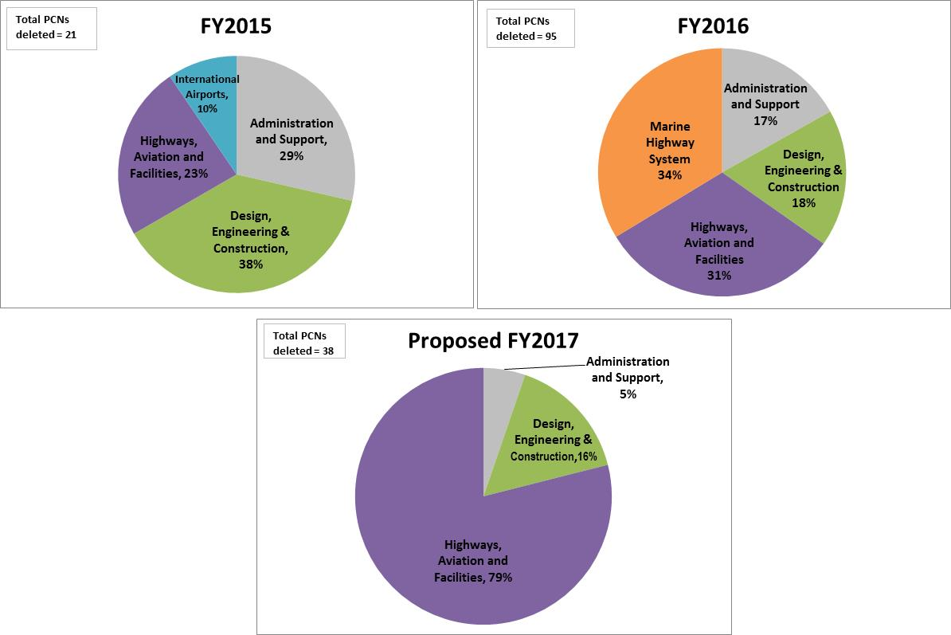
PCN Deletions

Slide 13
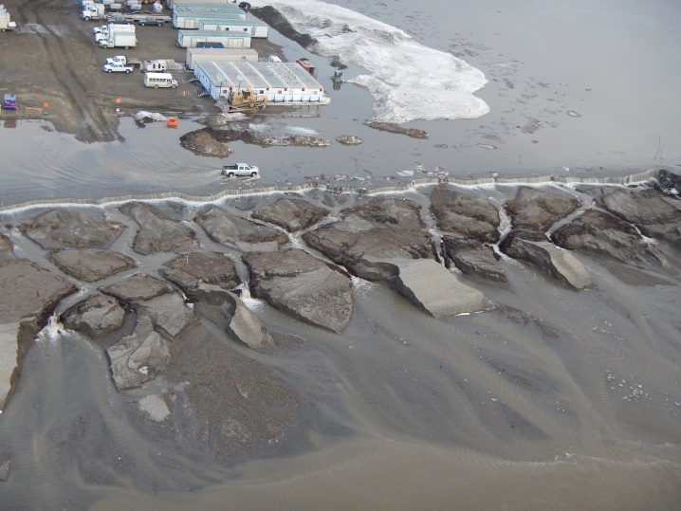
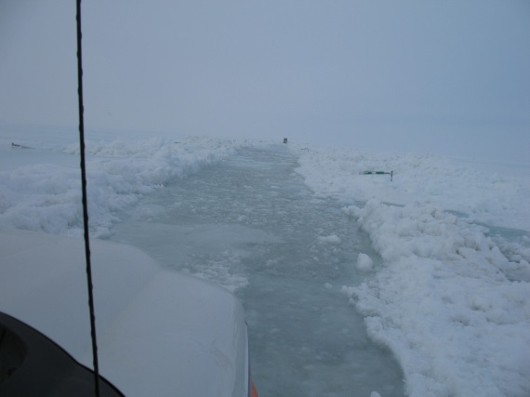
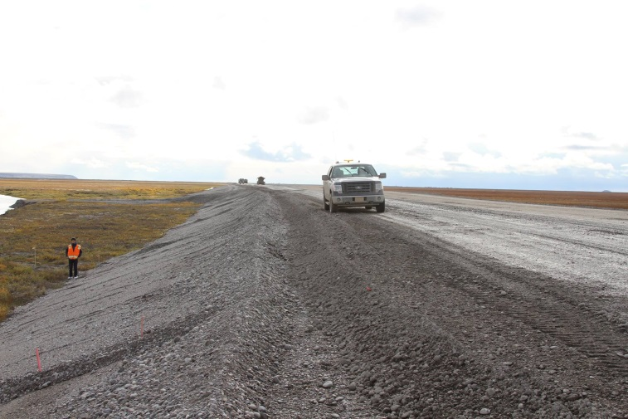
Delivering—A year of Successes
Dalton Highway Aufeis flooding
Instituted emergency procurement processes
Established a Unified Command Structure, led by DOT&PF—included state and private sector. Successfully prioritized the needs of North Slope
Leveraged federal agencies to get most of the costs funded by feds
Completed road elevation project this past summer
Notes:
Unified Incident Command consisted of: DOT&PF (Lead), Alyeska Pipeline Service Co., BP, ConocoPhillips, ExxonMobil and the North Slope Borough.
The incident response was a collaborative effort between the DOT&PF and industry.
Response was a model for other government entities and industries to follow in the future.
The partnership between the State of Alaska and industry during this phenomenal event was essential.
Together, the State of Alaska and industry were able to identify priorities and systematically address those needs.
The DOT&PF would not have reopened the Dalton Highway as soon as we did without the cooperation and teamwork of every single stakeholder.
Overall the Unified Incident Response to the Dalton Highway flood events proved to be incredibly successful under extremely difficult and complex

Slide 14
Delivering—A year of Successes
Obligated $780M in federal funding in Federal FY2015
$584 million obligated FHWA highway projects
$486 million for the construction phases
$188 million obligated for FAA Airport projects
$8M awarded in Federal Transit grants for operating and capital expenses
Updated, socialized via public process, and gained approval for FY16-19 STIP
STIP is programmed at the FAST Act funding levels
Anticipate 40 new construction projects in 2016
AMATS receives $24M
FMATS receives $8M
AIAS and Aviation
AIAS stakeholder engagement realized 9% cargo growth/4.5% pax growth
ANC #2 in North America/#5 in the world for air cargo traffic

Slide 15
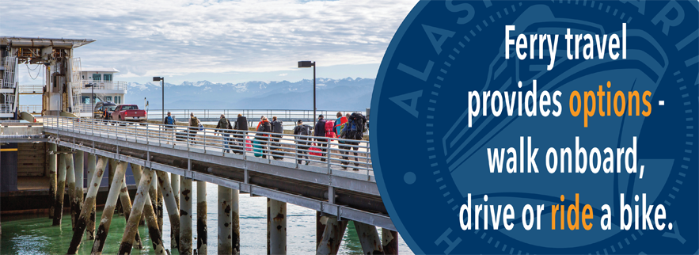
Delivering—A year of Successes
AMHS
Set an all time record for revenue generated at $53.9M in an effort to be more self sustaining, implemented tariff leveling.
Reduced operating cost by $5.2M to achieve a 33.5% cost recovery rate, up from 30.7% last year.
Safely moved 310K passengers/106K vehicles (stable traffic volumes) despite running less ships and expending fewer GF dollars.
Contracts to Alaskans
$511.3M worth of contracts were awarded in 2015

Slide 16
Improving—TEAM Guiding Principles
We are an Executive TEAM who embraces these guiding principles:
Remember and emphasize we are servants
Every communication, decision, and action must be governed by Core Values
Integrity, Excellence, and Respect
Remember our Mission: Transportation for Alaskans
Must be solutions oriented
Must respect the role and intent of others in the solutions conversation
As best we can, we’ll make decisions as a TEAM
Must communicate proactively and clearly, especially when it’s contentious
No Whining
Notes:
Remember and emphasize we are servants
Servant leadership messaging
Commissioner Quarterly Town Halls; Videos
Peer Awards Program
Core values: One DOT&PF Transformation
Transportation for Alaskans: no favored mode
Solutions
Results Based Alignment (RBA);
Engage the organization down to the front line: Everyday Lean, T3, Shared Services
Executive Team Decision-making (facilitated as needed)
Risk-based Analysis of reductions
Leading facilities management shared services project
Respecting others: Tribal Liaison; AMHS Engagement; Legislator outreach; community outreach; State sister agency outreach; Federal agency relationships
Communicate: Social media; proactivity and transparency emphasis
No Whining means no whining—do our very best with resources we have

Slide 17
Improving—One DOT&PF
One DOT&PF is the Organizing Principle and Change Management Brand
One DOT&PF leverages and validates what we’ve already done over the last five years with DOT&PF Strategic Plan and with Summits for Success
One DOT&PF means we are not a house divided in challenging times—a call for Trust, Teamwork, and Results
One DOT&PF creates communication and sharing of best practices up, down, and across a huge and geographically dispersed organization
One DOT&PF embraces the idea that leaders—at all levels have huge influence
One DOT&PF embraces the belief that those closest to front line delivery often have the best ideas

Slide 18
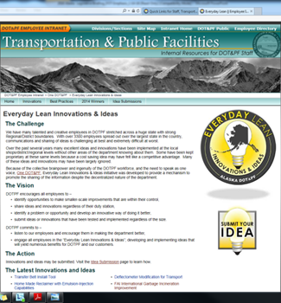
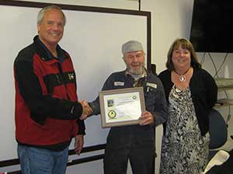
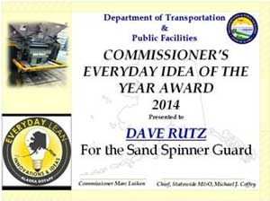
One DOT&PF—Everyday Lean
Everyday Lean taps creativity/expertise of DOTers closest to service delivery
User friendly intranet site
Leadership emphasis –rewarding people
and units
Already recognized by national level
organization—grant funding
FAI International Garbage Incineration
Improvement resulted in $20K/year savings

Slide 19
Questions?

