Slide 1
2011 Alaska Department of Health & Social Services Overview
William J. Streur, Acting Commissioner
Alison Elgee, Assistant Commissioner

Slide 2
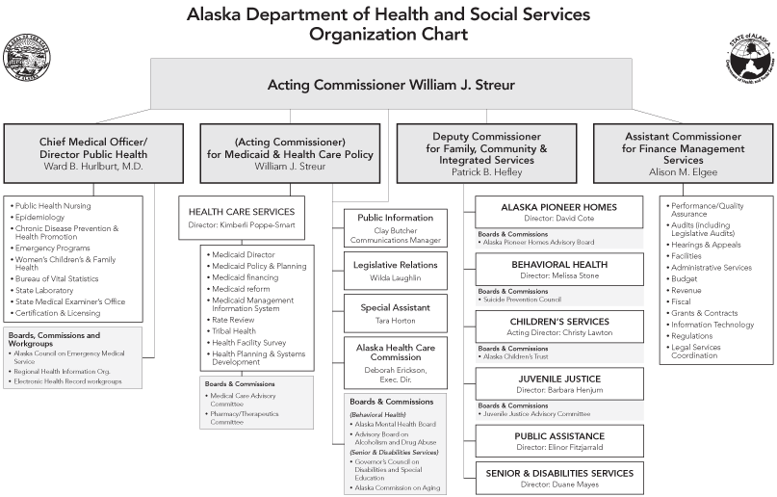
Mission: to promote and protect the health and well-being of Alaskans

Slide 3
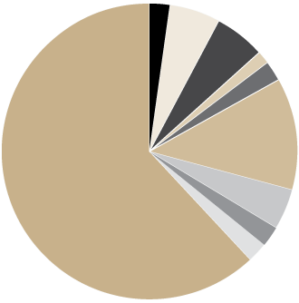
Department of Health & Social Services
Budget Highlights
2.4%
5.6%
5.5%
1.4%
2.3%
Alaska Pioneers Homes
Behavioral Health
Office of Children’s Services
Health Care Services
Juvenile Justice
Public Assistance
Public Health
Senior & Disabilities Services
Finance & Management Services
Medicaid Services
59,671.9
136,651.4
133,317.6
33,567.5
55,619.2
298,499.3
104,882.0
57,657.6
51,748.7
1,513,491.9
12.2%
4.3%
2.4%
2.1%
2,445,107.1
61.9%
Mission: to promote and protect the health and well-being of Alaskans

Slide 4
Department of Health & Social Services
Alaska Pioneer Homes
Mission: assist older Alaskans to have the highest quality of life by providing assisted living in a safe home setting which promotes positive relationships, meaningful activities, and physical, emotional, and spiritual growth

Slide 5
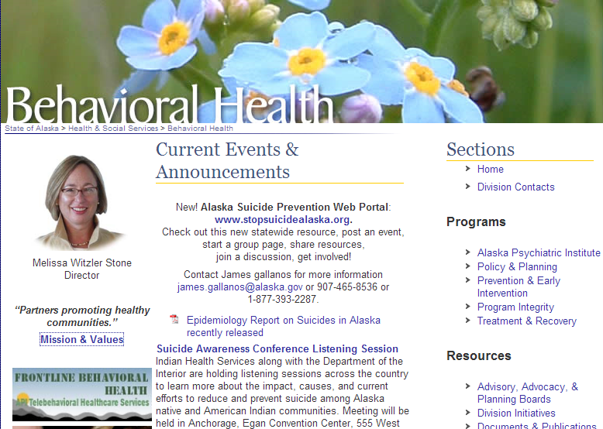
Department of Health & Social Services
Behavioral Health
Mission: to manage an integrated and comprehensive behavioral health system based on sound policy, effective practices and partnerships

Slide 6
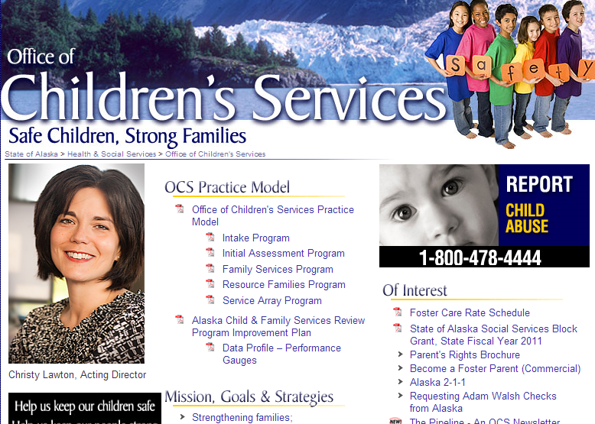
Department of Health & Social Services
Office of Children’s Services
Mission: to protect and serve Alaska’s children and families

Slide 7
Department of Health & Social Services
Health Care Services
Mission: to provide health coverage to Alaskans in need.

Slide 8
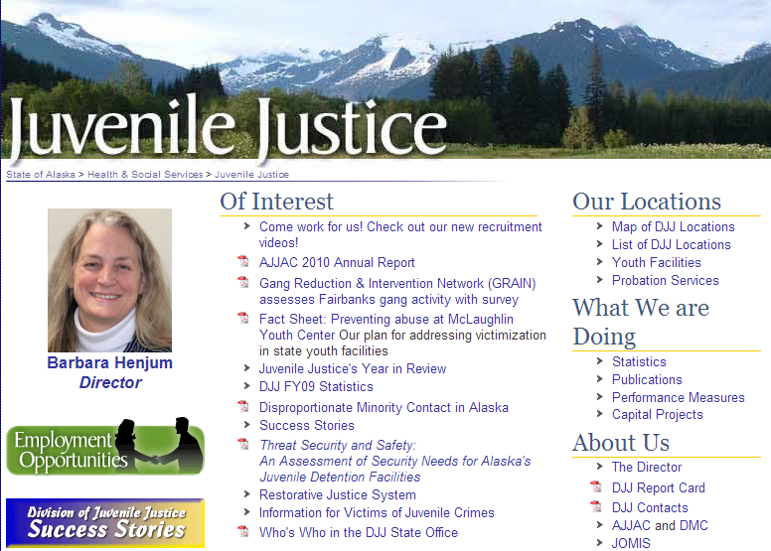
Department of Health & Social Services
Juvenile Justice
Mission: We are committed to holding youths accountable for their actions while also protecting communities, repairing the harm to victims and working to ensure that youths gain necessary skills to function successfully in society

Slide 9
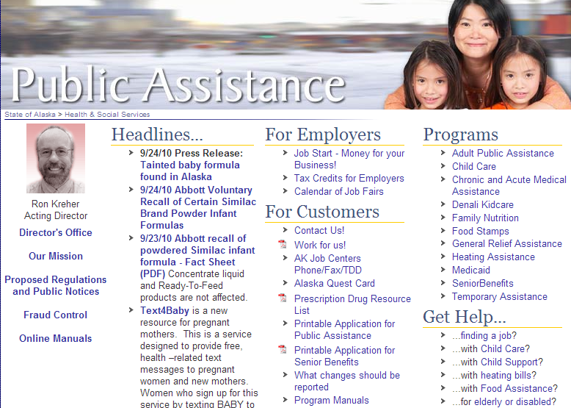
Department of Health & Social Services
Public Assistance
Mission: We promote self-sufficiency and provide basic living expenses to Alaskans in need

Slide 10
Department of Health & Social Services
Public Health
Mission: To protect and promote the health of Alaskans

Slide 11
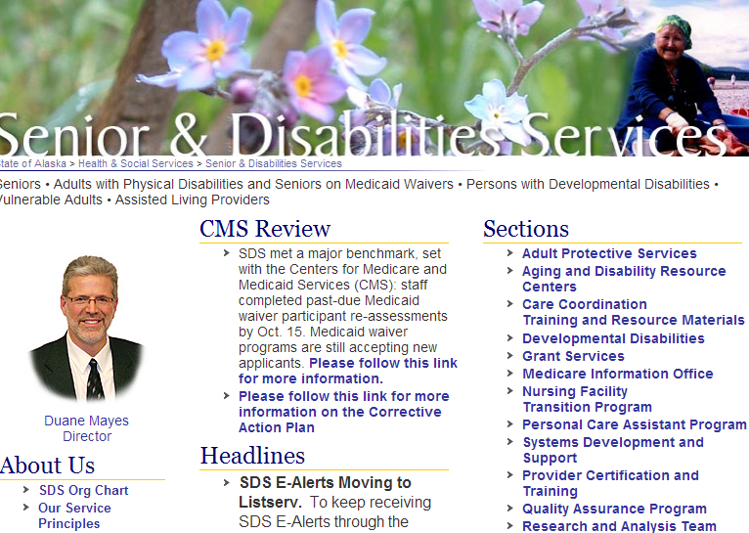
Department of Health & Social Services
Senior & Disabilities Services
Mission: We serve Seniors • Adults with Physical Disabilities and Seniors on Medicaid Waivers • Persons with Developmental Disabilities • Vulnerable Adults • Assisted Living Providers

Slide 12
Department of Health & Social Services
Financial Management Systems

Slide 13
Conclusion
Department of Health & Social Services
Questions?
Mission: to promote and protect the health and well-being of Alaskans

