Slide 1
University of Alaska Investing in Alaska’s Future
Senate Education Committee
February 8, 2017

Slide 2
University Mission
"The University of Alaska inspires learning, and advances and disseminates knowledge through teaching, research, and public service, emphasizing the North and its diverse peoples.”
Regents' Policy 01.01.01
Notes:
Core Services: Student Instruction, Research, Service

Slide 3
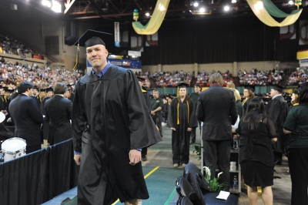
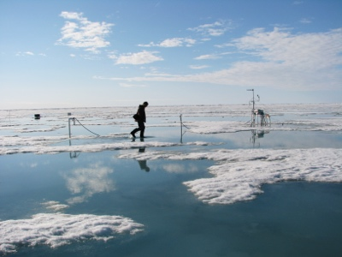
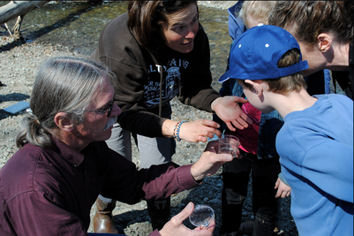
University Mission
Education Academic and vocational instruction
Research Scientific and academic research, advancing knowledge basic and applied
Service Sharing knowledge to address community needs

Slide 4
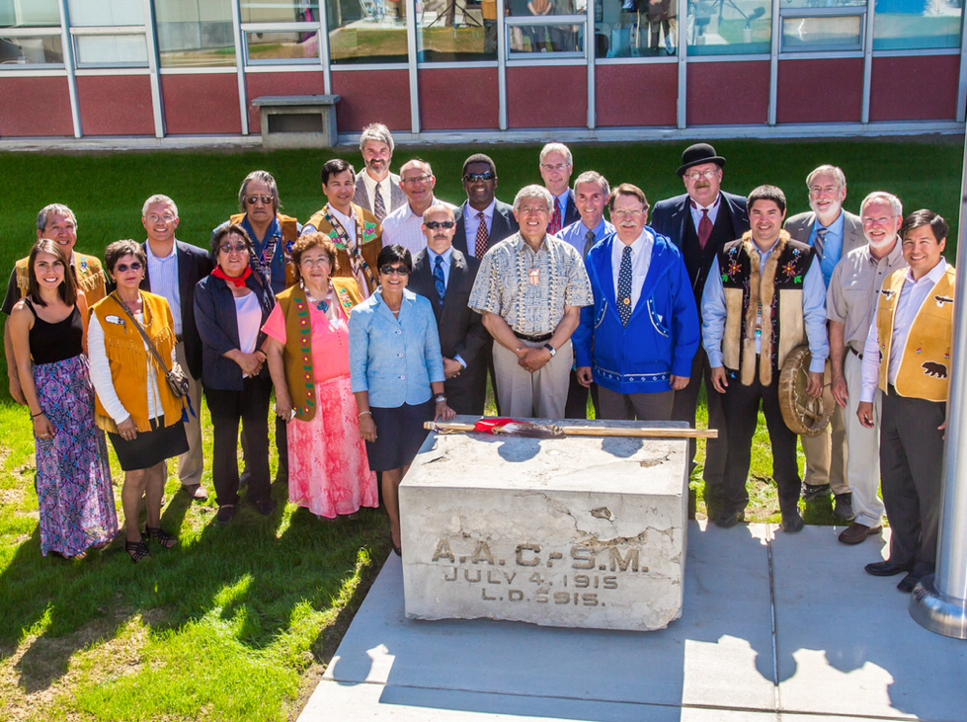
Celebrating Our History – Planning Our Future
July 1915 - Laying the Cornerstone
July 2015 – Our 100 year Commemoration

Slide 5
It Takes a Great University to Create a Great State
It is a simple truth all over the world, past and future
The University of Alaska is committed to making it happen in Alaska
It must happen if Alaska is to have a bright and prosperous future

Slide 6
100 Years of Service
Established in 1917 as the Alaska Agricultural College and School of Mines, today:
One campus in 1922 – 15 statewide campuses today
One graduate in 1923 – 4,600 graduates in 2016
Alaska’s #1 higher education institution – in education, research, and workforce preparation
America’s #1 higher education institution - affordability
World’s #1 research university on the Arctic

Slide 7
Meeting Alaska’s Needs
Broadening access to higher education for Alaskans
Focusing research on issues of importance and potential commercial application in Alaska
Preparing Alaskans for Alaska’s high-demand jobs
Developing capacity to meet Alaska’s increasingly diverse, knowledge based economy
Building a strong education pipeline from K-12 to the workforce
Diversifying revenues and moderating reliance on state general funds

Slide 8
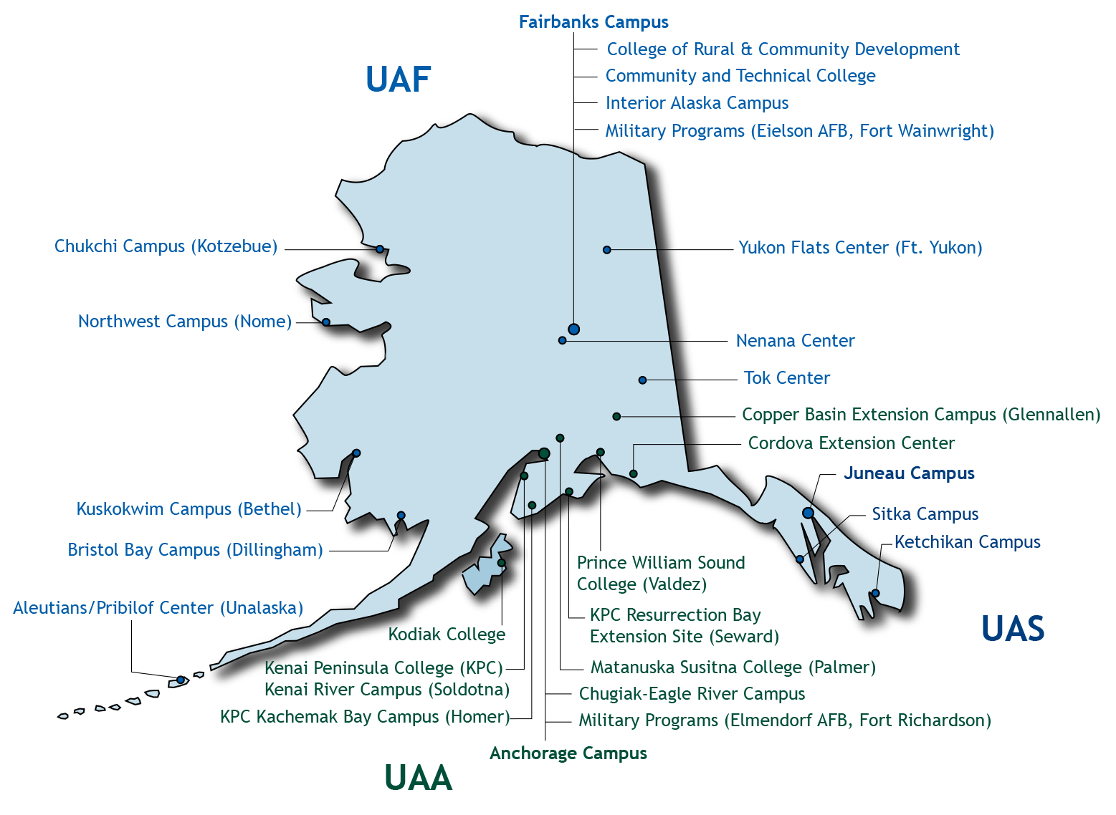
Serving All Alaskans
One Integrated System:
3 Universities
12 Community Campuses
Outreach Centers
Distance Delivery
Notes:
Division Overview
Number of community campuses depends on what you count separately as campus. For our current purposes, we count as community campuses:
Sitka
Ketchikan
Valdez
Mat-Su (Palmer)
Chugiak-Eagle River
Homer
Soldotna
Kodiak
Dillingham
Bethel
Nome
Kotzebue
You’ll sometimes hear different numbers…we used to count TVC (the old Tanana Valley Campus in downtown Fairbanks) separately but when reorganized as CTC, it’s now counted as part of UAF. Rural outreach centers are not counted. Homer campus is technically part of KPC in Soldotna, but has grown over the years so we now count it separately. Interior Alaska is not so much a campus as it is an umbrella for many of UAF’s rural outreach centers in the villages.

Slide 9
Alaska Sized Benefits
A major economic engine in Alaska generating direct and indirect benefits:
15,740 jobs result from UA activities
$1.1 billion in annual economic/employment impacts statewide
$43.7 million in economic impacts to rural Alaska alone
$1 dollar of investment generates $3 dollars in economic activity
$1 in state research investment generates $4.1 in research dollars
9

Slide 10
Organizational Chart
Board of Regents
Gloria O'Neill, Chair; John Davies, Vice Chair; Lisa Parker, Secretary; Deena Bishop, Treasurer; Dale Anderson; Sheri Buretta; Karen Perdue; Jyotsna Heckman; Mary Hughes; Stacey Lucason; Andy Teuber
VP of University Relations
Michelle Rizk
UA President
Jim Johnsen
VP for Academic Affairs & Research
Daniel White
Chief Finance Officer
Myron Dosch
General Counsel
Michael Hostina
Chief Info Tech Officer
Karl Kowalski
Chief HR Officer
Keli Hite-McGee
UAA Chancellor
Tom Case
UAF Chancellor*
Dana Thomas
UAS Chancellor
Richard Caulfield
* Interim
Notes:
I am Jim Johnsen…. Selected by Regents and leader of the univesity system

Slide 11
Student Profile
In fall 2015, 30,496 students enrolled for credit at the University of Alaska
In fall 2015, 18,852 students attending UA declared a primary major leading to a degree or credential, while 3,190 students enrolled as pre-majors
In FY15, UA students earned 4,678 degrees, certificates, and endorsements
The majority of students attended UA part-time in fall 2015, accounting for 59 percent of the total student population
Graduate students accounted for 8 percent of all students attending
Students reporting a minority racial background accounted for 27 percent of all UA students in fall 2015, with 15 percent of UA’s student population identified as Alaska Native and American Indian

Slide 12
Economic Power of Research
University research infuses dollars into the state economy and supports and expands the economy by paying the salaries of Alaskan workers and supporting sales to Alaska business and industry partners.
UA generated 81 percent of its research revenue from non-general fund sources. In FY15, each state dollar appropriated to UA research generated an average of $4.1 in revenue from other sources.
Increased invention disclosures can lead to commercialization of technologies valuable to Alaska; working to move “science to services”; building partnerships with business and private sector on real world applications.

Slide 13
Research Diversity & Service
The university houses more than 60 research centers and institutes across the state, plus faculty and undergraduate research at every campus
Geophysical Institute (GI)
Alaska Center for Energy and Power (ACEP)
Alaska Volcano Observatory (AVO)
Geographic Information Network of Alaska (GINA)
Ocean Acidification Research Center
Institute of Social and Economic Research (ISER
Institute for Circumpolar Health Studies (ICHS)
Center for Behavioral Health Research and Services (CBHRS)
Alaska Coastal Rainforest Center

Slide 14
Key Research Initiatives
Build upon our well-established reputation as the powerhouse in high latitude and Arctic research
Serve our state and nation by addressing critical issues related to our strategic global position
Assist our military in developing the domain awareness to function capably and safely in the Arctic
Expand economic development and diversity in Alaska by increasing discoveries, patents and business partnerships
Improve the lives of Alaskans through research in health and social sciences

Slide 15
Service Mission: Sharing Knowledge with Alaskans
Cooperative Extension agents work in communities throughout Alaska conducting science, technology, engineering and math (STEM) school programs, youth mentoring, working with rhodiola and peony growers, and helping families with food preservation or gardening.
Cooperative Extension is part of the largest informal education system in the world, connecting programs at land-grant colleges and universities in every U.S. territory and state.
Cooperative Extension offers hundreds of publications, written and produced by university specialists, which contain practical information of interest to Alaska residents.
Major program areas include: agriculture and horticulture; health, home and family development; natural resources and community development; 4-H and youth development.

Slide 16
Challenges
Geography – location, size, regionalism
Students – low high school graduation rate, low college going rate, low college completion rate, half require developmental education
Economy – high in natural resources - low in new economy, historically high wage to education ratio, industry workforce gaps
Structure – 4 administrative structures, 3 institutional accreditations, geographic spread
Budget – heavy reliance on resource-dependent state funding, 3rd year of budget reductions
Revenue – private giving, comparatively low tuitions, land grant deficit
16

Slide 17
Alaska’s Brain Drain
Of 100 average 9th graders only 5 will graduate from UA within 10 years.

Slide 18
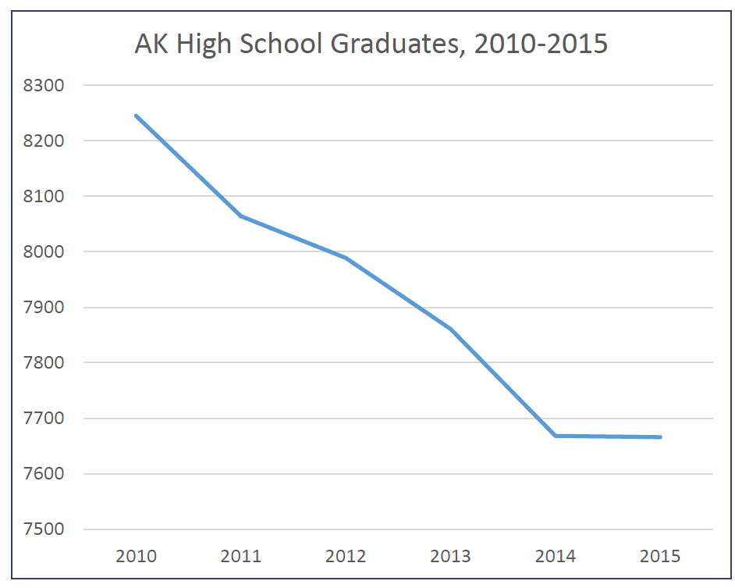
High School Graduation
There is a 7% decrease in Alaska high school graduates between 2010 – 2015.

Slide 19
Percent of Residents Aged 25-64 with an Associates Degree or Higher Born In-State, 2010
Source: U.S. Census Bureau, 2010 American Community Survey (ACS) Public Use Microdata Sample (PUMS) File.

Slide 20
Percent of 25-64 Year Olds with College Degrees – Associate and Higher, 2013
Source: U.S. Census Bureau, 2013 American Community Survey 1-Year Public Use Microdata Sample.

Slide 21
Wage and Education Relation
High College Attainment, Low Personal Income
High College Attainment, High Personal Income
Percent of Adults 25 to 64 with College Degrees (2009)
State New Economy Index 2010
Top Tier
Middle Tier
Bottom Tier
Low College Attainment, Low Personal Income
Low College Attainment, High Personal Income
Personal Income per Capita (2010)
Source: U.S. Census Bureau, 2010 American Community Survey; Bureau of Economic Analysis; Kauffman Foundation

Slide 22
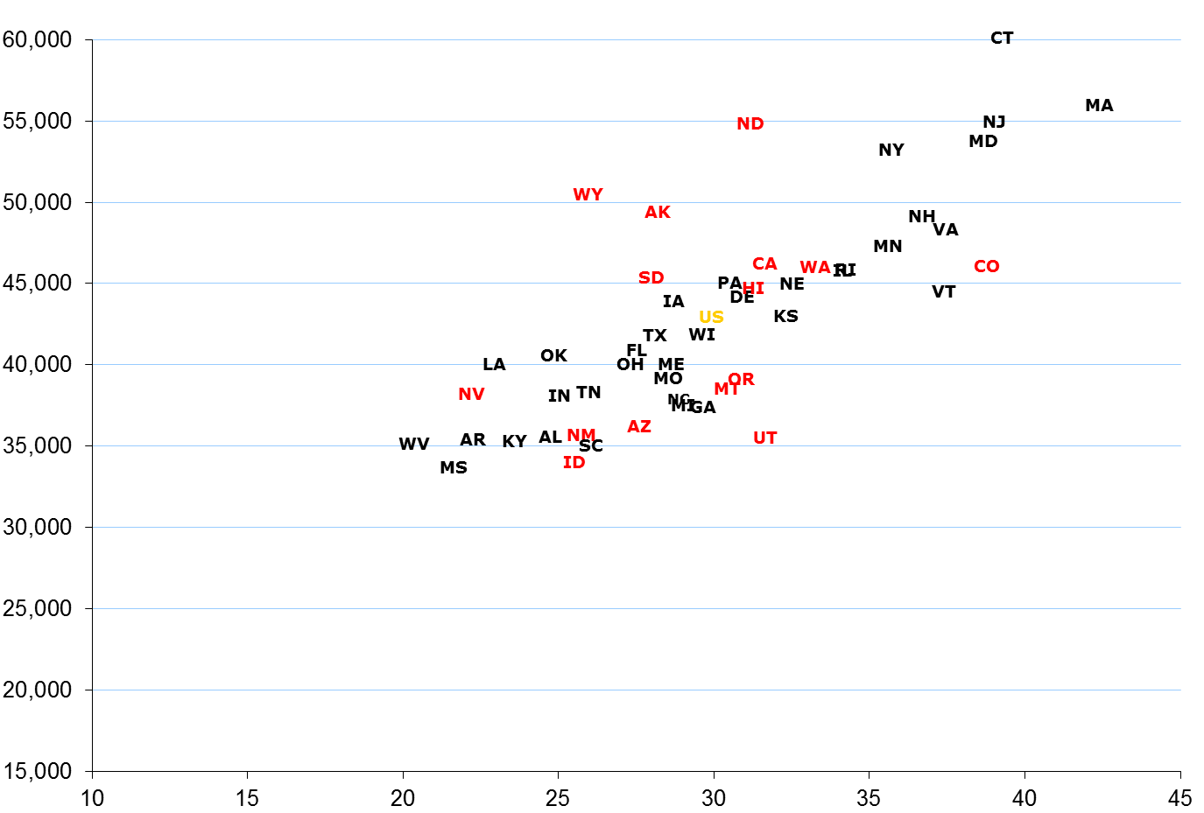
Education Attainment and Income
2012
Personal Income Per Capita
Correlation = 0.77
Percent of Adults Age 25-64 with Bachelor’s Degrees

Slide 23
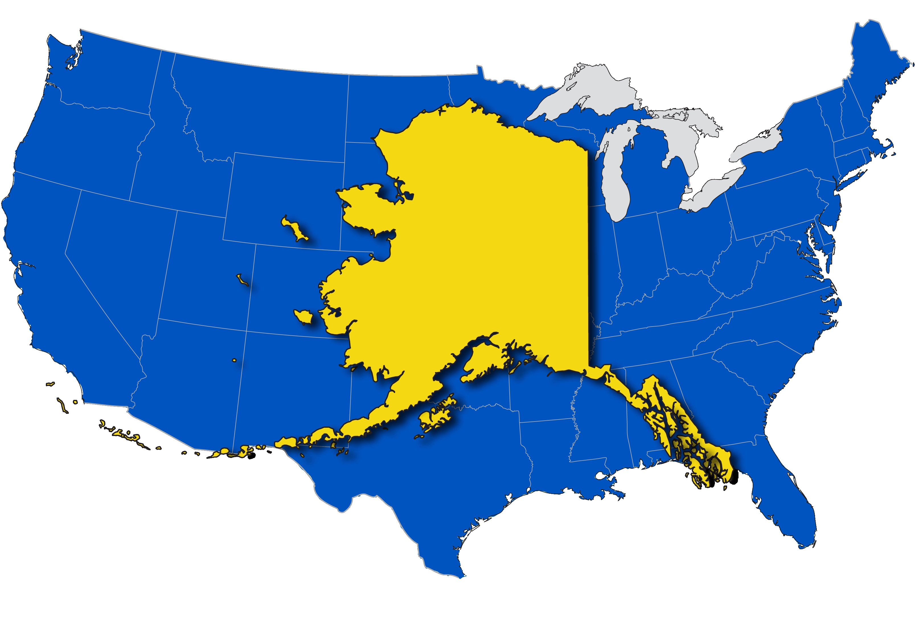
Landless University
Of the estimated acres Alaska should have received, just over 110,000 acres have been conveyed
Only Delaware has a smaller Land Grant

Slide 24
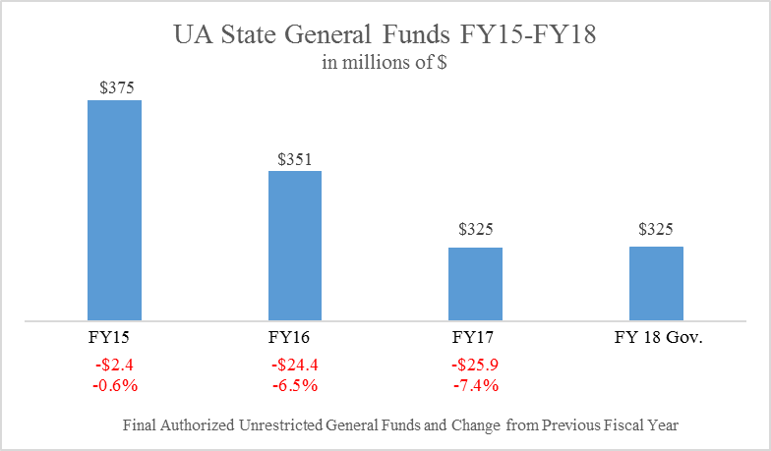
State Budget Reductions
The university’s budget has been reduced $53 M (14 percent) over the past three years.
The overall institutional impacts are greater than just the reduction of programs and personnel.

Slide 25
Budget Reduction Impacts
Jobs impacted
Cumulative FY15-FY17 headcount reduction: more than 900
More than 250 reduced assignments or increased workload
Academic program reductions
Since January 2016, 50 academic programs eliminated or suspended
Fewer sections and larger class sizes
Increases in faculty instructional workloads
Administrative function consolidation and service reductions
Closed Galena, McGrath, & Shishmaref Learning Centers
Reduction of faculty travel and professional development funding
Reduced research faculty start-up/seed availability
Telecommunications contract cost reduction
Reduced owned & leased space; defeased & refinanced debt

Slide 26
Target: 65 by 2025
By 2025, 65% of Alaska jobs are expected to require some postsecondary education; current attainment is 37%.
UA’s long-term goal is to support Alaska’s evolving workforce needs by producing more graduates and developing a stronger culture of education.

Slide 27
Johnson & Johnsen
Partnering with the Department of Education to:
Increase access to quality, affordable education
Partner with K-12 and with employers to meet post-secondary expectations
Produce highly qualified Alaskans to teach in Alaska’s schools
Develop the right workforce for Alaska’s diversifying economy
Build a culture of education in Alaska
27

Slide 28
Aligning for Alaska’s Future
Charge DEED Commissioner and UA President to develop plan with goals, objectives, and timeline
Use BOE/BOR subcommittee to guide and track progress
Expand concurrent enrollment
Strengthen college readiness
Continue study of high school to UA “preparatory” requirements
Align curricula
Increase Alaska educated teachers to 90% by 2025
Strengthen professional development for current teachers
Consider state accreditation

Slide 29
Alaska Scholarships
UA Scholars and Alaska Performance Scholarship
Since the inception in 1999 through FY15, UA Scholars have earned a total of 3,882 degrees, certificates, and endorsements from the University of Alaska
Prior to the UA Scholars Program in 1999, approximately 100 students from the top 10 percent of Alaska high school graduates enrolled at the University of Alaska. Today, UA attracts over 400 new Alaska high school students each year who graduated in the top 10 percent of their class, 42 percent of those eligible
In fall 2011, the initial semester for the program, 854 Alaska Performance Scholarship recipients enrolled at UA. The number of new APS recipients increased 21 percent to 1,032 for fall 2015, with these awardees receiving more than $1.8 million in APS funds.
The APS influenced 83% of eligible students to stay in Alaska
29

Slide 30
Strategic Investments
Student Success
Extend recruitment to attract more students and target Alaskans with some college but no degree
Expand localized programs proven successful in retaining students and improving graduation rates
Increase scholarship opportunities and expand Honors College to attract top-quality students
Workforce Development
Expand programs to meet state workforce goal (65% by 2025) including nursing, engineering, maritime trades/fisheries, and process technology
Facilities Maintenance
A multi-year plan to incrementally increase the annual funding dedicated to facilities maintenance (current and deferred), to slow the accumulation of deferred costs and reduce the risk of localized mission failure.
Research
Grow competitive capacity and invest in critical research for Alaska at ISER and ACEP
Sustain world-class leadership of Arctic research
Economic Development and Diversification
K-12 Partnership
ANSEP, teacher education, standards alignment, and dual enrollment

Slide 31
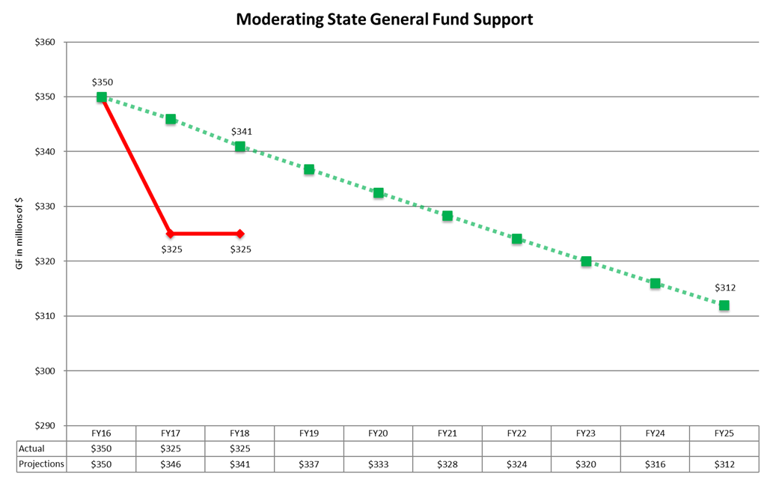
10-Year Glide Path Framework
The University’s 10-year framework uses benchmarked goals to incorporate gradual, sustainable reductions in state general fund appropriations while increasing university revenues through enrollment and diversified revenue.

Slide 32
Enrollment Strategies and Planning
Process started Fall 2016
Enrollment Summits at each university
McDowell Phase 1 enrollment analysis
Fiscal framework shared with BOR and University leadership
SDM (Structured Decision Making) process started
Enrollment Planning document
Initial strategic enrollment investments funded
Upcoming Spring 2017
McDowell Phase II
High school survey
Employer analysis

Slide 33
What’s needed to transform enrollment at UA
Emphasize retention and graduation
Investment in predictive analytics to help universities target and provide information and resources to students when they need it
A cadre of advisors trained in the use of cutting edge technology will be required
Focus on Alaskan adults with some college, but no degree
Invest in a fast, friendly and efficient “intake” process through a sophisticated web site or portal application
Have technology and staff dedicated to helping adult students with transfer of credit and credit for prior learning and experience
A major investment in on-line learning

Slide 34
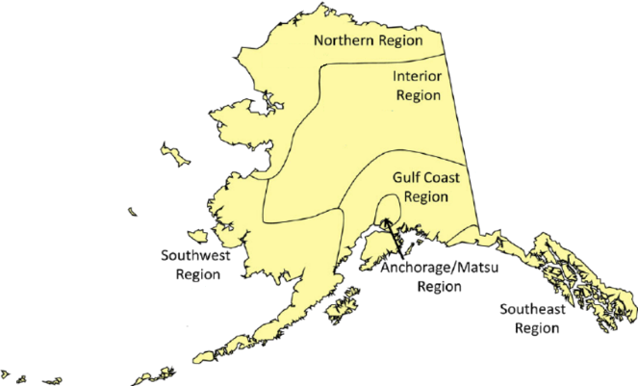
Adult Education Profile
Population Aged 25-44
 | Less than High School | Just High School Graduate or Equivalency | Some College, No Degree | Total Population
Anchorage/ MatSu Region | 6,772 | 29,673 | 33,590 | 114,290
Gulf Coast Region | 1,213 | 6,249 | 5,851 | 19,891
Interior Region | 1,691 | 7,900 | 10,984 | 33,833
Northern Region | 886 | 3,264 | 1,963 | 7,304
Southeast Region | 1,118 | 5,093 | 5,925 | 19,522
Southwest Region | 1,465 | 5,263 | 2,487 | 10,954
Alaska | 13,145 | 57,442 | 60,800 | 205,794
Population Aged 25-64
 | Less than High School | Just High School Graduate or Equivalency | Some College, No Degree | Total Population
Anchorage/ MatSu Region | 13,119 | 56,074 | 61,463 | 215,766
Gulf Coast Region | 2,756 | 14,192 | 13,069 | 44,207
Interior Region | 3,113 | 15,291 | 18,705 | 60,962
Northern Region | 1,735 | 5,878 | 3,814 | 14,019
Southeast Region | 2,462 | 11,466 | 12,333 | 42,484
Southwest Region | 3,006 | 9,575 | 5,099 | 21,296
Alaska | 26,191 | 112,476 | 114,483 | 398,734
Slide from Dennis Jones/Sally Johnstone, NCHEMS

Slide 35
Target Alaska’s Adult Market
Adult “Market” must be considered in at least three distinct categories
Some college/no degree
High school completion, but no college
Less than high school
The needs of each group are different and require different responses.

Slide 36
Needs for Students with Some College, No Degree
Ability to complete programs already started and/or with high employment potential
Not general/liberal studies programs
Recognize learning acquired in non-formal settings
Delivered in formats that accommodate work and other demands on students’ time
Likely to be extremely varied from one student to another
Asynchronous delivery a requirement

Slide 37
Strategic Pathways
Our economy is experiencing a historic transition and the state’s finances are being stressed – we must find ways to serve our purpose as cost effectively as possible.
Strategic Pathways is the framework we are using to improve our service to the state.

Slide 38
Strategic Pathways
How do we optimize our university system to achieve our higher educational goals for Alaska?
38

Slide 39
Initial Pathways Outcomes
Consolidation of 3 research administration offices into 1;
Consolidation of 3 procurement offices into 1;
Consolidation of information technology (IT) functions at each of the universities, with governance at Statewide;
Collaboration and efficiencies between the two schools of engineering;
Collaboration between the UAA and UAF management and business programs;
Consolidation of the UAS management programs into the School of Arts and Sciences;
Consolidation of three schools of education into one at UAS, serving all of UA

Slide 40
Conclusion
UA is becoming a stronger, more effective institution to better meet Alaska’s educational and workforce needs.

