Slide 1
Alaska Department of Education & Early Development
House Finance Sub-committee
Missions & Measures, Results on Investment

Slide 2
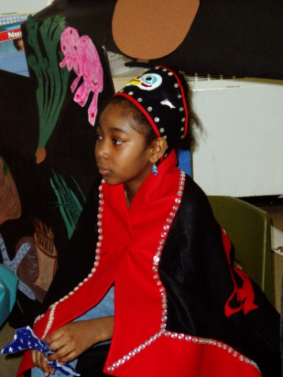
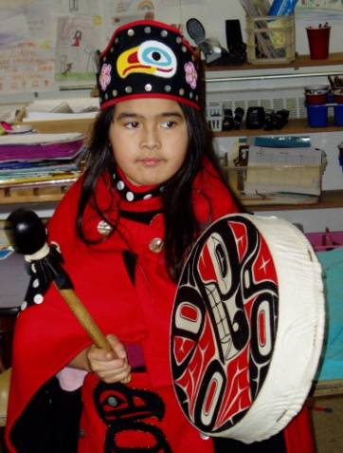
Department of Education and Early Development Constitution
Alaska Constitution Section 7.1 – Public Education
The legislature shall by general law establish and maintain a system of public schools open to all children of the State, and may provide for other public educational institutions. Schools and institutions so established shall be free from sectarian control. No money shall be paid from public funds for the direct benefit of any religious or other private educational institution.

Slide 3
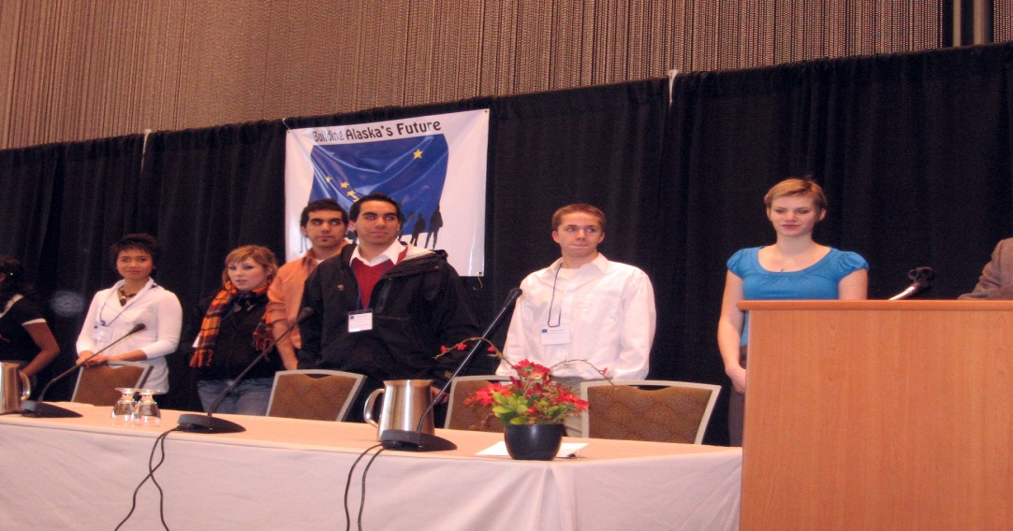
Department of Education and Early Development Constitution, continued
Alaska Superior Court defined, in 2007, the State’s responsibilities under the Education clauses:
Appropriate Educational Standards
Adequate Assessments
Oversight & Accountability
(A fourth is funding, which is a statutory decision)

Slide 4
Constitutional Mission
To ensure a quality standards based educational system that includes adequate assessments and monitoring, as well as measures of accountability and oversight to improve academic achievement for all students.

Slide 5
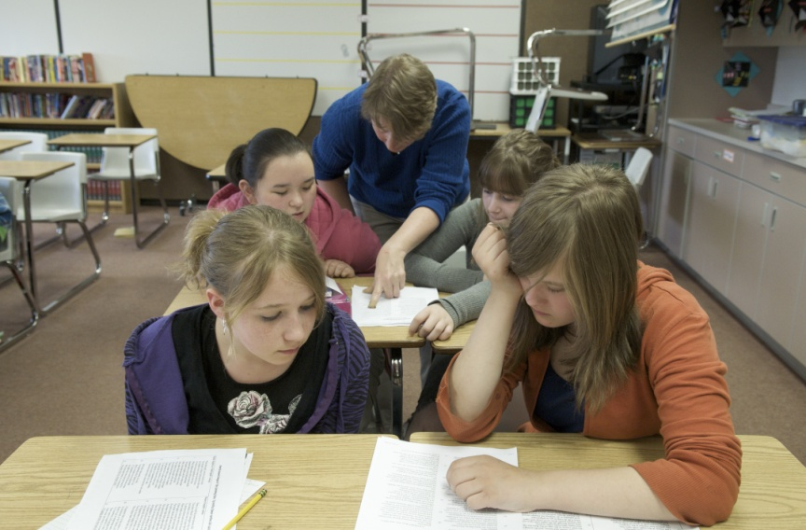
Mission Statement
To ensure quality standards-based instruction to improve academic achievement for all students.

Slide 6
Structure
State Board of Education & Early Development
Commissioner
Teaching & Learning Support
School Finance & Facilities
Administrative Services
Libraries, Archives, & Museums
Mount Edgecumbe Boarding School
Professional Teaching Practices Commission
Alaska State Council
on the Arts
Alaska Commission on Postsecondary Education

Slide 7
EED Core Services
Provide and evaluate a Comprehensive Student and School Standards, Assessment and Accountability System for all students and schools in Alaska that is based on student, school, educator, and culturally responsive standards.
Provide and support standards-based professional development and mentoring for Alaska's educators to ensure high quality instruction and growth in student achievement.
Provide a statewide program to ensure all students have the foundational skills required for a successful transition to college and/or the workforce after high school.
Secure and award state, federal, and private educational funding to school districts and other educational organizations to result in higher student achievement.
Providing high quality data to school districts and stakeholders through the use of the Alaska Statewide Longitudinal Data System.

Slide 8
Core Services – Standards, Assessments, and Accountability
Provide and evaluate a Comprehensive Student and School Standards, Assessment and Accountability System for all students and schools in Alaska that is based on student, school, educator, and culturally responsive standards.

Slide 9
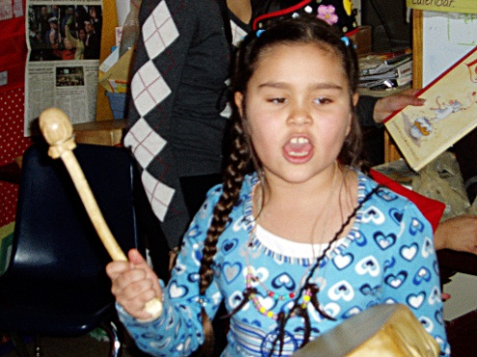
Core Service – Professional Development and Mentoring
Provide and support standards-based professional development and mentoring for Alaska's educators to ensure high quality instruction and growth in student achievement.

Slide 10
Core Services – Statewide Program
Provide a statewide program to ensure all students have the foundational skills required for a successful transition to college and/or the workforce after high school.
Secure and award state, federal, and private educational funding to school districts and other educational organizations to result in higher student achievement.
Providing high quality data to school districts and stakeholders through the use of the Alaska Statewide Longitudinal Data System.

Slide 11
Performance Measures
End Results
End Result A: Students demonstrate growth in academic achievement, demonstrating continuous growth, and meeting Proficiency or higher, on assessments defined in the Alaska Comprehensive System of Statewide Assessment.
End Result B: Increase the Statewide Graduation Rate.

Slide 12
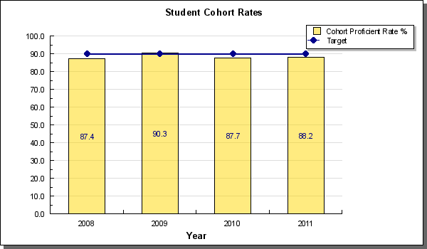
Performance Measures
School/Student Achievement
End Result A
Target 1: Increase to at least 90% the number of students that achieve a proficient score on all three content areas of the state high school graduation qualifying exam.

Slide 13
Alaska’s Standards Based Assessment Results
End Result A

Slide 14
Performance Measures
School/Student Achievement
End Result A
Target 2: Maintain proficient and higher achievement levels and increase growth of individual student achievement on Alaska’s Standards Based Assessments (SBA).

Slide 15
Performance Measures
School/Student Achievement
End Result A
Target 2: Maintain proficient and higher achievement levels and increase growth of individual student achievement on Alaska’s Standards Based Assessments (SBA).

Slide 16
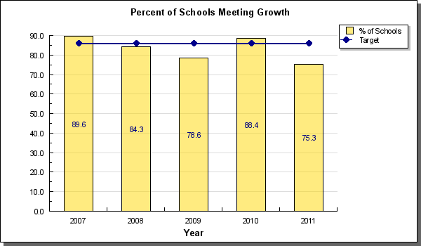
Performance Measures
School/Student Achievement
End Result A
Target 3: Increase the percentage of schools demonstrating student growth with a school growth score of 86 or higher.

Slide 17
Performance Measures Mentor Program
End Result A1 Strategy - Ensure students are learning the grade level expectations for reading, writing and mathematics as defined in the “Alaska Standards: Content and Performance Standards for Alaska Students” Fourth Edition.
Target #1: Through Mentorship reduce the turnover rate for teachers
Status #1: The Alaska Statewide Mentorship Program documented a 84% retention rate for first-year teachers in all districts in FY11. The retention rate for urban first-year teachers in FY11 was 93% and the rate for first-year rural districts was 80%.

Slide 18
Performance Measures Alaska Developmental Profile
End Result A1 Strategy
Target #2: Increase the measurable progression of communication, language and literacy skills and behaviors for incoming Kindergarten students
Status #2: The Alaska Developmental Profile (DP) showed modest progress in three of the five measureable categories for communication, language and literacy when comparing 2009-2010 results to 2010-2011. Of the two remaining categories one showed a slight decrease and the other showed no change.

Slide 19
Performance Measures
Graduation Rate
End Result B
Increase the Statewide Graduation Rate.
The Adjusted Cohort Graduation Rate is reported as a fraction.
The numerator is the sum of the number of graduates within the cohort who receive a regular diploma on or before June 30.
The denominator is the sum of all students assigned to the cohort from the 9th grade class three years prior.
# of graduates in cohort
# in 9th grade cohort*
* Takes into account the transfers in and out.
= graduation rate

Slide 20
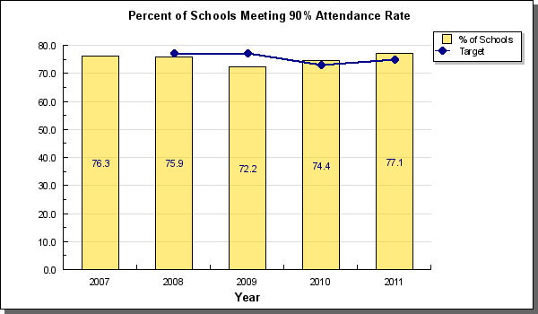
Performance Measures
Graduation Rate
End Result B
Target 1: Increase the percentage of schools that meet or exceed a 90% attendance rate.

Slide 21
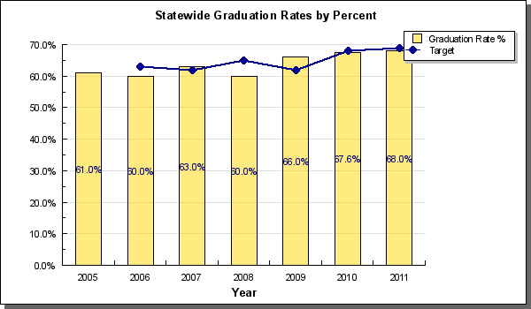
Performance Measures
Graduation Rate
End Result B
Target 2: Increase the statewide student graduation rates by 2% a year.

Slide 22
Performance Measures Improve Statewide Graduation Rate
B1: Strategy – Improve statewide graduation rate by implementing the Alaska Performance Scholarship Award Program.
Target # 1 Increase the number and percent of students who qualify for the Alaska Performance Scholarship Program.
Status #1: The Alaska Performance Scholarship Program (APS) was first implemented for the 2011 high school graduating class. A total of 2,303 graduating seniors were eligible for the APS out of 8,060 public high school graduates in 2011. The percentage of graduates eligible for the APS was 28.6%.

Slide 23
Performance Measures Improve Statewide Graduation Rate
B2: Strategy – Improve statewide student graduation rates by implementing statewide WorkReady / CollegeReady curriculum and assessment program.
Target #1: Increase the number of students receiving a National Career Readiness Certificate
Status #1: In 2011 7,381 students received a National Career Readiness Certificate (NCRC). This was an increase of 6,117 NCRCs when compared to 2010. The increase was largely due to regulations requiring students in grade 11 and interested grade 12 students to participate in the career readiness assessment.
In 2011, 84.5% of students who completed the assessment earned a NCRC, which is a 6.4% increase from 2010.

Slide 24
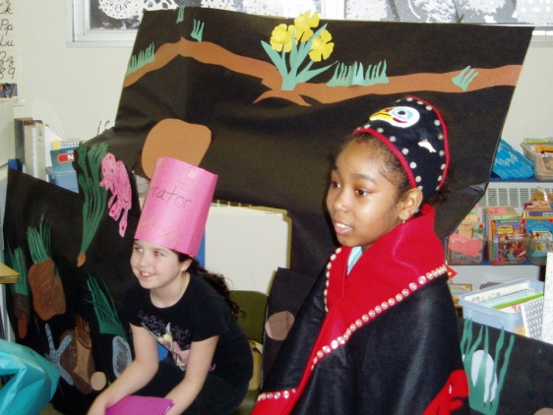
Department Accomplishments
Development of K-12 Standards
Alaska Performance Scholarship

Slide 25
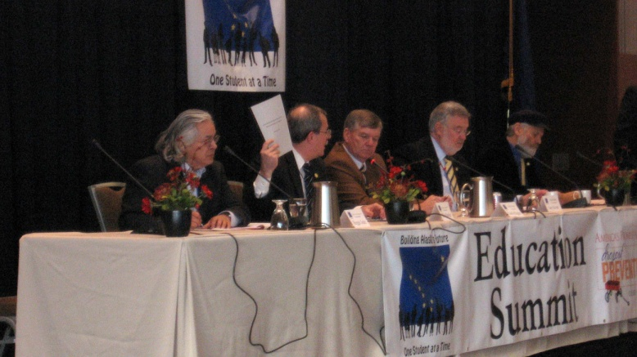
Department Challenges
Refining state assessments in relation to new standards
Closing the Achievement Gap

Slide 26
Alaska Department of Education & Early Development
House Finance Sub-Committee
2005 Look Back

Slide 27
Department of Education & Early Development
The 7 year look back provides historical reference to the department’s research based responses to the data provided by the Comprehensive Student Assessment System documenting student proficiency levels and DEED’s obligation under the Education Clause for accountability and oversight.
The Standard Based Assessments and the HSGQE provide the basis for implementing new strategies to impact student achievement. The high stakes impacts for the individual student are real and without sustainable, solutions the children can suffer the consequences for a lifetime.

Slide 28
Appropriations Embedded in EED Budget Structure
Alaska Native Science and Engineering Program (ANSEP)
Alaska Mineral & Energy Resource Education Fund (AMEREF)
Best Beginnings
Parents as Teachers
Theme-based grant to Iditarod School District

Slide 29
Alaska Department of Education & Early Development
House Finance Sub-Committee
Ten Year Plan

Slide 30
10 Year Plan Operating Budget
The Department of Education and Early Development has incorporated the highlighted changes discussed later in the presentation into the 10 year plan as well as other changes supported by the Office of the Governor reflected in the FY13 request.
In FY2015-FY2022, the Foundation Formula assumes an annual BSA increase of $100.00
The Alaska Performance Scholarship Program is projected to be fully capitalized for anticipated awards.
Operating cost increases include annual inflation adjustments of 2.75% for contractual obligations.

Slide 31
Alaska Department of Education & Early Development
House Finance Sub-Committee
Audit Check
Timekeeping for Federal Programs –Improved Methodology
USDA State Plan – New version submitted

Slide 32
Status of Current Year Changes
Student & School Achievement – School Health and Safety Coordinator - $160 UGF $40.0 I/A
The School Health and Safety Coordinator position has increased the department’s capacity to assist districts with school health and safety collaboration and capacity building.
The position has been instrumental in the Fourth R Healthy Relationships curriculum training, implementation and evaluation.
Additionally this position has participated on statewide committees affiliated with the Governor’s Initiative as well as served as the department’s representative to the State Council on Domestic Violence and Sexual Assault.

Slide 33
Status of Current Year Changes
Student & School Achievement – Theme Based Learning - $500.0 UGF
This funding was specifically targeted at the Iditarod School District through SB84 to allow the district to capture and digitize the theme based learning in the district and make it available to other districts.
Student & School Achievement – State System of Support content coaches and district trustees - $400.0 UGF
Additional content coaches are currently working on projects and the district trustee for Yupiit is in place. As stated previously concerning these services, it is this type of support that specifically addresses the Superior Court’s concern regarding the state’s obligation to provide appropriate levels of intervention services required under the Education Clause in the constitution.

Slide 34
Status of Current Year Changes
Early Learning Coordination – Pre-K Funding Base - $1,000.0 UGF & Pre-K Funding OTI - $700.0 UGF
Alaska Pre-K continues to show growth toward the goal of having more Alaskan children ready to learn when they enter the public school system. There have been improvements in the quality of the programs being offered our young children.
Early Learning Coordination – Pre-K Funding - $300.0 UGF
Targeted specifically at the intervention districts who did not apply for the grant funding, this funding allowed the districts to work with the programs that existed locally to begin to strengthen them.
Early Learning Coordination – Best Beginnings - $200.0 UGF
The funding for Best Beginnings is used to promote their initiatives related to early literacy and partnerships. This includes the Dolly Parton Imagination Library and Babies on Track.

Slide 35
Status of Current Year Changes
Library Operations – Broadband Technology Opportunities Program - $2,704.3 Federal/Other Funds
Alaska OWL (Online With Libraries) is in Phase 1 deployment to libraries. 26 of 34 libraries have received broadband/network enhancements; computer and videoconferencing equipment for libraries, videoconference scheduling assistance, in-person training events, and a monthly webinar schedule are underway.
ACPE – Program Administration & Operations AlaskAdvantage Grant Funding - $3,000.0 UGF
ACPE made grant awards to 2,009 postsecondary students. Average grant amount was $1,580.
ACPE – Alaska Performance Scholarship Awards - $6,000.0 UGF
ACPE awarded scholarships to more than 900 students. Average award amount was just over $3,500.

Slide 36
FY13 Governor’s Budget Highlights Meeting the Mission
Constitutional Mandate for Alaska’s Education System requires content & performance standards, valid, reliable and legally defensible comprehensive system of student assessments (CSSA) and accountability and oversight.
CSSA– Contractual costs to maintain aligned assessment system and continuous test item development - $750.0
On-line Advanced Placement Courses to qualify for the Alaska Performance Scholarship available to all 53 School Districts through the Alaska Learning Network - $1.2 million
Fully fund year two of the Alaska Performance Scholarship Program - $2.0 million
State System of Support Content Coaches - $400.0
Statewide Literacy Program - $300.0
Early Learning Coordination Pre-K Program - $700.0

