Slide 1
YKHC JVCP APPLICATION
NOVEMBER, 2014

Slide 13
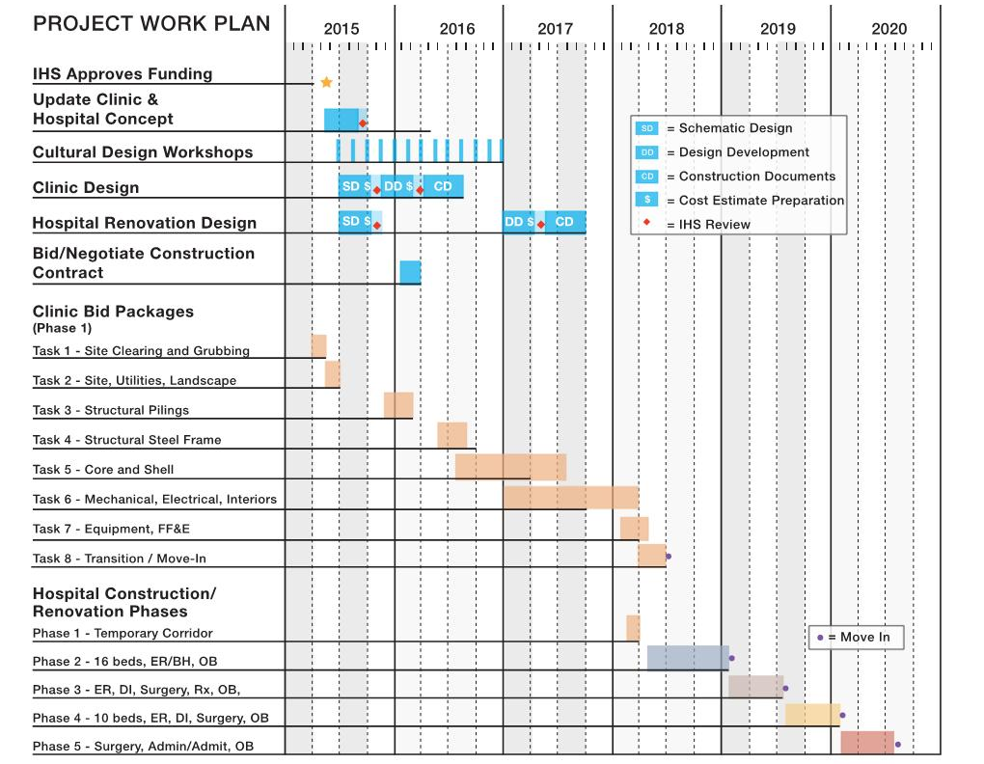

Slide 14
QUESTIONS

