Slide 1
Department of Military
and Veterans Affairs
FY2018 Division Overview
Alaska Military Youth Academy
Bob Roses
Director, Alaska Military Youth Academy

Slide 2
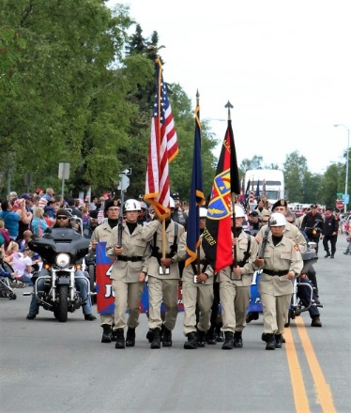
Alaska Military Youth Academy
National Guard ChalleNGe Program established in 1993 as a five year pilot with 100% federal funding
Became a permanent program in 1999; currently funded at 60/40 state/federal matching funds.
There are 40 ChalleNGe sites in 28 States, Puerto Rico and the District of Columbia that serve ~10,000 teens per year
Our Pre-Apprenticeship Program is setting the standard for other ChalleNGe programs
Cadets will receive Community Emergency Response Team (CERT) training
AMYA Program Graduates: 4,968 (as of Aug 2016)
AMYA Awarded HS Diplomas or GED: 3,264 (as of Aug 2016)
ChalleNGe graduates generate labor market and other benefits of $2.66 for every dollar expended on the program, a return on investment of 166%
Largest Mentoring program in the State of Alaska – opportunity for uniformed personnel to be mentors
We invite you to join us for our next graduation on February 24th, 2017!

Slide 3
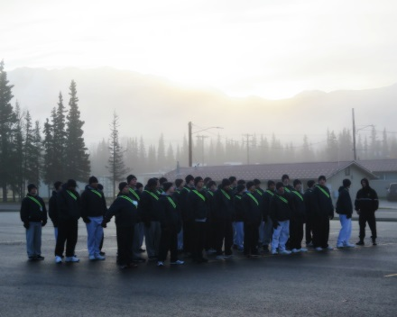
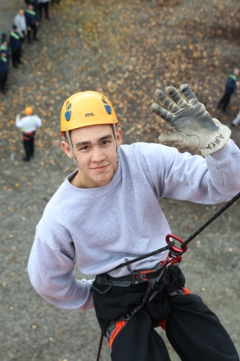
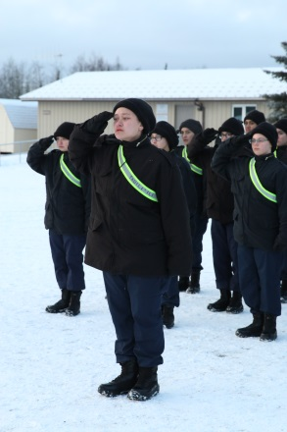
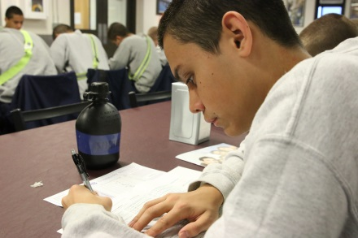
Alaska Military Youth Academy
Mission: Instill life coping skills in and meet educational needs of 16-18 year old Alaskans who are at risk of not completing their secondary education
66 full and 2 part time budgeted positions
$8,735.8 total budget request
4,567.1 UGF, 1.0 DGF, 34.2 Other, 4,135.5 Fed

Slide 4
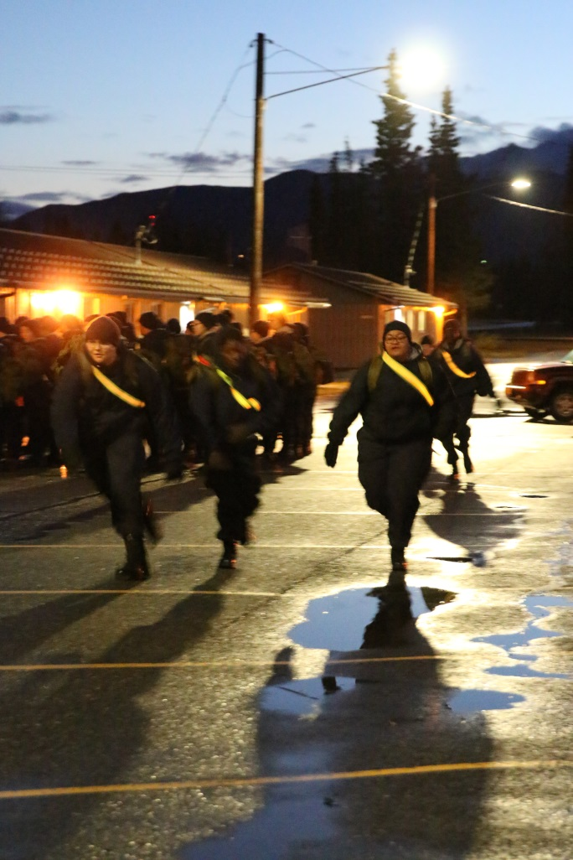
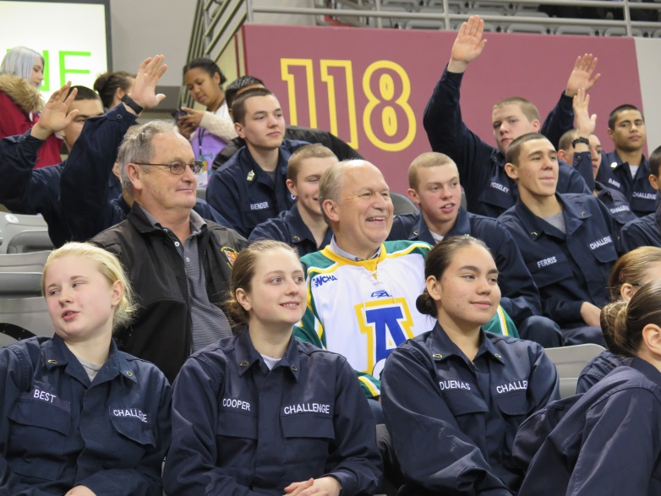
Eight Core Components
While at AMYA cadets operate under a strict code of conduct and are taught and assessed in eight core components:
Academic Excellence
Leadership/Followership
Responsible Citizenship
Service to Community
Physical Fitness
Job Skills
Health & Hygiene
Life-Coping Skills

Slide 5
Alaska Military Youth Academy
FY2016 Successes
Launched Construction Trades, Culinary Arts, and Computer Technology pre-apprenticeship programs
Established AMYA as a certified WorkKeys satellite test center for cadets
Added Science, Technology, Engineering and Math (STEM) to AMYA curriculum
FY2017 Operations
Enhancing career awareness instruction in remodeled VoTech Lab
Added Health Care Services Pre-apprenticeship Training
Added Community Emergency Response Team (CERT) training
FY2018 Outlook
Expand CERT training opportunities for more cadets
Continue to build partnership for greater success of cadet placement
Maintain adequate staffing to remain in compliance with the federal cooperative agreement

Slide 6
Contacts
For additional information, please contact:
Bob Roses, Director
Bob.roses@alaska.gov
(907) 428-7317
James Jones, Manager
James.jones1@alaska.gov
(907) 428-7302

