Slide 1
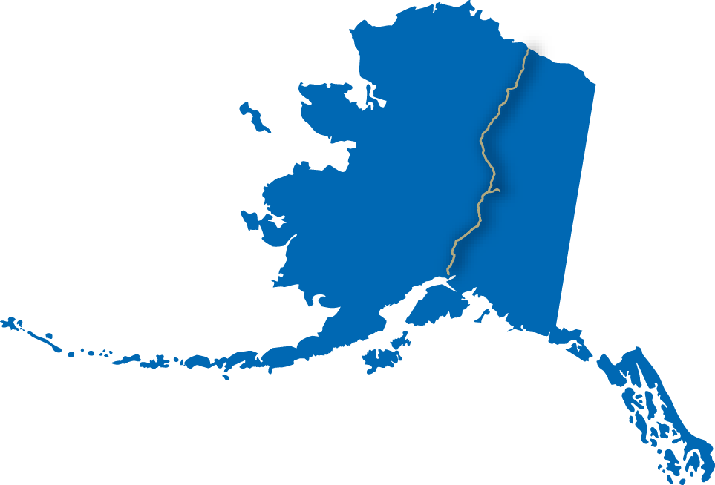
Alaska Stand Alone Gas Pipeline
Senate Special Committee
on In-state Energy
ASAP Project
Update
February 5, 2013
Notes:
Thank you for inviting us here to today to provide on update on our project and what we have accomplished over the last 2 and a half years . We welcome this chance to share with you some very good news about changes we have made to the project that can provide long term natural gas to Alaskan consumers and businesses energy needs but also provide for economic opportunities.
We appreciate the support voiced by the Governor in his State of the State address. We have advanced the project a long ways in a short time and are ready to continue towards a completed project with help from the Administration and the Legislature

Slide 2
Who? AGDC and What? ASAP
April 2010: HB 369 mandated that Alaska Housing Finance Corporation (AHFC) facilitate development of a plan for an in-state pipeline project.
July 2010: AHFC established the Alaska Gasline Development Corporation (AGDC) as a subsidiary corporation to take over project planning and execution.
ASAP is that project: the Alaska Stand Alone Pipeline.
Also known as the in-state pipeline.
Notes:
I’ll start off by clarifying what AGDC is and what ASAP is.
AGDC is the Alaska Gasline Development Corporation, which was created by legislation in 2010 to facilitate (or ‘advance’) an in-state gasline project for Alaskans. AGDC was set up as a subsidiary of the Alaska Housing Finance Corporation, specifically to develop and execute a in-state natural gas pipeline project.
That “project” is ASAP – the Alaska Stand-alone Pipeline.
Our objective is to advance and sanction a pipeline that will deliver natural gas from Fairbanks and Cook Inlet areas at the earliest possible date with the lowest possible cost to consumers
----advancing an in-state natural gas pipeline from Prudhoe Bay to Cook Inlet allowing for distribution of natural gas for residential and commercial use along the pipeline route, at the earliest possible date!

Slide 3
ASAP Progress Up-date
604 miles of State Right-of-Way lease; includes Fairbanks lateral
Final Environmental Impact Statement (FEIS) completed November 2012
FEIS Record of Decision expected January 2013
AGDC team optimized the project plan to Lean Gas
Up-dated capital costs and tariff models
Contracted a facility design firm
Identified enabling legislation required to move ASAP forward
2013 Summer field work plan in progress
Notes:
Major project assets acquired to-date includes: including
604 miles of state lands granted (without condition) as ROW
A completed FINAL EIS and soon a Record Of Decision
We are also poised to receive another 100 miles of federal ROW.
As the markets around the world have changed for NGL’s we have optimized the project to deliver lean gas
That will allow less costly access by more Alaskan consumers and business
Contracted with a facilities design firm for gas conditioning facility - $2.8B facility

Slide 4
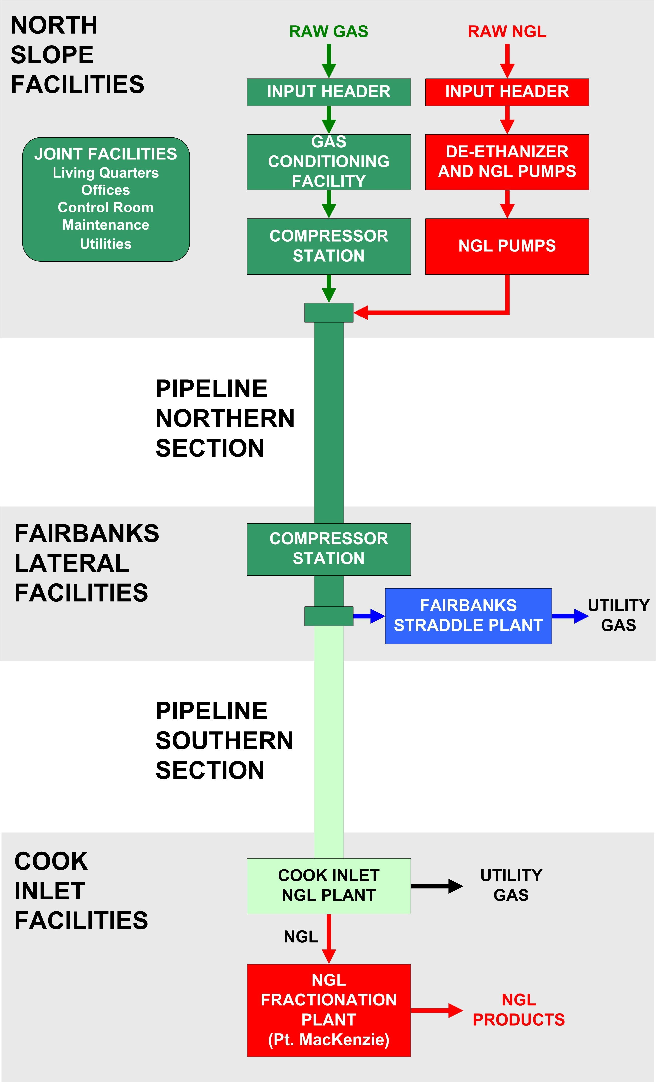
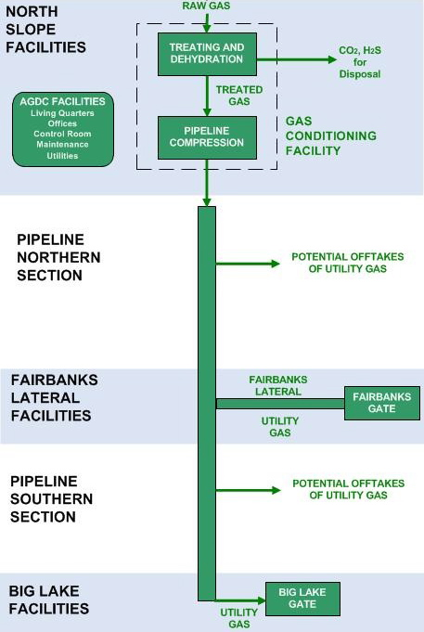
2011 Plan vs. Optimized Project Plan
36” diameter pipe
1,480 psi max
Fairbanks Lateral: 12” diameter pipe, tie-in with mainline at MP 458
North Slope GCF at Prudhoe Bay
More off-takes possible
24” diameter pipe
2,500 psi max
Fairbanks Lateral: 12” diameter pipe, tie-in with mainline at MP 458
North Slope GCF at Prudhoe Bay
Straddle Plants
NGL Extraction Plant
Fractionation Facility
Intermediate Compressor Stations
Notes:
2011 Plan: This was the base case that we used for the FEIS
737 mile, 24” dia. 2,500psi pipeline transporting natural gas entrained with Natural Gas Liquids with 35 mile 12” dia pipeline
With North Slope Gas Conditioning facility, fractionation facility,
Intermediate compressor stations and a straddle plant to extract the NGLs to allow delivery of utility grade gas to Fairbanks
NGL Extraction facility at the terminus near Pt. Mackenzie
Higher tariff for Fairbanks to cover cost of straddle plant
World has changed for NGL’s so we elected to shift from Rich to Lean Gas decision. This has allowed for fewer facilities, easier , less risk for design and construction.
Optimized case –
36” dia 1,480 psi pipeline
One compressor station and NO Fractionation, straddle plant of NGL extraction facilities needed
Reducing capital expenditures, lowering O&M costs and reducing RISK
Lower costs for Fairbanks

Slide 5
Optimized Project Plan Benefits
Issues | Optimized Project Plan (Lean Gas) | July 2011 Project Plan
Customers | Easier and less expensive connections More off-take points More potential customers and greater access Deliver natural gas to Alaskans by 2019 | Costly connections Fewer off-take points for Alaskans
EIS/Permits | Supplemental environmental document required with minimal impact to schedule Smaller footprint and reduced carbon impacts | Risk of carbon tax More permits; greater complexity/impact FEIS complete (November 2012)
Complexity | Less risk — One facility (GCF) with standard pressure & equipment Design process less costly Propane extraction still available for in-state demand | 5 + facilities with high pressure pipeline and specialized materials and equipment required
Tariff | Lower tariff | Higher tariff
Cost | $7.7B (+/- 30%) in $2012 Lower construction risk Lower O&M costs | $7.5B (+/- 30% )in $2011 ($7.7B in $2012) Higher construction risk Higher O&M costs
Political / External | Improved economics for Interior users Increased customer base with ease of connections Requires enabling legislation to more effectively and efficiently advance the project and schedule NOT viewed as competition to AGIA | Petrochemical plant ambitions Lack of market for by-products Efficiencies not realized NOT viewed as competition to AGIA
Notes:
The new design is still limited to a maximum flow of 500 MMscf/day to comply with the AGIA limitation.
We eliminate costly facilities
Industry standard pipe and equipment
Less facilities means less cost
Lean gas stream can still allow for propane extraction to meet in state demand
Lean gas maximizes access for Alaskan communities - no need for expensive straddle plants
Lower operating costs without in-line compressor stations

Slide 6
Stage Gate Approach
End 2014
Notes:
This illustration depicts the front end development state gate approach to project development. As more information is obtained and more refinement of the project occurs, certain gates must be reached and passed through to go on to the next gate.
This project has passed through concept selection and FEL-1, business development and are poised to move on into FEL-2. Last year, we presented to you a project plan that represented what we could accomplish in FEL-2. Unfortunately we did not get the legislation and funding necessary to advance meaningfully far into FEL2 stage. We are currently at the beginning of FEL-2 with both our pipeline and facilities work.

Slide 7
ASAP Optimized Project Schedule
Open Season
Notes:
This chart depicts the accelerated schedule that was given to us by the legislature in 2010. It was clearly an aggressive schedule that was not realistic for a mega-project. And an $8B is a mega project.
The optimized schedule shown below is still an aggressive schedule that shows FEL-2 phase that is a year longer due to the delays of the last year.
We can advance this project along this timeline and get gas to Alaskans beginning in 2019/2020 if we are granted the legislation and funding to do the work.

Slide 8
ASAP Project Milestones
Open season late 2014
Determine commercial interest
Project sanction late 2015
Procure pipe and long lead items 2016
Construction 2017 - 2019
2+ years (772 miles of pipeline including lateral)
First gas in late 2019
Full gas transmission 2020

Slide 9
Optimized Project Tariff Update
Longer term: 30-year levelized vs. original 20-year
Updated capital cost estimates with more appropriate contingency
Pipeline now 10% vs. 5% (facilities 30%)
Equity share and return on equity adjusted
Debt/equity split now 75/25 vs. 70/30
ROE 11% vs. 12%
Year delay ($2011 -> $2012)
2.5% inflation per year
Notes:
With a optimized design we also look at the impacts of the tariff. A tariff is the cost that the pipeline would charge its customers to ship gas. The tariff would cover the overall cost including paying off debt and covering the operations of the pipeline.
Our commercial team optimized the tariff model including changes to the term, financing, ROE, and cost of capital.
The net result was positive costs

Slide 10
Tariff Assumptions Comparisons
Notes:
I provide this chart as comparison for all of the projects – APP, Denali, our 2011 base case and our new design case.
Note that the far right column is the tariff assumptions for the lean gas case.

Slide 11
Tariff Comparison
Notes:
Remember the tariffs are the cost of the pipe construction and operation.
This is the cost we would charge to shippers to use the pipeline.
There are many ways that the tariff can be influenced.
Cost to construct
Equity contribution by the State
ROE
Term of the bond
And delays to the schedule
The annual cost of delay equates to over $200M/year

Slide 12
ASAP Costs
Cost to Alaskans: $400M up-front cost to be recovered through gas royalty and taxes
Cost Benefit: Long term natural gas supply for Alaskans
Project Cost: $7.7 Billion* in 2012 dollars, +/- 30%
Cost of Gas to Consumers (burner tip)
Anchorage | Fairbanks
Optimized $ 9 - 11.25/MMBtu in 2012 dollars Base case $ 9.63/MMBtu in 2011 dollars | Optimized $ 8.25 - 10/MMBtu in 2012 dollars Base Case $ 10.45/MMBtu in 2011 dollars
*Each year the project is delayed, 2.5% inflation is added to the cost of the project
Notes:
Our project plan has been to advance the project through an open season to let shippers and buyers of gas determine if we have a viable project. To do this we need $400M in total to get through the open season to project sanction.
As we have said, the new cost estimate is $7.7B in 2012 dollars +/- 30%. We give this range because we have only performed preliminary engineering at this point.
Based on the tariff numbers we presently earlier the cost to consumers are lower for Fairbanks than we originally presented in our project plan last year: A range from $8 -$10/Mmbtu as compared to the $10.45 – the main difference due to elimination of the $210M straddle plant
Our projected rates for Anchorage ranges from $9-$11 compared to $9.63 last year
IT is important to note that every year of delay equates to over $210M based on the Philadelphia Fed Reserve Bank published rate of inflation of 2.5%.

Slide 13
Funding Required to Advance
Achieving legislative objectives to advance an in-state natural gas pipeline for Alaskans is contingent on legislative funding
Full funding will keep project on schedule
Advance facilities and pipeline engineering
Regulatory permitting activities and agency engagement
Engineering field investigations
Partial funding will cause schedule delays
Limited pipeline and facilities engineering
Limited field investigation
Notes:
How we proceed forward is entirely contingent on the level of funding we receive.
To advance the project on an expedited fashion we must advance the engineering on both the pipeline and the gas treatment plant. This will require sufficient funding to engage contractors on multi-year basis and not small annual increments.
Field work is necessary to prepare better estimates on the cost of construction. We need to define where we will have bridges crossing major rivers or drill underneath them as a considerable saving. We need to advance the facilities design so we can estimate the processing equipment necessary to condition the gas.

Slide 14
ASAP Requires Enabling Legislation
Critical legislation components:
Ability to enter into confidential agreements
Contract carrier status is needed to allow AGDC to enter into long-term contracts
Authority to determine ASAP ownership structure is key to attracting shippers/buyers; financing; and pipeline tariffs
Enabling legislation will significantly advance meeting the purpose of the original legislation: “. . . deliver natural gas to as many communities as practicable along the route ..”
Notes:
Enabling legislation is needed: Speaker Chenault and Rep. Hawker have filed HB4 this year to provide AGDC with meaningful direction. As the Governor said, he supports boosting AGDC ability to build a pipeline. To do that we will need:
Confidential agreements are critical. This would allow for meaningful commercial and proprietary discussion. Confidential agreements are industry standard
Confidentiality needed to have open meaningful dialogue with the shippers and buyers of the natural gas
And define that the pipeline is for contract carrier pipeline
Determine ownership – whether or not the state will retain any ownership or pass this project on to a commercial operator
Provide access to the $200 million set aside for this project

Slide 15
Thank You
Alaska Gasline Development Corporation
ASAP Project Office
3301 C Street, Suite 100 • Anchorage, AK 99503
Phone: (907) 330-6300 • Website: www.agdc.us
Frank Richards, P.E.
Government Affairs & Pipeline Engineering Manager
Phone: (907) 330-6352

