Slide 1
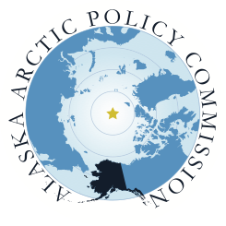
Alaska’s Arctic Policy
and
Implementation Plan
Alaska Arctic Policy Commission
Senate Special Committee
on the Arctic
Feb 5, 2015

Slide 2
Alaskans are at the forefront of emerging opportunities
Notes:
• Our vision for the Arctic is based on
economic and resource development, a healthy
environment, secure and safe communities, and
transparent decision making.
• The Arctic is an integral part of Alaska’s identity.
It is home to many Alaskans and is an important
part of our history, our culture, and our future.
• The Arctic also presents multitudes of
opportunities that are being realized with
an increasingly accessible Arctic. These
opportunities are of strategic importance to
Alaskans who are building on years of vision,
hard work and experience living and working in
the region.

Slide 3
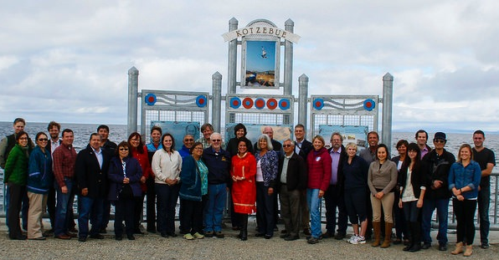
develop an Arctic Policy for the state Create an implementation plan for that Policy
Goals of the Commission:
Notes:
In April 2012, the Alaska State Legislature established the Alaska Arctic Policy Commission to “develop an Arctic policy for the state and produce a strategy for the implementation of an Arctic policy.”
The Commission has operated under the conviction that the state is an active and willing leader and partner in Arctic decision-making with its reliable expertise and resources.
Furthermore, the Commission has remained committed to producing a policy for Alaska’s Arctic that reflects the values of Alaskans, provides a suite of options to capitalize on the opportunities and safeguard against risk. It is a policy that will stand the test of time and act as a living document.

Slide 4
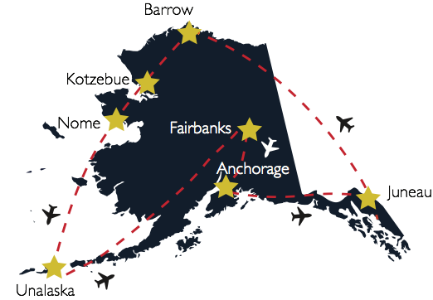
The Commission convened public meetings around the state
Notes:
Through this process the
Commission has investigated
and relied upon coordination
among jurisdictions, cooperation
at all levels of government –
international, national, state,
local and tribal – and sought
to balance multiple values to
protect, promote, and enhance
the well-being of the Alaskan
Arctic including the people,
flora, fauna, land, water and
other resources.

Slide 5
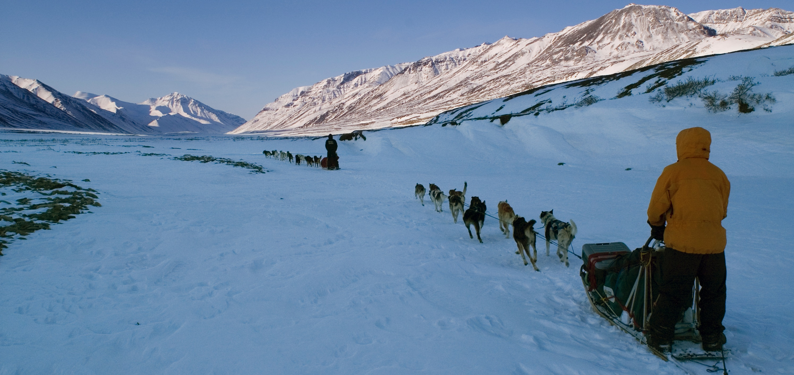
Alaska’s Arctic Policy articulates our vision and will guide the state’s initiatives and inform U.S. domestic and international policy in ways that will ensure a benefit to Alaskans.
Notes:
• Uphold the state’s commitment to economically vibrant communities
sustained by development activities consistent with the state’s
responsibility for a healthy environment
• Collaborate with all levels of government, tribes, industry and
nongovernmental organizations to achieve transparent and inclusive
Arctic decision-making resulting in more informed, sustainable and
beneficial outcomes
• Enhance the security of the state through a safe and secure Arctic for
individuals and communities
• Value and strengthen the resilience of communities and respect and
integrate the culture and knowledge of Arctic peoples

Slide 6
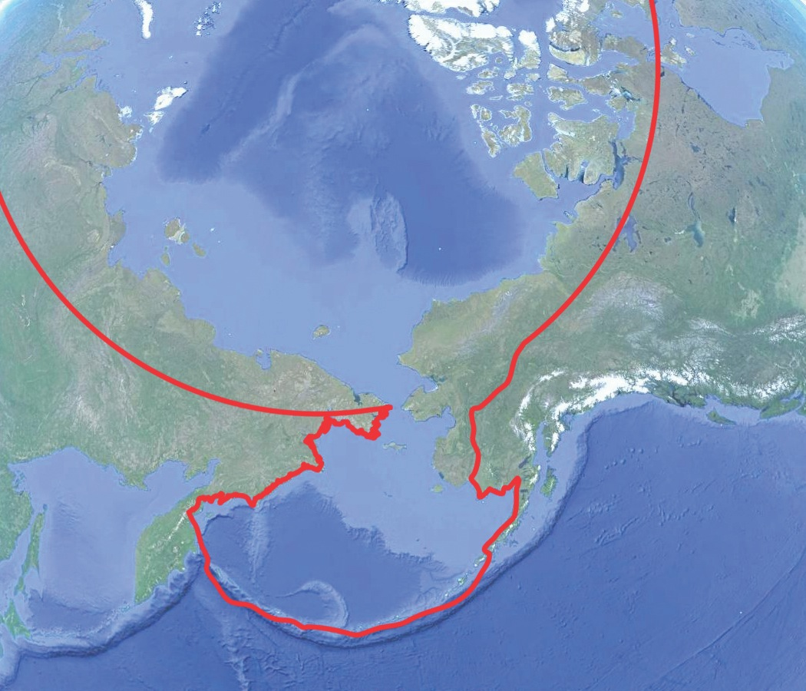
“[A]ll United States…territory north and west of the boundary formed by the Porcupine, Yukon and Kuskokwim Rivers; all contiguous seas, including the Arctic Ocean and the Beaufort, Bering and Chukchi Seas; and the Aleutian Chain.”
–Arctic Research and policy Act 1984

Slide 7
Policy Statement #1 - Uphold the state’s commitment to economically vibrant communities sustained by development activities consistent with the state’s responsibility for a healthy environment
Communities benefit from economic and resource development activities
Improve permitting and regulatory processes
Create positive investment climate and develop strategic infrastructure
Responsive to changing climate
Innovation should focus on emerging opportunities and challenges
Notes:
• Ensure that Arctic residents and communities benefit from economic and
resource development activities in the region;
• Improve the efficiency, predictability, and stability of permitting and
regulatory processes;
• Attract investment through the establishment of a positive investment
climate and the development of strategic infrastructure;
• Sustain current, and develop new, approaches for responding to a
changing climate;
• Encourage industrial and technological innovation in the private and
academic sectors that focuses on emerging opportunities and challenges;

Slide 8
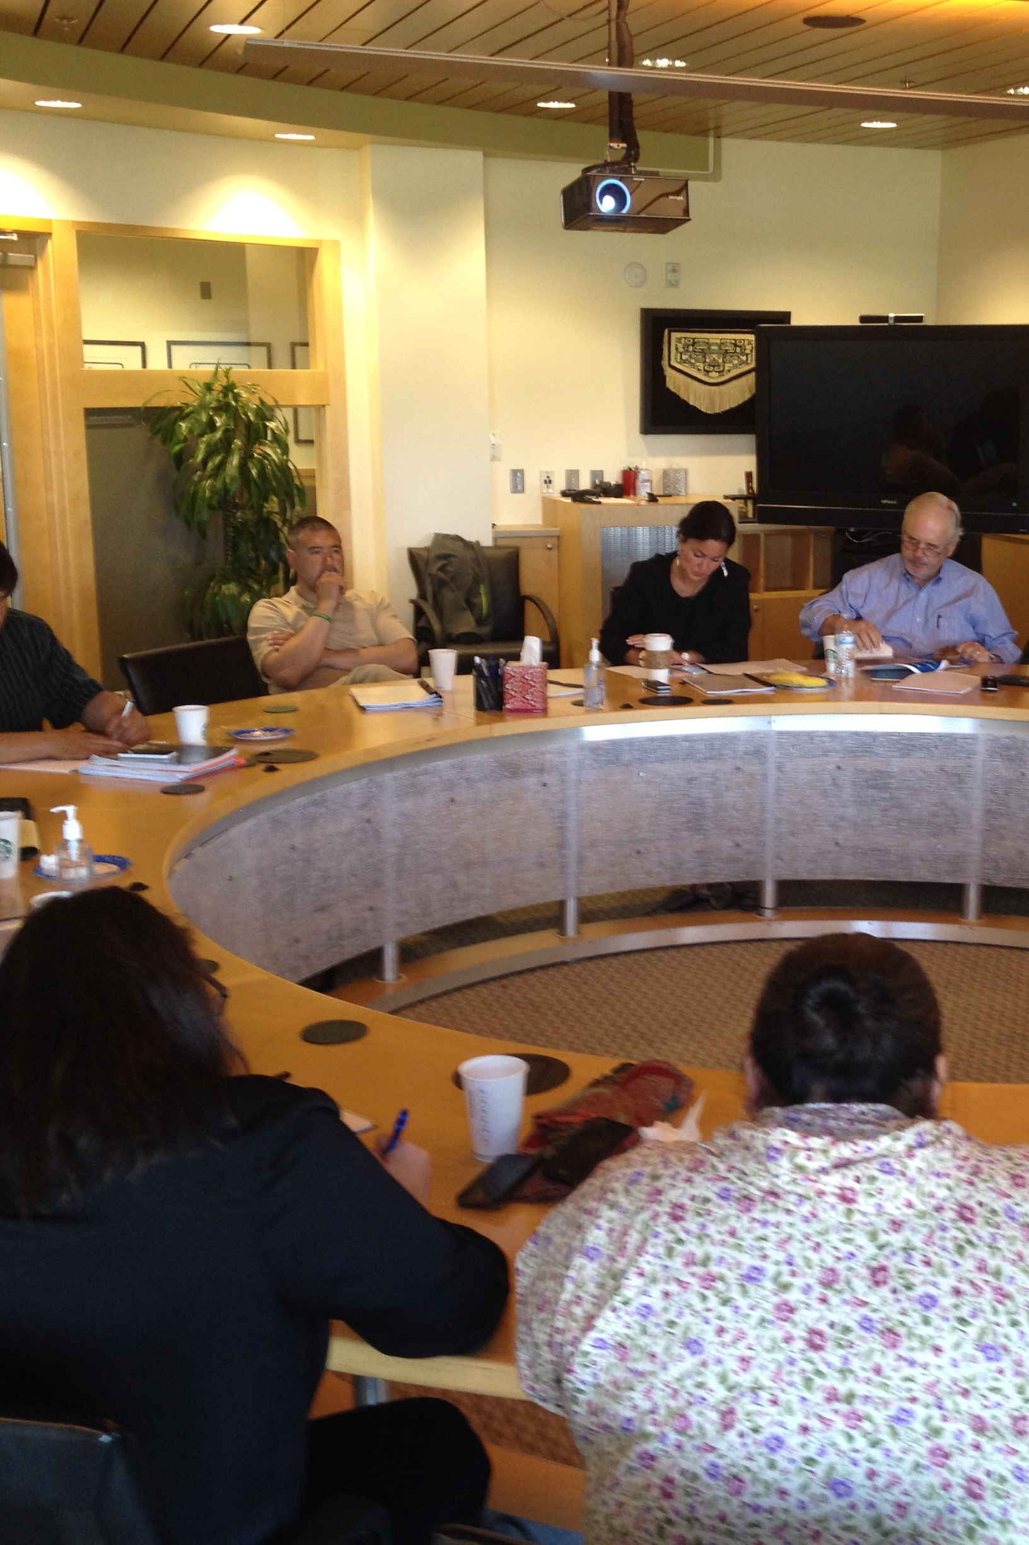
Policy Statement #2 - Collaborate with all levels of government and stakeholders
Strengthen and expand cross-border relationships and international cooperation
Sustain and enhance state participation in the Arctic Council
Pursue opportunities to participate meaningfully as a partner in the development of federal and international Arctic policies
Strengthen communication with Arctic Council permanent participants
Reiterate the state’s long-time support for ratification of the Law of the Sea Treaty
Notes:
• Strengthen and expand cross-border relationships and international
cooperation, especially bilateral engagements with Canada and Russia;
• Sustain and enhance state participation in the Arctic Council;
• Pursue opportunities to participate meaningfully as a partner in the
development of federal and international Arctic policies, thereby
incorporating state and local knowledge and expertise;
• Strengthen communication with Arctic Council permanent participants,
who include and represent the state’s indigenous peoples;
• Reiterate the state’s long-time support for ratification of the Law
of the Sea Treaty;

Slide 9
Policy Statement #3 - Enhance the security of the state through a safe and secure Arctic
Enhance disaster and emergency prevention and response, oil spill prevention and response and search and rescue capabilities
Provide safe, secure and reliable maritime transportation
Sustain and develop new, community, response, and resource related infrastructure
Coordinate with the federal government for an increase in United State Coast Guard presence and national defense obligations
Notes:
• Enhance disaster and emergency prevention and response, oil spill
prevention and response and search and rescue capabilities in the region;
• Provide safe, secure and reliable maritime transportation in the areas of
the state adjacent to the Arctic;
• Sustain current, and develop new, community, response, and resource related
infrastructure;
• Coordinate with the federal government for an increase in United States
Coast Guard presence, national defense obligations and levels of public
and private sector support; and

Slide 10
Policy Statement #4 - value and strengthen the resilience of communities
Recognize Arctic indigenous peoples’ cultures and unique relationship to the environment
Build capacity to conduct science and research and advance innovation and technology
Employ integrated, strategic planning that considers scientific, local and traditional knowledge
Safeguard the fish, wildlife and environment of the Arctic for the benefit of residents of the state
Encourage more effective integration of local and traditional knowledge into conventional science, research and resource management decision making
Notes:
• Recognize Arctic indigenous peoples’ cultures and unique relationship to the
environment, including traditional reliance on a subsistence way of life for
food security, which provides a spiritual connection
to the land and the sea;
• Build capacity to conduct science and research and advance innovation and
technology in part by providing support to the University of Alaska for Arctic
research consistent with state priorities;
• Employ integrated, strategic planning that considers scientific, local and
traditional knowledge;
• Safeguard the fish, wildlife and environment of the Arctic for the benefit of
residents of the state;
• Encourage more effective integration of local and traditional knowledge into
conventional science, research and resource management decision making.

Slide 11
Commission’s Final Report to the Alaska State Legislature
Notes:
Over the course of the next few decades and into
the future, increased access to the Arctic will bring
more activity, traffic and people to the region. While
this presents enormous opportunities for Alaska,
there are potential risks involved. It is critical that
policy makers act strategically to advantage Alaska in
a changing Arctic. Therefore, the Alaska Arctic Policy
Commission has provided as part of its final report:
• A review of economic, social, and environmental
factors of relevance to the Arctic and more broadly
to all Alaskans.
• An Implementation Plan that presents four
lines of effort (drawn from our Vision of the Arctic)
and strategic recommendations that form a
suite of potential independent actions for
legislative consideration.

Slide 12
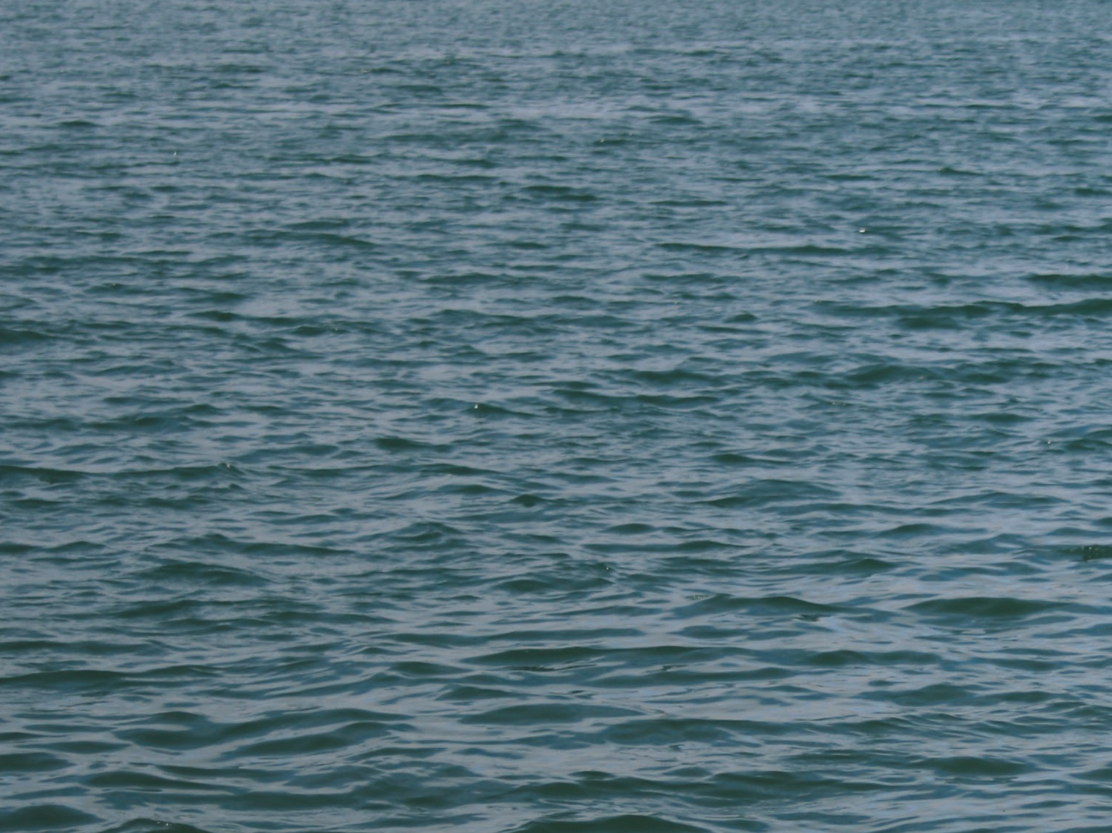
Four lines of effort
Arctic Policy Implementation Plan

Slide 13
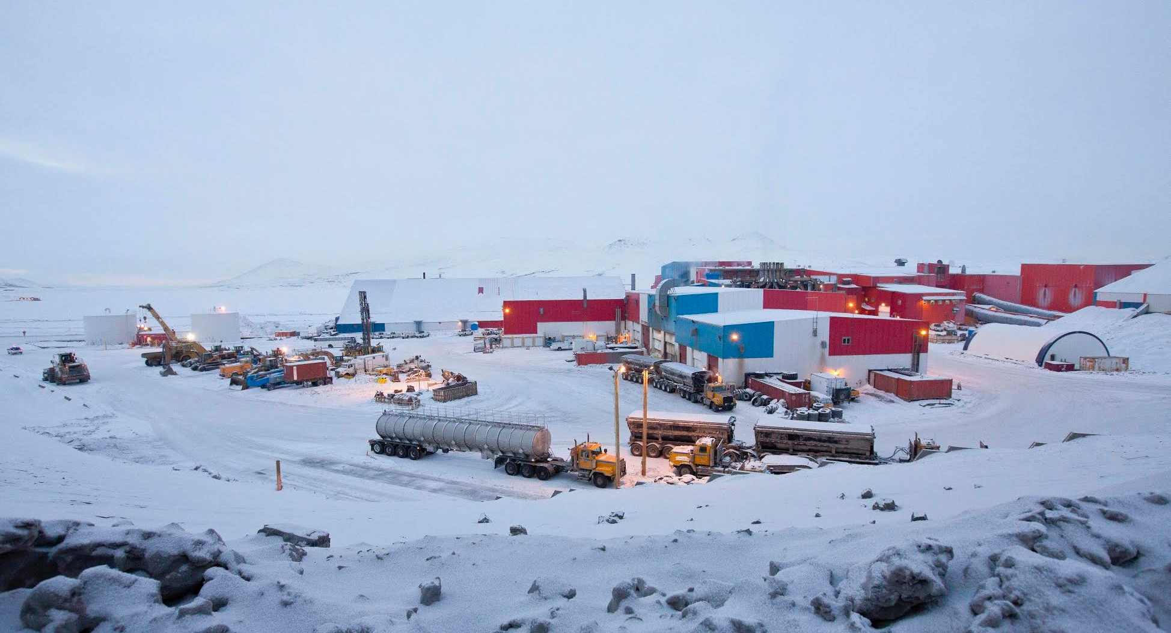
Promote Economic and Resource Development
LIne of effort #1
With careful consideration and state investment, the Arctic region will continue to produce returns to the state and communities that ensure community health and vitality.

Slide 14
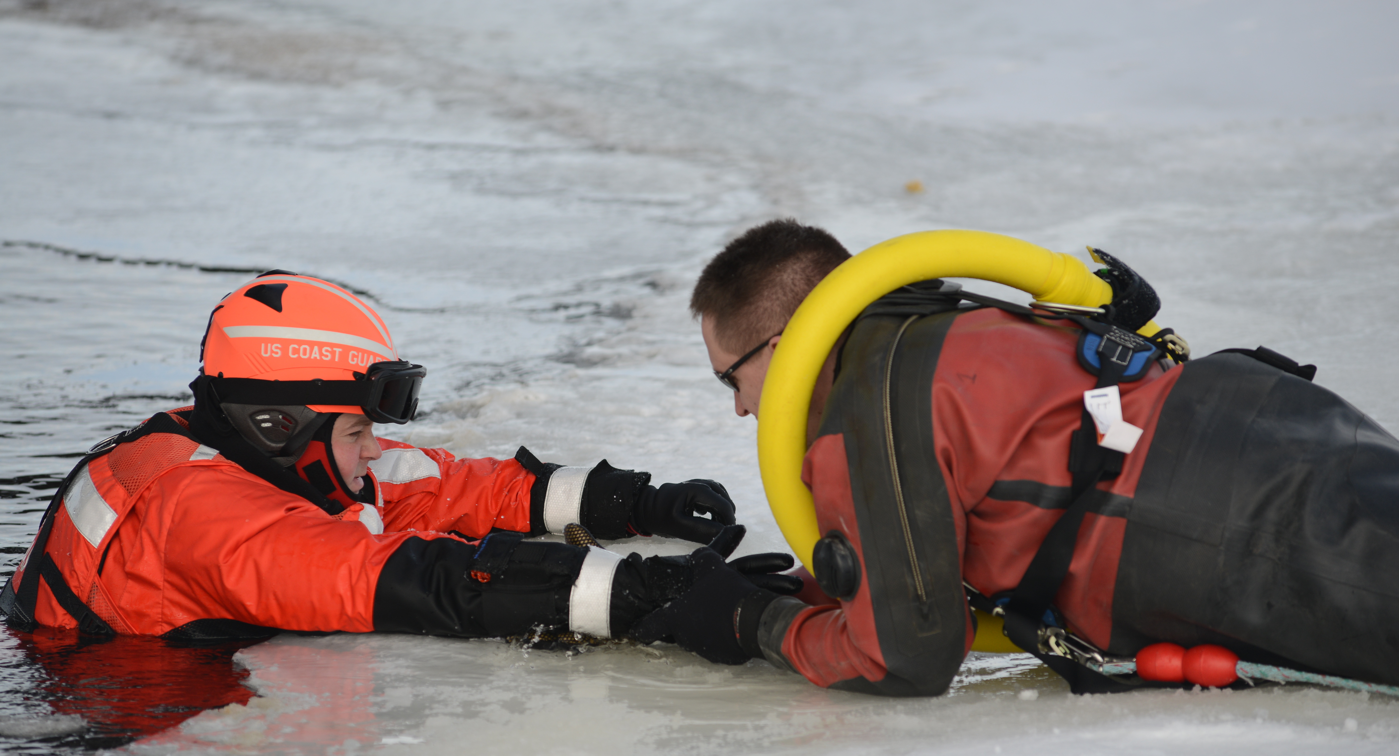
Address Response Capacity
Line of Effort #2
Response capacity will require strong partnership and communication to prepare for incidents, to respond and develop best practices.

Slide 15
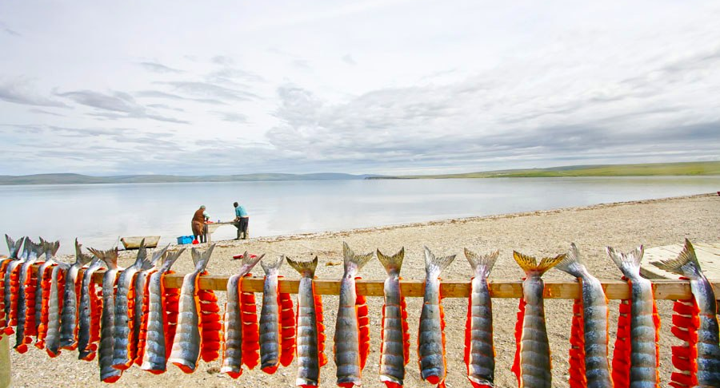
Support Healthy Communities
Line of Effort #3
Quality of life can be improved for the whole Arctic region without compromising the economic security and well-being of other communities or the state as a whole.

Slide 16
Strengthen Science and Research
Line of Effort #4
Alaska should pursue
strategies to broaden
and strengthen the
influence of its
agencies, its
academic experts and
its local governments
and associations

Slide 17
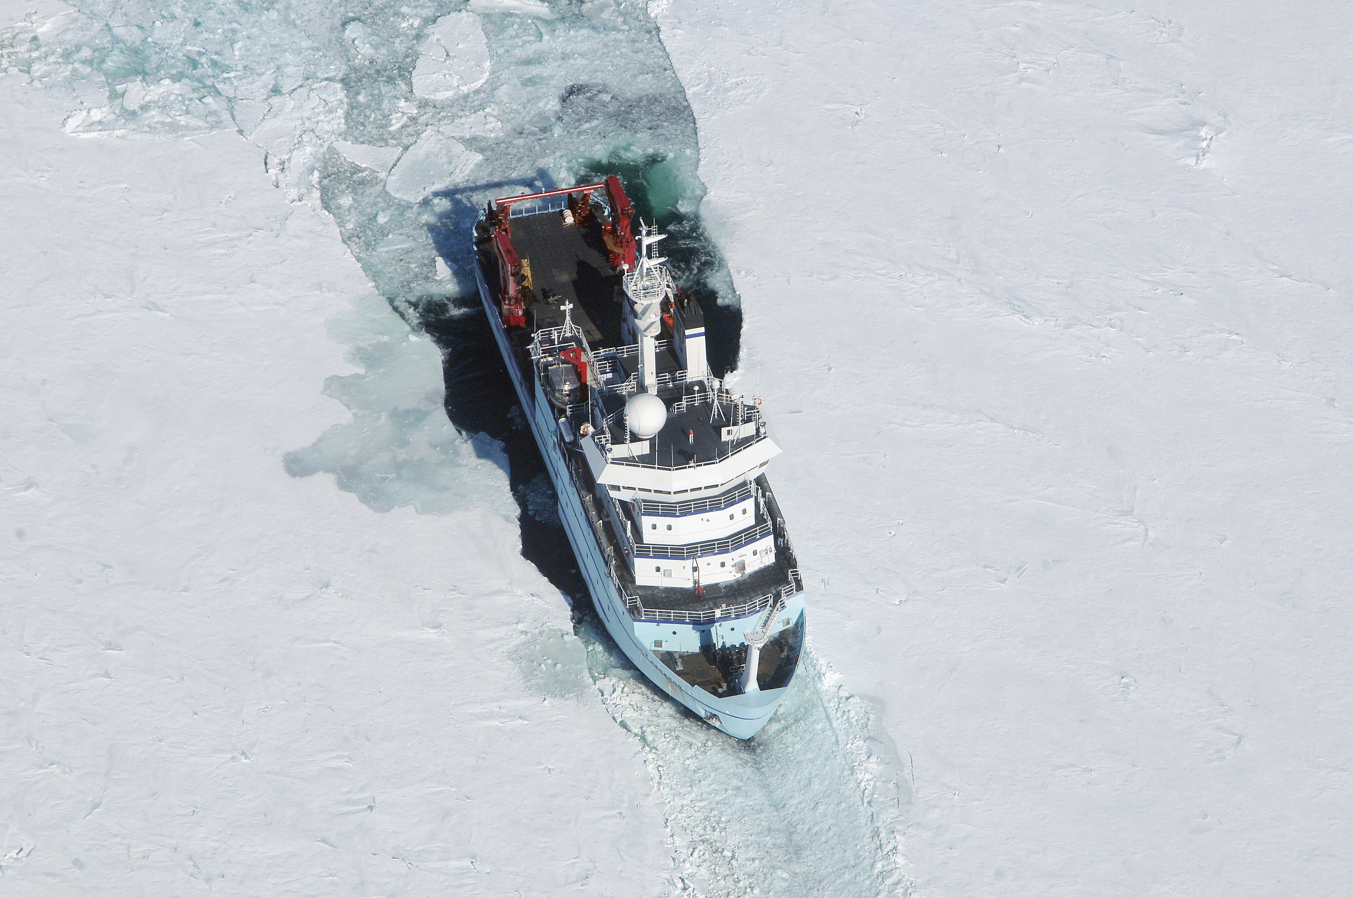
The Commission’s work -
Mobilizes the state’s
Human, Natural and
Financial Resources to
address current needs
Recognizes that adequate
resources should be
Available for Future
Generations
Understands that all of
these might come
In new and different Forms as technology and demands shift over time.

Slide 18
Alaska Arctic Policy Commission Members
Legislative Members:
Sen. Lesil McGuire, Co-Chair – Anchorage
Sen. Cathy Giessel – Anchorage
Sen. Lyman Hoffman – Bethel
Sen. Donny Olson – Golovin
Sen. Gary Stevens – Kodiak
Rep. Bob Herron, Co-Chair –
South Bering Sea
Rep, Alan Austerman –Kodiak
Rep. Bryce Edgmon – Dillingham
Rep. David Guttenberg – Fairbanks
Rep. Benjamin Nageak– Barrow
Public Members:
Jake Adams – ASRC
Nils Andreassen – Institute of the North
Dr. Lawson Brigham - UAF
Peter Garay – American Pilots Association
Chris Hladick – City of Unalaska
Layla Hughes – Conservation
Mayor Reggie Joule – The Native Village of Kotzebue - Kotzebue IRA
Stephanie Madsen – At-Sea Processors Association
Harry McDonald – Saltchuk
Mayor Denise Michels – City of Nome
Liz Qaulluq Moore – NANA Regional Corporation
Stefanie Moreland – Alaska DF&G
Kris Norosz – Icicle Seafoods
Lisa Pekich – ConocoPhillips Alaska
Pat Pourchot– U.S. DOI
Stephen Trimble – Trimble Strategies
Ex-Officio Members:
Daniel Abel, Rear Admiral D17 USCG and Jamie Robinson, USCG; Alice Rogoff, founder Arctic Circle Conference; Dan Sullivan, U.S. senator; Mead Treadwell, Former Lt Governor; and Fran Ulmer, Chair USARC.
Staff: Dr. Nikoosh Carlo, Executive Director | Rob Earl, Arctic Policy Advisor for Rep Herron | Jesse Logan, Arctic Policy Advisor for Sen McGuire

Slide 19
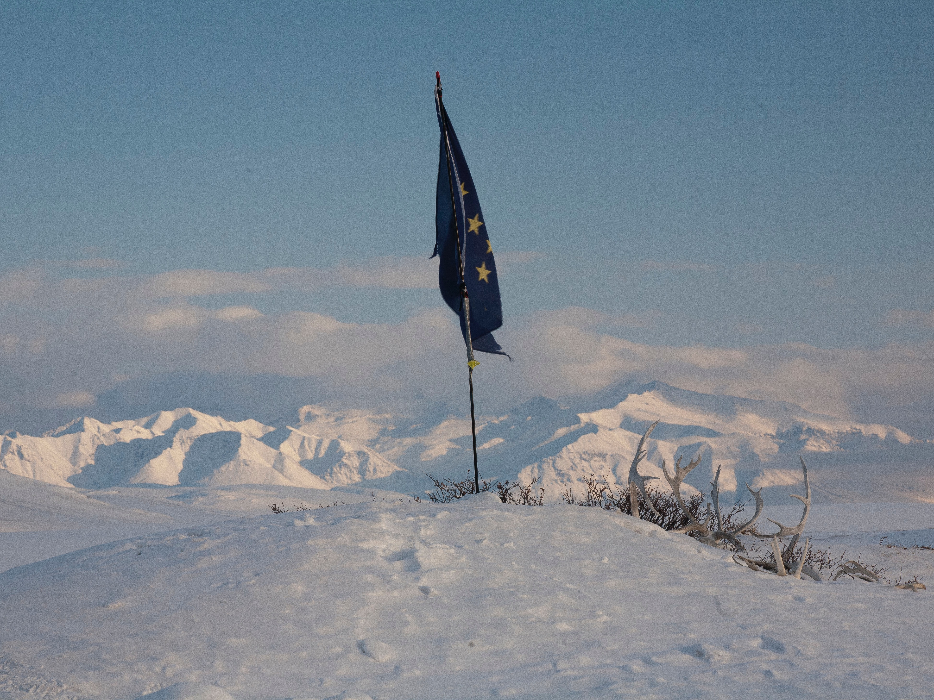
www.akarctic.com

