Slide 1
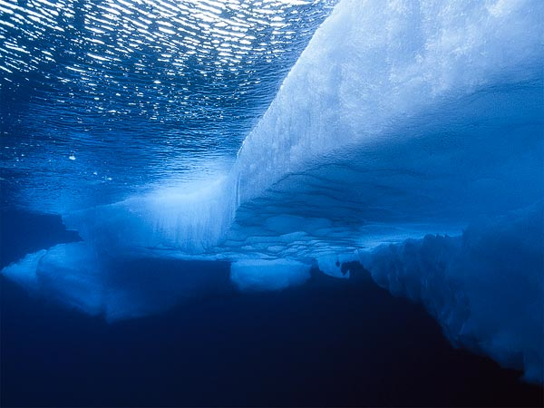
Arctic Waters Safety Committee
Protecting our Future

Slide 2
PURPOSE
The purpose of the Arctic Waters Safety Committee is to provide a unified forum for Arctic Communities, maritime operators, government regulatory bodies and NGO’s to propose, deliberate and adopt best practices and policies that promote safe, efficient and environmentally responsible Arctic maritime operations.

Slide 3
BOARD MAKEUP
Marine mammal hunting groups
NSB, NWAB, and Nome areas
Maritime industry
Tribal organization
Marine Pilots

Slide 4
POTENTIAL POLICY AREAS
Traffic routing
Sensitive habitats/areas to be avoided
Whale migration timing and areas
Conflict avoidance with local vessels
Emergency response capability/SAR
Marine pilotage
Navigation aids/tracking and communications systems
International cooperation

Slide 5
PUBLICATION PROCESS
Publish policies on AWSC website
Provide adopted policies to USCG, ADEC, Arctic Council and Arctic maritime operators and insurance carriers
USCG publishes policies in NVIC (Navigation and Vessel Inspection Circulars), Coast Pilot, Notices to Mariners, etc.
ADEC policies in sub-area response plans

Slide 6
FUNDING MECHANISM
Use of Excess Cruise Ship Headtax Funds
US Harbors Appropriation Act of 1884 as amended
(2) reasonable fees charged on a fair and equitable basis that:
(A) are used solely to pay the cost of a service to the vessel or water craft;
(B) enhance the safety and efficiency of interstate and foreign commerce

Slide 7
❖
ARCTIC WATERS SAFETY COMMITTEE
LOOKING OUT FOR OUR FUTURE

