Slide 1
Department of Military
and Veterans Affairs
FY2018 Division Overview
Homeland Security & Emergency Management
Local Emergency Planning Committee
Mike O’Hare
Director, Homeland Security & Emergency Management

Slide 2
The Alaska Disaster Act AS 26.23, Article 1
AS 26.23.020 The governor and disaster emergencies
Provides:
The governor is responsible for meeting the dangers presented by disasters
The governor shall declare a disaster if one has occurred or is imminent
The governor is commander in chief of forces available for emergency duty, can delegate/assign command
May expend up to $1 million without legislative approval

Slide 3
In Addition, the Governor May:
Suspend the provisions of any regulatory statute
Use all available resources of State and each political subdivision of the State
Transfer personnel or alter the functions of State agencies
Commandeer or use any private property
Direct and compel relocation
Prescribe routes, modes of transportation and destinations in connection with relocation
Control ingress and egress of a disaster area
Suspend or limit sale and dispensing of alcohol, explosives or combustibles
Provide for use of temporary housing
Allocate/redistribute food, water, fuel, clothing, medicine, and supplies
Use funds form the oil and hazardous substance release fund

Slide 4
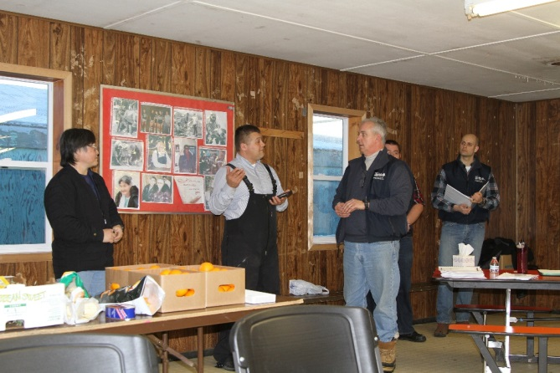
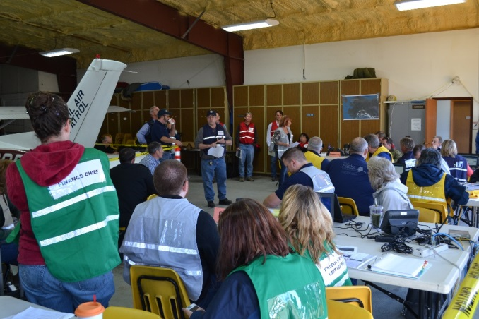
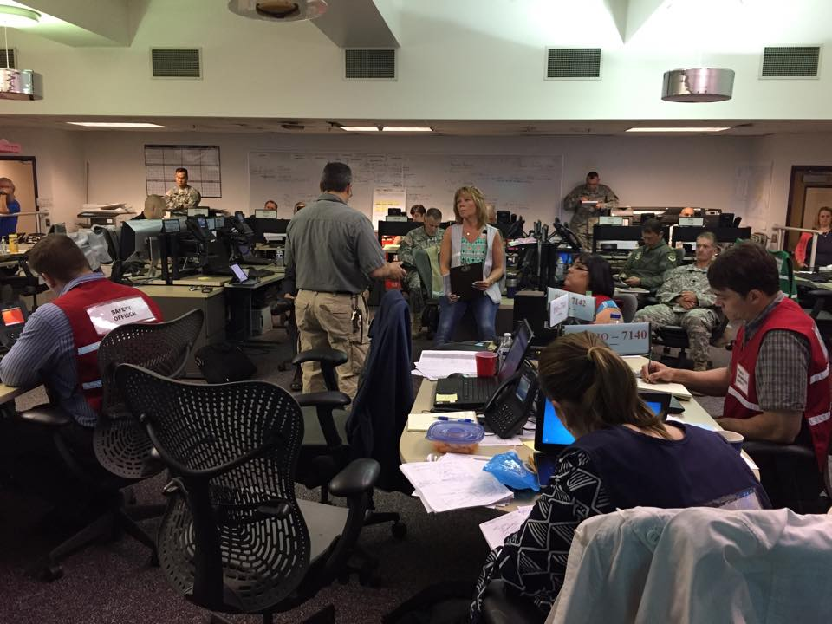
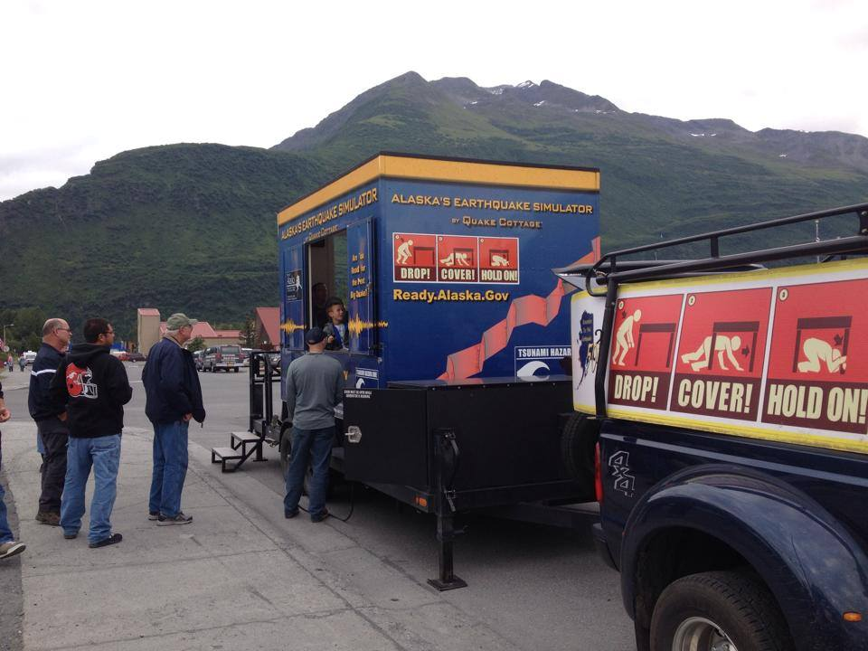
Division of Homeland Security & Emergency Management
Mission: Foster a prepared, resilient State capable of keeping Alaskans safe and secure in the face of all hazards
62 full time budgeted positions
$9,498.3 total budget request
$2,460.7 UGF
$4,057.8 Federal
$2,979.8 Other

Slide 5
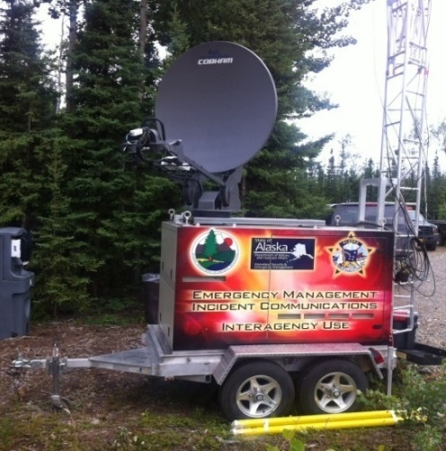
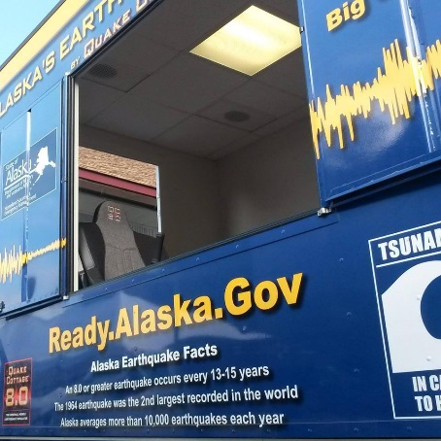
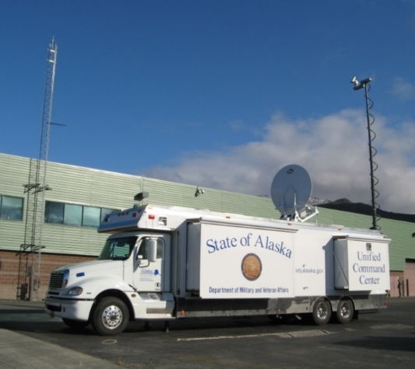
Division of Homeland Security & Emergency Management
Strategic Direction: Work internally as an integrated team and externally as a leader. Direct the development, implementation, and improvement of emergency management plans, programs, policies and collaboration efforts in order to systematically enhance the resilience of every Alaskan community.
Tailor our approach to meet communities’ needs and leverage the strengths of our many partners
Focus on extending our services to support communities statewide
Build long-term relationships with both our partners and our customers
5

Slide 6
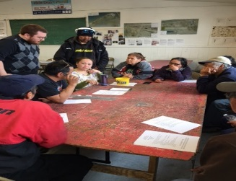
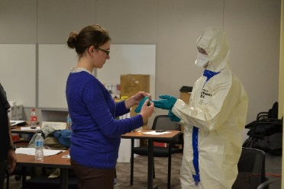
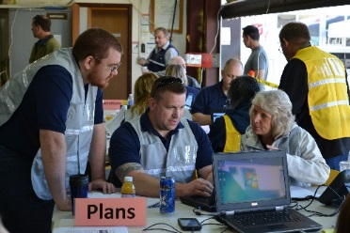
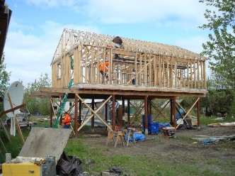
Division of Homeland Security & Emergency Management
2 positions
363.2 Total
181.6 GF
181.6 Fed
Director
Deputy Director
Operations
Financial and Program Support
Planning
Preparedness
State Emergency Operations Center/Response
Disaster Assistance
1 position
156.8 Total
78.4 GF
78.4 Fed
15 positions
1,528.7 Total
652.1 GF
709.3 Fed
167.3 Other
12 positions
1,189.8 Total
193.6 GF
391.6 Fed
604.6 Other
10 positions
1,063.4 Total
133.8 GF
531.7 Fed
397.9 Other
9 positions
1,005.6 Total
463.9 GF
463.9 Fed
77.8 Other
13 positions
1,398.0 Total
159.4 GF
32.7 Fed
1,205.9 Other
Mitigation
Community Planning
All-Hazards Resiliency
Cyber Security
Exercise
Training
Community Outreach
Public Information
Emergency Operations Center
Response
Emergency Communications
Public Assistance
Individual Assistance
Pre-Disaster
Post Event
6

Slide 7
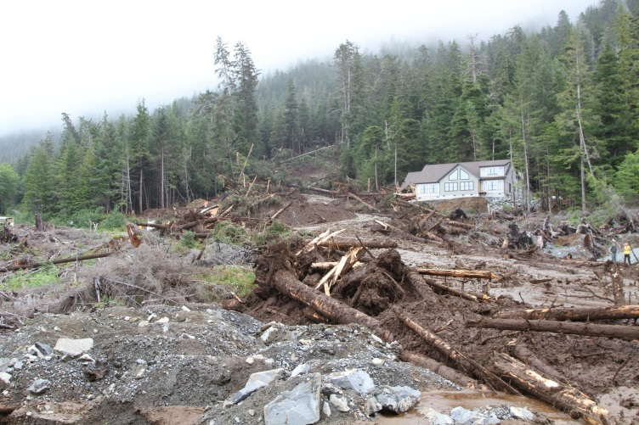
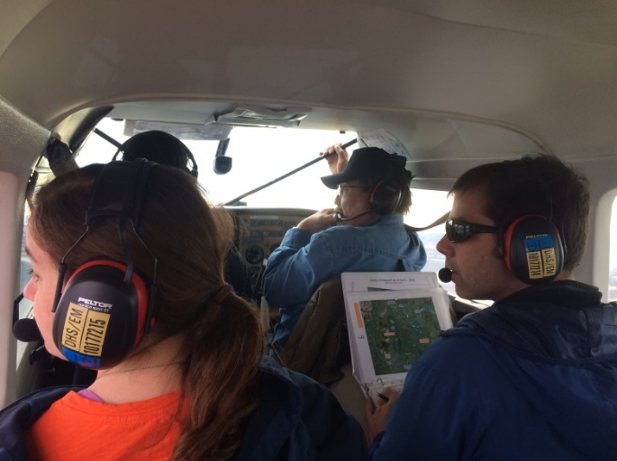
Division Disaster Response
State Emergency Operations Center
2015 Sitka Mudslide Disaster
Riverwatch on Kuskokwim

Slide 8
Planning Focus
State Emergency Operation Plan (EOP) development
Large community EOP support
Small community emergency response plan support
Continuity of operations plan
Catastrophic disaster plan
Long-Term recovery plan
Mitigation plans: State and local
Alaska assessment: Capability gaps
Statewide Resilience Workshops
Planning
Preparedness
Operations
Disaster Assistance
Program Support

Slide 9
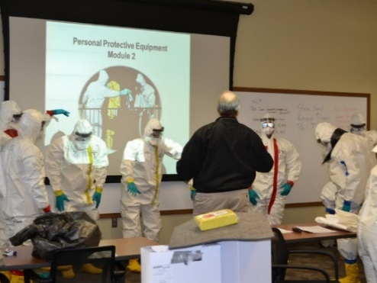
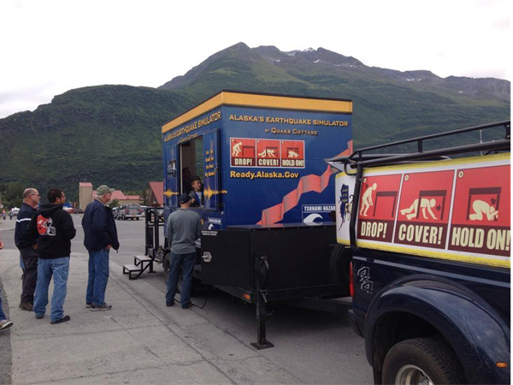
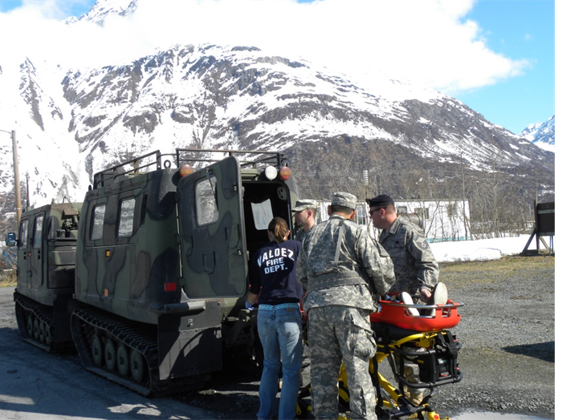
Preparedness Focus
Emergency management training: State/local events
Local exercises: Test local EOP
Annual statewide preparedness conference
Statewide regional workshops
Public emergency management information: Coordination before, during and after disasters
Public outreach campaigns: Alert/warning, family preparedness, and recovery
Great Alaska Shakeout
Earthquake Simulator

Slide 10
Disaster Recovery Focus
Recovery Programs (using state and federal funds)
Emergency protective measures
Public assistance: Infrastructure damages
Federal Funding 75%
State Funding 25%
Individual Family Grant: Personal and real property damages, temporary housing
Mitigation Programs (using state and federal funds)
Disaster mitigation grants: Post disaster projects improve resiliency, funding cap set by disaster
Pre-disaster mitigation grants: National competitive grants for resiliency

Slide 11
Innovative Partnerships
Communities/Boroughs
Local Emergency Planning Committees
Native Corporations
Business/Industry
Utility Companies
Alaska National Guard
Other AK State Agencies
Federal Emergency Management Agency
American Red Cross
Volunteer Organizations
Department of Defense
Office of the U.S. Attorney
Department of the Interior
U.S. Coast Guard
Department of Homeland Security
Federal Bureau of Investigation
Environmental Protection Agency
Emergency Management Assistance Compact (Nationwide)
Pacific Northwest Emergency Management Arrangement (Alaska, Washington, Oregon, Idaho, British Columbia, Yukon Territories)

Slide 12
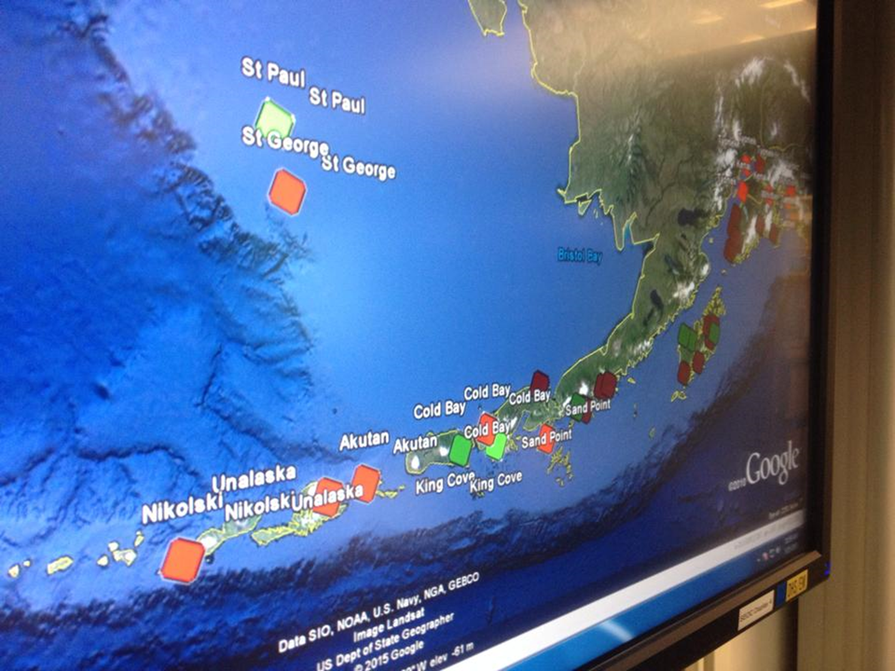
Innovative State Emergency Management
Disaster Relief Fund program/process
Statewide community preparedness: Grants, technical support, gap analysis
Resiliency and innovative mitigation: Relocations/elevations, partnerships
State capital investment in catastrophic plans: Generators/water purifiers/food
Interagency planning and response to disasters

Slide 13
Homeland Security & Emergency Management
FY2018 Budget
 | FY2017 Management Plan | FY2018 Governor | FY2017 Management Plan vs FY2018 Governor
All Funds | 9,439.3 | 9,498.3 | .6%
General Funds | 2,453.1 | 2,460.7 | .3%
Positions
PFT | 62 | 62 | 0%
PPT | 0 | 0 | 0%
NP | 0 | 0 | 0%

Slide 14
Local Emergency Planning Committee
FY2018 Budget
 | FY2017 Management Plan | FY2018 Governor | FY2017 Management Plan vs FY2018 Governor
All Funds | 300.0 | 300.0 | .0%
General Funds | 300.0 | 300.0 | .0%
Positions
PFT | 0 | 0 | 0%
PPT | 0 | 0 | 0%
NP | 0 | 0 | 0%

Slide 15
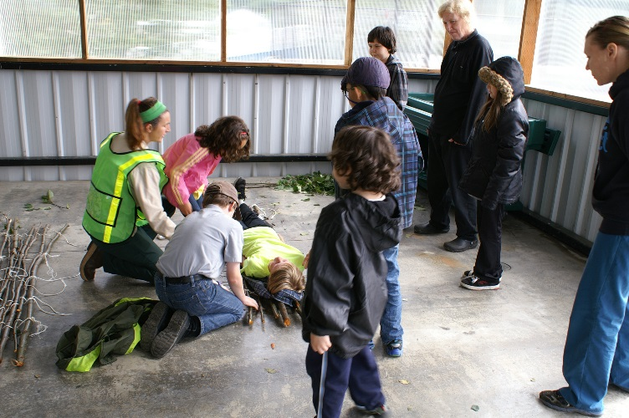
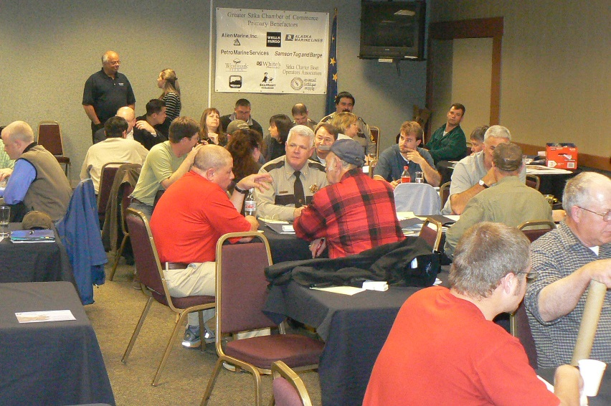
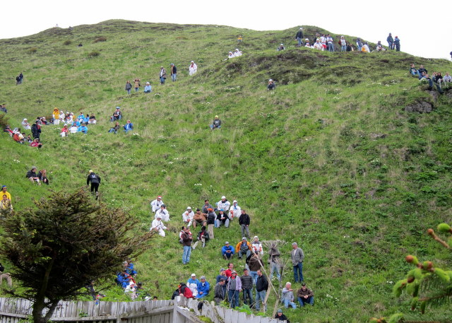
Local Emergency Planning Committee Locally Driven – Local Results
Prince of Wales
Ketchikan
Unalaska
Sitka

Slide 16
Community Grants Focus
FFY2015
$2,987,600 Homeland Security Grant Program (HSGP): 19 communities
FY2016
$3,101,752 Emergency Preparedness Grant (EMPG): Statewide
$300,000 State Local Emergency Planning Committee Grants (LEPC): 21 communities
Other Community Grant Programs
$2,717,629 Tsunami, Cooperating Technical Partners (CTP), Hazardous Materials Emergency Preparedness (HMEP), Pre-Disaster Mitigation (PDM)
$7,630,612 Hazard Mitigation and Recovery Assistance Grant Programs

Slide 17
Contacts
For additional information, please contact:
Mike O’Hare, Director
Mike.ohare@alaska.gov
(907) 428-7066
Mike Sutton, Deputy Director
Mike.sutton@alaska.gov
(907) 428-7062

