Slide 1
Alaska Sustainable Energy Act: SB 220
Presentation to Senate Finance (3/25/10)

Slide 2
Product of the Senate Resources Committee and Senate Special Committee on Energy

Slide 3
Interim Field Hearings
Tanana
Fairbanks
Ruby
Kenai
Anchorage
Kenai
Haines
Ouzinkie

Slide 4
Reached out to:
Renewable Energy Alaska Program
Alaska Center for Energy and Power
Alaska Federation of Natives
Cold Climate Housing Research Center
Commonwealth North
Alaska Power Association
Southeast Conference
Many other organizations

Slide 5
Products:
State Energy Policy and Program Recommendations (50+ pages)
Budgetary (Letter to Senate Finance Committee)
Statutory (SB 220)

Slide 6
Hundreds of Comments Received
Sifted through comments
Met with stakeholders
Reviewed plans & policies from other states
Refined ideas with experts

Slide 7
SB 220 Goals
Provide affordable and reliable energy for Alaskan families and businesses
Stimulate private sector investment
Produce long-term savings by maximizing energy efficiency
Lead by example
Promote innovation

Slide 8
Major Bill Components
State Energy Policy
Energy Efficiency Revolving Loan Fund
Efficiency in Government
Renewable Energy Tax Credit
Emerging Energy Technology Fund
Energy Loans for Businesses
Alaska Affordable Heating Program

Slide 9
State Energy Policy (Sections 2 & 3)
High level goals
Increase energy efficiency by 15% by 2020
Generate 50% of electricity statewide using renewable energy by 2020

Slide 10
State Energy Policy (Sections 2 & 3)
Promote the development of nonrenewable energy resources, including natural gas, heavy oil, nuclear energy, coal, gas hydrates, etc...
Support energy research, education and workforce development
Maintain a fiscal regime that encourages private sector development

Slide 11
Nuclear Energy (Sections 5, 6, 7, 8, 19 & 25)
Levels playing field for nuclear energy.
Removes requirement for Governor’s approval of projects.
Leaves in place requirement for municipal and DEC approval.
Stringent federal permitting process.
Enables nuclear projects to apply for funding from the Power Project Fund.

Slide 12
Energy Efficiency Revolving Loan Fund (Sections 4 & 10)
Authorizes AHFC to sell up to $250 million in bonds
Leverages $18 million in federal stimulus funds
60% to retrofit state buildings and 40% to retrofit school and municipal facilities
Fund should operate in perpetuity
Could create hundreds or thousands of job as weatherization & home energy rebate program have (estimated at 2,500 jobs)

Slide 13
Leading By Example (Sections 11, 12, 23, & 24)
Retrofit at least 25% of state buildings by 2020. Shown to save at least 20% a year on energy costs.
Could translate into $2.75¹ million/year since state spends roughly $55 million on heating & lighting.
[based on 25% of facilities being retrofitted

Slide 14
Pay-offs from Retrofitting (Sections 10 & 23)
State recently retrofit 8 state buildings
Were guaranteed savings of at least $278,000/year by the contractor.
In year 1, savings = $366,000
In year 2, savings = $592,000
Last year’s savings = $571,000
Savings alone from retrofitting 25 % of state buildings could cover the fiscal note for SB 220.

Slide 15
Leading By Example (Sections 23, 11 & 22)
Build all new state buildings to high efficiency standards.
Use alternative energy for new public works, if viable and cost-effective.
Purchase energy efficient appliances, equipment and vehicles.

Slide 16
Energy Efficiency Campaign (Section 24)
Tasks AEA and AHFC with educating Alaskans about low-costs ways to save energy.
Not only help for individual households, but way to contain cost of building new power generation facilities. ($9 billion needed in Railbelt alone over next 50 years)
Experts estimate between 8% and 50% can be saved through efficiency measures alone.
Cheapest ways to meet energy needs.

Slide 17
Emerging Energy Technologies (Section 18)
With high energy costs, Alaska is perfect place to test emerging technologies.
Can demonstrate technologies and reduce costs for local residents
Potential to export technologies
25% of world’s population lives without access to electricity – looking for new ways to energize

Slide 18
Emerging Energy Technologies (Section 18)
Would establish competitive grant program at AEA to foster innovation.
Matched with federal funds from Denali Commission, DOE & private research dollars.
Creates high-tech jobs and spurs investment in Alaska’s economy.
NY, CA, TX, MA, and others have funds.
Alaska has potential in be world leader in emerging technologies, given our resources.

Slide 19
Emerging Technology Fund (Section 18)
In 2009, Denali Commission solicited proposals.
50 proposals totaling $29 million were submitted.
9 selected to receive $4 million in grants.
Goal: To develop emerging technologies that have the potential for widespread deployment.

Slide 20
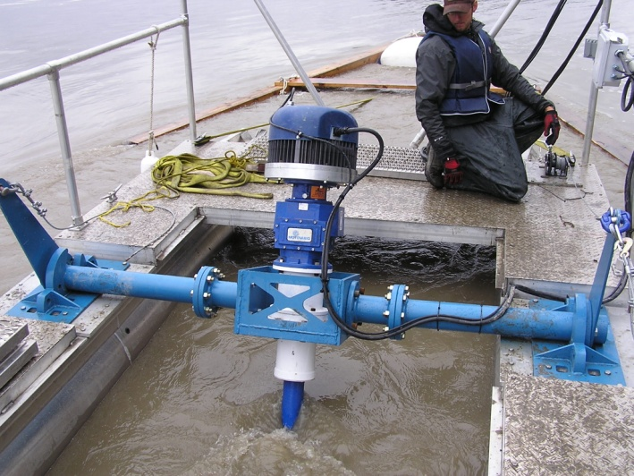
Example of EETF Project
Nenana Hydrokinetic Turbine: Ocean Renewable Power Corp.
Tests whether power can be reliably and economically generated from the movement of the Nenana River.
Alaska has significant hydrokinetic potential in both rivers and tidal basins.
Most in-land communities are situated along navigable waterways, such as the Yukon and Kuskokwim, that could produce hydrokinetic energy.
Ruby Hydrokinetic Turbine
Alaska Center for Energy & Power

Slide 21
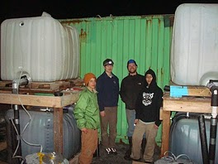
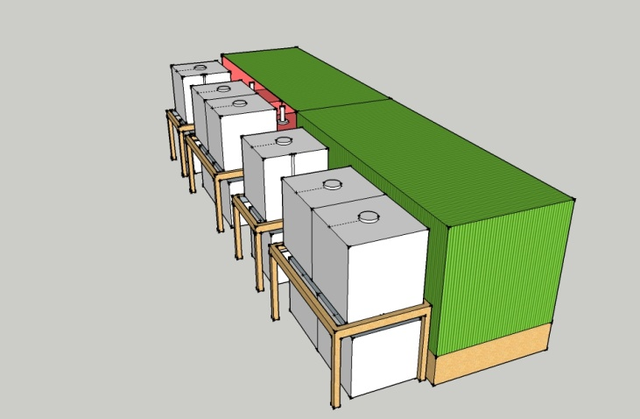
Example of EETF Project
Cordova Electric Cooperative: “Biogas digestor” technology
Widespread in India and China.
Microbes naturally break down organic feedstock to produce methane. Can be used for heating & cooking.
Will test use of various cold-loving microbes and compare efficiency for household scale projects.
Digestors could be used as a local, renewable energy source for Alaskan homes.
Source: freewheelings.com

Slide 22
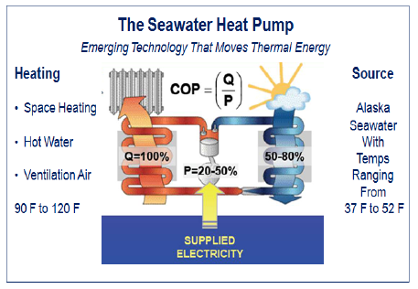
Example of EETF Project
Alaska SeaLife Center: Seawater Heat Pump
Will pump seawater through a heat exchanger containing antifreeze which will boil and vaporize a refrigerant into a pressurized compressor.
The condensed heat circulates into building at 120 degrees F.
Technology successfully deployed in Norway and Sweden.
Source: Denali Commission

Slide 23
Renewable Energy Tax Credit (Sections 20 & 21)
Encourages investment by the private sector in renewable energy
Supports the goal of generating 50% of electricity using renewable by 2025
25 states offer renewable energy corporate tax incentives; 5 states and the federal government offer production tax credits
Only accrue once a project is in operation
15% tax refundable credit based on sales
Capped at 10% of capital investment
Sunsets January 1, 2018

Slide 24
Renewable Energy Tax Credit (Sections 20 and 21)
Calculating the credit, what do we need to know?
What is the capital cost?
What state/federal grants did the project receive?
What is the cost per kilowatt-hour?
What is the capacity factor?
Remember:
There are 8760 hours in a year.
1 Megawatt/hr = 1000 Kilowatt/hrs
$.01 KW/hr = $10 MW/hr

Slide 25
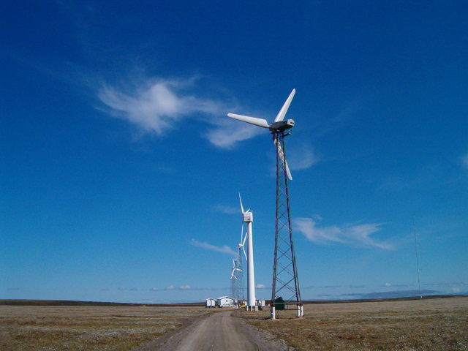
RETC: An Example
A 5 MW Wind Farm
CAPEX: $23.5 million
Grants:
$2 million federal grant
$3.5 million renewable energy grant fund
Capacity Factor: 20%
Cost per KW/hr: $.38

Slide 26
RETC: An Example
Step 1: Calculate gross electricity sales
5 MW/hr x 8760 hrs/yr x 20% capacity factor = 8760 MW/yr
8760 MW/yr x 1000 KW/MW x $.38 KW = $3,328,800 year
Step 2: Calculate the annual credit
$3,328,800 x 15% = $499,320
Step 3: Calculate the total allowable credit
CAPEX = ($23.5 mm - $2 mm - $3.5 mm = $18 mm) x 10% = $1.8 mm
Step 4: How does it work in practice?
Year 1: $499,320 Year 2: $499,320 Year 3: $499,320
Year 4 ($1.8 - [$499,320x3]): $302,040 Year 5: $0

Slide 27
RETC: Transferable vs. Refundable
Transferable credits are:
Approved by the Department.
Must be marketed and purchased.
Broker fees and demands of purchaser means less than full credit goes to the person receiving the incentive.
The cost to the state is the same. $1 in credit = $1 in forgone revenue.
Refundable credits are:
Subject to Appropriation.
100% of credit goes to the recipient.
Easier to administer.

Slide 28
Loans to Businesses (Sections 26-33)
Would provide loans of up to $50,000 for alternative energy systems and energy conservation improvements.
Businesses must be primarily owned by Alaskans. Interest rate: prime, plus 1%. Minimum of 5%.
Money can be used for insulation, thermal windows, furnace replacement, etc... Or on energy systems which are not dependent on oil or gas.

Slide 29
Affordable Heating Program (Section 35-42)
Objectives:
Make program more responsive to a family's actual heating costs.
Increase assistance as oil prices rise, need increases & the state enjoys a budget surplus.
Maintain statewide eligibility.
Use existing administrative structure.

Slide 30
How LIHEAP Works (Section 35-42)
Benefits are calculated by multiplying each applicant’s “points” by the dollar per point available.
Points are awarded based on household income; heating degree days in household location; type and size of house; presence of children, elderly or disabled in home.

Slide 31
Program refinement #1 (Sections 35-42)
Link program eligibility to price of oil.
Oil under $150/barrel = 225% of poverty level ($62,000 for a family of four).
Oil over $150/barrel = 250% of FPL ($69,000 for a family of four).

Slide 32
Program Refinement #2 (Sections 35-42)
Link program benefits to the price of oil
$130/point when crude is < $75/barrel
$140/point when crude is $75-$100/barrel
$150/point when crude is $100-$150/barrel
$165/point when crude is > $150/barrel
This year points are valued at $115.
Last year, points were valued at $220, which was bumped up to $316 by a special approp.

Slide 33
Program Details (Sections 35-42)
DHSS will pro-rate payments if appropriations are insufficient to cover full program cost.
Payments go to fuel vendors, not households.
Individuals must apply and qualify each year.
Current federal appropriation is $28 million.
Current state appropriation is $5 million.
20,191 households currently served.

Slide 34
Other Provisions
Technical assistance for municipalities regarding energy codes and efficiency standards. (S.9)
Standard methodology for energy consumption and expense date (S. 10)
Expands purposes of the Southeast Energy Fund (S.14)

Slide 35
Other Provisions
AEA facilitate organization and provide technical assistance for a statewide fuel cooperative (S.17)
Develop a plan to coordinate & consolidate energy programs (S. 48)
Study CNG vehicles (S.49)

Slide 36
Conclusion
SB 220 not a panacea, but a step forward
Proposes a variety of steps to stimulate private investment, lead by example, and promote efficiency and innovation.
Other bills address instate gas, gas storage, gas-to-liquids, exploration incentives, O&G taxes, etc...
Working closely with our House counterparts
SB 220 is just a piece of the pie, leading Alaska to greater self-sufficiency and sustainability

Slide 37
House energy omnibus
HB 305 = House energy omnibus bill
House Energy Committee held extensive field hearings during the interim
Assembled a stakeholder group
High level of commitment to passage of a meaningful omnibus bill
Just this week, the House unanimously passed HB 306, a declaration of state energy policy. Great 1st step.

