Slide 1
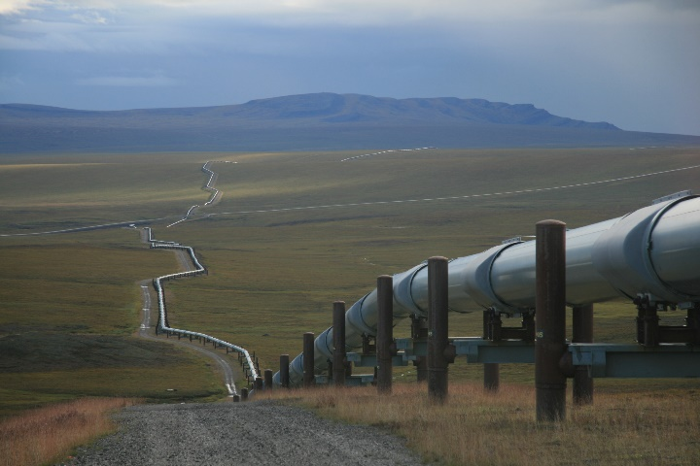
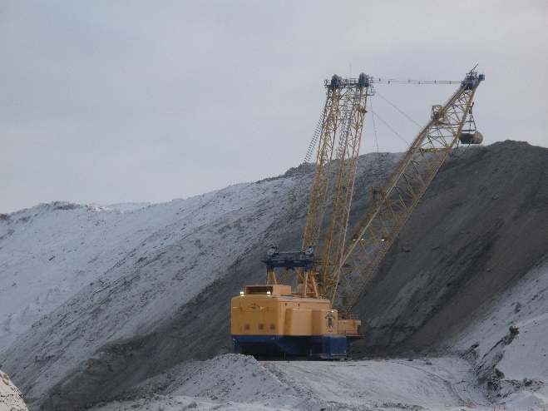
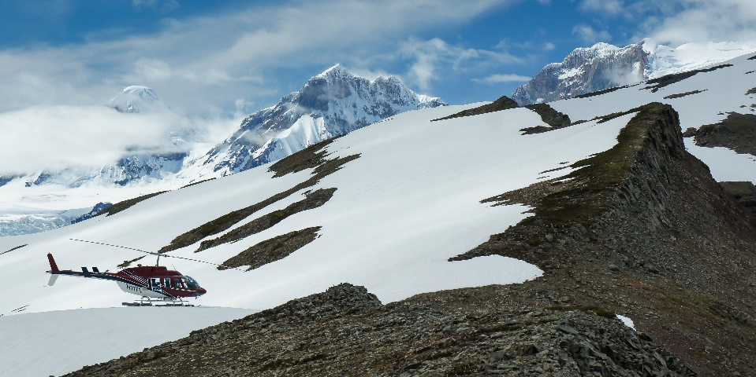
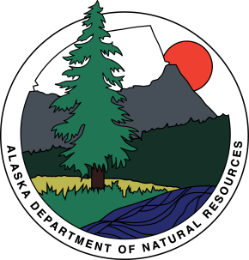
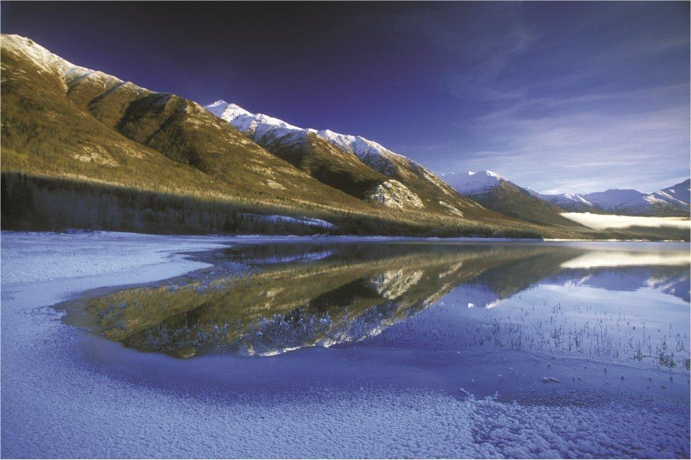
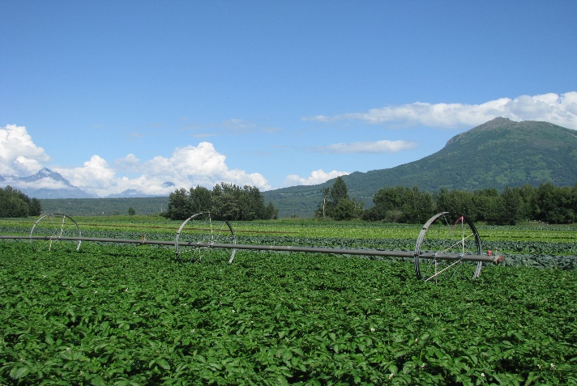
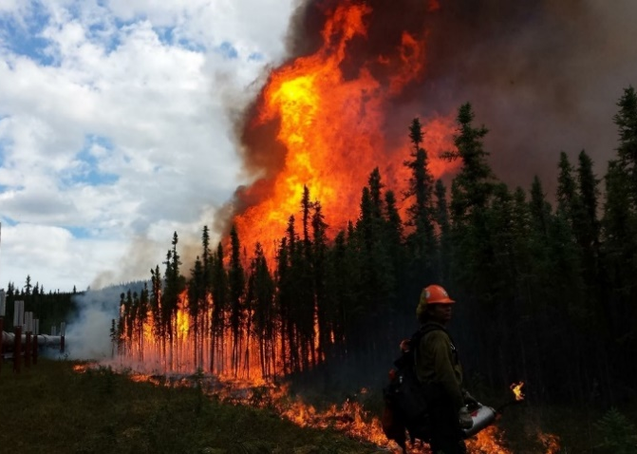
State of Alaska
Department of Natural Resources
Overview for House Resources Committee
January 18, 2017
1

Slide 2
Presentation Outline
PART I: Alaska’s resource base
PART II: DNR overview & recent activities
PART III: AKLNG Project update
PART IV: 2017 priorities & activities

Slide 3
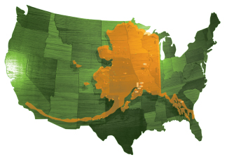
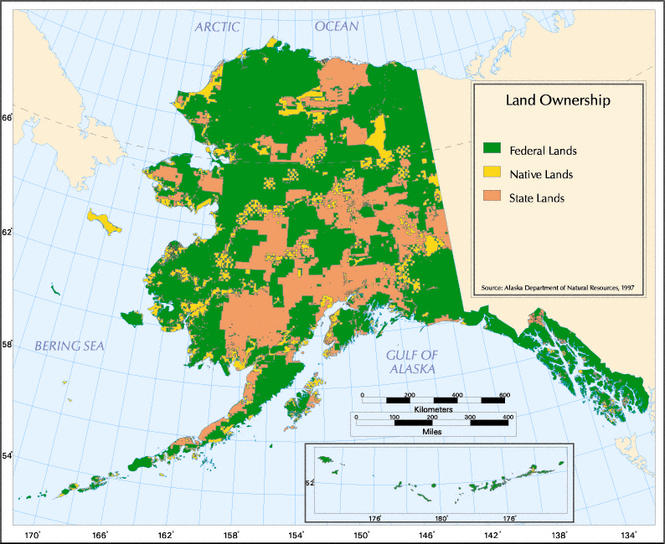
State of Alaska
- Land Base & Ownership -
Land Base
586,412 sq. miles―more than twice the size of Texas
Larger than all but 18 sovereign nations
More coastline than all other 49 states combined
More than 3 million lakes; half of world’s glaciers
Approximately 40% of the nation’s freshwater supply
Land Ownership
Federal Land: more than 200 million acres
State Land: Approx. 100 million acres of uplands, 60 million acres of tidelands, shore lands, and submerged lands, and 40,000 miles of coastline
Native Corporation Land: 44 million acres
Federal
State
Native

Slide 4
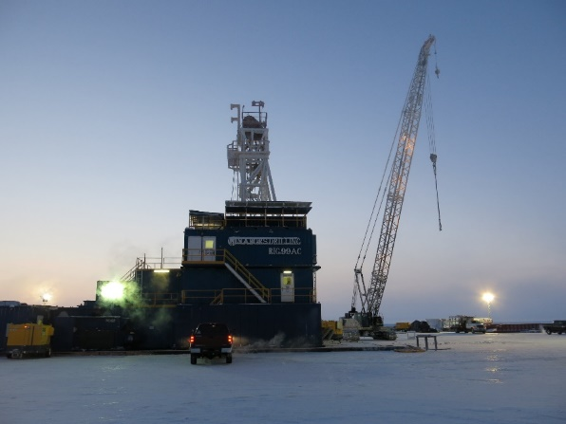
State of Alaska
- Resource Potential: Oil & Gas -
North Slope
More undiscovered, potentially recoverable oil than any other Arctic nation
OIL: Est. 40 billion barrels of conventional oil
GAS: Est. over 200 trillion cubic feet of conventional natural gas
Untapped unconventional resource potential, including tens of billions of barrels of heavy oil, shale oil, and viscous oil, and hundreds of trillions of cubic feet of shale gas, tight gas, and gas hydrates
Cook Inlet
Significant undiscovered resources remain
19 trillion cubic feet of natural gas
600 million barrels of oil
46 million barrels of natural gas liquids
Sources: USGS & BOEM
Compared to most basins, Alaska is relatively underexplored, with 500 exploration wells on the North Slope, compared to Wyoming’s 19,000.
Notes:
The estimated 40BB includes
~16 BB onshore on state and federal land (including ANWR, NPR-A)
~24 BB in Chukchi and Beaufort that are now withdrawn or not available for leasing under the current 5-year plan.
The area of the Beaufort still under consideration for future leasing is the most promising part, likely capturing a disproportionate share of the potentially discoverable and commercially producible resources
Middle Earth exploration by Doyon and Ahtna is continuing.
The latest Cook Inlet oil and gas assessment was published by USGS in 2011

Slide 5
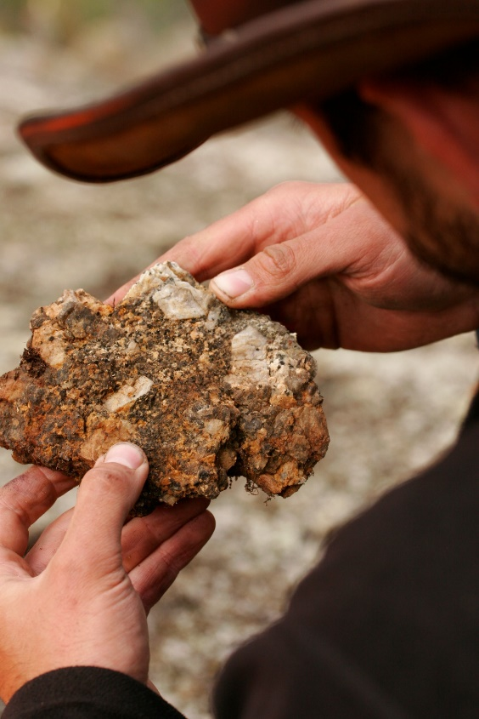
State of Alaska
- Resource Potential: Minerals -
The State of Alaska ranks in the Top Ten in the World for important minerals including:
Coal: 17% of the world’s coal; 2nd most in the world
Copper: 4% of the world’s copper; 8th most in the world
Lead: 4% of the world’s lead; 6th most in the world
Gold: 8% of the world’s gold; 5th most in the world
Zinc: 6% of the world’s zinc; 6th most in the world
Silver: 4% of the world’s silver; 9th most in the world
(USGS 2015 estimates)
Alaska ranked 2nd for mineral potential in the 2015 Fraser Institute Survey of Mining Companies.
With more than 7,400 documented prospects, Alaska has the potential to lead the nation in mineral production.
Notes:
In the US, Alaska currently ranks first in zinc and silver production, and second for gold and lead.

Slide 6
Department of Natural Resources
- Organization Chart -
Ed Fogels
Deputy Commissioner
Division of Oil & Gas
Director Chantal Walsh
Mark Wiggin
Deputy Commissioner
Division of Parks & Outdoor Recreation
Director Ben Ellis
Office of Project Management & Permitting
Executive Director
Sara Longan
Division of Support
Services Director
Fabienne Peter-Contesse
Division of Mining,
Land & Water
Director Brent Goodrum
Division of Forestry
Director Chris Maisch
Division of Agriculture
Director Arthur Keyes
Mental Health Trust Land Office Executive Director
John Morrison
Andy Mack
Commissioner
Division of Geological &
Geophysical Surveys
Director Steve Masterman

Slide 7
Division of Agriculture
Mission: Promote and encourage development of an agriculture industry in Alaska.
FY2017 Operating Budget: $6.97M ($2.8M UGF) | Positions: 38 | Director: Arthur Keyes
The Division of Agriculture
(DoAg) provides land sales, loans, inspections, the Alaska Grown program and other essential programs to the agricultural industry.
The division’s Plant Materials Center (PMC) is the sole source of seed and plant material developed for Alaska’s unique growing conditions.
The Alaska Grown marketing program has more than 800 members and is the 2nd longest-running agricultural marketing program in the nation.

Slide 8
Division of Agriculture
In 2016, the division ….
Led projects to treat 657 surface acres of Elodea-infested waterways (Anchorage, Mat-Su)
Produced a record 1,837 lbs of certified seed potatoes, sold to producers in Southcentral, Interior, Kodiak and Southeast
Processed more than 177,000 lbs of native seed, enough to revegetate/reclaim 3,900 acres
Educated 14 communities and 175 producers about farm food safety practices
Conducted 350 field inspections
Facilitated RFP process to transition Mt. McKinley meat plant to private ownership
Managed 66 loans for agricultural equipment, property and activities with principal loan balance of $7.69M (6 new loans in 2016)
Leveraged more than $1.3M in grant funding for state and industry-driven projects
Inspected more than 116 million board feet of timber to enable exports that generated ~ $93M timber industry revenue
Notes:
ARLF - Established in 1953 to provide moderate interest rate loans to promote the development of agriculture as an industry.
Land Sales - Sells state land designated for agricultural use ensuring future generations have access to land.
Farm to School – Growing/Inspiring the next generation of consumers, leaders, and producers to appreciate and value Alaska Grown products.
Alaska Grown Program – over 800 members; second longest running agricultural marketing program in the nation
PMC-407 acre applied science facility serving the needs in the production of native plants and traditional agronomic crops suitable for agriculture and reclamation projects in Alaska’s circumpolar environments
Elodea treatment background
Mat-Su: Alexander Lake
475 surface acres treated under DEC Emergency Exemption
Results: Will be know in spring of 2017
Funding Source: US Fish and Wildlife Service’s National Fish Habitat Partnership and Kenai Borough
Anchorage: DeLong, Little Campbell, Sand Lake
~105 surface acres treated in 2015 and 2016
Results: NO ELODEA found in 2016
Funding Source: US Fish and Wildlife Service
Anchorage: Lake Hood
~202 surface acres treated in 2015 and 2016 under DEC’s Emergency Exemption
pilot safety hazards
Results: NO Elodea found in 2016
Funding: DOT (manage the lake as airport)
Fairbanks
Received DEC Pesticide Use Permit
Environmental Assessment is out to public commenting until February 3rd
Seed potatoes—what have been the past few years of production, where did the 1,837 pounds go? Mat Su primarily, or any in Delta of Fairbanks?
2013 – 945lbs, 2014- 998lbs, 2015 – 1,110lbs, 2016- 1,837lbs
2016 Generation Zero seed was purchased by producers from; Homer, Kenai, Soldotna, Palmer, Trappers Creek, Healy, Nenana, Fairbanks, Delta Junction, Kodiak, multiple locations in Southeast.
Who are the big purchasers of the 177,000 lbs of native seed? Give a few examples.
Road, Rail, Airport construction contractors, mine sites, federal agencies, etc.
Details on the 350 inspections
Certified Grass/Grain/Forbs Seed Inspections-Delta, Healy, Clear, Palmer, Trappers Creek
Weed Free Forage & Gravel-Mat Su, Kenai
Certified Seed Potato Inspections-Mat Su, Homer, Kodiak, Fairbanks, Nenana
Fresh Fruit and Vegetable Inspections (Federal)-Anchorage
Elk Fencing Inspections-Delta, Mat Su
Timber Phytosanitary Inspections-Southeast Alaska, Kodiak, Korea
Farm/Retail inspections – Anchorage, Palmer, Bethel, Fairbanks, Delta, Homer, Tok, Kenai
Country of Origin Labeling – Anchorage, Palmer, Bethel, Fairbanks. Delta, Juneau, Wrangell, Kenai
Farmers Market Site Visits – Anchorage, Willow, Palme, Fairbanks, Delta
ARLF – 6 New Loans in 2016
Detail on the $1.3 M in grant funding - This represents total project funding in-hand managed and expended over multiple years. This includes:
Division led projects: grant funds covering personal services, equipment, and program activities carried out by program staff. Projects include: exotic pest monitoring, Elodea Management, National cover crop evaluation, ‘Denali’ alfalfa seed regeneration, BLM Seeds of Success, Teck/Red Dog Native Seed Production Project, Canada Thistle management,
Industry-driven Projects: funds that are awarded to the Division and then passed-through to industry groups for independent projects. Division program staff provide oversight and grant management for these projects. Projects include: Specialty Crop Block Grants (over 15 sub awarded industry projects underway), Organic Cost Share Program, and Farm to Summer Meal Site Grant

Slide 9
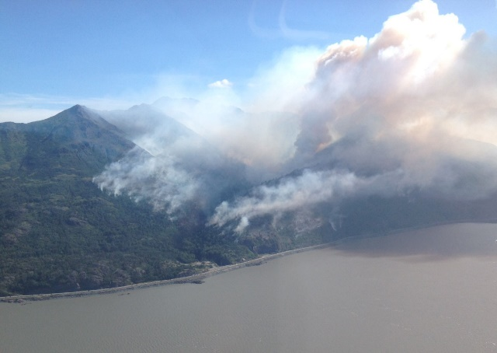
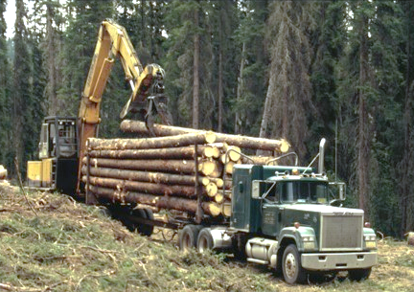
Division of Forestry
Mission: Serves Alaskans through sustainable forest management and wildland fire protection.
FY2017 Operating Budget: $47M ($24.2M UGF) | Positions: 239 | Director: Chris Maisch
The Division of Forestry (DOF) is the lead state agency for wildland fire management on 150 million acres with a primary goal to protect life and property.
DOF manages 47 million acres of forest for commercial timber sales and public use.
In 2016, the division …
Responded to 354 fires in state protection areas that burned 104,482 acres
Sold 8.2 million board feet of logs in 34 timber sales to 27 Alaska-based companies
Notes:
Fire Program Notes:
CY2016 was a lower year for both number of fires and acreage
In contrast, CY2015 was our second worst in terms of acreage burned (5.1 million acres) with a record number of fires 766
Cost to date for CY16 fires is approximately $26.2 million in UGF, in CY15 fire costs were $103.4 million in UGF!
Forest Management Program
Due to budget reductions and legal challenges/appeals to our southeast timber sale program, volume sold is down considerably.
Our ten year average of volume sold is 23.2 million board feet in 62 sales
Volume sold this year is off by 2/3 from our long-term average and number of sales is down by more than half
Examples of sales – Fairbanks, Delta, and Tok, Haines (contract still pending), Prince of Wales (very small)

Slide 10
Division of Forestry
Also in 2016, the division …
Managed large wildland fires on the outskirts of Tetlin and Anchorage
Generated $4.1 million in Emergency Firefighter (EFF) wages and $1.4 million in local vendor contracts, primarily to rural Alaska
Secured 94% Alaska hire in firefighting workforce
Lower 48 firefighting assignments returned $5.62M in wages to Alaskans
Received 4 hazard fuel reduction grants in Caswell, McGrath area, and Delta Junction
Conducted 54 inspections on private timber sales and 82 inspections on state timber sales for water quality & fish habitat compliance
Worked with Forest Service on Tongass young growth forest inventory
Signed Good Neighbor Authority agreement to provide timber sale layout and administration of timber sales on federal lands
Participated in 1st year of USDA Forest Inventory & Analysis Program in Alaska ($1.1M annual project)
Notes:
Fire highlights
Names of the fires near Tetlin (Tetlin River) and Anchorage (McHugh)
Approximately ¼ of CY16 fire costs went to EFF crews and local vendors ($5.5 million)
The high percentage of AK hire was in part a reflection of the less active fire season, in contrast in CY15 we had only a 50% AK hire rate
L-48 fire assignments returned significant payroll amounts ($5.6 million) to our crews, most of which are village based
Hazard fuel project amounts in order of slide listing by community: $300.0, $300.0, 74.3
Inspections are conducted under the authority of our Forest Resources and Practices Act (FRPA). The Act’s key focus is on protecting water quality and fish habitat. DNR is the lead agency and coordinates with DEC and ADF&G
Tongass Forest Service projects, forest inventory and GNA timber sale projects, are key parts of the transition from predominately Old Growth to Young Growth harvest. This transition will take 15-20 years. Staff capacity issues are a big challenge with this effort, but these projects are key to supporting the timber industry in southeast.
USDA Forest Inventory & Analysis Program
FIA program is an annual project that the state is contracting to preform and will bring $1.1 to $2.0 million in funding to the Division. This was the last location in the Nation to have the program implemented, which in simple terms equates to the nations tree census. The Division worked hard to secure this program and Sen. Lisa Murkowski was very helpful in securing $’s for the program in AK.
The FIA program puts Alaska on par with the other 49 states by providing important information on our forest resources. The information will be used to address long-term sustainability, fire and forest management questions concerning Alaska forests, especially in the boreal region where wood biomass projects are important ways for heating facilities in remote communities. Ensuring a long-term stable wood supply is critical for these types of operations.
The project is also employing young Alaskans for the field work and is a great recruiting pool for Forester and other natural resource positions in the Department. The integrated field crew was 15 employees from UAF, USFS and DOF in 2016 and in 2017 will grow to 14 DOF direct hires (1 FT, 1 FT-Seasonal, 3 LTNP, 9 STNP) Note: some of these position are in the approval process or soon to be and are not on the DOF books yet!
The program is funded at $1.1 million and should grow to $2.0 million as the project moves forward.
Provides an important source of funding and stability for the Division after three cycles of budget reductions and significant reductions in our workforce. It is a positive note and is helping with overall morale in the workforce.
Is a key tool used by the timber industry to answer wood supply questions when firms are considering expansion of mills and siting of new facilities.

Slide 11
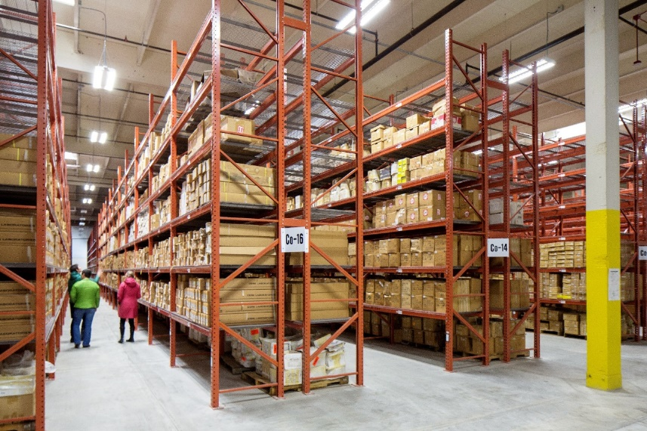
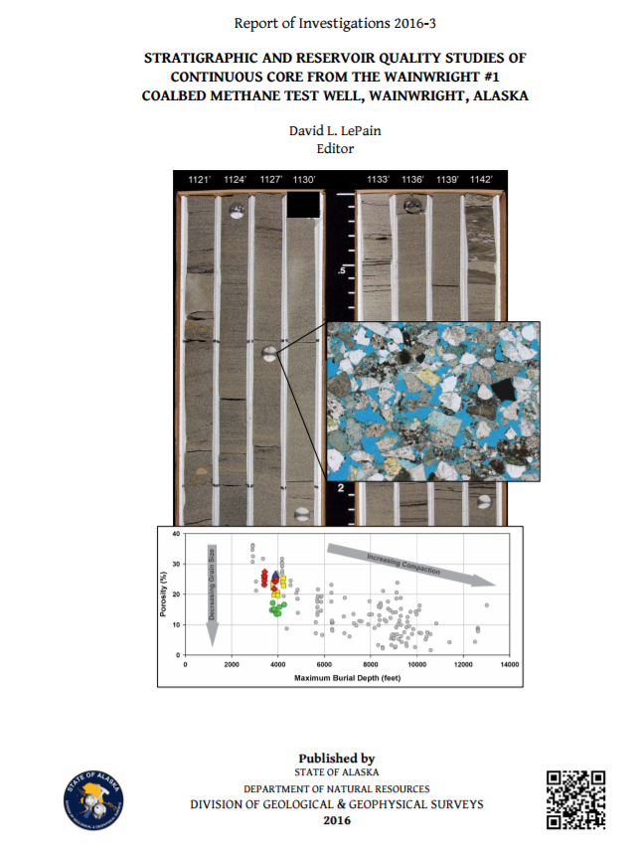
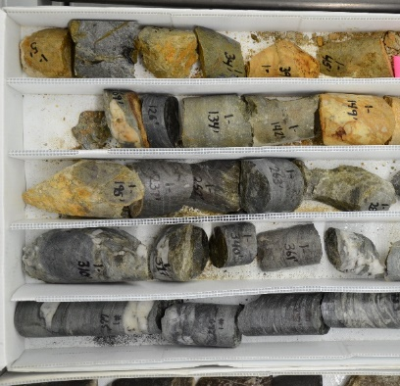
Division of Geological & Geophysical Surveys
Mission: Determine the potential of Alaska land for production of metals, minerals, fuels, and geothermal resources; the locations and supplies of groundwater and construction material; and the potential geologic hazards to buildings, roads, bridges, and other installations.
FY2017 Operating Budget: $8.5M ($4.4M UGF) | Positions: 51 | Director: Steven Masterman
The Division of Geological & Geophysical Surveys (DGGS) collects, analyzes, and publishes data, maps and reports that stimulate development and identify geologic hazards.
The division’s Geologic Materials Center (GMC) makes Alaska’s invaluable collection of cores, samples, and data available to developers and the public.
Notes:
The GMC has 15 million feet of rock!
It is also now responsible for releasing geophysical data gathered through seismic projects that received oil exploration tax credits, as well as the borehole data.

Slide 12
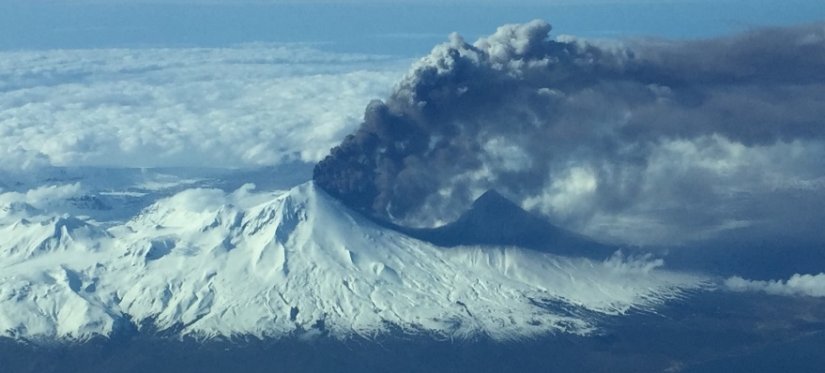
Division of Geological & Geophysical Surveys
In 2016, the division …
Generated 36.9 million web page views, 11,301 downloads of geospatial data, and 895,647 publication downloads
Mapped 480 square miles in Tok River area
Spurred claim staking activity with data releases (Tok River and Bonnifield district)
Began training Bristol Bay community residents to monitor shoreline change
Monitored and collaboratively issued volcano alerts on eruptions at Cleveland, Pavlof, and Bogoslof volcanoes (141 flights canceled)
Flew airborne magnetic survey over Icy Cape to locate heavy-mineral beach sands
Worked with USGS to determine if Alaska coal can produce oil; first 4 samples produced oil, 2 in substantial amounts.
DGGS produced 54 publications including …
17 reports on Cook Inlet and North Slope (Nanushuk) petroleum geology
Geologic maps of Tyonek and Sag River areas
Tsunami inundation maps and reports for 8 communities
New high-resolution imagery and elevation data for 2,200 miles of Alaska’s western coast
Notes:
2016 web/download traffic
This is three times the web traffic as 2015. The reason is that DGGS has been serving out all of the new digital elevation data that is available for Alaska through the Alaska Geospatial Council’s efforts. This includes LiDAR and ifSAR data that is useful to anyone who wants a digital topo surface map – for example, LiDAR is very useful for developers, ifSAR is very useful for aviation.
Tok mapping
The Tok River area, about 25 miles southwest of Tok, is a relatively underexplored region adjacent to zinc-lead-silver deposits of the Delta mineral belt, the Tetlin gold-silver-copper deposit, and the gold-antimony mineralization in the Stibnite Creek and White Gold areas. DGGS and University of Alaska Fairbanks geologists collected geochemical samples in the region earlier this year and DGGS will be releasing geological maps as well. Several 100 mining claims have been staked following the initial reports.
DGGS issued a series of reports on its Tok River investigations this year. One report described as many as 20 mineral occurrences not previously documented in the public record, and confirmed the mineralization at known prospects, including values of 0.29 ounce of gold per ton at the Shalosky vein, 0.18 ounce of gold per ton at the Hona (also known as Noah) porphyry prospect, and massive sulfide grading 13 percent zinc, 1.9 percent copper, and 0.75 ounce of silver per ton at the Eagle prospect.
Volcanoes - DGGS along with the USGS and University of Alaska form the Alaska Volcano Observatory. As part of AVO, DGGS geologists conduct routine volcano monitoring activities and form part of the collaborative group that decides whether to issue volcano alerts to aviation. DGGS geologists have a call list to call following all eruptions (Eielson AFB, Governors Office, Ak Division of Homeland Security) and a longer list following major eruptions (additional government, airport and military contacts), as do the other parts of AVO. DGGS is responsible for all the internet postings about the eruptions and all social media activity, and responds to media and public enquiries. Following the March 2016 Pavlof eruption 41 Alaska Air flights were cancelled, protecting 6,200 passengers, including Senator Murkowski.
Icy Cape – DGGS flew a helicopter magnetic survey over the MHTL Office Icy Cape lands to locate magnetite-bearing heavy mineral sands as a tool to help MHTL locate sample sites for further characterization of the resources present on the property. The survey was very successful in locating areas of high magnetite content.
Oil from coal – The USGS has developed a new test method (hydrous pyrolysis) to determine whether organic-rich sediments can generate oil. DGGS provided samples from Alaska to test, and the first 4 samples from Alaska all produced oil in these tests, two in substantial amounts. Results will be published through the USGS, which will take some time. It is encouraging that Alaska coal can produce oil under the right conditions, as Alaska has abundant coal.

Slide 13
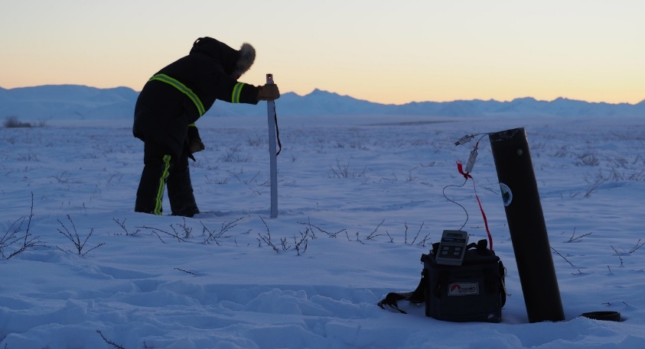
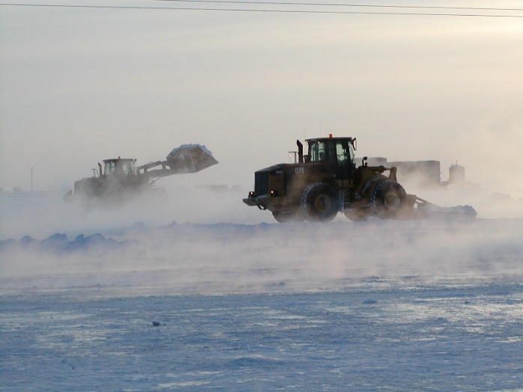
Division of Mining, Land & Water
Mission: Provides for the appropriate use and management of Alaska’s state owned land and water, aiming towards maximum use consistent with the public interest.
FY2017 Operating Budget: $26.4M ($6.6M UGF) | Positions: 209 | Director: Brent Goodrum
The Division of Mining, Land & Water (DMLW) manages more than 160 million acres – a land base comparable in size to California and most of Oregon combined.
The division’s responsibilities range from land acquisition and land-use planning to land sales, permitting, and stewardship.

Slide 14
Division of Mining, Land & Water
In 2016, the division …
Generated $28.4M in revenues to the state through authorizations for use of state lands and waters, royalty payments, and land sales
Issued 15 authorizations to facilitate a major fiber optic cable project on the North Slope, enabling improved communication opportunities to remote parts of Alaska
Initiated North Slope Area Plan, which will support borough municipal entitlement decisions and adopted Eastern Tanana Area Plan
Issued Lake and Peninsula Borough municipal entitlement preliminary decision impacting over 15,000 acres
Confirmed state title to submerged lands beneath navigable water bodies (Stikine River, Mosquito Fork, Chisana River, Nabesna River) in proceedings and litigation with the federal government
Conducted field investigation and aerial mapping to support state efforts to correct the ANWR boundary, which would enable Alaska to select 20,000 acres on the western edge of the refuge
Defended against efforts by BLM to adopt new unproven survey technology which could transfer significant costs to the state
Authorized ~173 miles of ice roads, 50 miles of snow roads, and 24 acres of ice pads in fiscal year 2016
Notes:
Eastern Tanana Area Plan summary
The Tanana Basin Area Plan (TBAP) was adopted in 1985 and it was last updated in 1991. The TBAP was a very large area plan encompassing approximately 22 million acres of land including approximately 15 million acres of state owned and selected lands.
Because of the scale and complexity of the lands involved DNR divided the area and developed two area plans, the Eastern Tanana Area Plan (ETAP) and the Yukon Tanana Area Plan (YTAP). The YTAP, adopted in 2014, revised the western portion of the TBAP while the ETAP revised the eastern portion.
The ETAP plan boundary encompasses approximately 12.6 million acres of land. Of this, approximately 6.6 million acres is general state or state selected land with an additional 1.7 million acres of Legislatively Designated Area lands. The remainder is private, Alaska Native Corporation, Borough, or other state or federal agency land.
One of the primary changes was to include an additional 480,000 acres in the Tanana Valley State Forest.
Over 3.3 million acres are classified or co-classified as Wildlife Habitat land, and 1.1 million acres are classified or co-classified as public recreation land. More than 200,000 acres classified for settlement and just over 56,000 acres for agricultural land. Approximately 1 million acres as mineral land.

Slide 15
Division of Oil & Gas
Mission: Manages lands for oil, gas & geothermal exploration and development in a fair and transparent manner to maximize prudent use of resources for the greatest benefit of all Alaskans; facilitates safe and environmentally conscious operation & maintenance of common carrier pipelines.
FY2017 Operating Budget: $22.2M ($8.9M UGF) | Positions: 112 | Director: Chantal Walsh
The Division of Oil and Gas (DOG) conducts lease sales, collects royalties, authorizes oil and gas activities, and regulates common-carrier pipelines on state land.
DOG provides commercial analysis, economic modeling, financial risk assessments, audits, and other professional services to ensure the State receives maximum value for its oil and gas resources.

Slide 16
Division of Oil & Gas
In 2016, the division …
Held 2nd largest North Slope lease sale by acreage (599,880) and 3rd largest by dollar amount ($16.9M) since 1998; received $17.8M in bids for 633,000 acres including Beaufort Sea
Initiated the release of seismic and well datasets for oil and gas exploration projects that received tax credits under AS 43.55.025
Prepared state’s FY2018 production forecast using new methodology to increase accuracy; forecast previously was prepared by DOR contractor
Receipted and verified $920M in FY2016 royalties, rents and bonus bids
Issued 7 royalty/NPSL audits resulting in additional $27M in state revenue
Processed revised 2009-2016 royalty reports as result of FERC-required TAPS tariff reduction, resulting in $90M additional revenue
Coordinated all state agency involvement in processing permits and finalized FERC-required Resource Reports for AKLNG and ASAP projects
Negotiated two royalty-in-kind (RIK) contracts for sale of oil to PetroStar; combined sales will yield $24M-$37M in revenue over a 5-year period.
Completed DR&R framework agreements with Chugach and ML&P

Slide 17
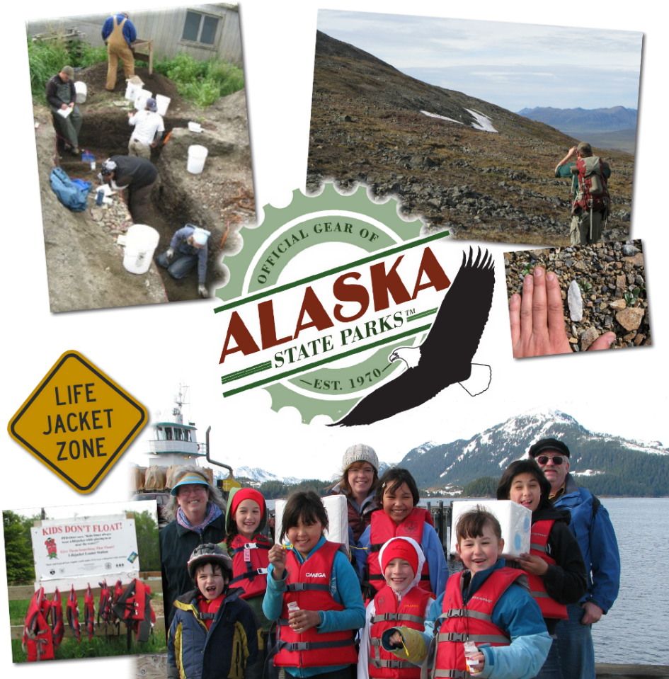
Division of Parks
& Outdoor Recreation
Mission: Provides outdoor recreation opportunities and conserves and interprets natural, cultural, and historic resources for the use, enjoyment, and welfare of the people.
FY2017 Operating Budget: $16.5M ($3.1M UGF) | Positions: 177 | Director: Ben Ellis
The Division of Parks and Outdoor Recreation (DPOR) operates and provides public safety in the largest state park system in the United States (3.3 million acres), including more than 120 park units and 900 miles of hiking trails.
The division administers federal recreational trail grants and oversees the statewide programs for boating safety and historic preservation.

Slide 18
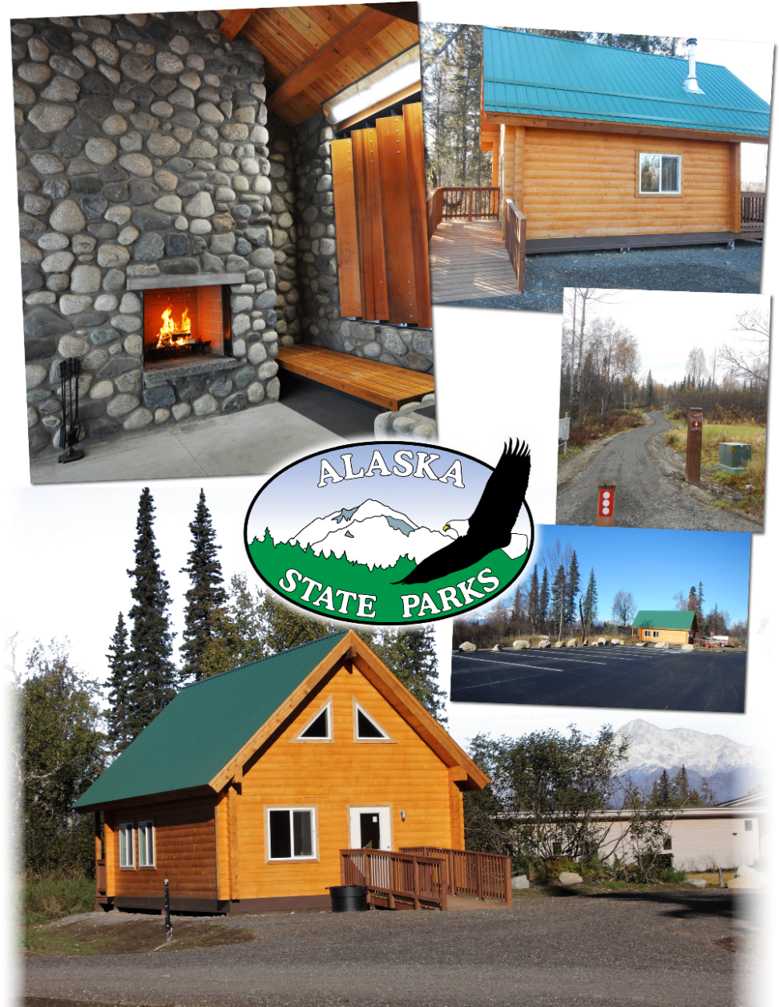
Division of Parks
& Outdoor Recreation
In 2016, the division…
Completed South Denali construction – 3,300-square-foot interpretive center, 35 full-hook-up campsites, 10 walk-in campsites, 3 public-use cabins, and a contact station opening Summer 2017
Continued initiative to reduce reliance on general funds for state park operations
Provided 4,041 loaner life jackets, taught 16,475 students through Kids Don’t Float Life program
Issued 57 archaeology survey permits and reviewed over 1,600 projects for impacts to historic properties
Awarded $360,000 in historical grants and more than $1.4M in recreational grants.
Notes:
The Kids Don’t Float Program is credited with saving 28 lives to date.
The $1.4 million in recreational grants includes recreational trails and SnowTRAC programs.

Slide 19
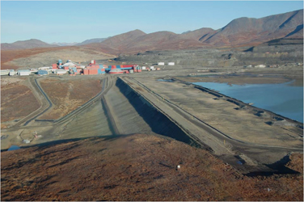
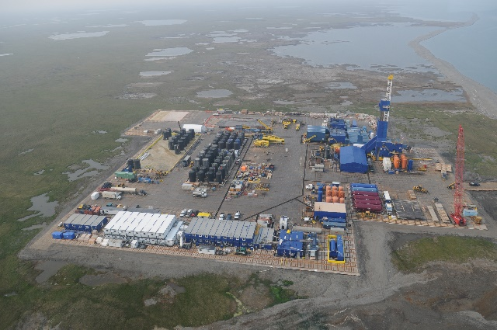
Office of Project Management & Permitting
Mission: Coordinates multi-agency regulatory reviews and authorizations, while collaboratively engaging federal agencies on land use planning and policy initiatives to maintain and enhance the state’s economy, quality of life, and maximize the value of Alaska’s vast natural resources.
FY2017 Operating Budget: $7.8M ($0.9M UGF) | Positions: 15 | Director: Sara Longan
The Office of Project Management & Permitting (OPMP) supports private industry, regulators, and the general public by implementing one-stop shop, multi-agency permit coordination to secure consistent, defensible, transparent, and timely permit decisions.
This model is unique to Alaska and offers a level of assurance to companies investing in Alaska that permit reviews are robust and transparent.

Slide 20
Office of Project Management & Permitting
In 2016, the office …
Coordinated permitting, NEPA review, and construction and permit compliance activities for major projects including:
Oil & Gas: Nanushuk Project (Armstrong), Greater Moose’s Tooth 1 and 2 (ConocoPhillips), Point Thomson (ExxonMobil), Liberty (Hilcorp), Smith Bay (Caelus Energy), Nikaitchuq (ENI)
Mining: Donlin Gold, Fort Knox, Kensington, Nixon Fork, Pogo, Red Dog
Consistently engaged with federal agencies to advance State interests during federal land management planning, including NPR-A, Arctic OCS, ANWR-1002 Area
Continued the multi-year process to develop a statewide wetlands mitigation in-lieu fee program to offset impacts to wetlands, as required by the Clean Water Act. This program would lower project development costs and generate state revenue
Renewed an MOU with the North Slope Borough to address issues and coordinate activities relating to North Slope oil & gas development
Coordinated Alaska Geospatial Council work to develop an accurate topographic base map of Alaska, which now covers 77% of the state

Slide 21
Mental Health Trust Land Office
Mission: Protect and enhance the value of Alaska Mental Health Trust Lands, including minerals, coal, oil and gas, timber, and real estate, while maximizing revenues from those lands over time to support mental health services.
FY2017 Operating Budget: $4.4M ($0 UGF) | Positions: 19 | Executive Director: John Morrison
The Trust Land Office (TLO) is responsible for managing the land and other natural resources owned by the Alaska Mental Health Trust Authority.
The TLO generates revenue for trust beneficiaries from land sales and leasing, real estate investment and development, timber sales, mineral, coal, oil and gas exploration and development, and sand gravel and rock sales.
In 2016, the TLO …
Generated $9.1M to fund programs for ~85,000 Alaskan Mental Health Trust beneficiaries:
$2.5M from land sales and rentals across the state (competitive and negotiated)
$2M from real estate investments and leases
$4.3M in oil, gas and mineral royalties
Explored Icy Cape to better define mineral resources for future development

Slide 22
Support Services Division
Mission: Provide client-focused, efficient and cost-effective financial, budget, procurement, human resource, information technology, and recording services to DNR and the public.
FY2017 Operating Budget: $13M ($5.6M UGF) | Positions: 117 | Director: Fabienne Peter-Contesse
The Support Services Division (SSD) provides land records management for more than 160 million acres of state land.
SSD develops and supports software and hardware solutions and provides IT support throughout Alaska.
The division oversees DNR procurement, budget, and financial transactions, and ensures public funds from 22 different sources are managed with integrity and transparency.
In 2016, the division:
Merged Dept. of Administration’s desktop support into DNR’s structure to improve service and reduce costs
Upgraded IT services to streamline the permit application and management process for water use authorizations
Completed Electronic Recording and Uniform Commercial Code online system implementation, enabling Recorder’s Office to reduce costs and improve service delivery
Participated in statewide initiatives to improve delivery of services and reduce costs
Notes:
Desktop support merger has saved DOA ~$200K and 2 positions were deleted.
Recorder’s Office efficiencies to date have saved ~$450K and 8 positions were deleted.

Slide 23
DNR Budget Reductions
- FY2016 and FY2017 Highlights -
FY2016 DNR reductions | Cut more than $7M (-9.8%) UGF and 75 positions
Agriculture | Cut 4 positions and removed base funding for Farm to School program, Natural Resources Conservation & Development Board, and ethnobotany program
Forestry | Cut 35 positions in forest management and wildland firefighting, eliminated wildland fire academy and reduced timber sale program
Geological & Geophysical Surveys | Cut 4 positions including 2 scientists evaluating coal/geothermal and energy resources, and administrative and publications staff; removed funding for airborne geophysics program
Mining, Land & Water | Cut 6 positions working on public land access/navigability and reduced budget for authorizations and inspections
Oil and Gas | Cut 9 positions by restructuring work processes
Parks & Outdoor Recreation | Cut 4 positions including Dillingham, Valdez and Sitka rangers; put 3 parks in passive management
Project Management & Permitting | Cut 1 position supporting ANILCA reviews and removed funding for coordination of Tongass plan reviews
Support Services | Cut 5 Recorder’s Office positions and 1 IT position; closed 6 rural Recorder’s Offices
Agency-wide | Mandatory furloughs for exempt/partially-exempt staff; delays in maintaining and replacing field and IT equipment
FY2017 DNR reductions | Cut $3.2M (-4.6%) UGF and 27 positions
Agriculture | Cut 1 seasonal mechanic position at Plant Materials Center and reduced marketing, inspections, and on-farm assistance
Forestry | Cut 1 administrative position and reduced funding for forest road maintenance and fire suppression
Geological & Geophysical Surveys | Reduced funding for publications, software, and travel to events to market Alaska’s resources potential
Mining, Land & Water | Cut 2 positions – realty services and IT – and reduced budget for inspections, compliance and stewardship activities
Oil and Gas | Cut 3 positions supporting best interest findings, lease sale preparation, public records requests, and information officer
Parks & Outdoor Recreation | Cut 1 position – Kodiak state park operations and reduced statewide support for permitting
Support Services | Cut 2 positions – administrative and accounting
Agency-wide | Mandatory furloughs for exempt/partially-exempt staff; reduced funding for Commissioner’s Office; cut 2 positions and eliminated the Citizen’s Advisory Commission on Federal Areas; reduced chargeback and facilities costs and cut 4 support function positions; cut 22 positions vacant for more than a year
Note: AKLNG funding is not included and not all position cuts are described in narrative.
Notes:
Highlights of position cuts don’t add up to the net total reductions; miscellaneous adjustments are included, as well as vacant position deletions.
More than 100 positions were deleted in FY2016 & FY2017, approximately half were filled.
FY2017 staffing of 996 is down 10% from FY2006
FY2017 UGF budget of $62.1M is below FY2006 of $65.3M

Slide 24
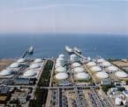
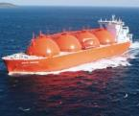
AKLNG Project
- Status Update -
2016 Pivotal Year for AKLNG Project
Technical and regulatory accomplishments
Pre-FEED technical work successfully completed
FERC Resources Reports completed and filed
Equity-based funding model deemed unworkable by some Producers in current economic environment
New Project structure developed
State taking on more active role with AGDC completing transition into project lead
Commercial negotiations halted in early 2016 when Producers elected to slow project pace
State gas team resized based on reduced work scope, with core team skills retained
Notes:
The AKLNG Project began in 2014
Key enabling agreements signed and SB138 enacted to initiate AKLNG Project with State as equity participant
Premised on equity participation by Exxon Mobil, BP, ConocoPhillips, TransCanada and State of Alaska
Pre-FEED engineering work started on the 3 major project components: Gas Treatment Plant, Pipeline and LNG Plant/Terminal
State Gas Team formed and staffed from DNR, DOR, LAW and AGDC to support integrated work plan and schedule
2015 work effort focused on progressing commercial & technical work
Project participants engaged in multiple parallel work streams with Upstream and Midstream technical teams supporting Pre-FEED engineering
Aggressive commercial negotiations initiated to address large number of key commercial agreements needed to advance AKLNG Project beyond Pre-FEED
State of Alaska buyout of TransCanada’s interest in Project approved during Fall 2015 Special Session of Legislature
Revised Gas offtake rates for PBU and PTU issued by AOGCC

Slide 25
AKLNG Project
- Status Update -
DNR’s primary AKLNG Project roles and responsibilities continue to include:
Maximizing resource value to State of Alaska while commercializing natural gas
Ensuring that State’s interests are protected and State’s policy objectives are advanced during resource development
Maintaining State’s sovereign responsibilities and duties relating to oil & gas lease royalty terms
Making Royalty-in-Kind (RIK) vs. Royalty-in-Value (RIV) decision
Promoting future North Slope hydrocarbon exploration & development

Slide 26
AKLNG Project
- Status Update -
State Gas Team Organization
Original DNR Gas Team had 10 positions, with 4 leads and 6 staff roles
Lead positions were Upstream, Midstream, Commercial, and Marketing
Staff positions included Commercial Analyst, Gasline Liaison, Admin Officer, Project Coordinator, Resource Specialist, and Marketing Analyst
Current DNR Gas Team reorganized to meet statutory obligations and thoroughly manage State’s interests
Upstream lead (Steve Wright), Commercial lead (Deepa Poduval), Legislative Liaison and Commercial Support (Ed King); two team members transferred to AGDC
DNR Team is efficiently leveraging additional shared resources from Division of Oil and Gas for commercial, economic and subsurface technical analysis

Slide 27
AKLNG Project
- Status Update-
2017 Outlook for AKLNG Project
Focus on progressing pending FERC application
AGDC preparing responses to FERC questions and comments on AKLNG Resource Reports filed in 2016
Continuing significant engagement with potential investors and markets
Soliciting 3rd party investment in midstream infrastructure portion of AKLNG Project, some Producers may elect to retain equity interest in midstream
Global LNG market demand window forecasted in mid-2020’s and targeted by AKLNG Project
DNR project team actively engaged with AKLNG Project
Fully prepared to meet current and future obligations and demands for key DNR project roles and responsibilities
DNR core team has retained expertise in upstream technical, commercial and analytical evaluation as project advances during 2017

Slide 28
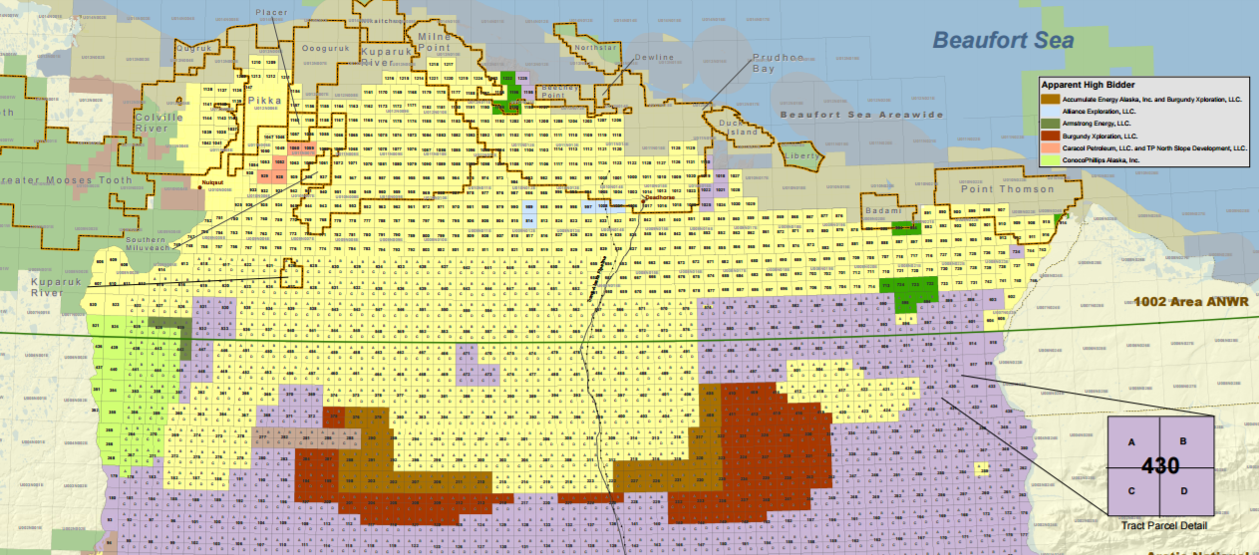
DNR Issues & Activities in 2017
- Oil and Gas -
Work with North Slope communities, presidential administration, and Congressional delegation on Arctic energy policy and decision making that support responsible development (ANWR 1002 Area, OCS, NPR-A)
Build on successful 2016 North Slope lease sale with focus on bringing leases into production
Rationalize fees, regulations, and work processes necessary to release seismic and exploration well data to promote and accelerate oil and gas production
Support appraisal and development activities by Cook Inlet independents
Refine production forecast model
Notes:
Details on Cook Inlet activity

Slide 29
DNR Issues & Activities in 2017
- Land Management & Permitting -
Work with local stakeholders, presidential administration, and Congressional delegation to address recent federal actions including:
BLM land management plans
1002 Area boundary & legislation
Submerged lands ownership (Knik River and other unresolved cases)
Controversial BLM method for surveying state land conveyances
Obtain federal approval for a wetlands mitigation In-Lieu Fee Program that provides new alternatives for developers to meet mitigation requirements
Clear the way to finalizing statehood land entitlement by pressing the federal government to lift obsolete public land orders and by updating the State’s selection priorities
Support federal permit reform and continue automating DNR’s permitting processes
Update fee regulations for land, water and mining authorizations

Slide 30
DNR Issues & Activities in 2017
- Agriculture & Forestry -
Complete transition of Mt. McKinley meat plant to private ownership while maintaining continuity of production and processing
Collaborate with state partners, industry, and federal agencies to develop and implement a produce safety program for Alaska to meet the federal standards of the Food Safety Modernization Act
Realign primary wildland fire service areas with federal partners to increase efficiencies and adjust workloads to compensate for budget reductions
Work with the Forest Service on Tongass forest plan implementation, working through the Good Neighbor Authority to assume responsibility for timber sale layout and administration of sales on federal lands
Continue federally-funded Forest Inventory and Analysis program in Interior Alaska which will collect physical data important for sustained yield management of state forests and will be particularly useful for biomass energy projects in rural Alaska
Notes:
Food Safety Modernization Act – FDA is rolling out one of the largest food safety program changes since the 1930s and it requires the states to implement produce safety programs; the State of Alaska needs to make sure its programs are in compliance or farmers may risk losing access to their markets (grocery stores or any point of sale); DoAg will focus on relationship building and education to farmers. Working cooperatively with UAF-Cooperative Extension Service and Alaska Farm Bureau.
Good Neighbor Authority – DOF is seeking to secure a Supplemental Project Agreement (SPA) for the Kosciusko Project a 28 million board foot timber sale that is a key part of the FY18 federal timber sale program on the Tongass.
USDA Forest Inventory & Analysis Program
FIA program is an annual project that the state is contracting to preform and will bring $1.1 to $2.0 million in funding to the Division. This was the last location in the Nation to have the program implemented, which in simple terms equates to the nations tree census. The Division worked hard to secure this program and Sen. Lisa Murkowski was very helpful in securing $’s for the program in AK.
The FIA program puts Alaska on par with the other 49 states by providing important information on our forest resources. The information will be used to address long-term sustainability, fire and forest management questions concerning Alaska forests, especially in the boreal region where wood biomass projects are important ways for heating facilities in remote communities. Ensuring a long-term stable wood supply is critical for these types of operations.
The project is also employing young Alaskans for the field work and is a great recruiting pool for Forester and other natural resource positions in the Department. The integrated field crew was 15 employees from UAF, USFS and DOF in 2016 and in 2017 will grow to 14 DOF direct hires (1 FT, 1 FT-Seasonal, 3 LTNP, 9 STNP) Note: some of these position are in the approval process or soon to be and are not on the DOF books yet!
The program is funded at $1.1 million and should grow to $2.0 million as the project moves forward.
Provides an important source of funding and stability for the Division after three cycles of budget reductions and significant reductions in our workforce. It is a positive note and is helping with overall morale in the workforce.
Is a key tool used by the timber industry to answer wood supply questions when firms are considering expansion of mills and siting of new facilities.

Slide 31
DNR Issues & Activities in 2017
- Alaska State Parks -
Open South Denali campground, cabins, trails and interpretive center
First new state park campground in 20 years
Increase state park revenue to reduce dependence on unrestricted general funds:
Online reservations through ReserveAmerica.com
Increase park merchandise sales
Raise specific park user fees
Build Kenai River Special Management Area projects including Bings Landing floating dock and Eagle Rock boat launch (2-yr project)
Continue riverbank stabilization to protect historic properties at Rika’s Roadhouse (Big Delta State Historical Park)
Build two new public use cabins at Eklutna Lake
Work with Alaska Historical Commission on this year’s 150th anniversary of the Treaty of Cession
Notes:
Online reservations – Parks will debut cabin reservations through Reserve America in 2017; not sure yet if campground & other facility reservations will be available in 2017 but staff are working on it.

Slide 32
DNR Issues & Activities in 2017
- Geological & Geophysical Surveys -
Conduct and publish results from USGS-funded airborne magnetic survey over the Porcupine River area
Complete bedrock geology mapping in Iniskin–Tuxedni Bay area of Cook Inlet
Train western Alaska residents to monitor coastal erosion and southcentral Alaska residents to monitor snow conditions for avalanche susceptibility
Complete avalanche release zone maps for Alaska’s highway corridors and landslide risk maps for Sitka
Work with USGS to publish results of recent testing that showed Alaska coal can produce oil
Publish new geologic maps for Umiat, Tyonek, Tok, Styx River, Kivalina, Shaktoolik, Kasatochi, Chiginagak, and the Alaska Highway Corridor areas
Notes:
Porcupine Geophysics – DGGS obtained a $500,000 grant from the USGS Mineral Resources Program to fly an airborne magnetic survey over approximately 5,000 square miles in eastern Alaska over the Porcupine River (ANWR and Yukon Flats National Wildlife Refuge – survey area picked by USGS). This will inform the understanding of formation of Alaska, including the North Slope basin, as well as the mineral potential in eastern Alaska.
Tuxedni Bay Mapping – This is the area we propose to map in 2017 with the state CIP project and USGS STATEMAP funding. It is the third and final area to map the Mesozoic rocks on the west side of Cook Inlet. These rocks form the source for the oil in Cook Inlet. This work will help characterize oil potential in these and overlying rock units, as well as an understanding of the formation of the Cook Inlet basin, which is essential for cost-effective exploration.
Training residents to monitor erosion – Coastal erosion is a major concern for many western Alaska communities. DGGS obtained an Alaska Sea Grant for $125,000 to train citizen scientists in Alaska to provide scientific data on coastal erosion. DGGS does not have funding or staff to obtain this level of information. Funding citizen scientists has multiple benefits, especially in rural communities, who can take ownership and interest in issues critical to their communities resilience.
Citizen scientists in avalanche mapping – Every year avalanches claim Alaskan lives. DGGS obtained a $300,000 grant from NASA to train citizen sceintists to collect snow distribution data and provide via a smart phone app. DGGS does not have funding or staff to obtain this level of information. This will greatly enhance collection of real data to calibrate climate and weather models, making avalanche forecasting for transportation corridors more possible.
Alaska Coal – Alaska contains 17% of the worlds coal. Coal can, under the right conditions, produce oil. Demonstrating that Alaska coals can produce oil may open to exploration areas previously considered unlikely to host oil. DGGS has obtained a 5-year $75,000 grant from the USGS to help fund this work.
Publishing Geologic Maps – Geology maps form the basis of mineral exploration, oil and gas exploration, geologic hazards analysis, as well as groundwater and construction materials assessments. Geologic maps are a foundational data layer for all work involving the earth. The field work, analyses and interpretation for these maps were all completed, in previous years, and our goal is to make this information available to affected industries and communities.
Umiat – Map area centered on the Umiat oil field on the North Slope. Should inform oil exploration in Brookian sequence rocks across the North Slope, which host Pikka, Smith Bay, and Willow discoveries.
Tyonek - a revised map on the west side of Cook Inlet incorporating seismic geophysical data into the geologic interpretation. Should inform oil and gas exploration in northern Cook Inlet.
Tok – STATEMAP, SOA and USGS funding was used in 2016 to map an area between the Cu-Pb-Zn deposits in the Delta massive sulfide district and the recently discovered Cu-Au deposits at the Peak prospect near Tetlin, which Contango and Royal Gold are exploring. An area of current mineral exploration interest.
Styx River – an area in the western Alaska Range with strategic and critical mineral, as well as Cu-Au porphyry potential. This was mapped under the strategic and critical minerals project to evaluate mineral potential of these lands.
Kivalina – Map of the area around the community of Kivalina, intended to inform construction materials location and potential village relocation sites.
Shaktoolik – Same as Kivalina
Kasatochi – a volcano that erupted in the Aleutian Islands where we were funded through the USGS to map the recent volcanic deposits.
Chiginagak – a volcano on the Alaska Peninsula, where we were funded by the USGS to map recent volcanic eruption deposits.

Slide 33
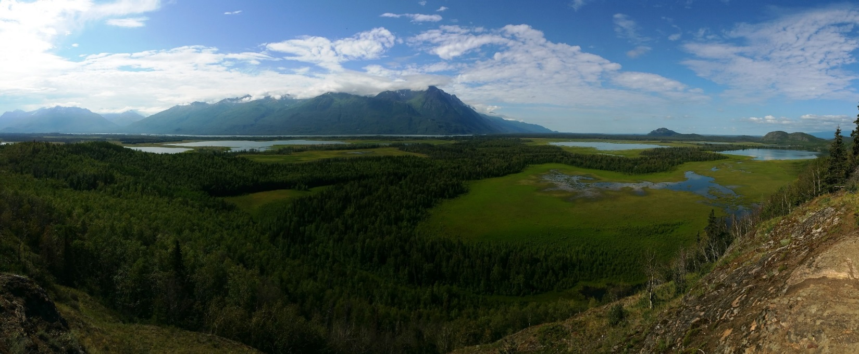
Conclusion
Thank you, any questions?
Notes:
Photo: Wetlands at Knik River Public Use Area

