Slide 1
University of Alaska System Budget Review

Slide 2
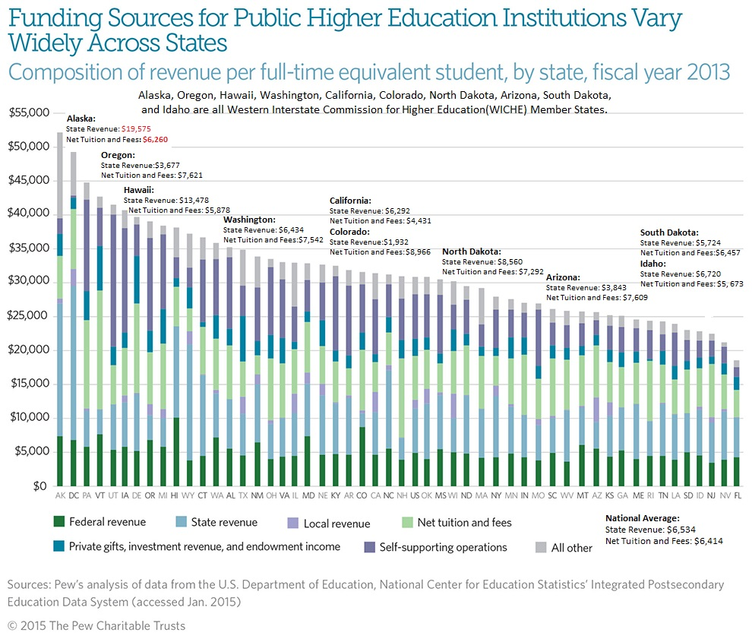

Slide 3
4-Year and 6-Completion Rate for 4-year Public Colleges: Bachelor Degree-Seeking Students
State-by-State Comparison: Enter 2007-Graduation in 2013
National Average:
57.6% Graduate in six years
33.3% Graduate in four years
51.7% of the 2007 entering class was included for the top chart’s graduation rate: Not all undergraduates are included in the official graduation rate. The U.S. omits part-time freshmen and those who have attended college before, among others, from its graduation-rate survey. The outcomes for those students are not known.
Alaska
Data and Charts are from the Chronical of Higher Education College Completion, which gathers their data from the National Center for Education Statistics.
Alaska
http://collegecompletion.chronicle.com/state/#state=ak&sector=public_four

Slide 4
FY16 and FY17 Budget Review University Of Alaska Statewide Programs (Total Funding)
 | FY16 House Subcommittee | FY16 Authorized | FY17 Governor’s Budget | FY16 Authorized vs FY17 Governor’s Budget
Statewide Services | 34,375.7 | 34,259.4 | 34,488.2 | 228.8
Office Info. Tech. | 17,578.5 | 17,538.5 | 19,116.2 | 1,577.7
System Education & Outreach | 11,933.2 | 11,928.5 | 10,951.2 | (977.3)
Total University Statewide Programs | 63,887.4 | 63,726.4 | 64,555.6 | 829.2
Funding in Thousands of Dollars
FY16 House Subcommittee - Version of FY16 operating bill passed by the House Finance Subcommittee
FY16 Authorized Budget - Includes impacts of legislative actions not included in Conf. Committee such as new legislation and vetoes.
FY17 Governor’s Budget - Governor’s proposed budget for the next fiscal year.
FY16 Authorized vs FY17 Governor’s Budget - Reductions and additions to the FY17 budget proposed by the Governor.

Slide 5
FY16 and FY17 Budget Review University Of Alaska Anchorage (Total Funding)
 | Campus | FY16 House Subcommittee | FY16 Authorized | FY17 Governor’s Budget | FY16 Authorized vs FY17 Governor’s Budget
 | Anchorage Campus | 267,930.5 | 269,310.6 | 273,712.8 | 4,402.2
 | Kenai Peninsula College | 16,627.8 | 16,649.3 | 16,897.9 | 248.6
 | Kodiak College | 5,780.5 | 5,795.1 | 6,133.7 | 338.6
 | Matanuska-Susitna College | 11,209.2 | 11,226.4 | 11,525.4 | 299
 | Prince Wm Sound College | 7,671.7 | 7,703.8 | 7,601.8 | (102)
 | Small Business Development Ctr | 3,164.9 | 3,181.2 | 3,178.1 | (3.1)
Total University of Alaska Anchorage |  | 312,384.6 | 313,866.4 | 319,049.7 | 5183.3
Funding in Thousands of Dollars
FY16 House Subcommittee - Version of FY16 operating bill passed by the House Finance Subcommittee
FY16 Authorized Budget - Includes impacts of legislative actions not included in Conf. Committee such as new legislation and vetoes
FY17 Governor’s Budget - Governor’s proposed budget for the next fiscal year
FY16 Authorized Budget vs FY17 Governor’s Budget - Reductions and additions to the FY17 budget proposed by the Governor

Slide 6
FY16 and FY17 Budget Review University of Alaska Fairbanks (Total Funding)
 | Campus | FY16 House Subcommittee | FY16 Authorized | FY17 Governor’s Budget | FY16 Authorized vs FY17 Governor’s Budget
 | Bristol Bay Campus | 4,090.9 | 4,095.1 | 4,085.2 | (9.9)
 | Chukchi Campus | 2,440.7 | 2,442.8 | 2,433.1 | (9.7)
 | Coop. Ext. Service | 10,685.8 | 10,675.6 | 0.0 | (10,675.6)
 | Fairbanks Campus | 263,610.9 | 265,362.3 | 282,988.3 | 17,626
 | Fairbanks Org. Res. | 143,001.0 | 145,241.4 | 143,451.7 | (1,789.7)
 | Interior-Aleutians Campus | 5,703.7 | 5,712.5 | 5,689.7 | (22.8)
 | Kuskokwim Campus | 6,752.7 | 6,766.9 | 6,566.3 | (200.6)
 | Northwest Campus | 4,571.6 | 4,591.8 | 4,460.6 | (131.2)
 | Rural College | 11,346.5 | 11,417.2 | 10,552.0 | (865.2)
 | UAF-CTC | 14,187.5 | 14,187.6 | 14,329.3 | 141.7
Total University of Alaska Fairbanks |  | 466,391.3 | 470,493.2 | 474,556.2 | 4,063
* Funding in Thousands of Dollars

Slide 7
FY16 and FY17 Budget Review University Of Alaska Southeast (Total Funding)
 | Campus | FY16 House Subcommittee | FY16 Authorized | FY17 Governor’s Budget | FY16 Authorized vs FY17 Governor’s Budget
 | Juneau Campus | 43,073.0 | 43,342.1 | 43,763.5 | 421.4
 | Ketchikan Campus | 5,464.5 | 5,474.0 | 5,531.1 | 57.1
 | Sitka Campus | 8,104.2 | 8,110.7 | 8,228.0 | 117.3
University of Alaska Southeast |  | 56,641.7 | 56,926.8 | 57,522.6 | 595.8
Funding in Thousands of Dollars
FY16 House Subcommittee - Version of FY16 operating bill passed by the House Finance Subcommittee
FY16 Authorized Budget - Includes impacts of legislative actions not included in Conf. Committee such as new legislation and vetoes.
FY17 Governor’s Budget - Governor’s proposed budget for the next fiscal year.
FY16 Authorized vs FY17 Governor’s Budget - Reductions and additions to the FY17 budget proposed by the Governor.

Slide 8
FY16 and FY17 Budget Review University Of Alaska System (Total Funding)
 | FY16 House Subcommittee | FY16 Authorized | FY17 Governor’s Budget | FY16 Authorized vs FY17 Governor’s Budget
University Statewide Programs | 63,887.4 | 63,726.4 | 64,555.6 | 829.2
Reduct’s & Addt’s | 144.9 | 10,581 | (5,769.5) | (16,350.5)
University of Alaska Anchorage | 312,384.6 | 313,866.4 | 319,049.7 | 5,183.3
University of Alaska Fairbanks | 466,391.3 | 470,493.2 | 474,556.2 | 4,063
University of Alaska Southeast | 56,641.7 | 56,926.8 | 57,522.6 | 595.8
Total University System | 899,449.9 | 915,593.8 | 909,914.6 | (5679.2)
Funding in Thousands of Dollars
FY16 House Subcommittee - Version of FY16 operating bill passed by the House Finance Subcommittee
FY16 Authorized Budget - Includes impacts of legislative actions not included in Conf. Committee such as new legislation & vetoes.
FY17 Governor’s Budget - Governor’s proposed budget for the next fiscal year.
FY16 Authorized vs FY17 Governor’s Budget - Reductions and additions to the FY17 budget proposed by the Governor.

Slide 9
FY16 and FY17 Budget Review University Of Alaska System (UGF Funding)
 | FY16 House Subcommittee | FY16 Authorized | FY17 Governor’s Budget | FY16 Authorized vs FY17 Governor’s Budget
University Statewide Programs | 22,195.10 | 22,034.10 | 23,458.4 | 1,424.3
Reduct’s & Addt’s | (10,331.2) | 104.5 | (15,785.4) | (15,889.9)
University of Alaska Anchorage | 126,128.40 | 127,485.20 | 127,385.1 | (100.1)
University of Alaska Fairbanks | 169,297.80 | 173,399.70 | 172,790.9 | (608.8)
University of Alaska Southeast | 27,478.40 | 27,763.50 | 27,152.6 | (610.9)
Total University System | $ 334,768.5 | 350,787.00 | 335,001.6 | (15,785.4)
Funding in Thousands of Dollars
FY16 House Subcommittee - Version of FY16 operating bill passed by the House Finance Subcommittee
FY16 Authorized Budget - Includes impacts of legislative actions not included in Conf. Committee such as new legislation and vetoes.
FY17 Governor’s Budget - Governor’s proposed budget for the next fiscal year.
FY16 Authorized vs FY17 Governor’s Budget - Reductions and additions to the FY17 budget proposed by the Governor.

Slide 10
Degrees, Certificates, and Endorsements Awarded by Level
University of Alaska System
 | FY09 | FY10 | FY11 | FY12 | FY13 | FY14
OEC | 80 | 209 | 249 | 267 | 279 | 395
Certificate (1 yr) | 38 | 24 | 44 | 31 | 27 | 40
Certificate (2 yr) | 159 | 214 | 159 | 264 | 249 | 296
Associate (AAS) | 630 | 692 | 773 | 738 | 834 | 934
Associate (AA) | 298 | 296 | 295 | 370 | 407 | 442
Bachelor's | 1,527 | 1,498 | 1,616 | 1,612 | 1,757 | 1,855
Licensure | 121 | 154 | 160 | 192 | 205 | 250
Master's | 537 | 622 | 641 | 650 | 679 | 644
Doctorate | 37 | 45 | 46 | 50 | 54 | 52
Total | 3,427 | 3,754 | 3,983 | 4,174 | 4,491 | 4,908
Source: UA in Review 2015. Page 103. https://www.alaska.edu/swbir/ir/ua-in-review/uar2015/UAR-2015_Final.pdf

Slide 11
Degrees, Certificates, and Endorsements Awarded by Level
University of Alaska Anchorage
 | FY09 | FY10 | FY11 | FY12 | FY13 | FY14
OEC | 49 | 116 | 123 | 153 | 136 | 162
Certificate (1 yr) | 34 | 21 | 38 | 18 | 14 | 31
Certificate (2 yr) | 40 | 39 | 40 | 49 | 43 | 35
Associate (AAS) | 474 | 509 | 562 | 518 | 569 | 608
Associate (AA) | 210 | 210 | 194 | 256 | 285 | 297
Bachelor's | 956 | 920 | 1,001 | 971 | 1,064 | 1,131
Licensure | 38 | 60 | 63 | 66 | 64 | 98
Master's | 270 | 296 | 305 | 276 | 312 | 268
Doctorate | 0 | 0 | 0 | 0 | 2 | 3
Total | 2,071 | 2,171 | 2,326 | 2,307 | 2,489 | 2,633
Source: UA in Review 2015. Page 103. https://www.alaska.edu/swbir/ir/ua-in-review/uar2015/UAR-2015_Final.pdf

Slide 12
Degrees, Certificates, and Endorsements Awarded by Level
University of Alaska Fairbanks
 | FY09 | FY10 | FY11 | FY12 | FY13 | FY14
OEC | 26 | 66 | 54 | 59 | 80 | 126
Certificate (1 yr) | 0 | 0 | 0 | 0 | 0 | 0
Certificate (2 yr) | 109 | 165 | 98 | 179 | 162 | 204
Associate (AAS) | 135 | 148 | 163 | 166 | 206 | 252
Associate (AA) | 58 | 56 | 70 | 60 | 77 | 81
Bachelor's | 483 | 473 | 523 | 535 | 550 | 579
Licensure | 30 | 34 | 35 | 30 | 37 | 44
Master's | 169 | 219 | 199 | 245 | 213 | 223
Doctorate | 37 | 45 | 46 | 50 | 52 | 49
Total | 1,047 | 1,206 | 1,188 | 1,324 | 1,377 | 1,558
Source: UA in Review 2015. Page 103. https://www.alaska.edu/swbir/ir/ua-in-review/uar2015/UAR-2015_Final.pdf

Slide 13
Degrees, Certificates, and Endorsements Awarded by Level
University of Alaska Southeast
 | FY09 | FY10 | FY11 | FY12 | FY13 | FY14
OEC | 5 | 27 | 72 | 55 | 63 | 107
Certificate (1 yr) | 4 | 3 | 6 | 13 | 13 | 9
Certificate (2 yr) | 10 | 10 | 21 | 36 | 44 | 57
Associate (AAS) | 21 | 35 | 48 | 54 | 59 | 74
Associate (AA) | 30 | 30 | 31 | 54 | 45 | 64
Bachelor's | 88 | 105 | 92 | 106 | 143 | 145
Licensure | 53 | 60 | 62 | 96 | 104 | 108
Master's | 98 | 107 | 137 | 129 | 154 | 153
Doctorate | 0 | 0 | 0 | 0 | 0 | 0
Total | 309 | 377 | 469 | 543 | 625 | 717
Source: UA in Review 2015. Page 103. https://www.alaska.edu/swbir/ir/ua-in-review/uar2015/UAR-2015_Final.pdf

Slide 14
Cost per Degree for each University Campus (UGF)
 | Campus | FY14 BOR Authorized Funds (UGF) ^{A} | Degrees and Certificates Awarded ^{B} | Cost per year per degree awarded ^{c}
 | Anchorage Campus | $ 114,920,600 | 2,043 | $ 56,251
 | Kenai Peninsula College | $ 7,902,500 | 161 | $ 49,084
 | Kodiak College | $ 2,951,600 | 23 | $ 128,330
 | Matanuska-Susitna College | $ 5,039,900 | 127 | $ 39,684
 | Prince Wm Sound College | $ 3,746,900 | 19 | $ 197,205
Total University of Alaska Anchorage |  | $ 134,561,500 | 2,373 | $ 56,705
* Board of Regents (BOR)
^{A} Source: FY16 Approved Operating and Capital Distribution Plan
^{B} Source: UA in Review 2015. Page 103.
^{C} Source: Cost per year per degree awarded calculated by dividing the Board Authorized Funds by the number of Degrees and Certificates awarded (UGF)

Slide 15
Cost per Degree for each University Campus (UGF)
 | Campus | FY14 BOR Authorized Funds (UGF) ^{A} | Degrees and Certificates Awarded ^{B} | Cost per year per degree awarded ^{c}
 | Bristol Bay Campus | $ 1,718,700 | 22 | $ 78,123
 | Chukchi Campus | $ 1,093,300 | 1 | $ 1,093,300
 | Fairbanks Campus | $ 124,659,800 | 815 | $ 152,957
 | Interior-Aleutians Campus | $ 1,977,400 | 67 | $ 29,513
 | Kuskokwim Campus | $ 3,655,600 | 29 | $ 126,055
 | Northwest Campus | $ 1,853,100 | 6 | $ 308,850
 | Rural College | $ 6,467,900 | 25 | $ 258,716
 | UAF-CTC | $ 6,471,400 | 423 | $ 15,299
Total University of Alaska Fairbanks |  | $ 147,897,200 | 1,388 | $ 106,554
* Board of Regents (BOR)
^{A} Source: FY16 Approved Operating and Capital Distribution Plan. Page 15.
^{B} Source: UA in Review 2015. Page 103.
^{C} Source: Cost per year per degree awarded calculated by dividing the Board Authorized Funds by the number of Degrees and Certificates awarded (UGF)

Slide 16
Cost per Degree for each University Campus (UGF)
 | Campus | FY14 BOR Authorized Funds (UGF) ^{A} | Degrees and Certificates Awarded ^{B} | Cost per year per degree awarded ^{c}
 | Juneau Campus | $ 23,360,900 | 444 | $ 52,615
 | Ketchikan Campus | $ 2,789,900 | 19 | $ 146,837
 | Sitka Campus | $ 3,655,600 | 39 | $ 93,733
Total University of Alaska Southeast |  | $ 29,806,400 | 502 | $ 59,375
* Board of Regents (BOR)
^{A} Source: FY16 Approved Operating and Capital Distribution Plan. Page 15.
^{B} Source: UA in Review 2015. Page 103.
^{C} Source: Cost per year per degree awarded calculated by dividing the Board Authorized Funds by the number of Degrees and Certificates awarded (UGF)

Slide 17
Cost per Degree for each University Campus (UGF)
Campus | FY 14 BOR Authorized Funds (UGF) ^{A} | Degrees and Certificates Awarded ^{B} | Cost per year per degree awarded ^{C}
University of Alaska Anchorage | $ 134,561,500 | 2,373 | $ 56,705
University of Alaska Fairbanks | $ 147,897,200 | 1,388 | $ 106,554
University of Alaska Southeast | $ 29,806,400 | 502 | $ 59,375
Statewide Programs | $ 29,426,600
Research, Development, & Service | $ 30,095,000
Total University of Alaska System | $ 371,786,700 | 4,263 | $ 87,212
* Board of Regents (BOR)
^{A} Source: FY16 Approved Operating and Capital Distribution Plan. Page 15.
^{B} Source: UA in Review 2015. Page 103.
^{C} Source: Cost per year per degree awarded calculated by dividing the Board Authorized Funds by the number of Degrees and Certificates awarded (UGF)

