Slide 2
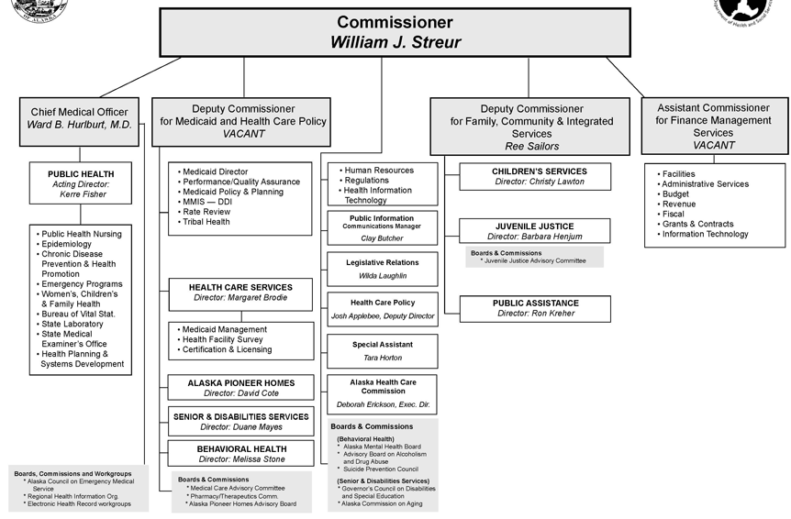

Slide 3
Priorities
Health & Wellness across the Lifespan
Health Care Access, Delivery and Value
Safe and Responsible Individuals, Families & Communities
Notes:
In FY2013, the department implemented a results-based management framework which led to:
a refinement of overarching priorities
the development of core service areas and agency performance measures
the alignment of division-level performance measures
This process set in motion an agency-wide shift in how we measure our impact on the health and well-being of Alaskan individuals, families and communities and how we align our budget.

Slide 4
Priority I: Health & Wellness Across the Lifespan
Core Services
Promote and protect the health of Alaskans
Provide quality of life in a safe living environment for Alaskans
Notes:
Examples:
Improve immunization rates
Decrease number of placements for children requiring our services.
Promote and protect the health of Alaskans
Alaskans are healthy
Alaskans are free from unintentional injury.
Alaskans are free from substance abuse and dependency.
Provide quality of life in a safe living environment for Alaskans.
Alaskan children receiving department services live in a supportive environment.
Older Alaskans live safely in their communities.
Alaskans with disabilities live safely in the least restrictive environment.
Alaskans with behavioral issues report improvement in key life domains.

Slide 5
Priority II: Health Care Access, Delivery and Value
Core Services
Manage health care coverage for Alaskans in need
Facilitate access to affordable health care for Alaskans
Notes:
Increase number of Alaskans with online access to health care records and health care education resources – starting campaign in Fairbanks during first quarter this year for electronic health records and health information exchange.
Manage health care coverage for Alaskans in need
Each Alaskan has a primary care provider.
Alaskans with chronic or complex medical conditions receive integrated care.
Facilitate access to affordable health care for Alaskans
Alaskans have access to health care
Alaskans in rural communities can access care.

Slide 6
Priority III: Safe and Responsible Individuals, Families and Communities
Core Services
Strengthen Alaskan families
Protect vulnerable Alaskans
Promote personal responsibility and accountable decisions by Alaskans
Notes:
Improving rate of recidivism for juveniles on probation supervision.
Improving percent of Medicaid recipients who receive subsidized health insurance.
Strengthen Alaska families - Work skills, affordable child care, warm homes, food security
Alaska families develop work skills.
Alaska families have safe and affordable child care.
Alaska families have warm homes.
Protect vulnerable adults
Alaska children at risk of maltreatment are protected from abuse and neglect.
Alaska adults at risk of maltreatment are protected from abuse, neglect and exploitation.
Health and social services in which Alaskans are served are safe.
Promote personal responsibility and accountable decisions by Alaskans
Alaska communities support tobacco enforcement.
Juveniles develop and demonstrate skills in positive decision making.
Alaskans with health conditions practice self-management.
Alaskans choose respect.
Communities prepare for disaster.

Slide 7
Service Philosophy
We aim to:
Integrate and coordinate services
Strategically leverage technology
Implement sound policy
Practice fiscal responsibility
Measure and improve performance
In order to deliver the right care to the right person at the right time for the right price.

Slide 8
Major Accomplishments
Health & Wellness Across the Lifespan
“Play Every Day” obesity prevention campaign. 7000 students in 110 schools across Alaska.
$1 million Elder Services Case Management award (one of only eight awards in the nation)
Comprehensive Mental Health Integrated Plan
Radiation health support during Fukushima nuclear disaster.

Slide 9
Major Accomplishments
Health Care Access, Delivery and Value
75,000 health care visits provided by public health nurses across Alaska in FY2012.
Aging and Disability Resource Centers expanded to four regions and served 10,367 individuals in FY2012.
30 new community-based mental health programs expanding access for earlier interventions

Slide 10
Major Accomplishments (cont.)
Health Care Access, Delivery and Value
U.S. Dept of Agriculture Performance Award for #1 in Nation – State Nutrition Assistance Program (SNAP) payment accuracy rate.
State maximum allowable cost pricing type for pharmaceuticals yielded nearly $5 million in savings.
New training model for Public Assistance- Equips staff in 12 weeks. Former training program took nearly 2 years.

Slide 11
Major Accomplishments
Safe & Responsible Individuals, Families and Communities
Domestic Violence and Sexual Assault Rural Pilot Project. (Dillingham, Bethel, Kodiak, Sitka)
Suicide prevention training “Kognito At-Risk” 3-Year Pilot. High school teachers, administrators and staff.
Juvenile Justice Quality Assurance Unit allows for continual assessment and timely address of service gaps.

Slide 12
Key Department Challenges
Medicaid
(Chart in millions of dollars)

Slide 13
Key Department Challenges
Health & Wellness Across the Lifespan
Managing quality assisted living services for rapidly aging population.
Chronic disease- three of every five deaths in Alaska are linked to chronic diseases. Primary risk factors are obesity, poor diet, lack of exercise and tobacco use.

Slide 14
Key Department Challenges
Health Care Access, Delivery & Value
Medicaid Management Information System (MMIS) design, development and implementation.
Insufficient provider capacity to meet the needs of a rapidly aging population. Increase in senior population in Alaska from 26,000 in 1993 to over 90,000 by 2015.
Affordable Care Act (ACA) opportunities and challenges to all Medicaid Service programs.

Slide 15
Key Department Challenges
Safe and Responsible Families & Communities
Recruitment and retention of qualified employees in a time of workforce shortages.
Promoting self-sufficiency, assisting families to move off public assistance & leave poverty thru employment. 30% of Temporary Assistance families require intensive services.
Keeping families intact through preventative, in-home services, avoiding entry into child protection system.

Slide 16
Formula Funded Program
A program with specific eligibility standards which guarantees a specific level of benefits for any qualified recipient. The eligibility standards and benefits must be based in statute.

Slide 17
Non-Formula
Grants
Components with major grants to other organizations or major contracts for service delivery, such as Residential Child Care, Energy Assistance Program, Community Health Grants and various treatment programs.
Program Services
Administration and delivery of direct services, such as public health nursing and social services, and the program management of entitlements and grants.

Slide 18
Non-Formula (cont.)
Administration
Departmental administrative oversight and support programs, including the Commissioner’s Office and Administrative Services.
Facilities
The department manages and operates 24-hour facilities and institutions. These include youth correctional facilities, the Alaska Psychiatric Institute and Alaska Pioneer Homes.

Slide 19
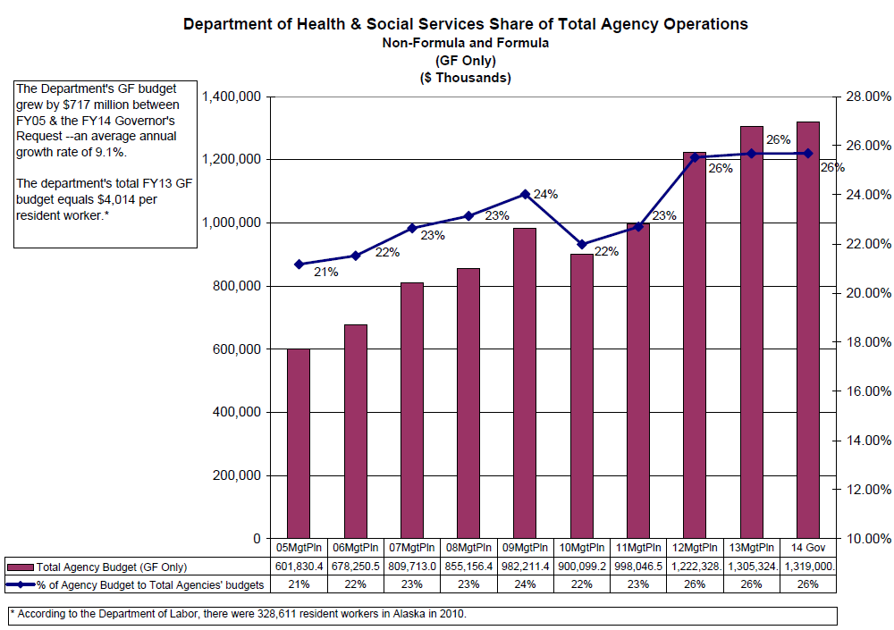
19

Slide 20
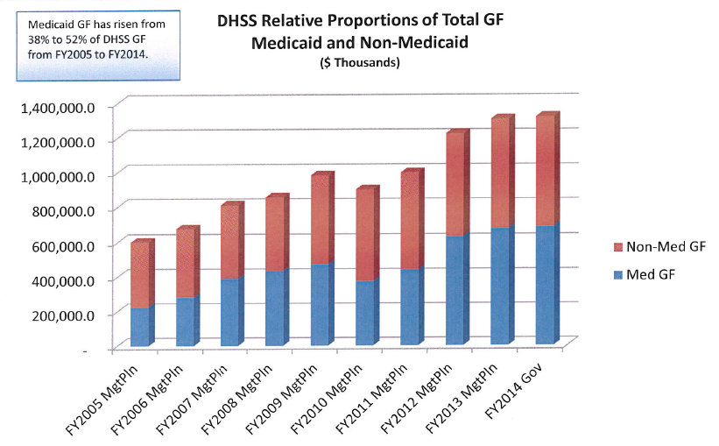
20

Slide 21
21
Formula Programs
Children's Services | 49,430.4
Public Assistance | 208,425.2
Health Care Services | 1,471.0
Medicaid Services | 1,662,639.0

Slide 22
22
FY2004-FY2014 Comparison,
Formula and Non-Formula

Slide 23
23

Slide 24
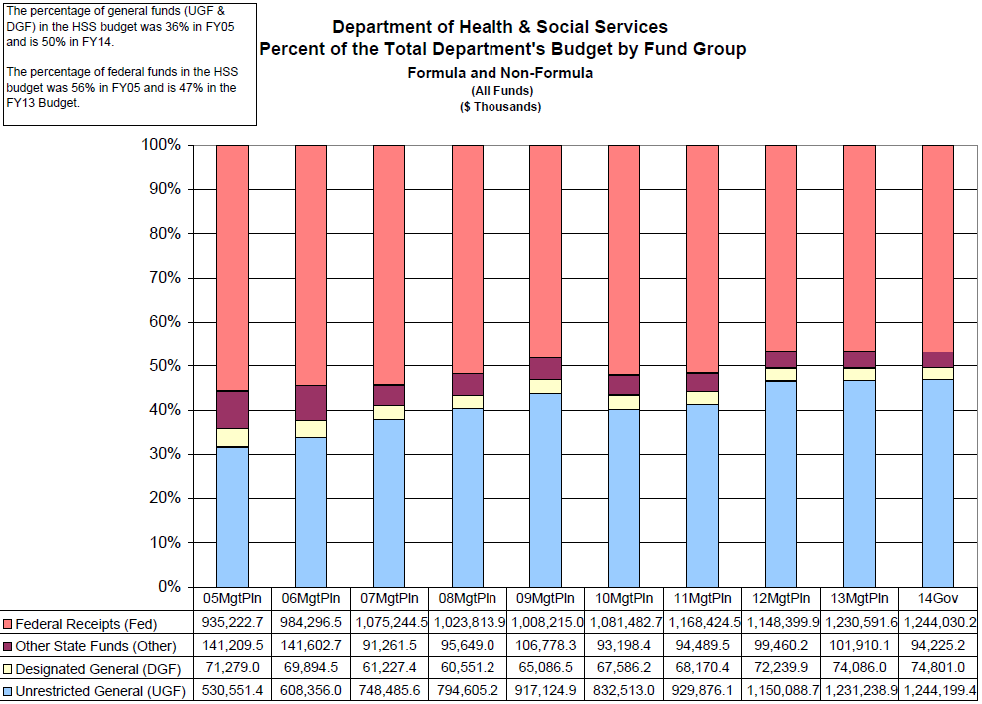
24

Slide 25
Proposed Budget for FY2014 Compared to FY2013
 | FY2013 Management Plan | FY2014 Governor’s Request
Unrestricted General Funds | $1,231.2 million | $1,244.2 million
Designated General Funds | 74.1 million | 74.8 million
Federal Funds | 1,230.6 million | 1,244.0 million
Other Funds | 101.9 million | 94.2 million
Total | $2,637.8 million | $2,657.2 million
Increased Federal Revenue |  | $13.4 million
Increased General Fund |  | $13.0 million

Slide 26
Proposed Budget for FY2014
Compared to FY2014 Adjusted Base
 | FY2014 Adjusted Base | FY2014 Governor’s Request
Unrestricted General Funds | $1,221.7 million | $1,244.2 million
Designated General Funds | 74.1 million | 74.8 million
Federal Funds | 1,228.8 million | 1,244.0 million
Other Funds | 95.5 million | 94.2 million
Total | $2,620.1 million | $2,657.2 million
Increased Federal Revenue |  | $15.2 million
Increased General Fund |  | $23.1 million

Slide 27
DHSS FY2014 Governor’s Operating Request GF
Highlights
Formula Programs ($15,935.4 total):
Medicaid growth - $11,001.4
Public Assistance growth - $4,034.0
Children’s Services - $900.0

Slide 28
DHSS FY2014 Governor’s Operating Request GF
Highlights (cont.)
Governor’s Domestic Violence/Sexual Assault Initiative ($2,250 total):
Telehealth Strategic Capacity Expansion, Phase 2 - $100.0
Child Advocacy Centers - $400.0
Strengthening Families Through Early Care and Education - $250.0
Child Abuse Prevention and Treatment Act Integration (CAPTA) - $1,500.0

Slide 29
DHSS FY2014 Governor’s Operating Request GF
Highlights (cont.)
Other:
Social Worker Class Study Implementation - $1,185.0
Health Services for Youth in Juvenile Justice Facilities - $400.0
Energy Assistance Program (language section to numbers conversion) - $8,629.0
Health Information Security/Privacy Compliance and Remediation - $595.0

Slide 30
DHSS FY2014 Governor’s Capital Request
Highlights
Deferred Maintenance:
Pioneer Home DM - $3,871.2 ($3,871.2 GF)
Non-Pioneer Home DM - $2,902.8 ($2,902.8 GF)
MH Deferred Maintenance and Accessibility Improvements - $1,000.0 ($1,000.0 GF)

Slide 31
DHSS FY2014 Governor’s Capital Request
Highlights (cont.)
Other:
Master Client Index, State Interface Improvements to the Health Information and Direct Secure Messaging Gateway - $5,749.7 ($2,411.0 GF)
Electronic Vital Record Registration System Phase 2 of 2 - $1,785.0 ($1,785.0 GF)
Bethel Youth Facility Renovation Phase 2 of 2 - $10,000.0 ($10,000.0 GF)

Slide 32
Thank you …
Questions?

