Slide 1
Alaska Department of Transportation & Public Facilities
Senate and House Transportation Committees
Captain Michael Neussl, DOT&PF Deputy Commissioner for Marine Operations
February 7, 2012

Slide 2
Agenda
Alaska Class Ferry Procurement Status
Website Vessel Tracking
511 Traveler Information and GovDelivery
Requests for New Service
Ouzinkie
Old Harbor
Dock Issues
Questions (Please ask at any time)

Slide 3
Alaska Class Ferry (ACF) Procurement

Slide 4
Alaska Class Ferry (ACF) Procurement
Two $60,000.0 GF additions to the Vessel Replacement Fund
Legislative Intent
DOT&PF Commissioner Best Interest Finding
Construction Manager/General Contractor Overview
Phase 1 Professional Services Agreement Contract
Partnership between DOT&PF, EBDG, ASD
Guaranteed Maximum Price Proposal
Phase 2 Construction Contract
Timeline

Slide 5
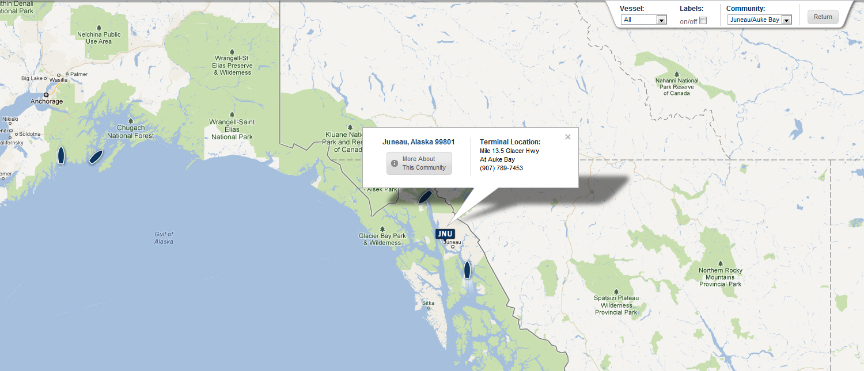
Website Vessel Tracking
24x7 Public Access to AMHS Information

Slide 6
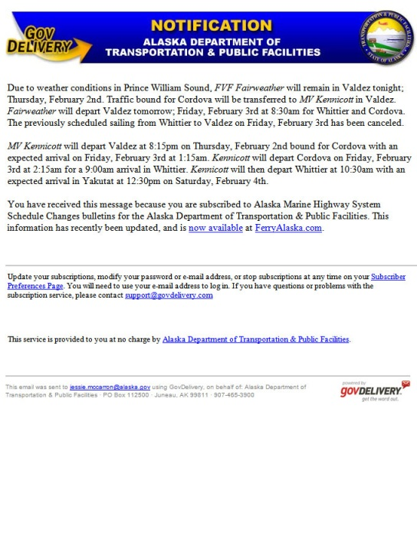
511 Traveler Information and GovDelivery
511 Now Includes AMHS Information
Additional 24x7 Public Access to Information
GovDelivery “Pushes” Selected Information to Subscribers

Slide 7
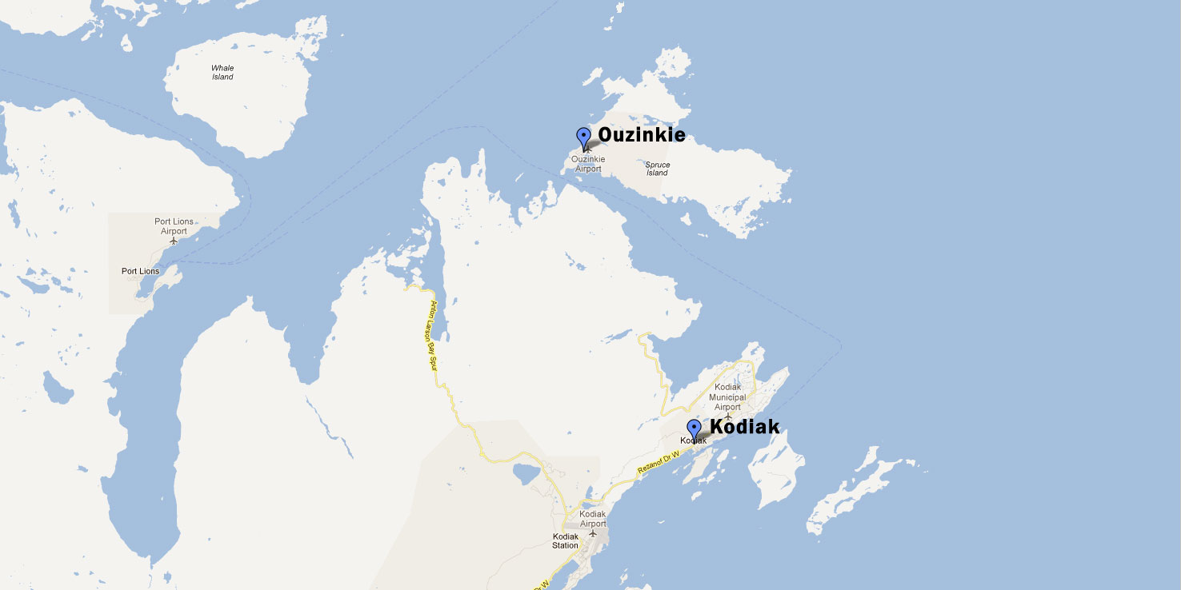
Request for New Service

Slide 8
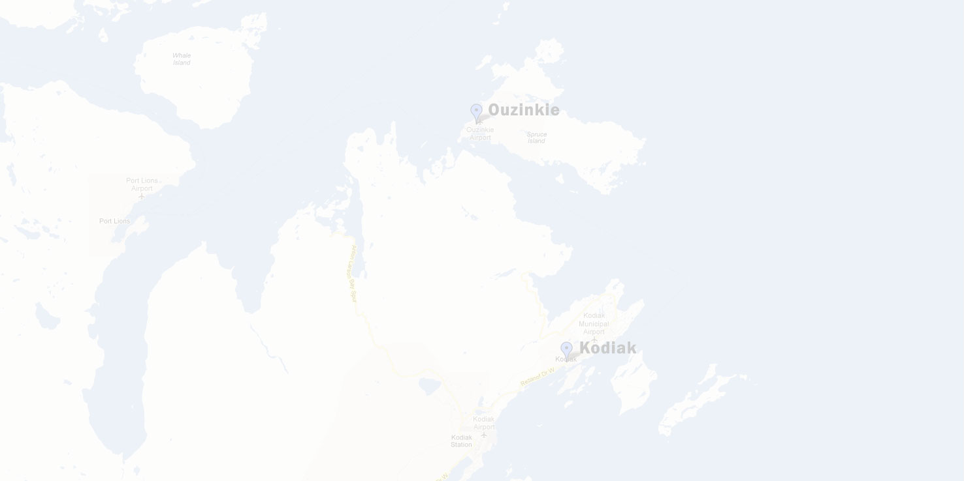
Request for New Service
Ouzinkie
New Municipal Dock Tustumena Compatible
Planned to Start in Spring 2012
Relatively Easy, Inexpensive, Highly Desired

Slide 9
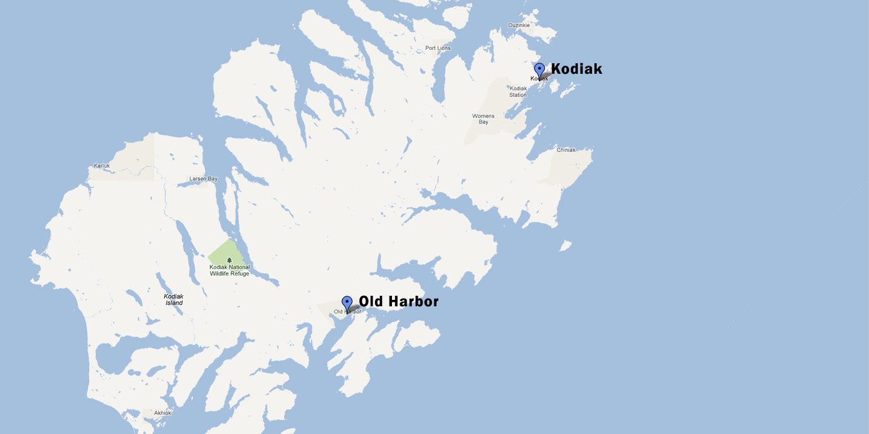
Request for New Service

Slide 10
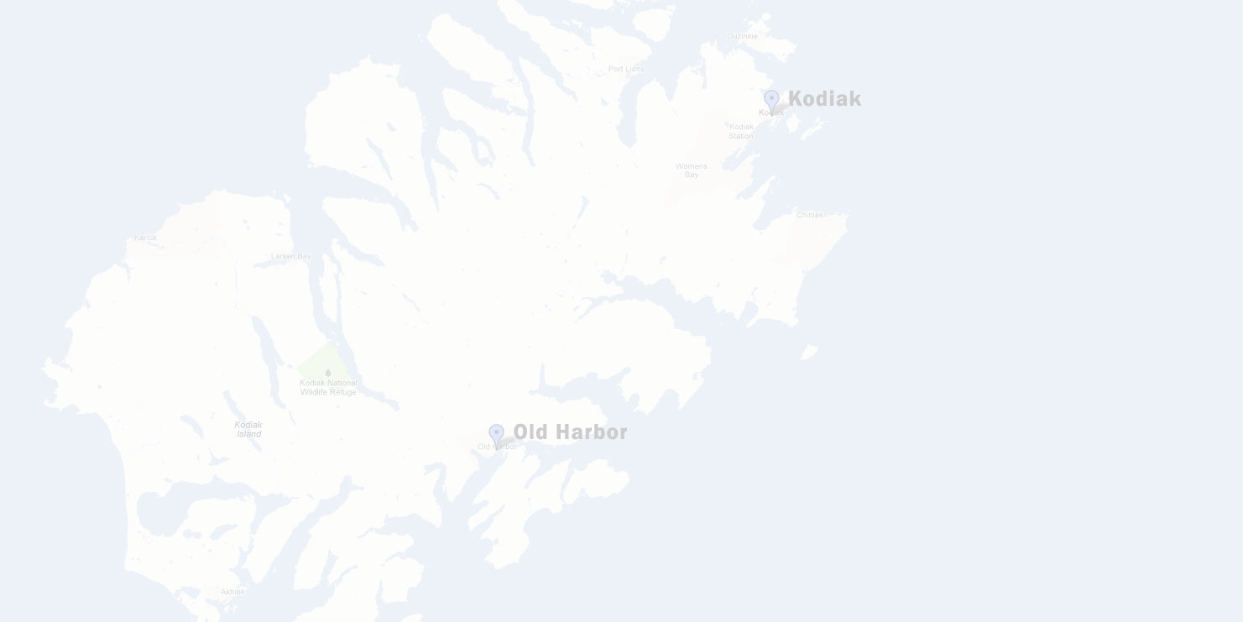
Request for New Service
Old Harbor
New Municipal Dock Tustumena and Kennicott Compatible
Still Exploring Possible Service Options
More Difficult Due to Location
Cost Implications

Slide 11
Dock Issues
“Ships Alone Does Not a Ferry System Make”
Successes:
Angoon
Hoonah
Challenges:
Chignik
Cordova
Gustavus
Pelican
Tenakee

Slide 12
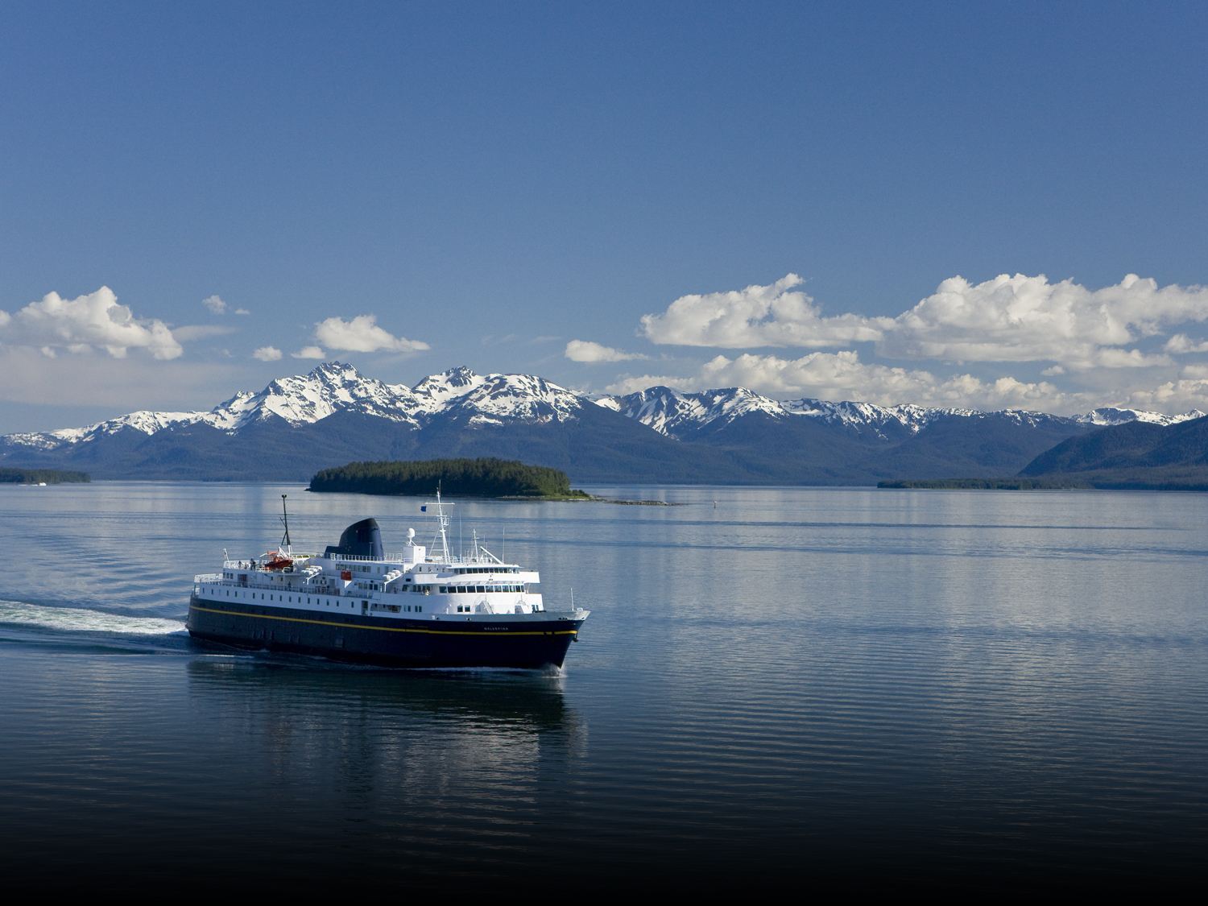
Thank You For Your Attention and for Allowing Me to Speak About AMHS Questions?
Captain Michael A. Neussl
Deputy Commissioner for Marine Operations
Alaska DOT&PF, AMHS
(907) 465-6977
michael.neussl@alaska.gov

Slide 14
Successes: Angoon

Slide 15
Successes: Hoonah

Slide 16
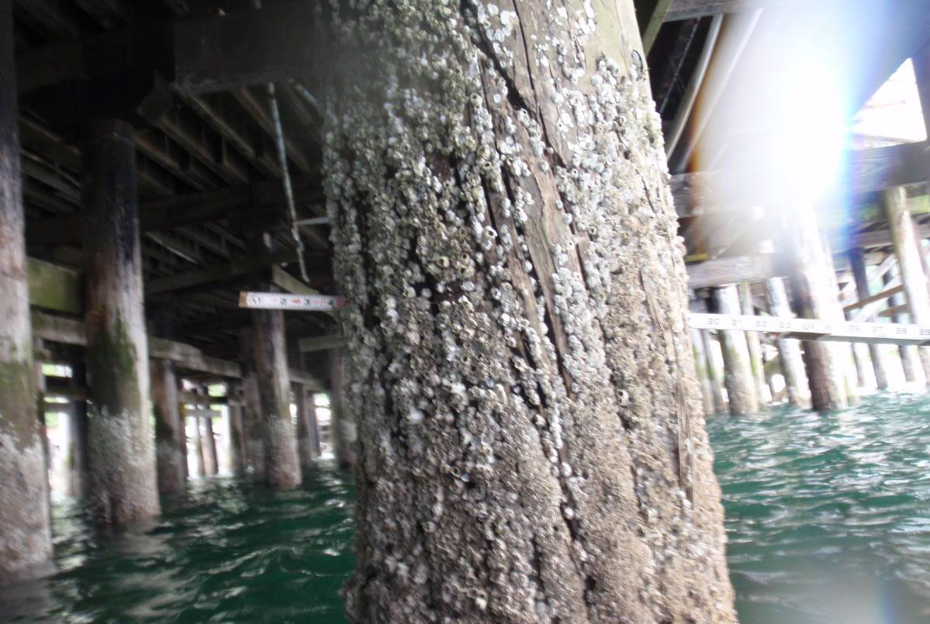
Challenges: Chignik

Slide 17
Challenges: Chignik

Slide 18
Challenges: Cordova

Slide 19
Challenges: Cordova

Slide 20
Challenges: Cordova

Slide 21
Challenges: Cordova

Slide 22
Challenges: Gustavus

Slide 23
Challenges: Gustavus

Slide 24
Challenges: Pelican

Slide 25
Challenges: Tenakee

