Slide 1
Margaret Brodie, Director

Slide 2
Roadmap for Today’s Discussion
Medicaid 101
Medicaid Task Force Initiatives
Affordable Care Act Implications - potential

Slide 3
Medicaid has an Integral Health Care Component
Services
Economy
Jobs

Slide 4
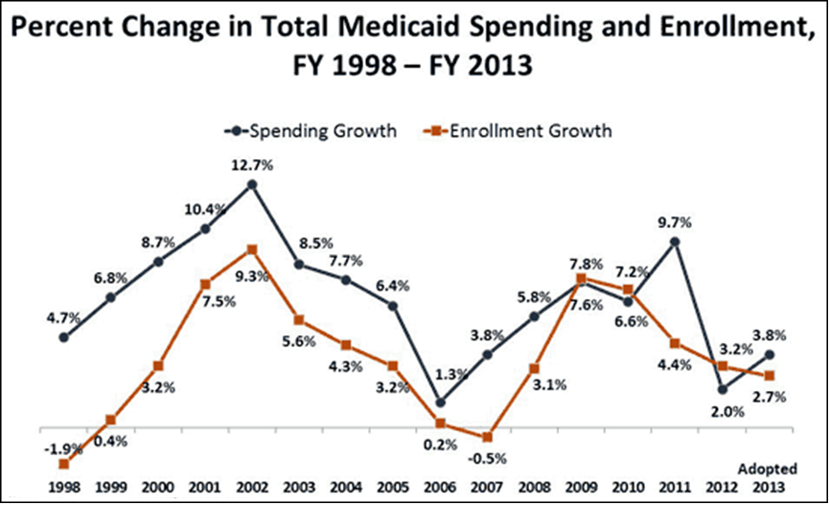
Percent Change in Total Medicaid Spending and Enrollment, FY 1998 – FY 2013
NOTE: Enrollment percentage changes from June to June of each year. Spending growth percentages in state fiscal year.
SOURCE: Enrollment Data for 1998-2009: Medicaid Enrollment in 50 States, KCMU. Spending Data from KCMU Analysis of CMS Form 64 Data for Historic Medicaid Growth Rates. FY 2010 and FY 2011 data based on KCMU survey of Medicaid officials in 50 states and DC conducted by Health Management Associates, September 2010.

Slide 5
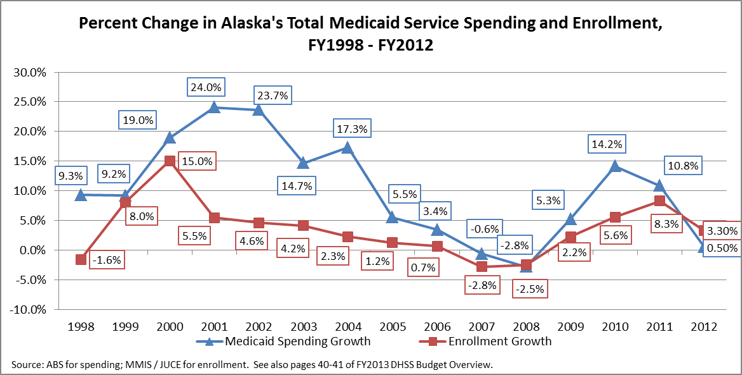
Percent Change in Alaska’s Total Medicaid Spending and Enrollment, FY 1998 – FY 2012

Slide 6
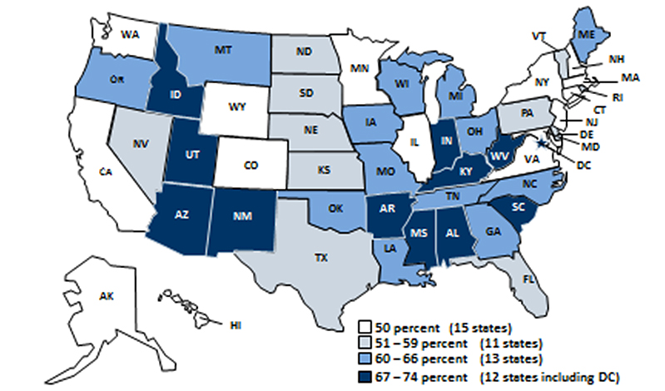
Statutory Federal Medical Assistance Percentages (FMAP). FY 2012
NOTE: Rates are rounded to nearest percent. These rates will be in effect Oct. 1, 2011. SOURCE: Federal Register,, Nov., 10 2010 (Vol. 75, No. 217), pp. 69082-69083
http://edocket.access.goo.gov/2010/pdf/2010-28319.pdf

Slide 7
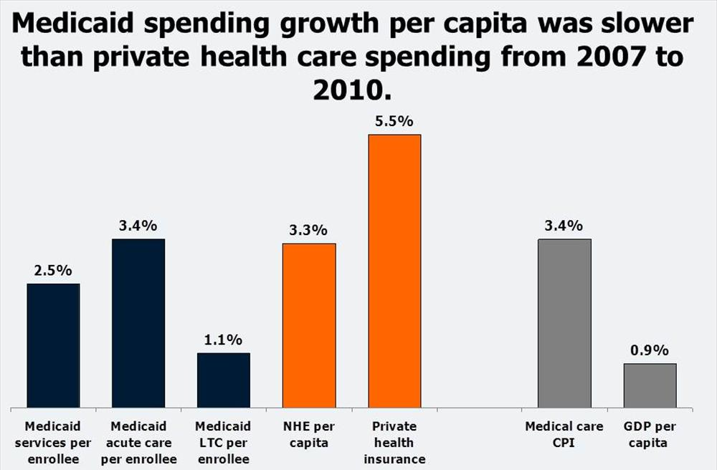
Medicaid spending growth per employee was slower than growth in private health spending from 2007 to 2010
SOURCE: Urban Institute, 2010. Estimates based on data from Medicaid Financial Management Reports (HCFA/CMS Form 64), Medicaid Statistical Information System (MSIS), and KCMU/HMA enrollment data. Expenditures exclude prescription drug spending for dual eligibles to remove the effect of their transition to Medicare Part D in 2006.

Slide 8
Controlling Growth In Medicaid
The Options are Limited
Eligibility | Compliance/Anti-Fraud
Covered Services | Innovations in Service Delivery
Rates | Technology
Utilization Controls | Maximize Revenue

Slide 9
State Policy Actions Implemented in FY 2011 and Adopted for FY 2012
FY 2012
Adopted FY 2013
States with Expansions/Enhancements
33
37
32
34
29
21
19
15
Provider Payments
Eligibility
Benefits
Long Term Care
2
6
8
7
10
18
45
42
States with Program Restrictions
NOTE: Past survey results indicate not all adopted actions are implemented. Provider payment restrictions include rate cuts for any provider or freezes for nursing facilities or hospitals. SOURCE: KCMU survey of Medicaid officials in 50 states and DC conducted by Health Management Associates, September 2011.

Slide 10
Eligibility
Limited opportunity
Maintenance of Effort implications

Slide 11
Covered Services
Optional Benefits, but not really
Limits on benefits?
Considerations
Shifting bulge
Medicaid rules, Olmstead and other implications
CMS approval process
Access and quality impacts

Slide 12
Mandatory Optional
Inpatient hospital
Outpatient hospital
Physicians
Nurse midwives
Lab and X-ray
Advanced Nurse Practitioners
Early Periodic Screening, Diagnosis, and Treatment
Family planning services
Pregnancy-related services
Nursing facility (NF) services
Home Health (NF qualified)
Medical/surgical dental services
MH Rehab/Stabilization
Diagnostic/Screening/Preventive
Therapies (OP, PT, SLP)
Inpatient psychiatry <21 years
Drugs
Intermediate Care Facility/ Intellectual Disability
Personal care
Dental
Other home health
Other licensed practitioners
Transportation
Targeted Case Management

Slide 13
Rates
Most common reduction by states
Considerations
Reducing rates in one area may cause cost increases in another
Potential litigation
CMS approval of State Plan Amendment (SPA)
Impact on access and quality of care

Slide 14
Payment Comparisons
Payment Levels Office Visit (99215) Obstetrical Care (59400)
Alaska Medicaid | $221.58 | $2821.81
Alaska Medicare | $177.40 | $2354.90
Alaska Commercial Mean | $290.64 | $4704.80
Washington Medicaid | $76.86 | $2034.50
Washington Commercial Mean | $183.24 | $2601.20
North Dakota Medicaid | $186.19 | $2339.40
Idaho Medicaid | $117.01 | $1539.21
Milliman Client Report: Physician Payment Rates in Alaska and Comparison States prepared for Alaska Health Care Commission 2011

Slide 15
Utilization Controls
States may impose utilization controls to ensure appropriateness of treatment being funded
Wide range of controls and screens
Prior Authorization
Post payment reviews
Hard or soft edits
Bundling, unbundling, and order of billing
New edits and audits for FFS (fee-for-service)

Slide 16
Compliance / Anti-Fraud
In some states may be an untapped area for savings
Fraud in Medicaid is a reality
Numerous methods and vendors
Fraud undermines the entire program
Politically popular reduction

Slide 17
Program Integrity Collections

Slide 18
Existing Compliance Efforts in Alaska
Surveillance Utilization Review (SUR)
Audits required by AS 47.05.200
Credit Balance Audits
Focused reviews
CMS Medicaid Integrity Program
Payment Error Rate Measurement
“Cluster Audits”
Medicaid Recovery Audit Contractors
Medicaid Fraud Control Unit (MFCU)
Provider, referrer, prescriber, renderer enrollment
Medicaid Recovery Audit Contractor

Slide 19
Innovations in Service Delivery/Payment
Medical Home
Tribal Health – exemplar of alternative provider types
Bundled services
Integrated BH/Primary care services
more

Slide 20
Technology
Operational efficiencies
Care delivery implications

Slide 21
Maximize Match/Collections/Refinancing Opportunities
Replace state funding with federal funding where allowable
Tribal Partner opportunities

Slide 22
Accounting & Recovery Collections

Slide 23
Medicaid Task Force
Medical Home – primary, integrated care
Consultant
Pilots
Technical assistance
Data
Estimate of cost avoidance: $78,000 - $165,000/1,000 participants. Mature programs are showing 10% savings.

Slide 24
Care Management Program – expanded element of medical home with focus on recipients at highest risk who offer the greatest potential for improvements in both health outcomes and enhanced funding/cost avoidance.
Estimate of cost avoidance: Enhanced FMAP for 8 quarters for each participant. Conservative savings estimate of $1,040,000 for 7,500 participants.

Slide 25
Pharmacy Initiatives
Increased substitution to generic medications
Fully implemented in May 2012. Annual cost avoidance $5-$6 million.
Increased Generic Medication through edits/PA
Phase 1: 6 months $1,405,938 cost avoidance annualized at $2,810,000. The annual cost avoidance will decrease over time as brand named medication patents expire
State Maximum Allowable Cost
Fully implemented: $500,000 cost avoidance annualized at $5.5-$6 million annually

Slide 26
Pharmacy continued
Psychiatric Medication Policy – implemented in June 2012
Estimate of cost avoidance $182,000 – right care.
Opioid Second Opinion contract implemented September 2012
Cost avoidance is difficult to quantify
Pharmacy initiative cost avoidance through Q2: $4,655,938 annualized to $13,310,000 - $13,810,000

Slide 27
New State and Federal Medicaid Expenditures under ACA, with All and No States Expanding Medicaid, 2013-2022
$952
$in billions
State
Federal
$152
$76
$68
$8
ACA with All States Expanding Medicaid
ACA with No States Expanding Medicaid
Incremental Impact Medicaid Expansion
SOURCE: Urban Institute estimates prepared for the Kaiser Commission on Medicaid and Uninsured, October 2012.

Slide 28
Questions?

