Slide 1
Department of Military and Veterans Affairs
Joint Armed Services Committee
9 February 2016

Slide 2
DMVA Mission
To provide military forces to accomplish military missions in the state or around the world; provide homeland security and defense; emergency preparedness, response, and recovery; veterans services; and youth military style training and education.

Slide 3
Core Services
Defend and Protect Alaska and the United States
Disaster Preparedness/Response and Recovery
Outreach to Veterans and Military Families
Youth Intervention

Slide 4
DMVA Vision and Core Values
Vision: Through constant collaboration internally and with external partners, DMVA implements a viable Arctic strategy, increases emergency management capacity, and expands engagement with Alaskan communities, all while achieving federal mission assurance.
Core Values
Professionalism “Be the real deal”
Commitment “All oars in the water…”
Teamwork “…rowing the same direction”
We will rely on:
Adherence to Doctrine
Sound Processes
Customer Focus
Moral, Legal, Ethical Actions
Transparency
Viable Arctic Strategy
Rural Engagement
Initiative
Engagement with
Alaskan Communities
Emergency Management Capacity

Slide 5
DMVA Commissioner’s Goals
Establish a culture or moral, ethical, positive and productive leadership and followership
Motivate the force to pursue actions, focus thinking, and shape decisions for the greater good of the organization
Restore the confidence of Alaskans in the Alaska National Guard
Trust is gained through actions over time
Establish and implement sound processes: doctrinally based, legal and ethical, replicable, predictable, and transparent
Establish conditions to increase the footprint of DMVA in rural Alaska
Plan for and negotiate declining budgets

Slide 6
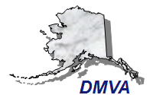
DMVA Strategy
Rural
Engagement
Objectives
Implement an integrated Arctic strategy supporting the State’s policy
Partnering
Objectives
Shaping
Objectives
Posturing
Objectives
Readiness
Objectives
Communication
Objectives
Goal:
Integrated DMVA activities to improve security and resilience of all Alaskan communities
Expand Emergency Management Capacity
Engage Alaska Communities
Federal Mission Assurance

Slide 7
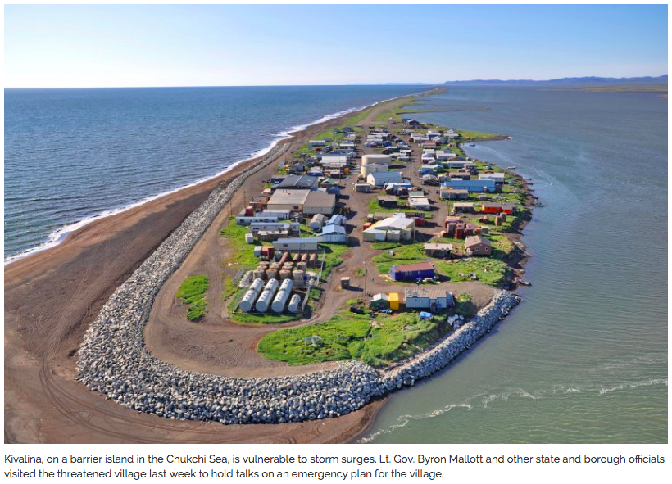
Kivalina

Slide 9
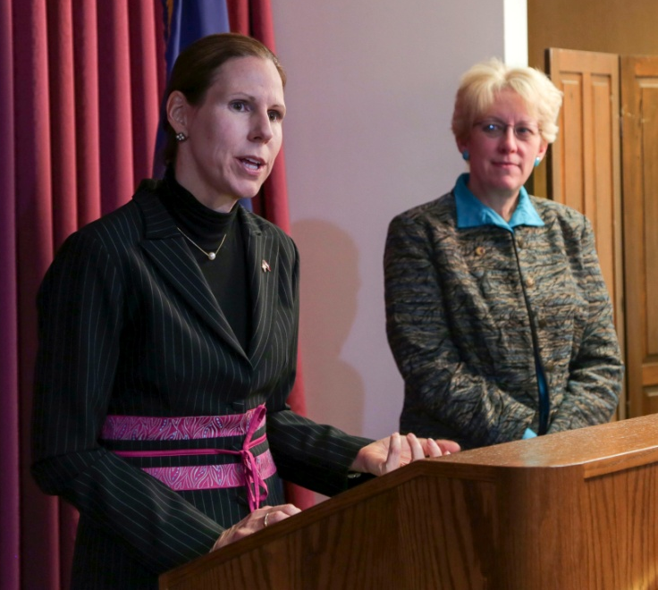
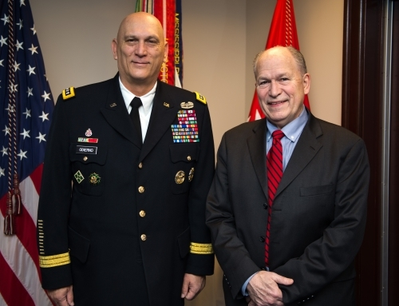
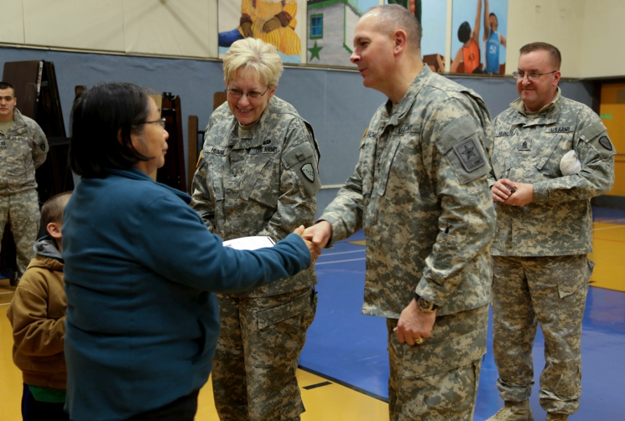
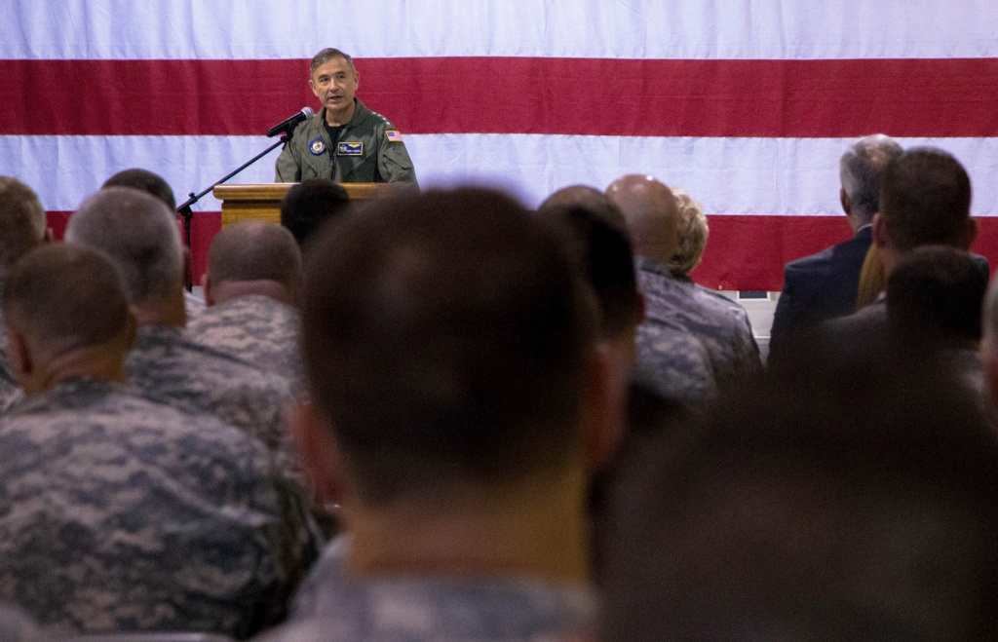
Relevance
Former US Ambassador to Mongolia
Piper Campbell
Secretary of Defense
Ash Carter
38th Chief of Staff of the U.S. Army
GEN Ray Odierno
Director, Army National Guard
LTG Timothy Kadavy
Commander, US Pacific Command
ADM Harry Harris

Slide 10
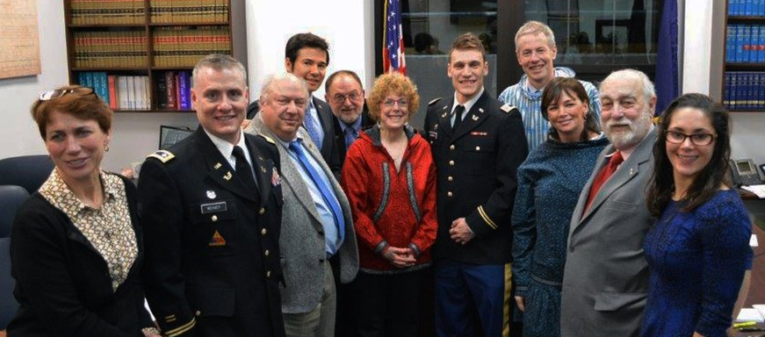
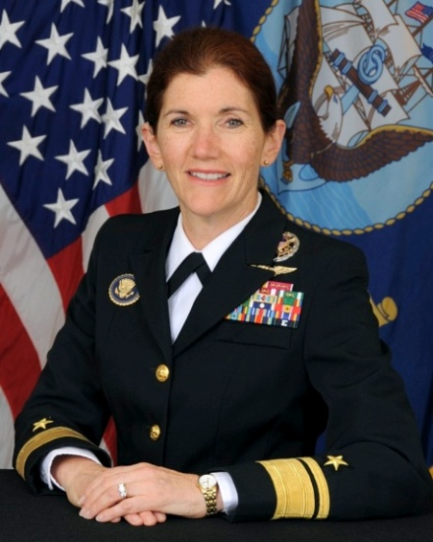
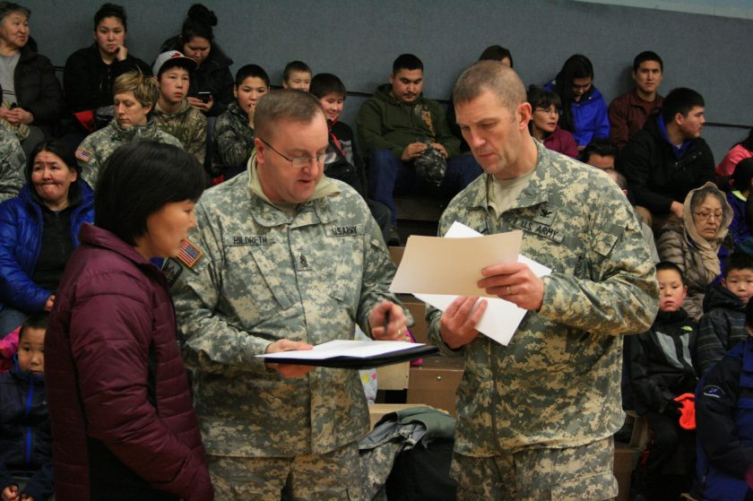
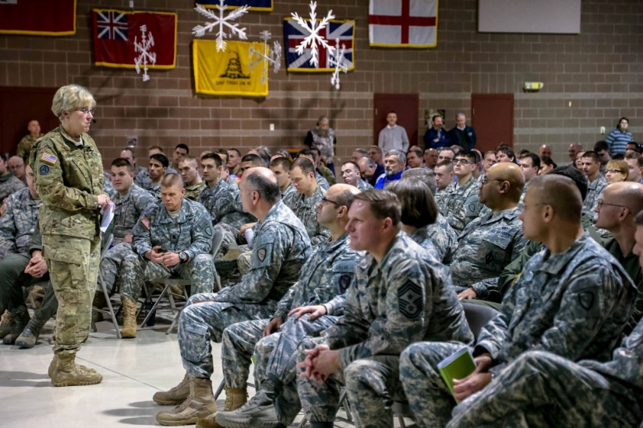
Initiatives
LTC Weaver and CPT Dunbar with
House Judiciary Members
RADM Margaret Klein
DOD Senior Advisor for Military Professionalism
CSM Richard Hildreth
AKNG Liaison to Rural and Tribal Communities
DMVA Town Hall

Slide 11
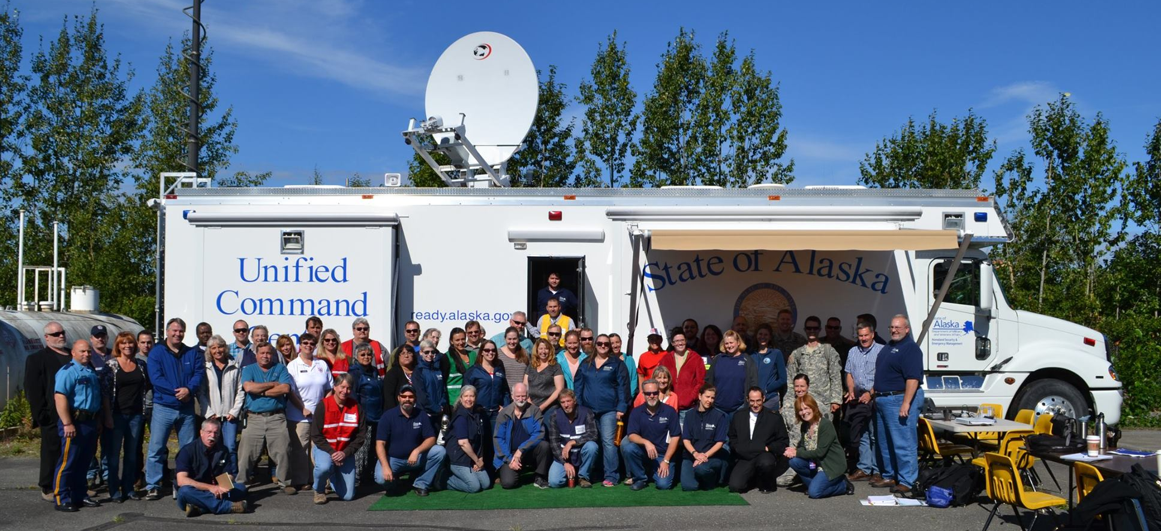
Division of Homeland Security and
Emergency Management
Notes:
Currently Managing 12 Federal Disasters and 10 State Disasters
Public Assistance is managing over 700 projects worth over $250M in communities around the State
Provided Emergency Management training to over 700 people in over 40 training events statewide
Preparing for a Statewide Homeland Security Exercise emphasizing cyber security and local response to terrorist active shooter scenarios
Working with over 30 communities on their Small Community Emergency Response Plans

Slide 12
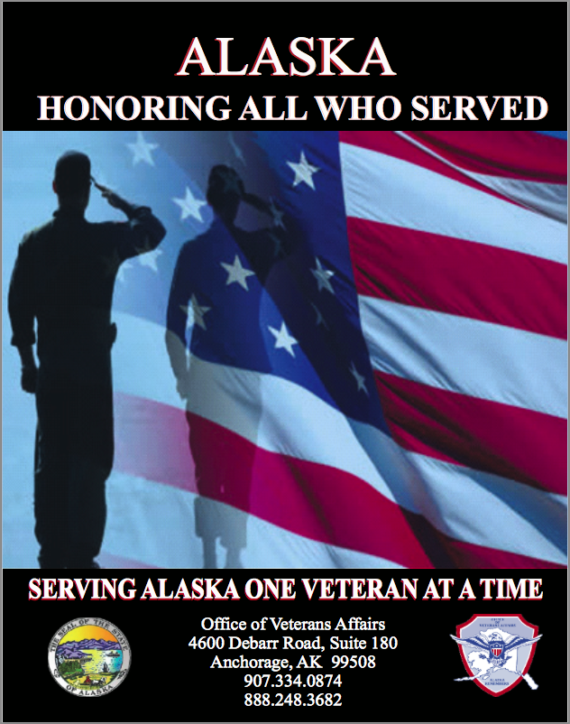
Office of Veterans Affairs
Assisted 57,989 Alaskans with state and federal VA benefits requests. This is an increase of over 10,000 from SFY 2014 and reflects a workload of 7.5 clients per day for each member of Veterans Affairs
Assisted Alaska veterans in receiving over $222 million in federally funded medical care
Assisted Alaska’s veterans to receive disability compensation payments totaling $244 million in direct federal funds
Assisted 4,605 students (veterans and eligible family members)to receive $74 million in federally funded Education/vocational rehabilitation benefits
Assisted 5,208 veterans in obtaining home loan certificates resulting in over $1.4 billion in guaranteed loans. This is the first time the VA Home Loan program passed $1 billion in Alaska

Slide 13
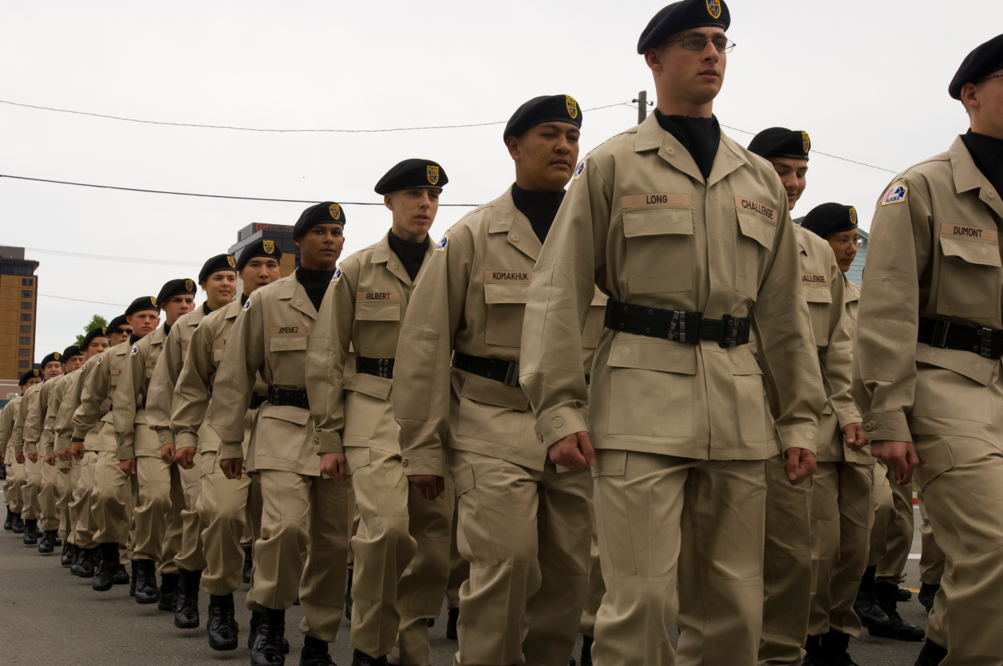
Alaska Military Youth Academy
First Class: January 30, 1994
Total Graduates: 4,665
Next Graduation: February 26, 2016 (118 Cadets)
Cadet to Work Program

Slide 14
Alaska National Guard Overview
Joint Armed Services Committee
Air National Guard
Col Karen Mansfield, Commander, Alaska Air National Guard
CMSgt Steve Calvin, Command Chief, Alaska Air National Guard
Notes:
Mr. Chairman, representatives of the Joint Armed Service Committee -- Good Afternoon,
I am Col Karen Mansfield, the Commander of the Alaska Air National Guard. My assumption of command was April of last year. I served as an Alaska Air Guardsman for 10 years, from 2000-2010, then served four 4 years as a Washington Guardsman, before returning to the state of Alaska.
Next to me CMSgt Steve Calvin, the command chief for the Alaska Air Guard. He has been with the Air Guard for almost 13 years, joining directly from active duty when stationed at the Air Defense Squadron on EAFB. He represents the foundational capability of your Air National Guard, our Airman – and I am honored to sit with him today and to tell you about your Alaska Air Guard.

Slide 15
Air National Guard (ANG)
Air National Guard units located in 54 States & Territories
89 Wings total (Flight/Squadron/Group/Wing)
105, 700 Personnel (approximately 30% of Total Air Force)
Two Wings in Alaska (176th Wing & 168th Wing)
ANG accomplishes ~33% of mission for ~7% of budget
Last two decades ANG posture transitioned from Strategic to Operational reserve
ANG filled 19% of FY15 Air Force deployment taskings
ANG will fill 30% of FY16 Air Force deployment taskings
I n t e g r i t y - S e r v i c e - E x c e l l e n c e
Notes:
My first handout slide represents the ANG as a whole, but your Alaskan Air Guard has evolved, as all have nationwide, over the last decade – guardsmen represent approximately 30% of the Total Air Force and our use as an operational reserve, vice a strategic reserve, is now well established. The ANG is projected to fill approximately 30% of the Air Force deployment taskings for FY16. I’ll review in a moment the missions/areas of involvement for the Alaska Air Guard for 2015.
But first,

Slide 16
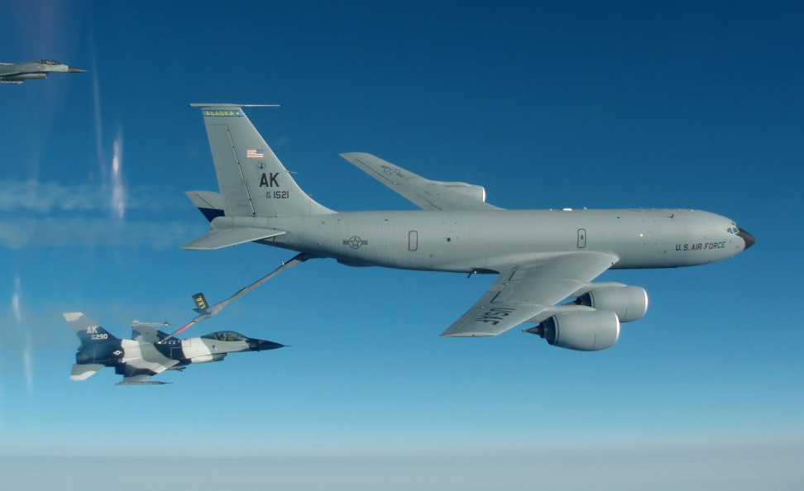
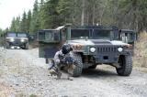
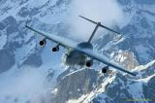
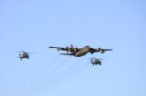
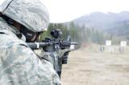
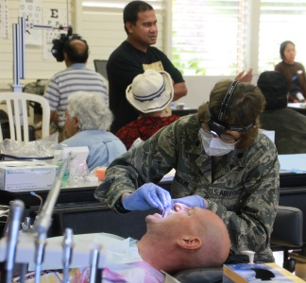
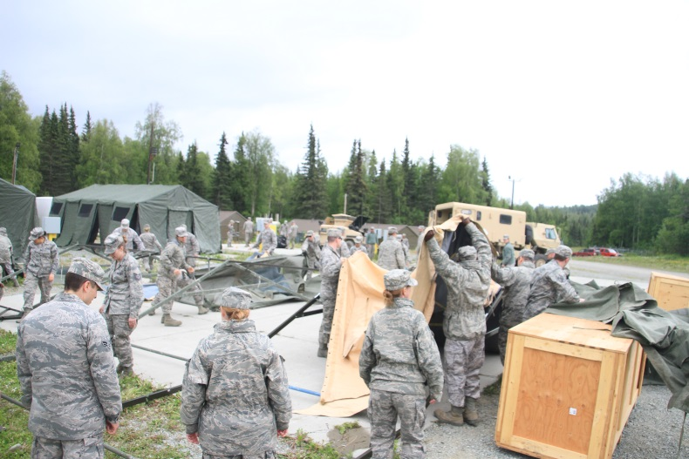
Dual Roles of the Alaska Air National Guard
Federal Role (Title 10 Status)
Responsible to Pacific Air Forces, Air Combat Command, Air Mobility Command, Northern Command & Space Command for Contingencies
Involuntary Mobilization/Presidential Call-up
Voluntary activation for Federal missions
State Role (Title 32/Federal Training Status)
Federally Funded to Organize, Train and Equip for Federal (Title 10) Mission
Governor can call up Guard to:
Protect life, property, peace and order
Provide military support to civil authorities
State of Alaska can utilize AKANG via State Active Duty (must reimburse federal gov’t)
Natural Disasters & Homeland Security
Notes:
As you know, the guard supports both the Federal missions and State missions. The AK ANG has forces continually training, exercising and deploying for the commander of Pacific Air Forces, our major command, as well as Air Combat Command, Air Mobility Command and Norad/Northcom. Concurrently we perform the state missions on an as needed, or as requested basis, most notably and frequently in the form of search and rescue. I know DMVA provided the “iceberg” slide which reflects State General Funds spent and Federal Dollars received --- the Air Guard executes approximately 2.9 mil in state general funds, while executing over 166.6 mil in federal dollars for the federal missions supported.

Slide 17
Locations & Primary Missions
+2100 Personnel in
3 Locations
168th Wing
Air Refueling
and
176th Wing
Tactical Airlift
Strategic Airlift
Rescue Triad
Air Defense
Clear Air Force Station
Space Warning
Civil Engineering
Security Forces
Logistics (Supply, Trans, Fuel)
Medical Support
Communications
Notes:
We do this with over 2100 air guard members in 3 locations. At Eielson AFB in Fairbanks is the 168th Wing, which previous to 3 Feb of this year was the 168th Air Refueling Wing. It was officially re-designated to reflect the inclusion of the 213th Space Warning Squadron at Clear Air Station. South at JBER, is the 176th Wing, one of the most complex organizations in the Air Guard, with 4 primary mission sets, to include strategic and tactical airlift, the Air Defense Squadron, and our Rescue triad which includes the Guardian Angels, the rescue helicopters and the HC130s that provide refueling capability to the rescue helos. Both wings also have the “standard” supporting units typical to the Air Force Wing construct; to include civil engineering, security forces, logistics, medical support and communications squadrons. The diverse primary mission sets as well as the supporting organizations can be leveraged for state domestic operational needs.

Slide 18
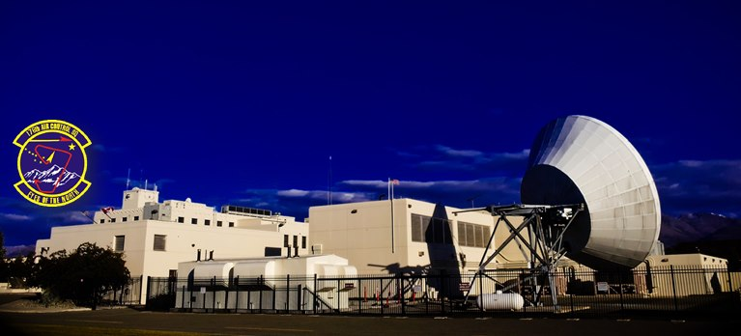
Total Force
249th AS;
Classic Association
213th SWS; Operations Crew - 24/7
176th ADS; Operations Squadron - 24/7
Rescue Triad and Tanker Alert; in support of Active Duty forces - 24/7
Notes:
In keeping with the DoD’s focus and prioritization on total force integration, your Alaska Air Guard is a committed total force participant, seamlessly deploying with active duty to overseas missions, and just as notably, integrating to a high level here at home. We provide a classic guard association of operators and maintainers to the active duty C-17 strategic airlift mission on JBER through the 249th Airlift Squadron. Your Alaska Air Guard is also unique in the number of on-going federal missions being funded/executed, essentially deployed in-place, 24/7, 365 days a year. Our tankers sit alert at Eielson in support of the Alaska NORAD Region, while the Rescue forces provide alert capability to the 11th Air Force active duty fighters, enabling their NORAD response and expanded training capacity. The Air Defense squadron on JBER is on duty 24/7, 365, maintaining continuous air defense threat watch over the Alaskan area of responsibility. The 213th Space Warning Squadron also executes a 24/7, 365 mission – with the Air Guard providing 90% of the space operators and 100% of the Clear AFS defense forces for the Air Force Space mission.

Slide 19
At Home
Arctic Care
Veterans’ Stand Down
Galena Flood
Mission of Mercy
Operation Santa Claus
Non-Deployment Rescues since 1 July 1994
- 5, 334 missions/2229 saves
- 2015: 101 missions/71 saves
Notes:
The AK ANG is manned with a higher percentage of fulltime guardsmen due to our expanded federal mission set, which gives us capacity to leverage skill sets and capability in support of state needs. For example, in 2015, the 168th Medical Group participated in Mission of Mercy for the Fairbanks region, treating over 886 patients and providing approximately $850K in medical care. Veteran’s stand-down assisted 570 Fairbanks region veterans with medical services, hygiene supplies, food donations and clothing. The 176th Wing supported the largest reoccurring Incident Response Team in the nation; Operation Arctic Care; visiting 16 villages, delivering medical and dental care to over 3000 Alaskans, and transporting personnel and over 67 tons of cargo. The 176th Wing also provided airlift for the multiple village visits for Operation Santa Claus, bringing goods/supplies and holiday cheer to rural regions of the state. I mentioned rescue earlier, as it is the most visible, immediate and frequently requested capability --- the ANG supported 101 missions in 2015, with 71 saves reported.

Slide 20
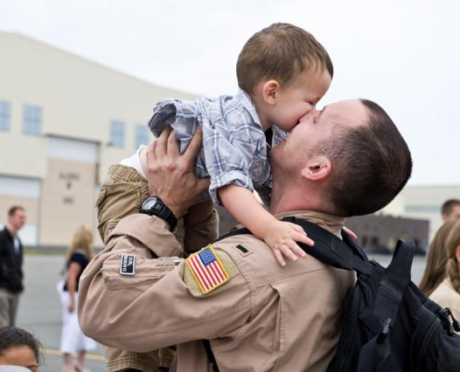
Deployed
Overwhelming majority of AKANG have deployed (65% of 176th, 80% of 168th)
Constant tempo for over a decade
DSG Airmen average 120 duty days/year
300+ deployed in 2015
Operation IRAQI FREEDOM
Operation ENDURING FREEDOM -Afghanistan
Operation INHERENT RESOLVE – ISIS/ISIL
Operation REGENT SENTINEL
Operation NOBLE EAGLE – Homeland Defense
Operation TOMODACHI – Japan Earthquake/Tsunami
KHAAN QUEST – Mongolia (State Partnership)
Hurricane’s KATRINA, Gustave, ike, Hannah, Irene
Operation NOBLE EAGLE
PACOM Tanker TSP at Guam
Notes:
And the deployments keep coming -- our tankers have one of the highest ops tempos in the guard, with 67% of their missions being operational, not training – in 2015 they deployed over 150 members to Central Command, flew 686 combat hours and offloaded 2.6 mil pdns of fuel during 328 combat missions. For the 176th Wing, our Guardian Angel teams were deployed over 13 months of the last 24, and the 144th Airlift Squadron deployed C-130s aircraft, flying over 800 missions and carrying over 20 mil pdns of cargo. Our C-17 expeditionary crews supported multiple rotations, logging almost 4000 hrs while delivering over 29 mil pnds of cargo and moving over 7000 passengers. Our civil engineering and security forces warriors only recently returned from their Operation Enduring Freedom commitments. Your Alaska Air Guardsmen were busy, and they will be just as busy in 2016.

Slide 21
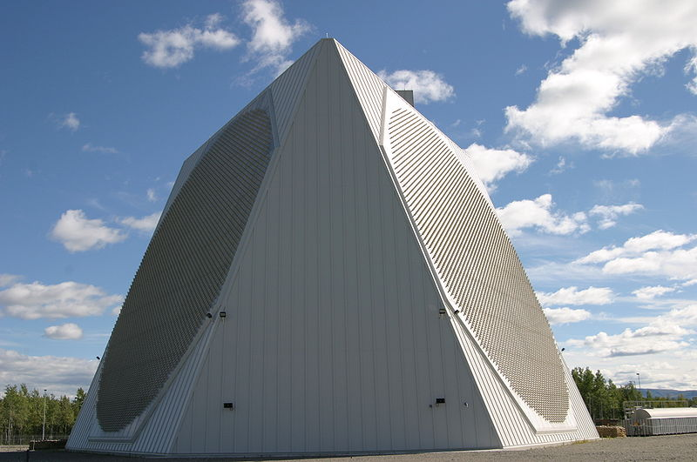
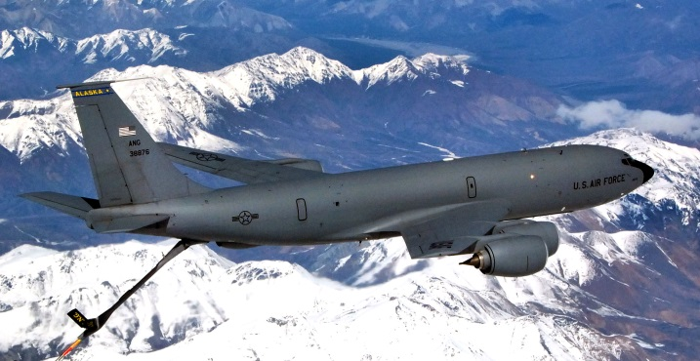
Current and Future
168th Redesignation; 3 Feb 2016
KC-135 Active Association
Notes:
But that doesn’t mean we don’t have our eyes on the future --- ensuring that we stay vital and relevant to the state and nation. I mentioned the re-designation of the 168th Wing, recognizing the inclusion of the space mission, expanding their organizational construct. We are looking for ways to help meet the total force tanker requirements here in Alaska as well, as there is more refueling need than there is capacity in the state. A goal of establishing an active duty association, placing active duty operators and maintainers against the air guard tankers in conjunction with our current squadron, is a viable solution and one we are pursuing.

Slide 22
Health of the Force
Professional Development / Airman Care
Notes:
Chief and I know our missions, tempo and initiatives can’t come at the expense of our Airman. To close, I’ll ask him to take a moment to explain some of our professional development and Airman care priorities.
Chief Calvin: The professional and personal development of every airmen in the Alaska Air National Guard is a top priority of the organization; to ensure members have the skills necessary to be successful. Towards that goal, we have implemented standardized, written performance evaluations for our Traditional Guardsmen to give them the feedback they need for future development. In addition, we have developed a Chief Master Sergeant Development Panel to highlight future senior enlisted leaders in the organization and to groom them for advanced leadership opportunities.
Airmen care is always at the forefront of the Alaska Air National Guard’s priorities. This past year we have funded full-time Chaplain positions at both wings to ensure immediate access to meet their counseling and spiritual wellness needs. Finally, both wings have Director’s of Psychological Health professionals that provide short and long-term counseling, as well as serving as liaisons with other mental health professionals in both the military and in the civilian sector.
In closing, Mr Chairman, I want to assure you that your Alaska Air Guard is filled with highly trained and motivated Airman. They are your neighbors, friends and co-workers. As members of our community, they go above and beyond in their commitment to serve the nation and the great State of Alaska. We appreciate the opportunity to speak to you today about their accomplishments.

Slide 23
Discussion

Slide 24
Alaska Army National Guard
Colonel Joseph Streff
Commander
Command Sergeant Major Marc Petersen
State Command Sergeant Major
9 February 2016
Notes:
Mr. Chairman, representatives of the Joint Armed Services Committee, good Afternoon. I’m Colonel Joe Streff, the commander of the Alaska Army National Guard. I’m here with Command Sergeant Major Marc Petersen, the senior noncommissioned officer for our organization. We’d like to share with you a little bit about the Alaska Army National Guard and how we operate in our great state.

Slide 25
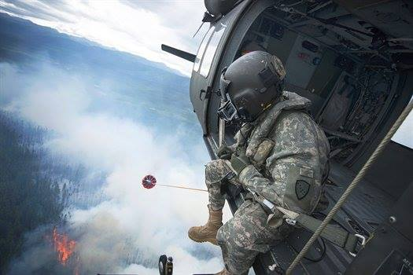
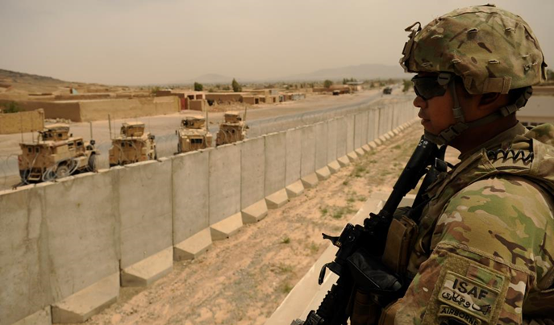
AKARNG Vision and Mission
Vision
A diverse, trusted, and capable organization
ready to conduct Unified Land Operations
for the federal government and the
State of Alaska.
Mission
Maintain ready units and Soldiers who are available to support the Governor and fellow Alaskans for domestic operations while also ready to deploy worldwide in support of the National Military Strategy.
Notes:
Our vision and mission are the foundational principles for how we organize, train, equip, recruit and sustain our force.
Our Vision: A diverse, trusted, and capable organization ready to conduct Unified Land Operations for the federal government and the State of Alaska.
Our Mission:
Maintain ready units and Soldiers who are available to support the Governor and fellow Alaskans for domestic operations while also ready to deploy worldwide in support of the National Military Strategy.
In addition to the vision and mission, we have four lines of effort which dovetail into the Adjutant General’s priorities. These include:
Lines of Effort:
1. Provide a relevant, ready and available force
Ensures mission readiness to the federal and state government
2. Continually improve AKARNG professionalism
This involves the spectrum of soldiering to include being experts in their occupational skills, to living the Army Values, and leadership.
3. Subject matter experts in the Arctic domain
This is an emergent line of effort for us, and we are determining our role in the opening of the Arctic
4. Partnered and aligned with appropriate agencies
From a federal prospective, this includes the major headquarters in Alaska, North America and the Pacific, ensuring we are ready to serve in those regions. Within the State of Alaska we will work with Department of Emergency Services, Forestry, local emergency management agencies and local responders to prepare for a disaster.
Definitions:
Unified Land Operations - describes how the Army seizes, retains, and exploits the initiative to gain
and maintain a position of relative advantage in sustained land operations through simultaneous offensive,
defensive, and stability operations in order to prevent or deter conflict, prevail in war, and create the
conditions for favorable conflict resolution.
National Military Strategy - The National Military Strategy (NMS) is issued by the Chairman of the Joint Chiefs of Staff as a deliverable to the Secretary of Defense briefly outlining the strategic aims of the armed services. The NMS's chief source of guidance is the National Security Strategy document.
Line of Effort - is a line that links multiple tasks using the logic of purpose rather than geographical reference to focus efforts toward establishing operational and strategic conditions. Lines of effort are essential to long-term planning when positional references to an enemy or adversary have little relevance.

Slide 26
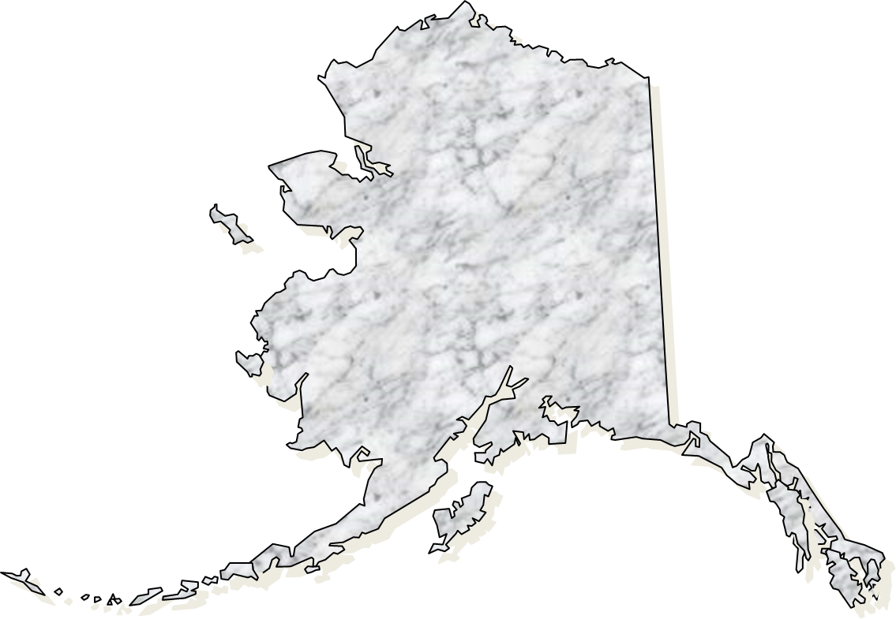
AKARNG Locations
17 Armories around Alaska
The demographics of a location predicated the placement of units and the retention of facilities
Federal and state funding reductions factored into the plan
The AKARNG is repurposing facilities in 60+ locations for use by the State of Alaska or other agencies
Environmental clean up, as necessary, is occurring prior to transfer
Barrow
Fairbanks
Nome
Fort Greely
Hooper Bay
Wasilla
Bethel
Kipnuk
Anchorage
Kwethluk
Quinhagak
Kenai
Valdez
Juneau
Kodiak
Sitka
Ketchikan
Klawock
Notes:
Each star represents where we currently have units.
We are facing reductions in federal and state funds, which is causing us to assess our stationing plan and subsequently where we can afford to have our armories. In the past, we’ve had up to 80 armories across the state. With the changes that we face, we are reducing our footprint to 18 locations. The benefit to Alaska is the reduction in infrastructure costs and the potential for unused armories to be repurposed within our communities.
Supporting data:
Two brigades:
the 297th Battlefield Surveillance Brigade and the 38th Troop Command
Joint Forces Headquarters for a total of 1850 soldiers.
Three battalions- Aviation with 20 Black Hawk helicopters, a Reconnaissance and Surveillance Squadron, and a Military Police headquarters.
There are a number of smaller units which serve as enablers such as engineers, signal, transportation and maintenance. Our force structure will undergo a significant conversion this year, changing the 297th Battlefield Surveillance Brigade to a Regional Support Group and the Recon and Surveillance unit to an Infantry battalion.

Slide 27
AKARNG FY15-19 End Strength Authorization
Notes:
The Army National Guard was mandated to reduce its overall end strength from 358,200 to 335,000 by Fiscal Year 2019. Each state has had to absorb cuts, and Alaska’s share is approximately 12% of our 2015 manning level.
As the Army draws down, the standards for recruits has gone up. This creates challenges in Alaska for those who might consider serving in the Armed Forces. Currently 70% of the recruit population ages 18-25 do not qualify to join the military, and that’s a national statistic. This is further exacerbated in Alaska, with some of the unique challenges that our youth face. We are working with the Alaska State Defense Force to afford as many Alaskans as possible the opportunity to serve our great state.
Supporting data:
Two brigades:
the 297th Battlefield Surveillance Brigade and the 38th Troop Command
Joint Forces Headquarters for a total of 1850 soldiers.
Three battalions- Aviation with 20 Black Hawk helicopters, a Reconnaissance and Surveillance Squadron, and a Military Police headquarters.
There are a number of smaller units which serve as enablers such as engineers, signal, transportation and maintenance. Our force structure will undergo a significant conversion this year, changing the 297th Battlefield Surveillance Brigade to a Regional Support Group and the Recon and Surveillance unit to an Infantry battalion.

Slide 28
Alaska Army National Guard 2015 Deployments
Missile Defense
210 Soldiers
Afghanistan
6 Soldiers
Mongolia
61 Soldiers
Kosovo
2 Soldiers
Wyoming/Texas
102 Soldiers
South Korea
5 Soldiers
Kuwait
2 Soldiers
Cambodia
17 Soldiers
Australia
20 Soldiers
Training Event
Deployment
Notes:
The Alaska Army National Guard continues to deploy Soldiers in support of missions and training events around the world. Of note we continued our deployment relationship with Mongolia, our State Partnership Program country. We also sent Soldiers to Mongolia to train with 24 other countries in a peacekeeping operations.
We sent pilots to fly in Afghanistan and two officers to serve in Kosovo. Alaska Army National Guard Soldiers also trained in South Korea, Cambodia, Australia and in the Continental United States.
There are also 210 Alaska Army Guardsmen who operate the Ground Missile Defense mission at Fort Greely – On watch, 24/7/365 operating as the nation’s defenders against an intercontinental ballistic missile attack. These Guardsmen are deployed in place to provide a vital intercontinental ballistic missile defense to our homeland.

Slide 29
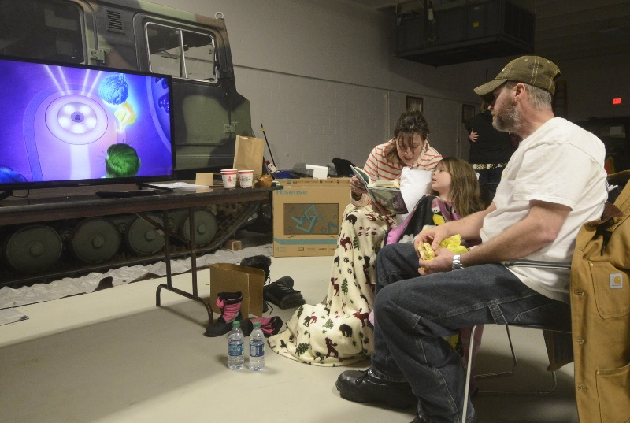
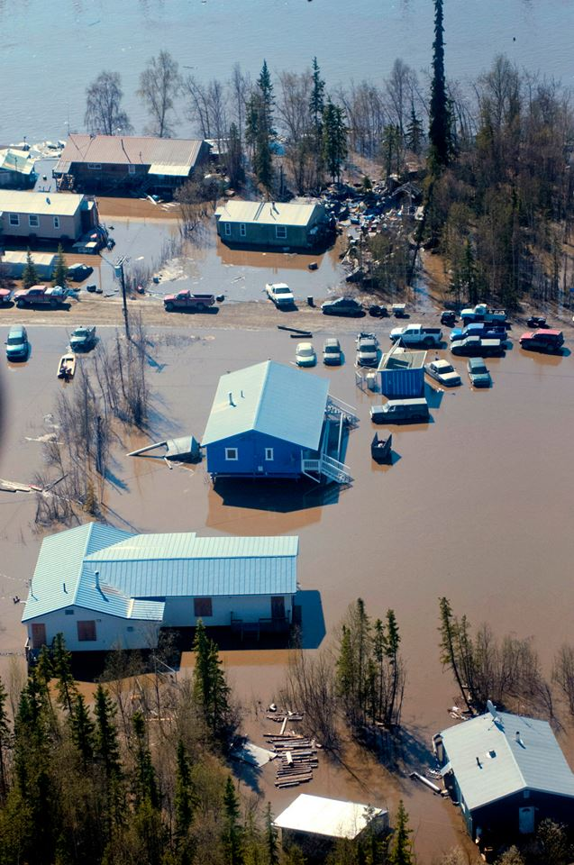
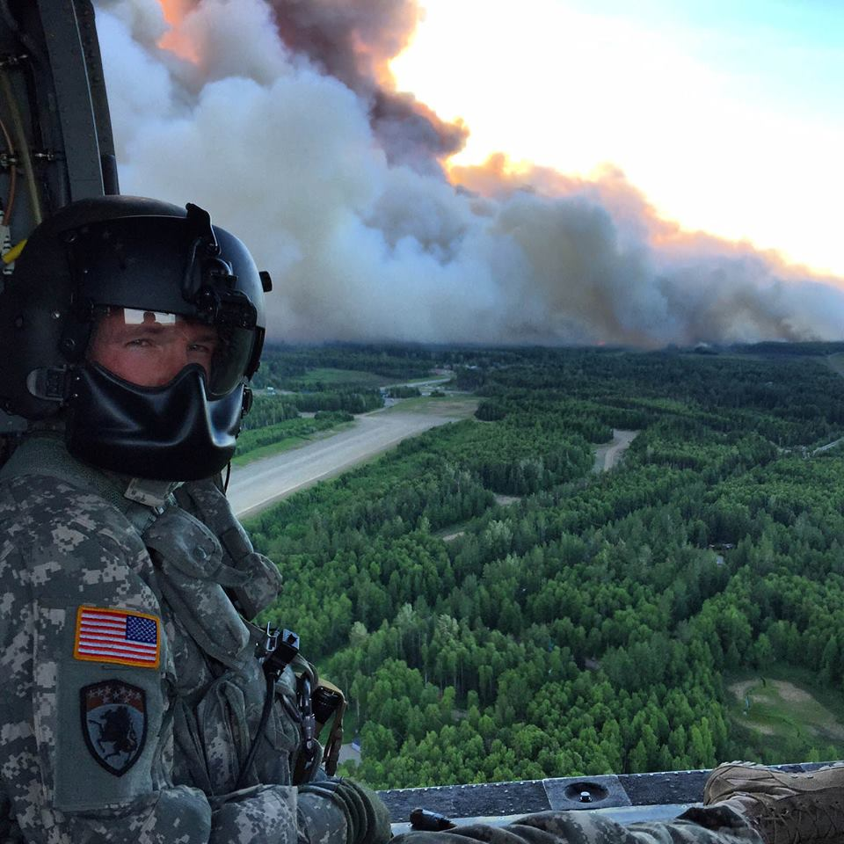
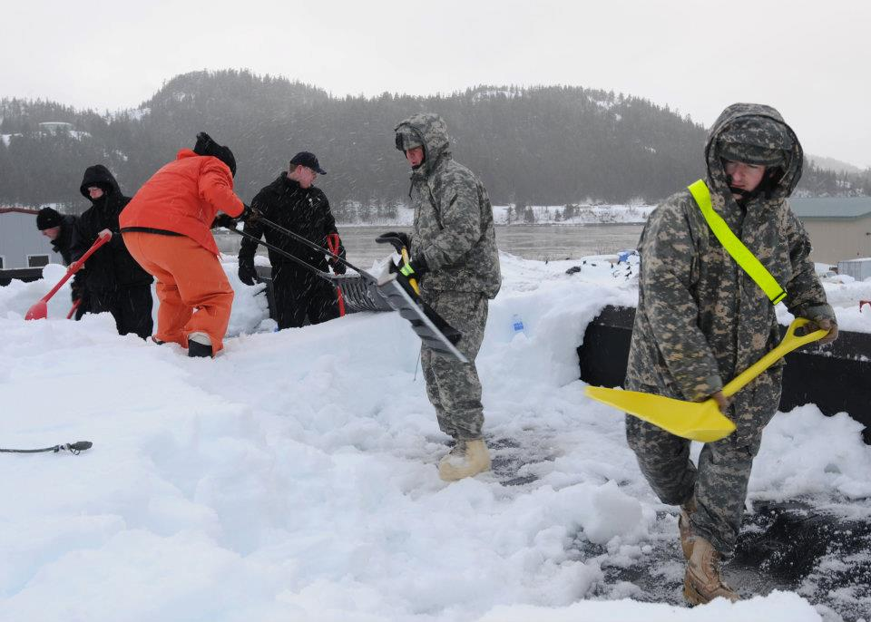
Defense Support to Civil Authorities
Natural Disasters
Army Aviation Wildfire
Support 2015
Kenai armory evacuation site
Fire 2015 and earthquake 2016
Galena Flooding 2013
Operation Deep Dig in Cordova 2012
Notes:
Our state missions include emergency response – preparing for and responding to requests by civil authorities for support, ranging from flood relief, search and rescue, and emergency housing for citizens in our armories.
Our helicopters supported the Department of Forestry with 131 hours on the Mat Su and Kenai fires last season.
We also have a Civil Support Team – 22 specially trained Army and Air Guardsmen to assist civil authorities in the case of a chemical, biological, radiological, nuclear and explosive events
We stand ready to provide non-emergency assistance to local and federal authorities. For example, in support of the Glacier Summit, we provided military police support to the Anchorage Police Department and State Troopers, Aviation support to the United States Secret Service, and refueling support to the Marine One, the President’s helicopter.
The Guard has helped deliver medical care, build structures and parks, and supply veterinary care throughout Alaska. The Innovative Readiness Training Program combines the efforts and skills of all of the branches of the Armed Forces to train in their career fields while benefitting citizens throughout the United States.

Slide 30
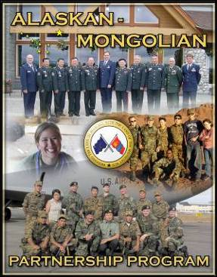
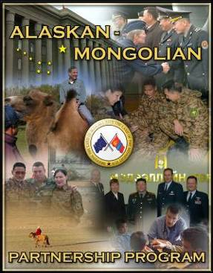
State Partnership Program Alaska - Mongolia
Building Partner Capacity in the Pacific
Combat Mission Partnership
in OIF and OEF Since 2004
Notes:
As mentioned earlier, Alaska’s state partnership program country is Mongolia. The program links the National Guard with the armed forces of a partner country in a cooperative, mutually beneficial relationship. This program is administered by the National Guard Bureau, and is guided by State Department foreign policy goals. It is executed by the Adjutant General in support of combatant commander and U.S. Chief of Mission security cooperation objectives and Department of Defense policy goals. The National Guard conducts military-to-military engagements and also leverages relationships and capabilities to facilitate broader interagency and corollary engagements spanning military, government, economic, educational and social spheres.

Slide 31
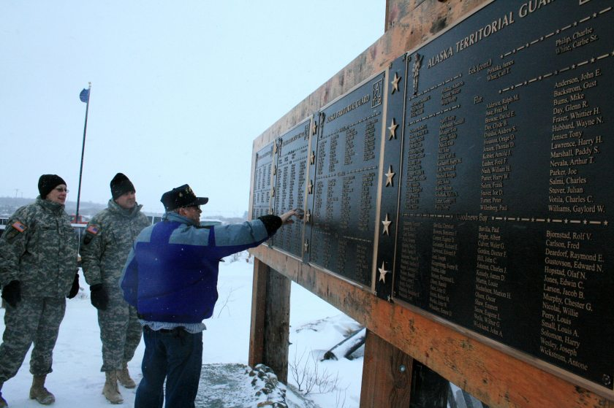
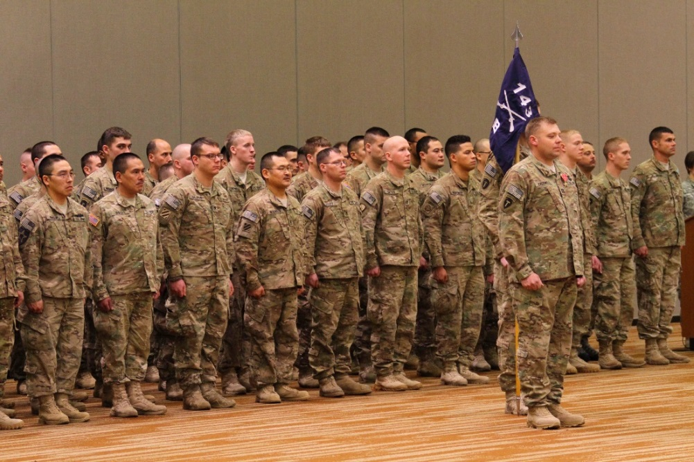
AKARNG Rural Engagement
LTG Kadavy, Director, Army National Guard, visited Western Alaska to experience challenges of AKARNG service in January 2016
Department of the Army and National Guard Bureau personnel visited Western Alaska in September 2015 to better understand the challenges of Western Alaska recruiting and participation in the AKARNG
Pursuing statutory change through Alaska’s Congressional Delegation to modify Joint Travel Regulation covering travel for drill periods (similar to Army Reserve policy)
Coordinate with Department of the Army and National Guard Bureau for specific waivers to assist with rural Alaska participation

Slide 32
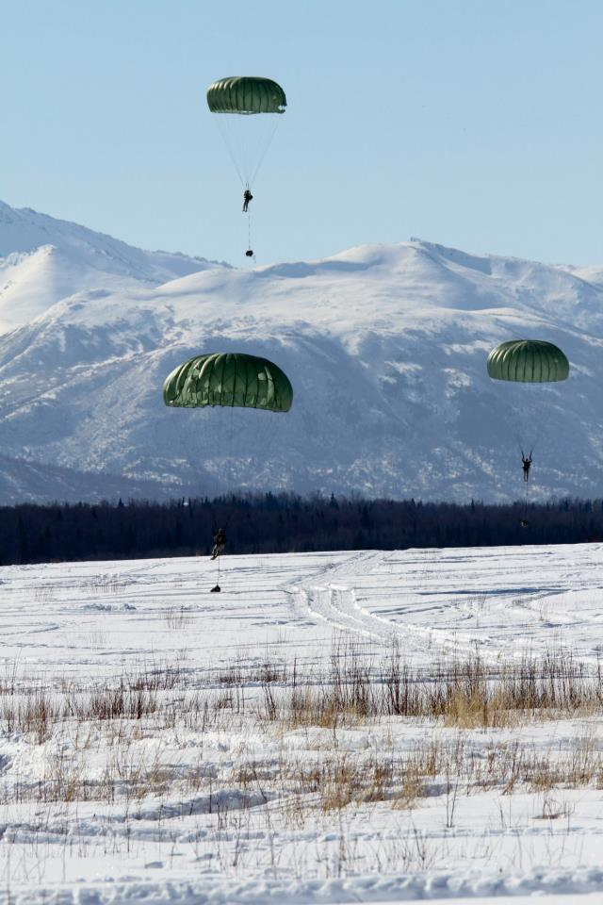
Discussion
Notes:
The Alaska Army National Guard is filled with highly trained and motivated Soldiers who volunteer to protect and defend the Constitution of the United States and the State of Alaska. We are united in our resolve to be a diverse, trusted, and capable organization ready to accomplish the missions set before us. We hold true to the Army Values, and uphold the laws of the state, nation and military. Thank you for the opportunity to share our story with you today.

