Slide 1
Overview of Fall 2008 Revenue Forecast & January 2009 Update
Presentation to the Senate Finance Committee February 5, 2009
Alaska Department of Revenue

Slide 2
Oil and Gas Revenue Forecast Variables
Production
Price
Costs / Investment

Slide 3
Interdependency of Forecast Variables
Supply Demand
Price
Production Costs / Investment

Slide 4
Oil and Gas Revenue Forecast Variables
Production
Price
Costs / Investment

Slide 5
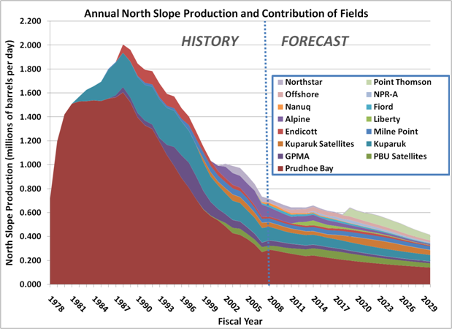
ANS Production, History & Forecast
Source: Fall 2008 Revenue Sources Book

Slide 6
Forecasted ANS Production, FY 2009 - 2030
6
Source: Fall 2008 Revenue Sources Book

Slide 7
Oil and Gas Revenue Forecast Variables
Production
Price
Costs / Investment

Slide 8
The Forecasting Timeline – part I
Oil Price “Delphi” Session (10/7)
Finalize All Unrestricted Revenue Forecasts (11/11)
Compile & Review Final FY 2008 Revenues (10/16)
Finalize Production Forecast (10/29)
Fiscal Model (11/12 – 11/14):
DOR → Treasury → APFC → OMB → Treasury → DOR
Finalize Oil Price Forecast (11/6)
Finalize Costs Forecast (11/10)
8

Slide 9
The Forecasting Timeline – part II
Fall 2008 Forecast Released (12/9)
Updated Revenue Forecast & Budget Released for FY 2009 (2/2)
Revenue Forecast Summary to OMB for Budget Development (11/14)
Prepare Narrative and Tables for RSB (First Draft 11/18)
Governor’s Budget Released (12/15)
Internal Review, Revisit Models, RSB to Printer (Final Draft 12/8)
9

Slide 10
The “Delphi” Session
Modified “Delphi” technique
Oct 7, 2008: Prices averaging $92.85
Expanded Invitee List: 50 Invitees, 29 Participants from DOR, DNR, DOL, OMB, University, Legislative Finance, Legislature, outside participants
Presentations: Fundamentals (supply & demand), geopolitics, financial markets, analyst expectations, etc.
28 forecasts received; Delphi forecast is the “median” forecast of the participants

Slide 11
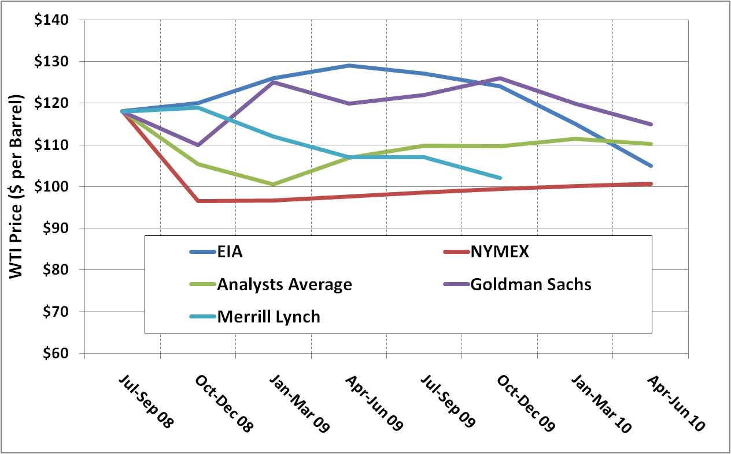
Price Forecasts Available At Delphi
Sources: Bloomberg, New York Mercantile Exchange, Energy Information Agency Note: Only Analyst Average, EIA and NYMEX were presented at Delphi. Merrill Lynch and Goldman Sachs were included in Analyst Average.

Slide 12
Oil Price Volatility – 80% decline in 5 months
Source: Reuters, Bloomberg

Slide 13
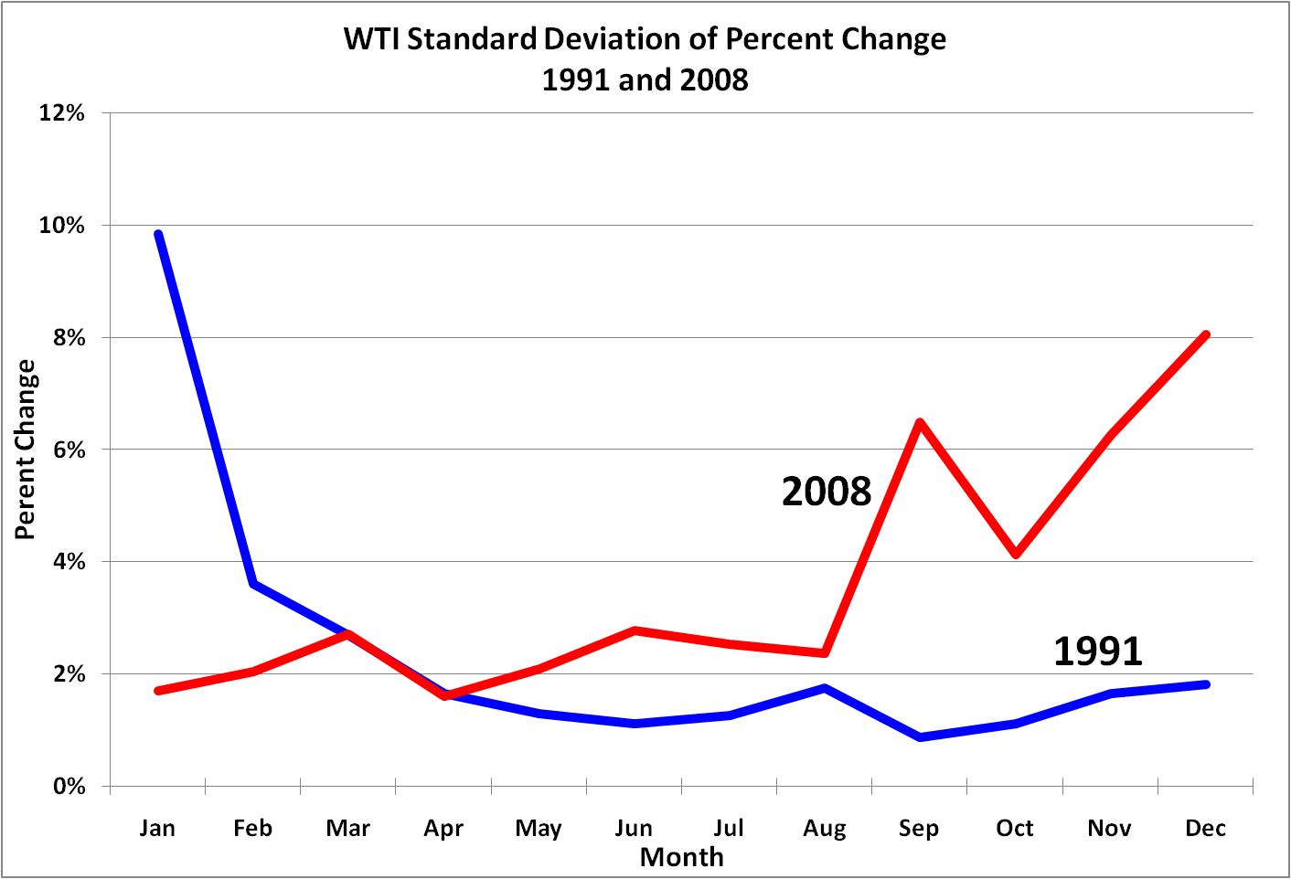
Oil Price Volatility – Two of the Most Volatile Years in History
13
Source: Reuters, Bloomberg, DOR Analysis

Slide 14
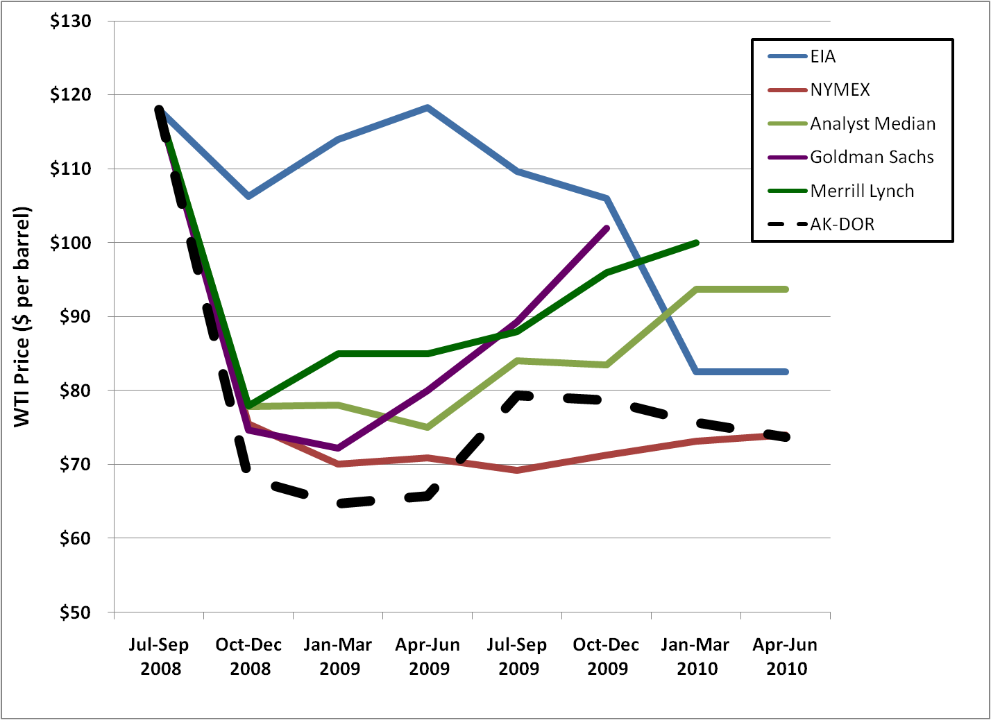
Price Forecasts as of 11/6/2008
Source: Bloomberg, Wall St Journal, Energy Information Agency

Slide 15
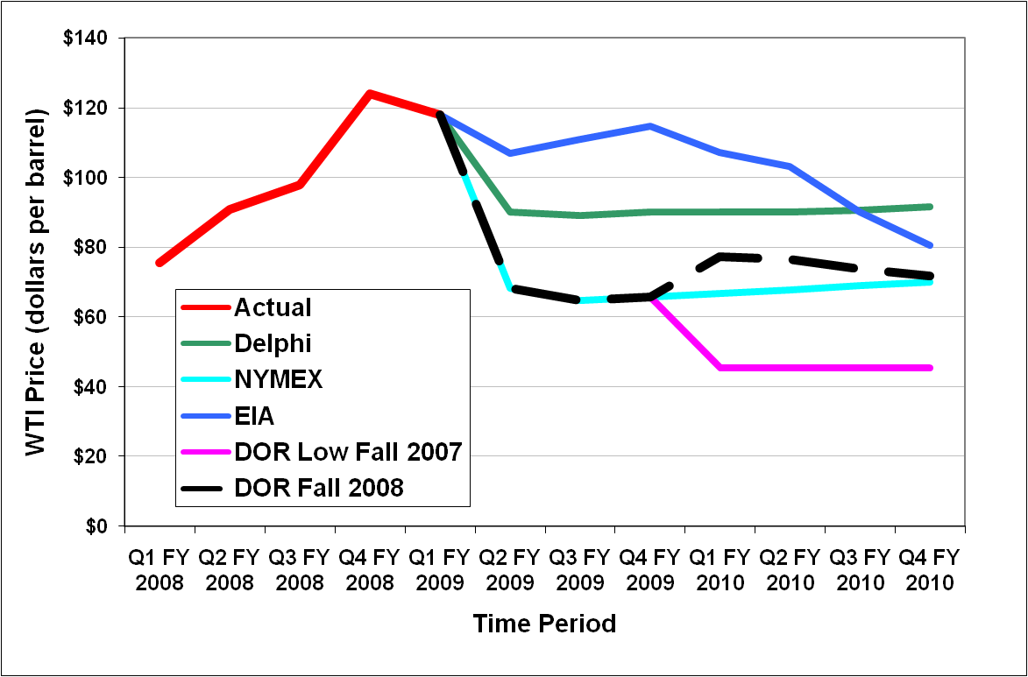
Our Forecast Was a Blend…
Source: EIA, NYMEX, Alaska Department of Revenue

Slide 16
How Did We Get to Our Price Forecast?
Source: Alaska Department of Revenue

Slide 17
Fall 2008 DOR Oil Price Forecast
Source: Fall 2008 Revenue Sources Book

Slide 18
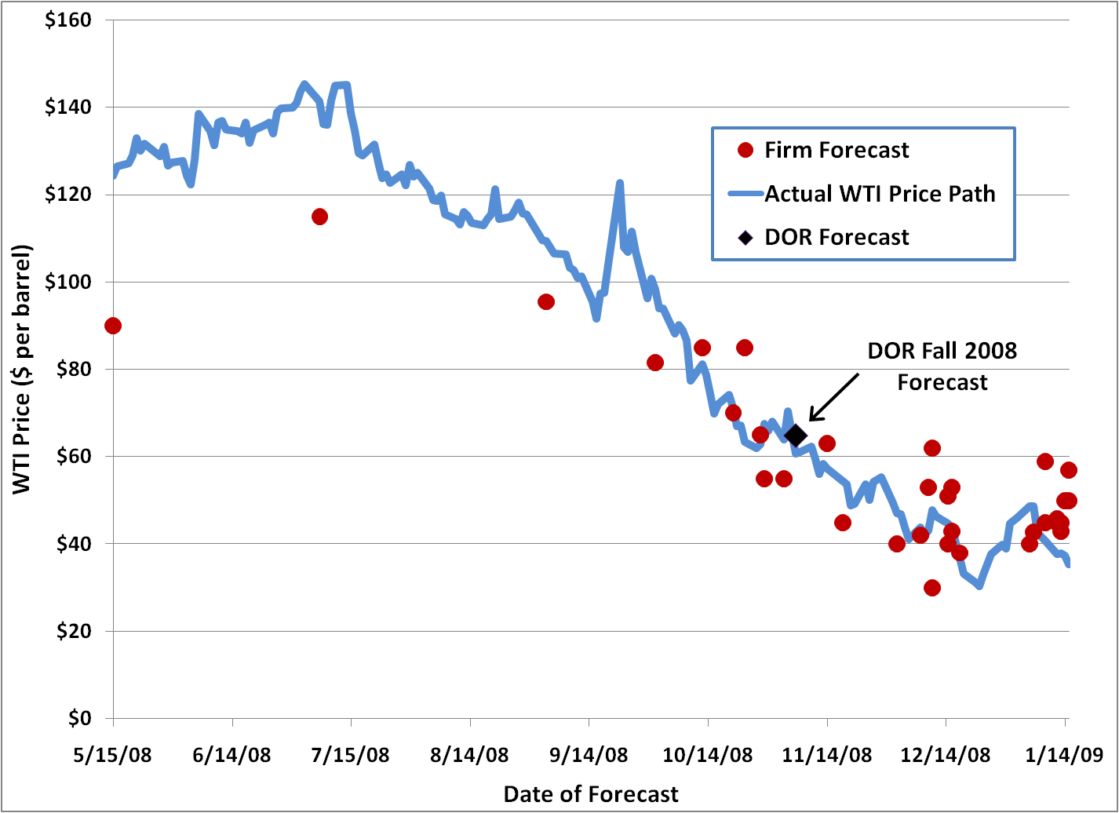
Price Forecasts for Jan-Mar 2009
Source: Bloomberg Analyst Survey

Slide 19
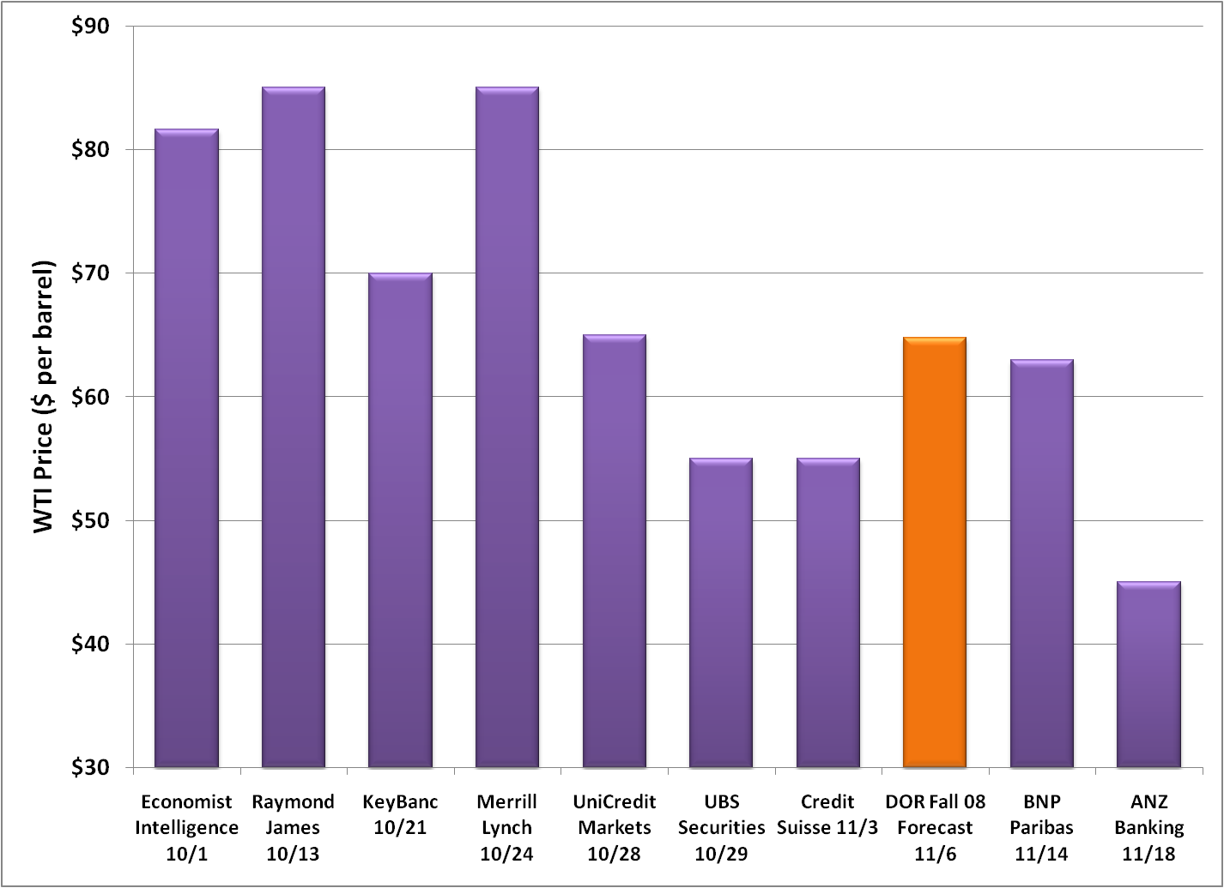
Price Forecasts for Jan-Mar 2009
Source: Bloomberg Analyst Survey

Slide 20
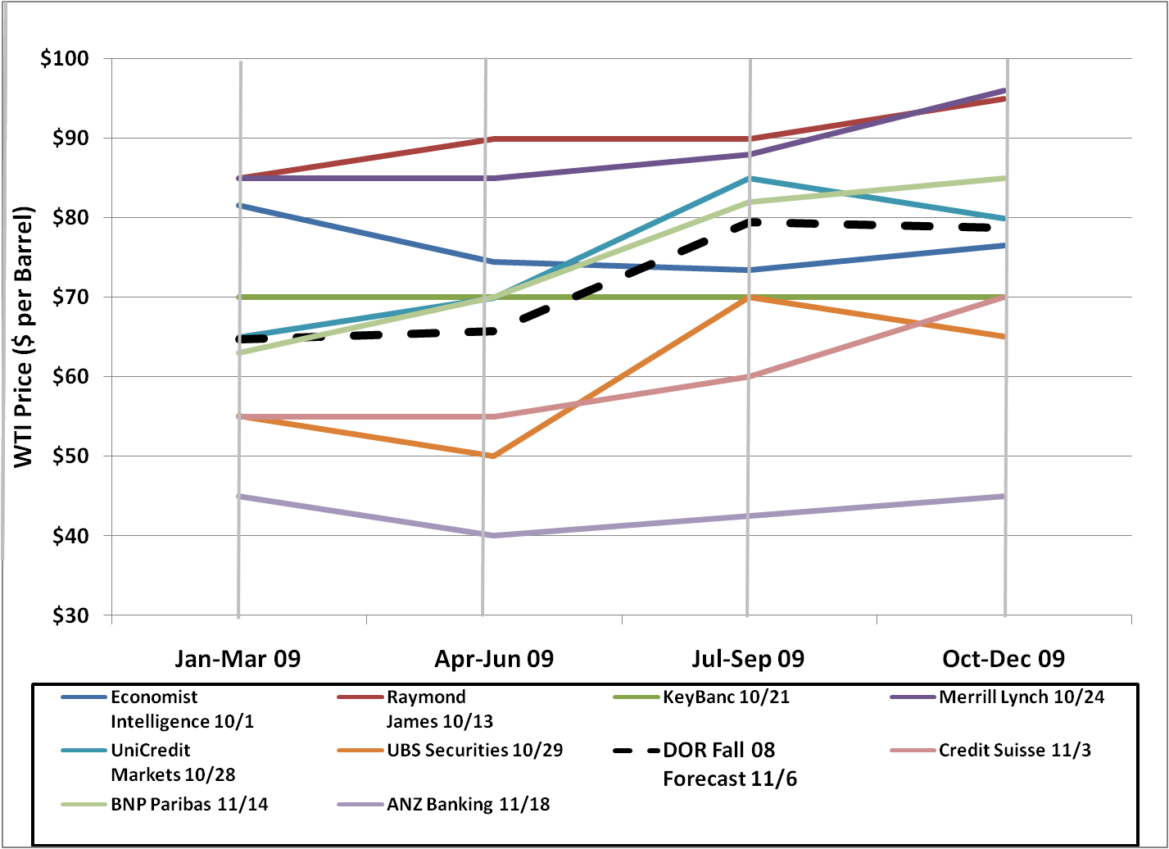
Price Forecasts for Calendar 2009
Source: Bloomberg Analyst Survey

Slide 21
Updated FY 2009 Oil Price Forecast
Source: January 2009 Forecast Update

Slide 22
Oil and Gas Revenue Forecast Variables
Production
Price
Costs / Investment

Slide 23
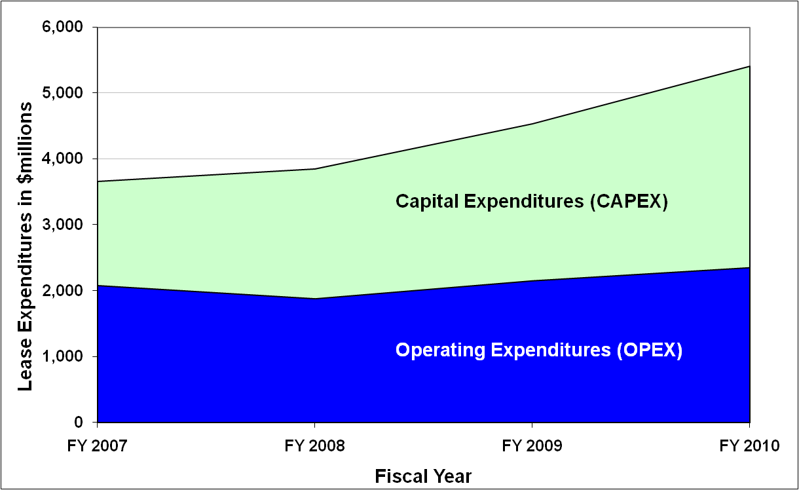
Lease Expenditures (Costs)
Source: Alaska Department of Revenue

Slide 24
Lease Expenditures per Barrel
Source: Alaska Department of Revenue

Slide 25
North Slope Investment (Historical and Projected)
Source: Alaska Department of Revenue

Slide 26
FY 2009 Total Revenue
Source: January Forecast Update

Slide 27
Restricted vs. Unrestricted Revenues
All revenue is classified as either “Restricted” or “Unrestricted”
All amounts in the presentation are Unrestricted Revenue only.
Restricted = Use of this revenue is restricted by constitution, state or federal law, trust or debt restrictions, or customary practice.
Unrestricted = Revenue available for general appropriation. This is the amount typically discussed in budget context.

Slide 28
Sources of Unrestricted Revenue
Oil – Property tax, Corporate Income Tax, Production Tax (ACES), Royalties.
Oil will make up 87% of unrestricted revenue in FY 2009
Investment Earnings – On General Fund
Other Non-Oil – Taxes, Charges for Services, Fines and Forfeitures, Licenses and Permits, Rents and Royalties, Miscellaneous

Slide 29
FY 2009 Revenue Overview (General Fund Unrestricted Revenue)
Source: January 2009 Forecast Update

Slide 30
FY 2009 Non-Oil Revenue Detail
Source: January 2009 Forecast Update

Slide 31
FY 2009 Revenue Forecast Comparison
Source: Fall 2008 Revenue Sources Book and January 2009 Update

Slide 32
Conclusions
Record level oil price volatility
Price forecast in “ballpark” when issued
Reduced for interim forecast
Minimum production level changes from previous forecast
Lower prices likely to impact future costs and possibly investment
32

Slide 33
Historical Production and Price Changes as of Fall 2008
Change in Revenue Forecasting from “cash basis” to “accrual” accounting
- Timing Issue: Production, prices, and revenue received in July for June production changed from June to July - Necessary due to significant monthly variation in oil revenues - Shift in fiscal year affected historical production and price, not revenue - Greater accuracy in reporting - Alignment with state financial documents

