Slide 1
Institute of the north Alaska’s Arctic Think-and-Do Tank
Review of 2013 Energy Projects
Nils Andreassen
Executive Director
Institute of the North

Slide 2
Mission
To inform public policy and cultivate an engaged citizenry, consistent with our focus on the North and belief that commonly-owned resources should be managed and developed for community and individual prosperity.

Slide 3
Reality, richness, responsibility
Our values
Value the Arctic as a commons with management of resources for the benefit of peoples and communities of the North
Focus on responsible energy and infrastructure development that facilitates sustainability
Goal of healthy, prosperous and resilient communities
Elevate the voices of northern peoples in state, national and international arenas

Slide 4
Reality, richness, responsibility
Our work
Convene and facilitate civic discourse in order to cultivate an engaged citizenry
Inform public policy through outreach and education
Sustain networks of stakeholders, policy makers and technical experts
Synthesize research for broader awareness and accessibility

Slide 5
Levels of Governance
National
Indigenous
Sub-national
From Stakeholders to Rightsholders

Slide 6
Responsibility
Not risk free, but commitment to risk mitigation
Necessary response ability
Community, culture, and environment
Development of indicators

Slide 7
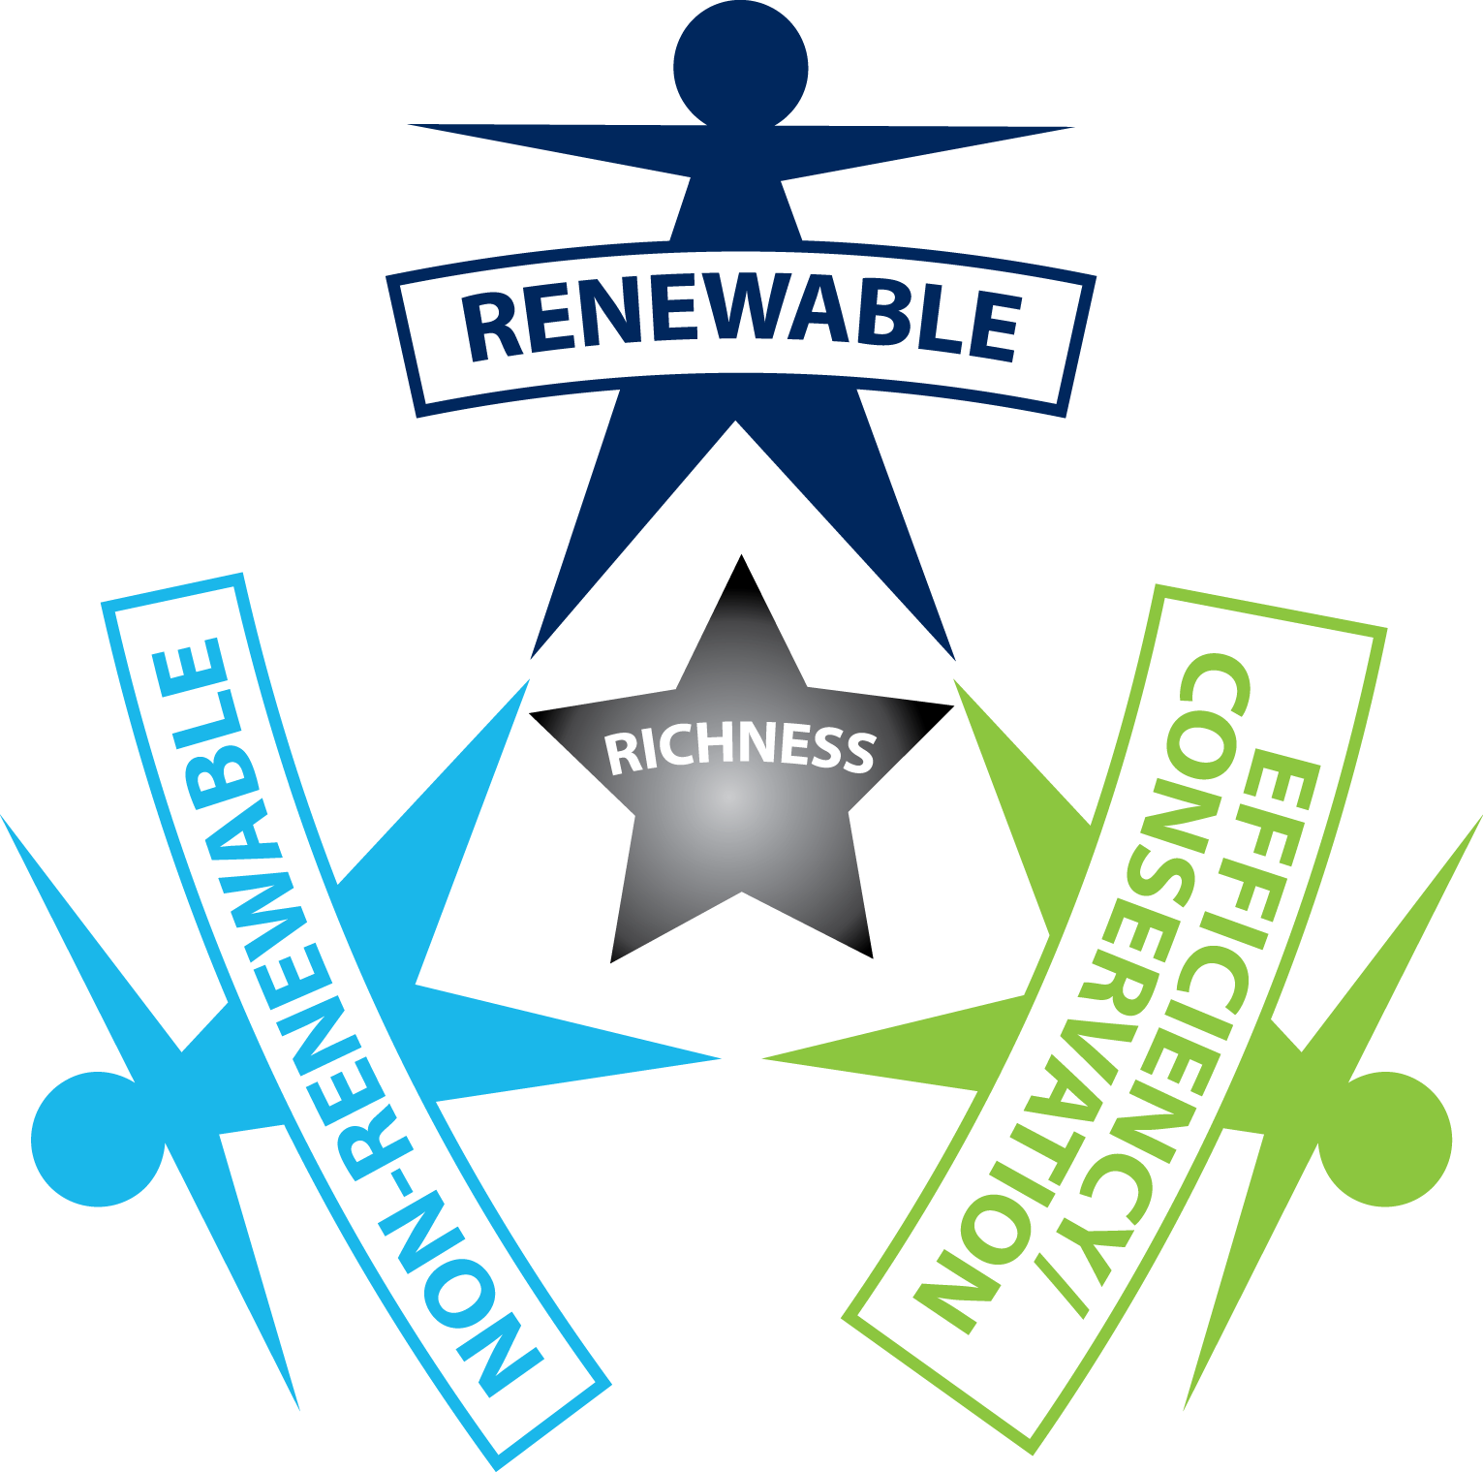
Richness

Slide 8
Resilience
Ability to respond and adapt to change – system capacity to bounce back
Asset dependent, plus scale and rate of change
Time sensitive – implement responsibility now
Resilient communities depend on resilient energy systems

Slide 9
Responding to
Fundamental challenges facing Alaska:
Declining oil production
Decreased state revenue
High energy costs in much of Alaska
Significant fiscal hurdles in next decade
Search for best practices, new and innovative policies and systems that have derived maximum benefit from their resources for their people

Slide 10
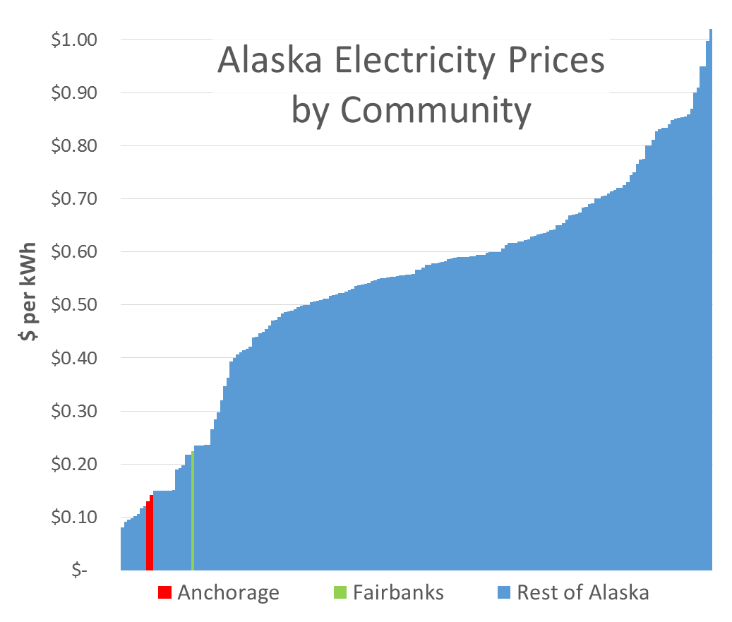
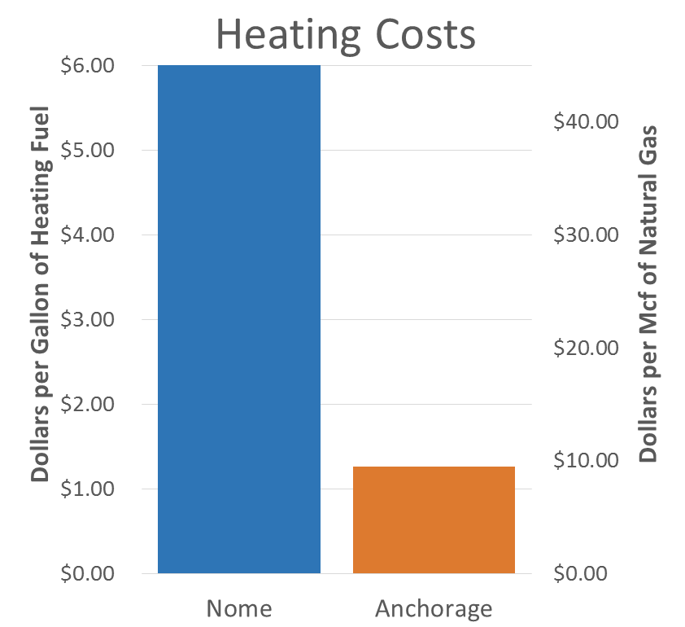
Energy Costs Vary

Slide 11
High energy costs
IMPACT- High Energy Costs are financially crippling Alaska households, costing Alaskans jobs and discouraging new industrial and resource development

Slide 12
Fiscal constraint
“Reasonable assumptions about potential new revenue sources suggest we do not have enough cash in reserves to avoid a severe fiscal crunch soon after 2023, and with that fiscal crisis will come an economic crash.”
ISER, Maximum Sustainable Yield, FY2014 Update (January 2013)

Slide 13
challenges
Production
Generation
Distribution/Transmission
Utilization

Slide 14
Production
1. Access - Roads, Permitting willing landowners and leaseholder
2. Investment - regulatory certainty, stable market, infrastructure, access to private capital
3. Ownership of data - incentives business climate technical feasibility
4. Permitting - Clear & Consistent Standards, Avoid Duplication, Public Acceptance, timelines, capacity to process permit applications
5. Market Conditions - incentives create demand, attract and support private investment, market access for independent producers, compliance with federal regulations
6. Infrastructure - regulatory certainty, potential state involvement
7. Railbelt - Operation/Governance, balkanized, upgrades needed
8. Rural - Standalone, redundancy, no regional grid, lack of economic development, balkanized
9. Federal land ownership, and restrictive federal land use policy. (Ex: Tongass National Forest, Roadless Rule, etc.)
10. Natural Resource Development - need affordable power, value-added development
Solutions:
Railbelt: Integrated operation/management, $900 million ($100-$200 annual savings) partnering, financing/ debt surcharge (from cost savings)
Rural: Micro-grids, renewables, open access to transmission
Extractive Industries: Partnering for rural energy renewables

Slide 15
Generation
Security of supply
Cost (fuel & capital/demand) → innovation, improve rates
Logistics → regional plan, locally sourced
Economies of scale
Environmental impacts → fee’s incentives and rules
Dispatch and integration → technology, training, and transmission
Firm v. Variable → battery storage curtailment
Additional problems…
Storage
Technology
Aging Infrastructure
O & M
System Operations & Human Capital
Permitting
Financing and Access to Capital

Slide 16
Distribution/transmission
Anchor Tenants (potential users)
Solution: Private investment for public benefit and create economies of scale (natural resource development, value-added industries)
High Contribution of renewables on grids, unbalanced load
Solution: Centralized operation of stand-alone utilities (keep old tech for backup)
Regulatory uncertainty & lack of coordination
Solution: Streamline permitting process to bring mines on-line faster (single agency POC)
Lack of infrastructure & lack of connection (distance, geo)
Solution: Partner with other western states (PNWER, legis, admins), Connect to the North American grid where economically feasible (Yukon), Transition between utility grids within Alaska
Land access restrictions
Solutions: Assert RS2477 & ANILCA, et al ROWs
No renewable land use designation
Solution: virtual connections, evaluate on STWD basis, No renewable Land Use Designation (LUD) within the Tongass National Forest, or Tongass Land Management Plan (TLMP)
Competing Projects
Solution: create big picture strategy that includes villages

Slide 17
Utilization
NO ONE has used the AHFC public building loan fund.
•Solution: administrative leadership → make the department heads figure this out (district admn. People). As well as educating decision makers (school boards) about the benefits of applying for loans
Need low interest rates on loan programs for commercial buildings to become more energy efficient
•Solution: AHFC add this to their efforts
New methods for funding energy efficiency needs
•Solution: Implement PACE, which 29 other states are currently doing.
Expand Opportunities:
•Recruit and Support Energy Intensive Industries (e.g., mining, data centers)
–Or small-scale e.g. local food processing in a village; opportunity to interconnect
•Better Management
–Need strong infrastructure grid, equal access, RCA regulatory environment ensuring equal access to transmission

Slide 18
2010 Plan
Establish an Energy Policy
Develop Strategic Goals
Adopt a plan to achieve the goals
Implement programs and projects consistent with the goals
Steps 2-4 are the current problem statement
To what extent is Alaska achieving affordability, ensuring project efficacy and stable funding for projects in the long-term, while practicing fiscal constraint?

Slide 19
Declaration of state energy policy AS 44.99.115
The State of Alaska recognizes that the state's economic prosperity is dependent on available, reliable, and affordable residential, commercial, and industrial energy to supply the state's electric, heating, and transportation needs.
The state also recognizes that worldwide supply and demand for fossil fuels and concerns about global climate change will affect the price of fossil fuels consumed by Alaskans and exported from the state to other markets.
In establishing a state energy policy, the state further recognizes the immense diversity of the state's geography, cultures, and resource availability.

Slide 20
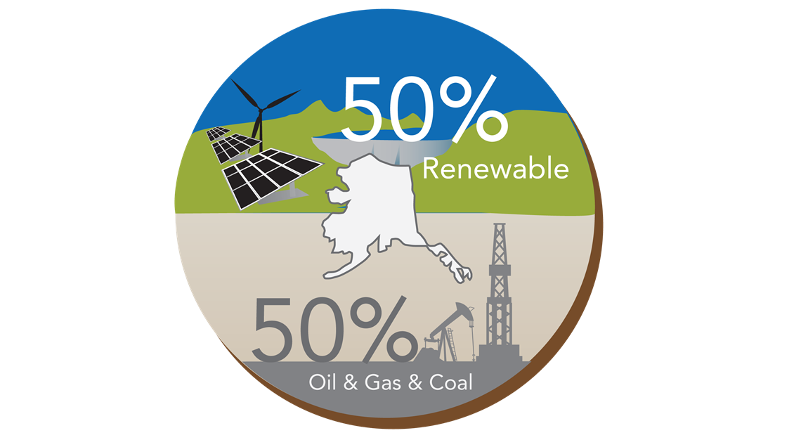
Diversifying Alaska’s Energy Portfolio

Slide 21
The Policy Sweet Spot
Less Complex
More Complex

Slide 22
Case Study analysis - Policy
Certainty
Longevity
Regulatory and fiscal environment
Empower the market (and individuals)
Open access—let market forces work
Vision/Mission statement
Clearly articulated vision leading to broad support
Energy independence equals low-cost power
Goal of consumer benefit
Ancillary benefits - Energy security and Jobs
Other
Broad statewide support because it is a common problem
Equalize costs between urban and rural
Leadership
Federal, state, and private investment
Legislative champion
Local entity adaptive (no restrictive policy)
Goal-oriented and Reality-based

Slide 23
Case Study analysis - Implementation
Get ‘er done! (Infrastructure)
Build for industry first...and the rest will follow
Grid infrastructure
Could have incentivized utilities to invest, and create efficiencies
Emphasis on construction (not studies)
Consensus
Spreading money around the state
Agreement among players
Positive change in land ownership (private)
Pro-active management of public lands for renewable energy development
Other
Lock-in through clear contracts
Policy adaptation
Well-defined objectives, transparent process
Immediacy of need
Use what’s abundant and affordable
Contracts
Outsourced to private sector
Existing organizations

Slide 24
Case Study analysis – Programs/Projects
Universal, broad base, diverse and inclusive
Public and private financial participation
Popular, high demand
Available statewide
Technical credibility facts! Info!
Good data
Well-prepared project plans
Projects were catalysts and foundations
Created framework to enable, not dictate projects
Industrial-size projects to drive the completion of increased transmission interconnectivity with open access
Innovation, reinforcing feedback, lowering costs
More innovation and technology, lower costs
Stable prices and conservation
Reduction in consumption

Slide 25
Alaska Dialogue - Qualities of Policy
An Energy Policy for the State of Alaska should:
Be driven by Vision and Strategy
Create and Supports Regulatory Clarity
Have Broad Stakeholder Buy-in
Be able to be evaluated against measurable indicators
Adapt and evolve based on results of evaluation
Establish a Loading Order (prioritization method)
Should include clear strategy or work plan for implementation

Slide 26
Alaska Dialogue – What Policy Achieves
An Alaska Energy Policy should achieve:
Economic Development/ Growth/ Sustainability
Stability & Predictability
Equity/Fairness
Innovation/ Entrepreneurism
Affordability
Stewardship
Transparency and Accountability
Consumer/User Responsibility
Support for private investment
Modern regulatory framework to attract, support, and protect new investment capital

Slide 27
Indicators
To what extent have we established, addressed, been affected by, incorporated…
Security of Supply
Environment and Pollution
Strategy for State
Politics and Pet Projects
Budgets
Risk Appetite
Resource Wealth
Technology Development
Social Considerations
Subsidies for People
Subsidies for Industry
Economic Development
Resource Development
Ratio of private investment to public investment
Price

Slide 28
Energy Price for Policy Sweet Spot
Capital & Operation Costs
+
Fuel
Demand

Slide 29
Key Takeaways
Does the current state energy policy meet the criteria?
Driven by Vision and Strategy
Creates/Supports Regulatory Clarity
Has Stakeholder Buy-in
Can be evaluated against measurable indicators
Results of evaluation guides adaptation and policy evolution
Establishes a Loading Order (prioritization method)
Economic Development/ Growth/ Sustainability
Stability & Predictability
Equity/Fairness
Innovation/ Entrepreneurism
Affordability
Stewardship
Transparent, Accountable Process
Consumer/User Responsibility
How are we evaluating the outcomes?

Slide 30
Remaining question
Is the current state energy policy aspirational or directional? And for whom?

Slide 31
AEA - Pathway from Policy to Projects
State Policy Goals
Project Development
Energy Projects
Administration
Alaska Legislature
AEA Policy Development
Board of Directors
Regional Planning
In-House Project Evaluation
Loans and Direct Grants
Project Management
Partnerships (Private, AIDEA)

Slide 32
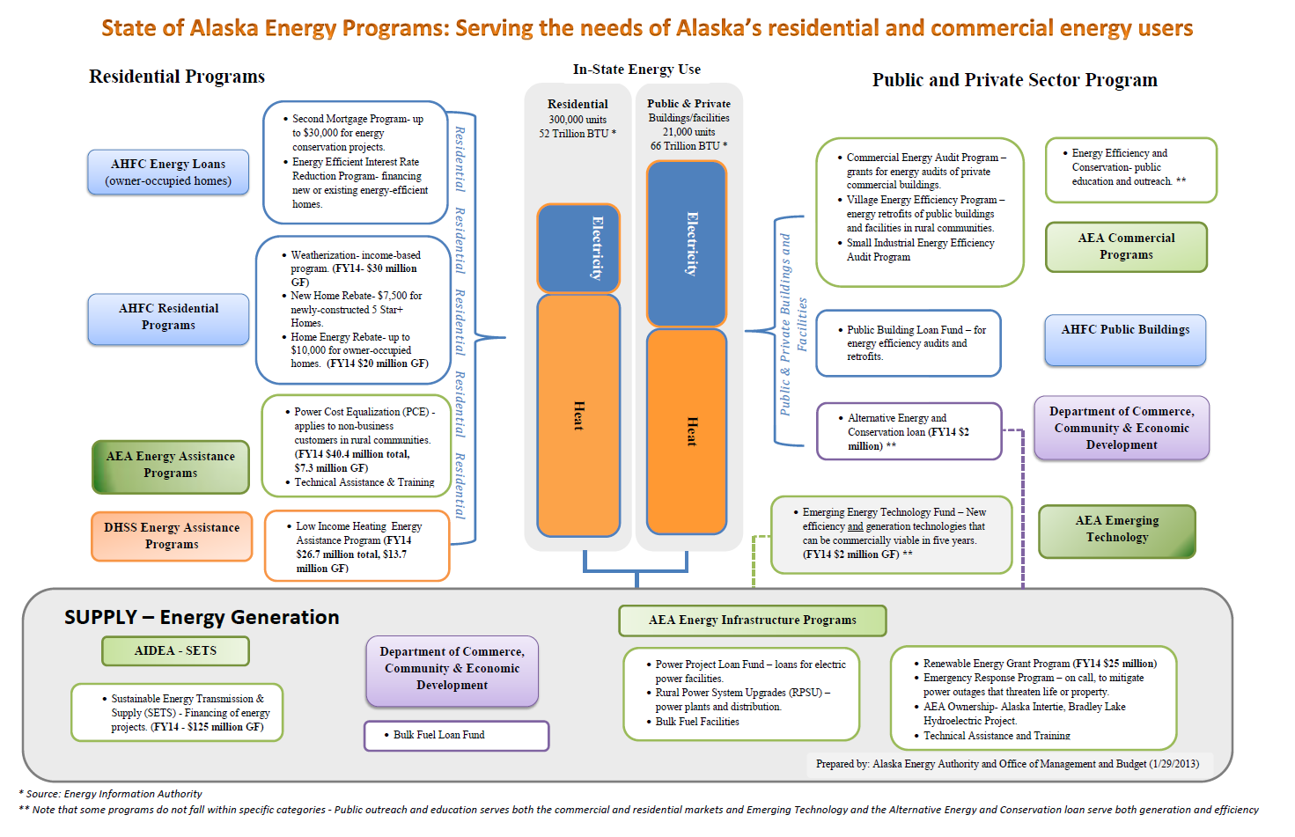

Slide 33
Roadmap
Criteria - A principle or standard by which something may be judged or decided
Strategy - prioritize or rank how we spend limited money in a way that produces results
System – tracks projects/expenditures to make sure that we are accomplishing the goals set out by the policy

Slide 34
Potential recommendations
Draft Recommendations
Make standing committees of House Energy and Senate In-State Energy – consolidate oversight
Think in terms of a balance sheet – assets and liabilities
Evaluate energy projects with accurate information, and options vetted and weighed against one another
Encourage better outreach and communication from state agencies – benchmarks of success
Encourage and support private investment
Implement energy policy as a key element of fiscal policy – fenceposts for policy makers and agencies

Slide 35
Potential Research
Impact of grid connectivity to social and economic development? Regional or microgrids?
Inventory of measures of government support to both extractive industry and renewable energy projects
Study examining the benefit sharing arrangements to local communities from private sector development
Lessons learned from policies promoting renewable energy
Dedicated financial vehicle (i.e.; Arctic Development Bank or Arctic Resilience Fund) to support renewable energy, local development, and resilience

Slide 36
Potential Projects
Development of an Arctic Risk Map that shows potential origin, probability, and consequence
Assess and map renewable energy sources, which can be overlaid on existing oil and gas mapping
Development of an energy development and distribution roadmap
Review regulatory and fiscal regimes for impact on the human dimension and social, economic and cultural development
Review stake/rightsholder engagement and effective consultation practices
Drafting of a master plan for community survivability
Develop best practices guide to northern energy efficiency, through engineering, architecture and design

Slide 37
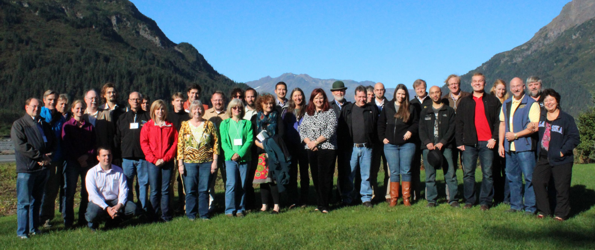
Next steps
Build on qualitative work at Dialogue by considering indicators for criteria
Develop quantitative evaluation measures for decision-making
Consider both as part of a strategic plan

Slide 38
Challenge
Arctic as a model of clean energy development
Arctic as a model for delivering affordable energy to its peoples and communities
“With great energy wealth comes great energy responsibility, on behalf of our people.”

