Slide 1
House Finance Health & Social Services Subcommittee FY14 Budget
Alaska Mental Health Trust Authority

Slide 2
Trust Beneficiaries
People with mental illness
People with developmental disabilities
People with chronic alcoholism and other substance related disorders
People with Alzheimer’s disease and related dementia
People with traumatic brain injury

Slide 3
Trust Advisors and Partners
Advisory Board on Alcoholism & Drug Abuse
Alaska Mental Health Board
Governor’s Council on Disabilities & Special Education
Alaska Commission on Aging
Commissioners of Health and Social Services, Revenue, Natural Resources and Corrections
Alaska Brain Injury Network
Statewide Suicide Prevention Council

Slide 4
Trust Funding FY14
Distributable Income Trust Fund Payout 4.25% Prior Years Lapse Land Office Income Interest Total Projected | $18,090,000* 3,670,000 3,190,000 650,000 $25,600,000
*Payout based on four-year average principal and reserve balances of $426M

Slide 5
Five Program Focus Areas
Bring the Kids Home
reforming Alaska’s mental health care for children and adolescents so they are diagnosed earlier and treated as close to home as possible
Disability Justice
reducing the involvement and recidivism of Trust beneficiaries in the criminal justice system
Affordable Appropriate Housing
increasing a continuum of housing options for Trust beneficiaries
Workforce Development
creating an available and competent workforce for Trust beneficiaries and service providers
Beneficiary Projects Initiative
supporting grassroots, peer-to-peer programs for Trust beneficiaries

Slide 6
Alcohol Initiatives
Recover Alaska
initiative lead by Rasmuson Foundation, includes The Trust, Mat-Su Health Foundation, DHSS and other stakeholders
goal to help individuals, families and communities in Alaska “recover” from impacts of alcohol
focus on systems, policy, statutory and practice changes that will lead to long-term improvements
Title 4 review
partnership with Alcohol Beverage Control Board, which is convening stakeholders to review and possibly recommend changes to Alaska’s alcohol beverage control statutes in Title 4

Slide 7
Bring the Kids Home
Problem
FY06: 743 Alaskan children with severe emotional disturbances received out-of-state residential psychiatric treatment services
separated from families and communities
difficult transitions back to Alaska
length of stay varied from several months to multiple years
costs peaked at $40+ million Medicaid paid to out-of-state providers
Committed partners
DHSS, behavioral health service providers, parent and youth advocates, Trust partner boards, Alaska Native health providers, Dept. of Education, Denali Commission and others
Strategic thinking
intervene earlier, more intensively, and with the family
use residential resources carefully
expand implementation of effective practices
develop in-state treatment for youth with complex needs
use data to guide service development

Slide 8
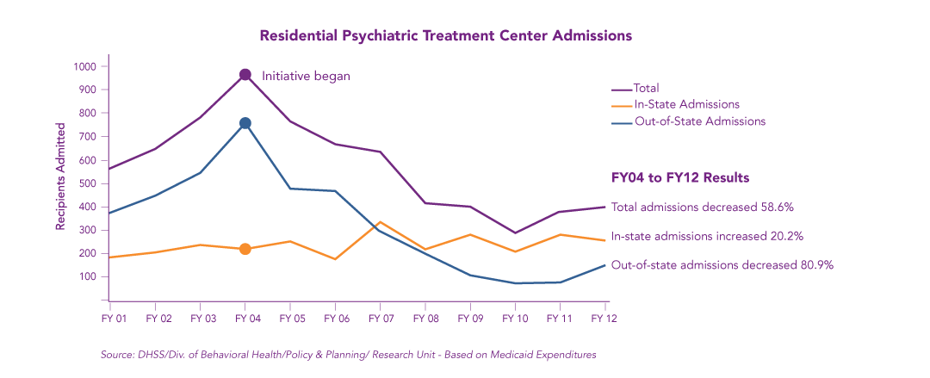
Results for Beneficiaries
Keeping youth in Alaska
Reducing recidivism
Youth who returned to RPTC within 1 year dropped from 20% to 5% (FY04 - FY12)
Notes:
Jeff – If people remember that recidivism was down at 3.4% last year, and ask questions about that – here is part of what we think is happening: we have trimmed the number of INTAKES into RPTC way down. So now we are having more discharges than we are intakes. That means that we have more youth to potentially “recidivate”. Also, the youth going into RPTC now have pretty severe problems so there is more of a good reason to expect that they might struggle upon discharge and need a re-admission.
For example:
for FY07 we had 620 admissions to RPTC
for FY07 we had about 560 discharges from RPTC
for FY10 we had 295 admissions to RPTC
for FY10 we had about 405 discharges from RPTC
So using this percentage starts to become tricky as the number of admissions get smaller because it is figured using the admissions rate. DBH started trying to figure out how to come up with a better way of looking at this, given our smaller numbers and they started using the “re-admission rate” which JUST looks at the percent of the total discharges who went back into an RPTC.

Slide 9
Shifting Expenditures in State
Out-of-state RPTC expenditures 64% lower than FY06
In-state RPTC expenditures 54% higher than FY06
Overall RPTC expenditures 33% lower than FY06
Community mental health expenditures for youth <18 are 26% higher than FY09
Cost Trends for Children and Youth Services
RPTC Expenditures
Solid = Out-of-State RPTC
Transparent = In-State RPTC
The FY12 Medicaid Community-Based (DBH Providers) Mental Health expenditures reflects a change in methodology due to the implementation of integrated regulations. The FY11 to FY12 decrease in expenditures is consistent with the methodology change and with other Medicaid claims analyses performed by the Division. Division staff are looking into additional factors that may be contributing to this decrease. The Division plans to reanalyze prior year data using the new methodology and this will result in an updated chart.
12

Slide 10
Results for Beneficiaries
Developing in-state treatment options for children with co-occurring and complex disorders
Complex Behaviors Collaborative
in-state RPTC unit
resources for youth who experience FASD
*Source: DHSS, Division of Behavioral Health, Policy and Planning for sample of youth in RPTC on 11/23/12; youth may also have a co-occurring Fetal Alcohol Spectrum Disorder or a substance use disorder.
Notes:
Jeff – If people remember that recidivism was down at 3.4% last year, and ask questions about that – here is part of what we think is happening: we have trimmed the number of INTAKES into RPTC way down. So now we are having more discharges than we are intakes. That means that we have more youth to potentially “recidivate”. Also, the youth going into RPTC now have pretty severe problems so there is more of a good reason to expect that they might struggle upon discharge and need a re-admission.
For example:
for FY07 we had 620 admissions to RPTC
for FY07 we had about 560 discharges from RPTC
for FY10 we had 295 admissions to RPTC
for FY10 we had about 405 discharges from RPTC
So using this percentage starts to become tricky as the number of admissions get smaller because it is figured using the admissions rate. DBH started trying to figure out how to come up with a better way of looking at this, given our smaller numbers and they started using the “re-admission rate” which JUST looks at the percent of the total discharges who went back into an RPTC.

Slide 11
Results for Beneficiaries
Working with young children to prevent severe disturbances
Working with families to keep/return children to their homes
expanding early childhood services
increasing delivery and quality of family therapy services
expanding trauma training
81.4% of the children were in the custody of their parents
* Source: DHSS, Division of Behavioral Health, Policy and Planning for admissions to RTPC between January 1, 2011 – March 31, 2011

Slide 12
Ahead in FY14
FY14 budget increments address the remaining challenges
Trustees Recommended: MHTAAR Authority Grant GF/MH Gov.GF/MH
Transition into BTKH base budget
Transitional aged youth $200.0
Build in-state capacity and/or base funding
Evidence Based Family Therapy Models 400.0 $600.0 $270.0
Early Intervention for Young Children 200.0 400.0 400.0
BTKH Administrative Costs 85.0
Independent Evaluation 75.0
Education Subcommittee Contract 40.0
Trustees Recommended: MHTAAR Authority Grant GF/MH Gov. GF/MH
FY14 Budget Increments Totals $800.0 $200.0 $1,000.0 $670.0
Funding in thousands of dollars
Governor’s budget amount is shown in red when it is lower than the Trustees’ recommendation

Slide 13
Looking Toward FY15
FY15 BTKH increments, if any, will transition on-going successful projects from MHTAAR to GF/MH for long-term sustainability
BTKH efforts will continue, using existing GF/MH resources to sustain planning and to maintain and build on success
The Trust believes further progress will require a shift in focus to earlier intervention, prevention and family-based services to decrease long-term costs for behavioral health while improving outcomes for children and families

Slide 14
Disability Justice
Problem
43% of youth in juvenile justice system are Trust beneficiaries
42% of incarcerated adults are Trust beneficiaries
Source: A Study of Trust Beneficiaries in the Alaska Dept. of Corrections, Hornby Zeller Assoc., Dec. 2007.
Note: New data is being gathered and analyzed, with a new report expected later in FY13.
Notes:
38,000 bookings a year (22,000 individuals)
76% of offenders returning to the community in 2009 were convicted of a misdemeanor crime
Alaska has the highest growth rate for incarceration per capita in the USA from 2005-2006 at 9.4%.
Not surprisingly, officials in the criminal justice system have encountered people with mental illness with increasing frequency
27% severe mental illness 8.2% organic disorder
60% substance disorder 2.8% FASD
16% bipolar disorder 2.8% dementia
11% psychotic disorder 1.7% MR
11% psychotic disorder 0.9% TBI
Calls for crackdowns on quality-of-life crimes and offenses, have netted many people with mental illness, especially those with co-occurring substance abuse disorders.
- Ill equipped to provide the comprehensive array of services that these individuals need, corrections administrators often watch the health of people with mental illness deteriorate further, prompting behavior and disciplinary infractions that only prolong their involvement in the criminal justice system
44% of the Dept. of Corrections Inmate Health Pharmacy budget is spent on psychotropic medications
DJJ Info (779):
48% - Attention Deficit & Disruptive Behaviors Disorders
13% – Cannabis & other drugs
12% - Depressive Disorders
7% - Alcohol related Disorders
6% - PTSD
4% - Adjustment
3% - BiPolar
1% - Other Mood Disorders
7% - Other

Slide 15
Committed Partners
Local governments
Alaska Native tribal entities
Alaska Court System
Departments of Administration, Corrections, Health and Social Services, Law, Public Safety
Trust partner boards
Community behavioral health providers

Slide 16
Strategic Thinking
Prevent and reduce inappropriate or avoidable arrest, prosecution, incarceration and criminal recidivism of juvenile and adult Trust beneficiaries
Increase criminal justice system’s ability to accommodate, support, protect and provide treatment for victims and offenders who are Trust beneficiaries
Reduce use of jails and prisons to provide protective custody of adult Trust beneficiaries under Alaska Statute 47.37.170 (protective custody hold)
Improve community re-entry planning from juvenile detention and treatment, and adult correctional facilities back into Alaska communities

Slide 17
Outcomes Driven Results
Working together state, local agencies save lives, improve public safety
75 % reduction in non-criminal Title 47 protective custody holds at Yukon Kuskokwim Correctional Center from 2010-2012
individuals screened, referred to appropriate treatment
Therapeutic Courts
Juneau Mental Health Court opened May 2012
Anchorage Mental Health Court combined savings almost 2½ times program annual operating cost ($293,000)

Slide 18
Ahead in FY14
Trustees Recommended: MHTAAR Authority Grant GF/MH Gov. GF/MH
Training for Criminal Justice Personnel
Anchorage & Fairbanks police CIT training $ 62.0
Deliver training for defense attorneys $ 15.0
Training for DOC mental health staff 15.0
Training for therapeutic court clinical staff 15.0
Sustain & Expand Therapeutic Models & Practices
Fairbanks Juvenile Mental Health Court 245.9 15.0
Mental Health Court expansion 204.4 25.0
Flex funds for Anchorage mental health court 65.0
Flex funds for Palmer mental health court 25.0
ASAP therapeutic court case management & monitoring – Barrow 139.9
Sustaining Wellness Court capacities $1,165.0 $1,165.0
Re-entry Planning for Beneficiaries Involved with Criminal Justice System
Div. of Juvenile Justice Rural Re-entry Specialist 110.9
Mental Health Clinical Oversight in DJJ facilities 152.9
Social Services Specialist position - Bethel (PDA) 138.8
APIC Discharge Planning Model 260.0
DJJ Trauma Informed Care 75.0 75.0 75.0
DOC mental health clinical positions 164.0 164.0
Funding in thousands of dollars

Slide 19
Ahead in FY14
Trustees Recommended: MHTAAR Authority Grant GF/MH Gov. GF/MH
Prevention & Support for Beneficiaries who are victims of crime
ASPEN (Alaska Safety Planning & Empowerment Network) $ 150.0
Alternatives to Incarceration for Beneficiaries Requiring Protective Custody
Pre-development activities (Nome) 100.0
Norton Sound Wellness Court capital and/or start-up funds $200.0
General Capacity Building
Criminal Justice Technician 67.2
Trustees Recommended: MHTAAR Authority Grant GF/MH Gov. GF/MH
FY2014 Budget Increment Totals $1,690.0 $392.0 $1,404.0 $1,404.0
Funding in thousands of dollars

Slide 20
Affordable Appropriate Housing
Problem
number of chronically homeless increased approximately 19% over prior year
high cost of housing versus beneficiaries’ income potential
* Source: HUD Homeless Point-in-Time annual surveys ** Sources: US Soc. Sec. Admin, Alaska DOL, National Low Income Housing Coalition

Slide 21
Committed Partners
Alaska Council on the Homeless: Alaska Housing Finance Corporation, the departments of Health and Social Services, Corrections, Labor and Public Safety, and the Veterans Administration
Housing development organizations
Social service agencies
Local affordable housing and homeless coalitions
Private business owners

Slide 22
Clarifying the Need
Vulnerability Assessment of Homeless Individuals Identified as Likely to Die on the Streets *
“Vulnerable” designation = three conditions **
major health condition
psychiatric diagnosis
substance addiction
These conditions = 3-4 times higher risk of death on the streets
* Sources: Juneau Homeless Coalition and Anchorage Coalition on Homelessness
** Source: research by Dr. Jim O’Connell http://www.bhchp.org/
Notes:
Anecdotal results: will have data points for the presentation about the reductions in hospitalization and corrections if possible.

Slide 23
Strategic Thinking
Adapting programs for sustainability - replicating successful strategies through AHFC
Special Needs Housing Grants (SNHG)
Homeless Assistance Program (HAP)
Collaborating on creating “no wrong door”
coordinating services statewide through homeless coalitions
assessment of housing barriers
Conducting a Supported Housing Stock Survey
DHSS Divisions of Behavioral Health and Senior and Disability Services
Assess needs by region and beneficiary group
Effective program models implemented
Trust/DHSS/AHFC collaboration on HUD pilot (reducing General Relief participants through supported housing)
program development: Bridge Home and more intensive community outreach models

Slide 24
Results for Beneficiaries
Working the Plans
Alaska Council on the Homeless Ten-Year Plan, Anchorage Ten-Year Plan on Homelessness, other community plans
Replicating Housing First
targeting the most vulnerable and costly homeless
Anchorage and Fairbanks on-track to replicate Outside results:
Seattle decreased drinking by 30% and reduced costs by $4 million in 12-month period
Anchorage tenants are becoming stable – 78% retention compared to 80% in similar programs
Karluk Manor phase II – expansion and design improvements
working with Municipality of Anchorage to identify land to relocate
new facility will allow more individuals to be served and will create space and staffing efficiencies
New projects under consideration: Anchorage, Juneau, Nome
* Source: Downtown Emergency Service Center www.desc.org

Slide 25
Ahead in FY14
Policy - Governor’s Council on the Homeless
state interagency collaboration modeled on federal agencies
10-year homeless plan and budget recommendations being implemented
Budget - $10 million annual recommendation for 10-year plan ($8 million allocated)
The Trust, AHFC, GF/MH and other funding sources
Effective program models implemented
Trust/DHSS collaboration to serve most challenging individuals cycling through API and DOC (Bridge Home and more intensive community outreach models)
replicating Housing First for beneficiaries who are chronically homeless with alcohol addiction and low income people with disabilities
services located on-site using housing projects large enough to make programs sustainable and robust
Long-term care strategic planning for Alaska
planning that makes use of right resources at right time
continuum of care for people with disabilities, Alzheimer’s disease and related dementia
Notes:
Notes:
Social services support is covered in part in our major BH and SDS grants and are also important to maintaining housing stability:
BH grants, in-home support services (PCA, elder care supports, etc)
In the absence of a strategic plan, services tend toward more costly institutional levels of care. In communities where there is long term care services and planning, elders and people with disabilities are able to reside at home for longer and for much less.

Slide 26
Ahead in FY14
Trustees Recommended: MHTAAR GF/MH AHFC/GF Gov. GF/MH
Homeless Assistance Programs
Homeless Assistance Program (housing trust
replication $10.0M annual recommendation) $ 850.0 $ 850.0 $8,350.0 $7,150.0
Special Needs Housing Grant Program 1,750.0
Resources assisting beneficiaries leaving institutions
DOC Discharge Incentive grants 100.0 200.0 200.0
Bridge Home program and expansion 750.0 200.0 200.0
Assisted Living training 100.0 100.0 100.0
Home modifications program (DHSS) 300.0 750.0 750.0
Technical assistance and business planning resources
Office of Integrated Housing (DBH admin) 225.0
Rural Long-Term Care Development (SDS) 140.0
Aging and Disability Resource Centers 125.0
Trustees Recommended: MHTAAR GF/MH AHFC/GF Gov. GF/MH
FY14 Budget Increment Totals $2,590.0 $2,100.0 $10,200.0 $8,300.0
Funding in thousands of dollars
Governor’s budget amount is shown in red when it is lower than the Trustees’ recommendation

Slide 27
Workforce Development
Problem
growing need for workforce to serve Trust beneficiaries, especially Alaskans 65+ (fastest growing population segment)
high vacancy rates in many health care jobs
high turnover, especially in rural areas
many are temporary workers from Outside
lack of housing
lack of in-state training/education for some fields
lack of continuing education required for licensure and certification for some professions
30
Notes:
A public-private partnership created to develop, implement, and support a statewide approach to ensure a robust workforce to address Alaska’s growing health care needs

Slide 28
Alaska Health Workforce Coalition
Core Team
The Trust, departments of Labor, Education, Health and Social Services; University of Alaska, Alaska State Hospital and Nursing Home Association, Alaska Primary Care Association, Alaska Workforce Investment Board and Alaska Native Tribal Health Consortium
Coalition
Health Commission, AFL/CIO Alaska Nurses Association, U.S. Dept. of Labor, Providence Health and Services, Fairbanks Memorial Hospital, Laborers Local 341, Alaska Area Health Education Centers, Trust Training Cooperative, Alaska Rural Behavioral Health Training Academy, Alaska Behavioral Health Association, service providers, non-profit agencies, faith-based organizations and Alaska Native Health Board

Slide 29
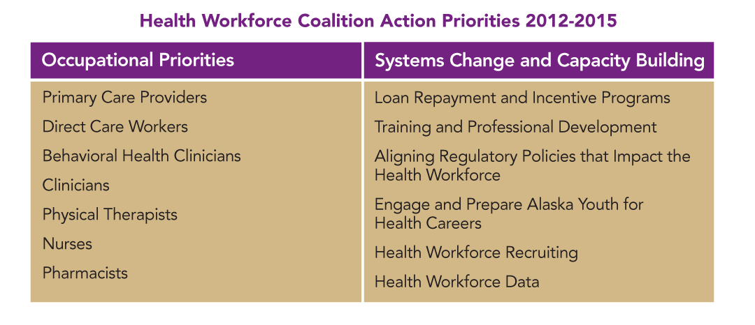
Strategic Thinking
Engage, Train/Educate, Recruit & Retain
34

Slide 30
Ahead in FY14
Funding Alaska Health Workforce Coalition Coordinator
Analyzing and applying results of the 2012 Vacancy Study
Supporting development of a Graduate Certificate in Marriage and Family Therapy (LMFT) program at University of Alaska
Securing a permanent home within UA system for non-academic training and professional development for health careers
36

Slide 31
Ahead in FY14
Trustees Recommended: MHTAAR GF/MH Gov. GF/MH
Recruitment & Retention
Loan Repayment & Incentives $ 200.0
Workforce Marketing 100.0
Training & Education
UAA Interdisciplinary Education in Children’s Mental Health $50.0 $ 0.0
Trust Training Cooperative & ARBHTA 955.0
Interpersonal Violence Prevention for beneficiaries 80.0
Specialized skills & service training on serving cognitively impaired offenders 55.0
Technical assistance & implementation of
D.A.R.T. Teams in targeted communities 210.0
AHEC 652.0 0.0
Alaska Native Community Advancement in Psychology (ANCAP) 50.0 50.0
Focus Area Administration
Workforce Coordinator 180.0
Trustee Recommended: MHTAAR GF/MH Gov. GF/MH
FY2014 Budget Increment Totals $1,780.0 $752.0 $50.0
Funding in thousands of dollars
Governor’s budget amount is shown in red when it is lower than the Trustees’ recommendation
37

Slide 32
Beneficiary Projects Initiative
Community need:
peer-based recovery support programs and peer workforce to provide support to others with similar experiences
community-based peer support and other peer-based recovery programs to help prevent need for more expensive, intensive levels of service, including hospitalization and/or incarceration
recovery support for persons with high severity and complex social and behavioral health issues who do not fare well in traditional services
Partners:
27 beneficiary grantee organizations since 2006
Alaska Peer Support Consortium
Divisions of Behavioral Health, Senior & Disability Services, Vocational Rehabilitation
Trust Training Cooperative, Center for Human Development
Advisory Board on Alcoholism and Drug Abuse, Alaska Mental Health Board, Governors Council on Disabilities and Special Education, Alaska Commission on Aging

Slide 33
Strategic Thinking
Funding and technical assistance to support safety, effectiveness and sustainability of peer programs and services throughout Alaska
Effective collaborations across service system, advocacy groups and coalitions
Training and education for peer support workforce
Integration of peer support specialists across service delivery systems
Mini Grants to improve beneficiaries’ quality of life
Small Project Grants for small, beneficiary-focused projects

Slide 34
Results for Beneficiaries
Promotes recovery, stability and wellness
Provides sense of empowerment and connection
Reinforces consumer choice in managing recovery
Wide range of beneficiary-led programs statewide
peer-support services
recovery-community support programs
housing
clubhouses
drop-in centers
community outreach and engagement
illness self-management
alternatives to residential treatment
supported employment
training and education
34

Slide 35
Ahead in FY14
Trustee Recommended: MHTAAR Authority Grant GF/MH Gov. GF/MH
Grant Funds for Projects
BPI Program Grants $1,620.0
Technical Assistance (TA)
TA for beneficiary groups & agencies 265.0
Partners in Policymaking $200.0
Program Management
Initiative Administration 100.0
Beneficiary & family leadership conference 80.0
Evaluation 30.0
Consumer choice & expanded services
Mini Grants – Behavioral Health 909.6
Mini Grants – Alzheimer’s Disease and Related Dementia 286.3
Mini Grants – Developmental Disabilities 250.3
Small Projects Grants 250.0
Micro-Enterprise Small Business Capital 125.0 $ 25.0 $25.0
Trustee Recommended: MHTAAR Authority Grant GF/MH Gov. GF/MH
FY2014 Budget Increment Totals $ 575.3 $3,540.9 $ 25.0 $25.0
Funding in thousands of dollars

Slide 36
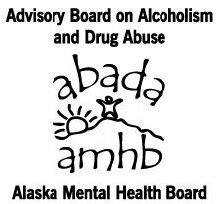
FY14 Joint Legislative Priorities
Shared with all beneficiary advisory boards
long-term support services for people with disabilities
Complex Behaviors Collaborative
Alaska Commission on Aging

Slide 37
Thank You
Contacts:
Jeff Jessee, Chief Executive Officer
jeff.jessee@alaska.gov
907-269-7963
Delisa Culpepper, Chief Operating Officer
delisa.culpepper@alaska.gov
907-269-7965
3745 Community Park Loop, Suite 200
Anchorage AK 99508
www.mhtrust.org

