Slide 1
Lunch and Learn
March, 2017
Patrick Sidmore, MSW
Patrick.sidmore@alaska.gov

Slide 2
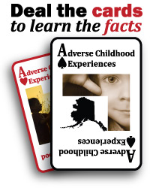
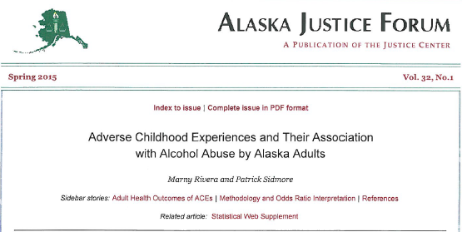
Some Products Created by this Effort – as of October 2016
Departments:
Public Safety Health & Social
Education & ED
How does Alaska
Compare to Other
States?
$90 Million in Savings
From Six Health Issues
Specific Link from
ACEs to Alcohol
Abuse in AK
Getting People to
The Website –
2,000 & Counting
Hundreds of Slides
Scores of Presentations
More Than 3,100 Reached
Regional and Specific
Demographic ACEs
Data

Slide 3
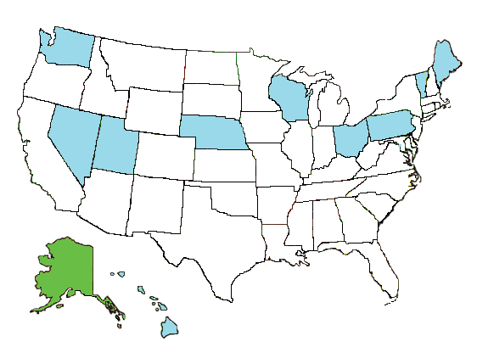
Ten State and DC - ACE Results
The prevalence estimates reported are from Washington, DC and ten states (HAWAII, MAINE, NEBRASKA, NEVADA, OHIO, PENNSYVANIA, UTAH, VERMONT, WASHINGTON, and WISCONSIN) who included the ACE module on the 2010 BRFSS (n=53,784)

Slide 4
*In the category of Emotional Abuse the Ten State & DC Study used all positive answers (once and more than once) as a measure of indicating the presence of that ACE. This hasn’t been done in other BRFSS ACE studies but in this comparison it was used with the Alaska data to provide a comparable rate between the two populations. Sources: 2013-2015 Alaska BRFSS, Section of Chronic Disease and Prevention, Alaska Division of Public Health, Centers for Disease Control and Prevention. Behavioral Risk Factor Surveillance System Survey ACE Module Data, 2010

Slide 5
Sources: 2013-2015 Alaska BRFSS, Section of Chronic Disease Prevention and Health Promotion, Alaska Division of Public Health, & Centers for Disease Control and Prevention. Behavioral Risk Factor Surveillance System Survey ACE Module Data, 2010

Slide 6
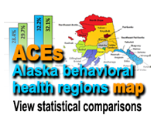
Want Details about your Area?

Slide 7
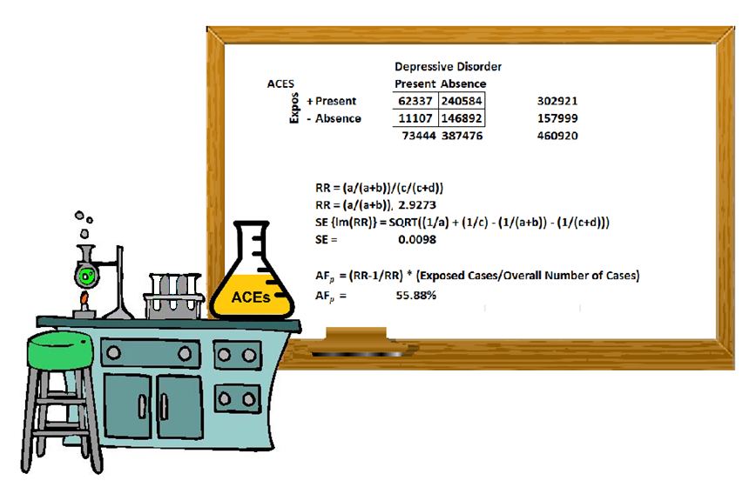
Population Attributable Fraction

Slide 8
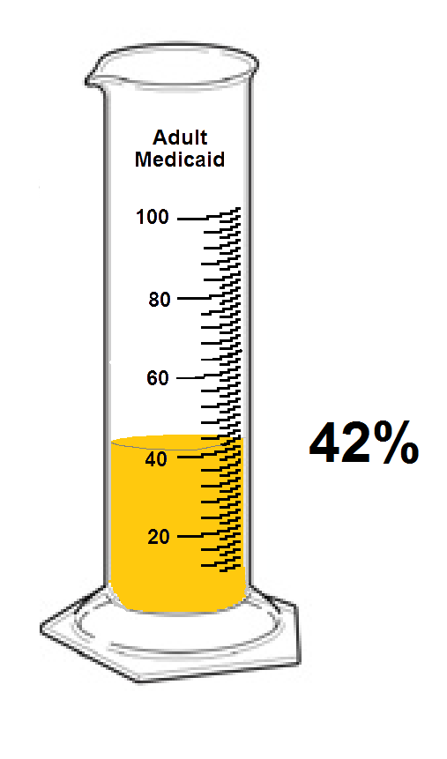
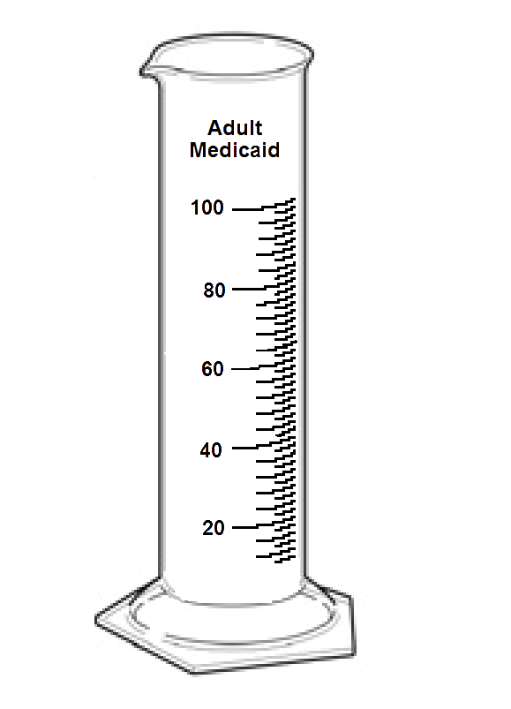
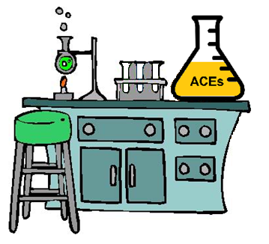
ACEs and Adult Medicaid
How much of adult Medicaid usage can be tied back to ACEs?
Source: 2013-2015 Alaska BRFSS, Section of Chronic Disease Prevention and Health Promotion, Alaska Division of Public Health, Graphic by Alaska Mental Health Board Staff

Slide 9
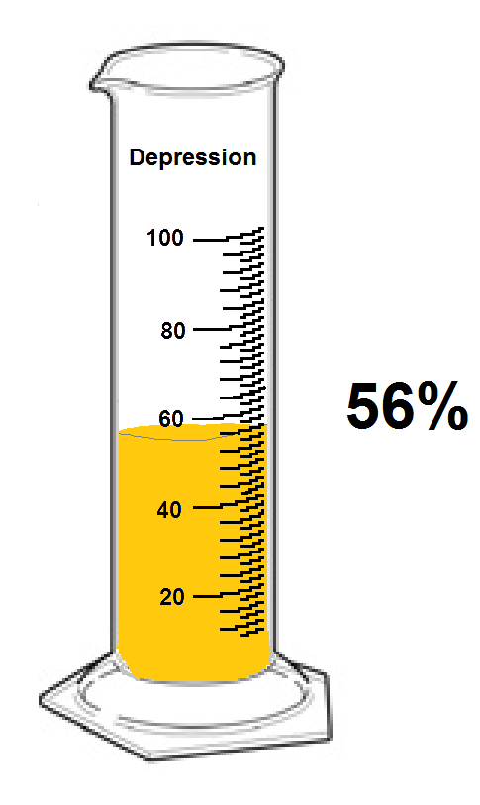
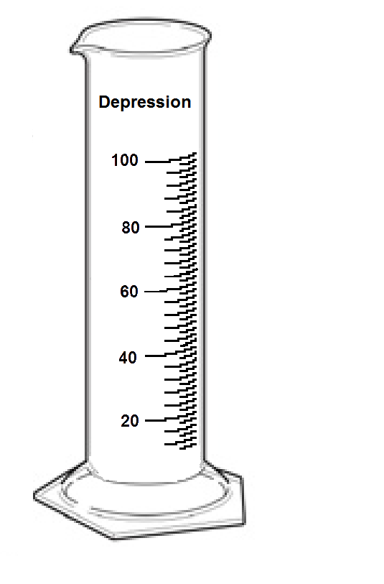
ACEs and Depression
How much of adult depression can be tied back to ACEs?
Source: 2013-2015 Alaska BRFSS, Section of Chronic Disease Prevention and Health Promotion, Alaska Division of Public Health, Graphic by Alaska Mental Health Board Staff

Slide 10
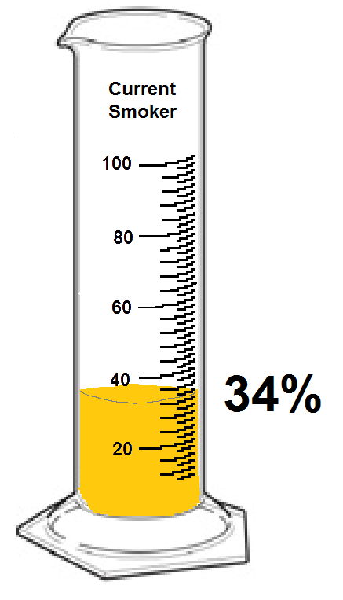
ACEs and Current Smoking
How much of current adult smoking can be tied back to ACEs?
Source: 2013-2015 Alaska BRFSS, Section of Chronic Disease Prevention and Health Promotion, Alaska Division of Public Health, Graphic by Alaska Mental Health Board Staff

Slide 11
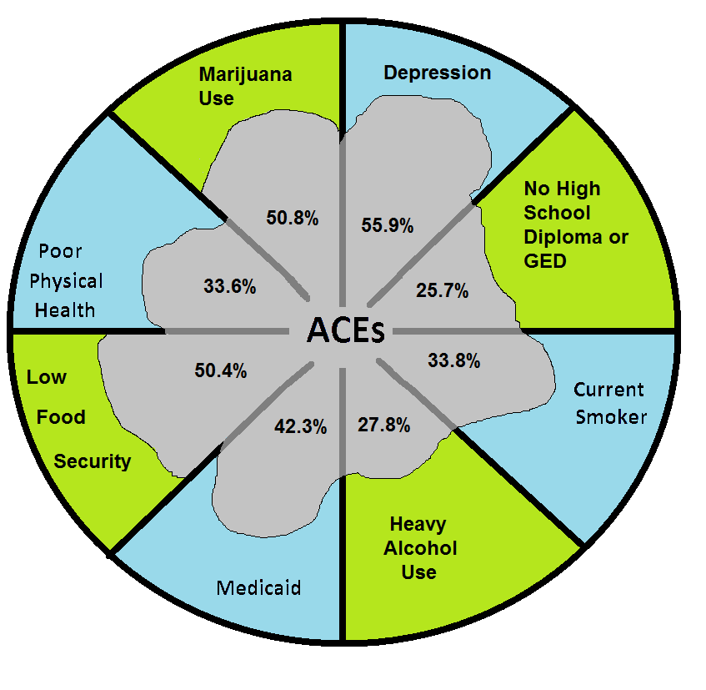
Population Attributable Fraction
Source: 2013-2015 Alaska BRFSS, Section of Chronic Disease Prevention and Health Promotion, Alaska Division of Public Health, Graphic by Alaska Mental Health Board Staff

Slide 12
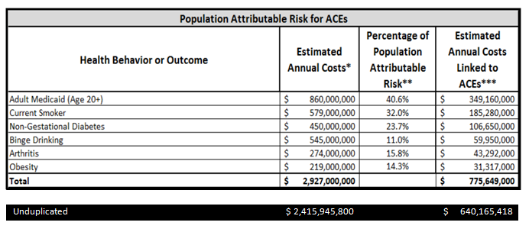
Some Estimated Alaska Costs
* For the source of each health behavior or outcomes costs see the individual analysis of the individual items below.
** These population attributable risks were calculated for this report by the Alaska Department of Health and Social Services, Division of Public Health, Section of Chronic Disease Prevention and Health Promotion from the Alaska ACE data captured in the 2013 BRFSS
*** These cost were calculated by multiplying the two adjacent columns
For full analysis go to http://dhss.alaska.gov/abada/ace-ak/Documents/ACEsEconomicCosts-AK.pdf

Slide 13
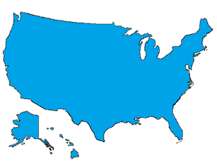
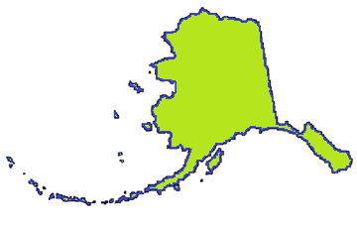
Adverse Childhood Experiences Alaska and the U.S.
1,800
94,000
Notes:
The number of children’s information surveyed from Alaska was approximately 1,800 and 94,000 from the U.S. Most of the respondents were parents

Slide 14
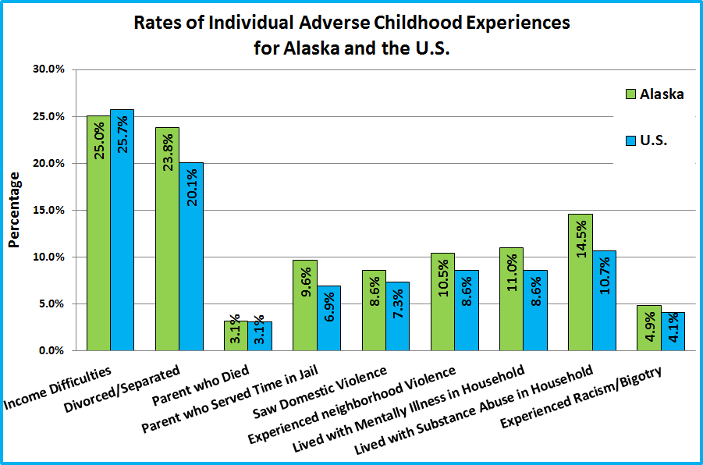
Source: Child and Adolescent Health Management Initiative (2012). “2011-2012 National Survey of Children’s Health (2012), U.S. Department of Health and Human Services, Health Resources and Services Administration. Graphics and analysis done by the Alaska Mental Health Board and Advisory Board on Alcoholism and Drug Abuse Staff
Notes:
Statistically significant differences between Alaska and the U.S can be found in three ACE categories: Separation and Divorce, Household Mental Illness and Incarcerated family Member.

Slide 15
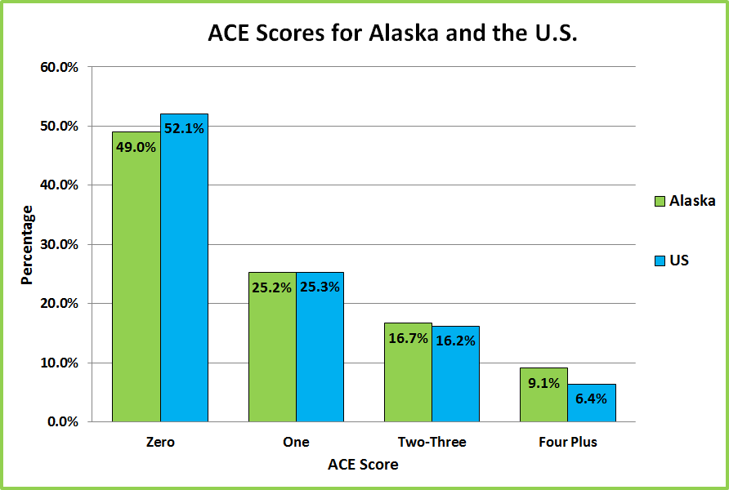
Source: Child and Adolescent Health Management Initiative (2012). “2011-2012 National Survey of Children’s Health (2012), U.S. Department of Health and Human Services, Health Resources and Services Administration. Graphics and analysis done by the Alaska Mental Health Board and Advisory Board on Alcoholism and Drug Abuse Staff
Notes:
The average number of ACEs in the Alaska population was 1.1 per child or youth while the average for U.S. children and youth it was .94.

Slide 16
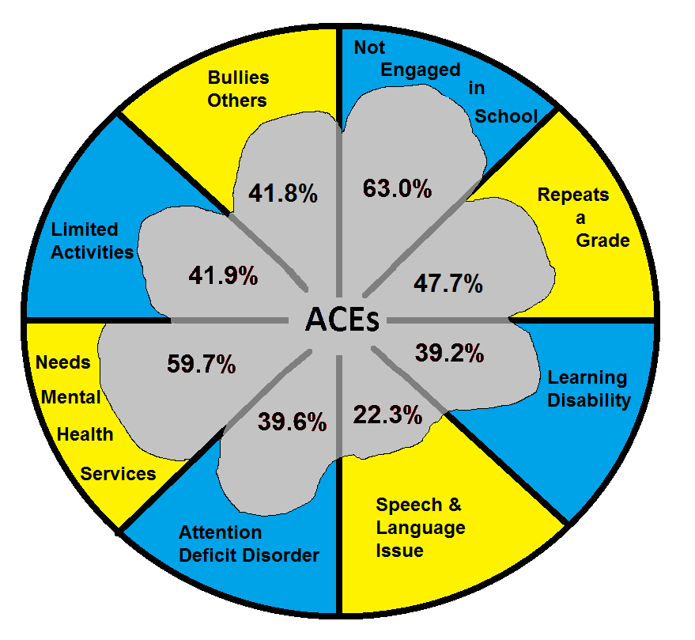
Source: Child and Adolescent Health Management Initiative (2012). “2011-2012 National Survey of Children’s Health (2012), U.S. Department of Health and Human Services, Health Resources and Services Administration. Graphics and analysis done by the Alaska Mental Health Board and Advisory Board on Alcoholism and Drug Abuse Staff
Population Attributable Fraction
Notes:
Population Attributable Fraction (PAF)
Definition
The contribution of a risk factor to a disease or a death is quantified using the population attributable fraction (PAF). PAF is the proportional reduction in population disease or mortality that would occur if exposure to a risk factor were reduced to an alternative ideal exposure scenario (e.g. No ACEs).

Slide 17
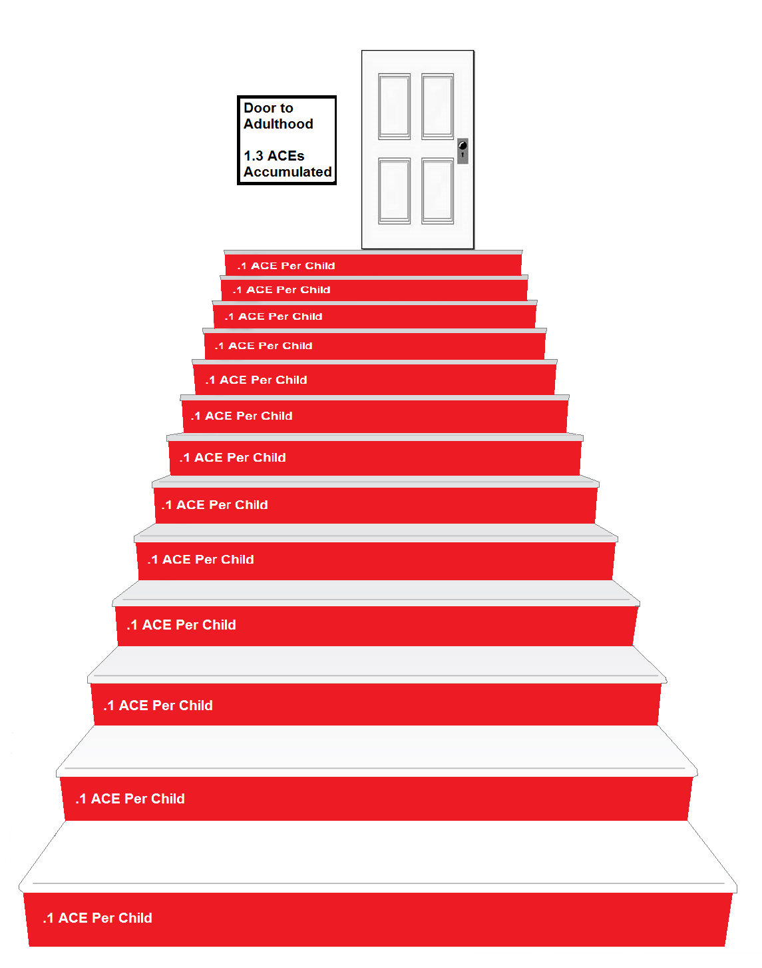
By age 17 Alaskan young people on average have 1.3 ACEs they have acquired
Source: Child and Adolescent Health Management Initiative (2012). “2011-2012 National Survey of Children’s Health (2012), U.S. Department of Health and Human Services, Health Resources and Services Administration. Graphics and analysis done by the Alaska Mental Health Board and Advisory Board on Alcoholism and Drug Abuse Staff

Slide 18
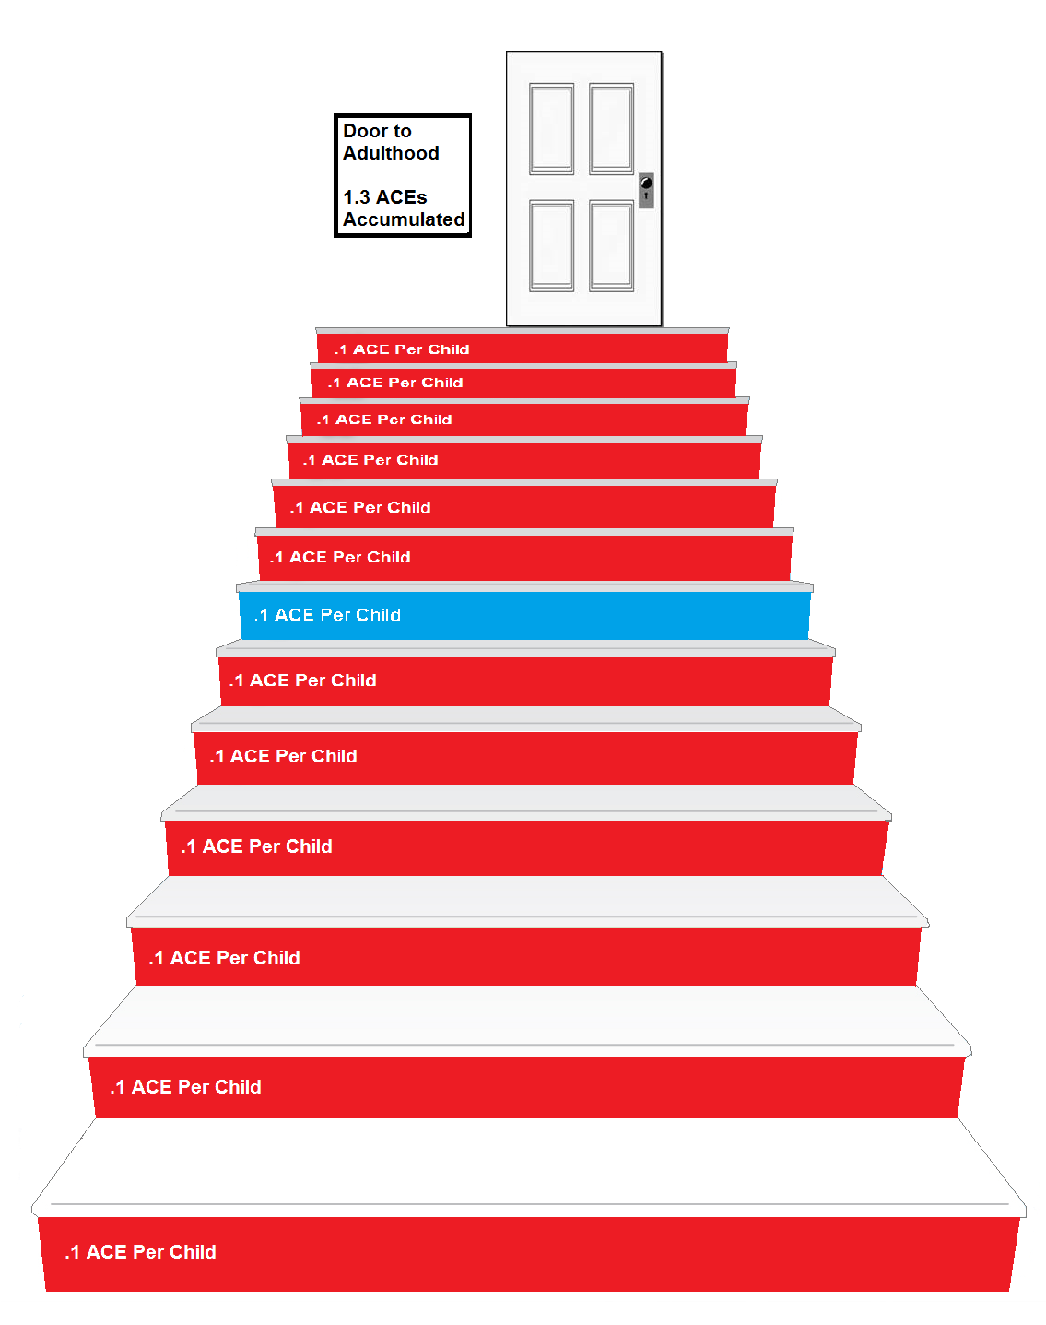
By age 17 Alaskan young people on average have 1.3 ACEs they have acquired
At what age do you think that
they are half-way to their total
ACEs?
Source: Child and Adolescent Health Management Initiative (2012). “2011-2012 National Survey of Children’s Health (2012), U.S. Department of Health and Human Services, Health Resources and Services Administration. Graphics and analysis done by the Alaska Mental Health Board and Advisory Board on Alcoholism and Drug Abuse Staff

Slide 19
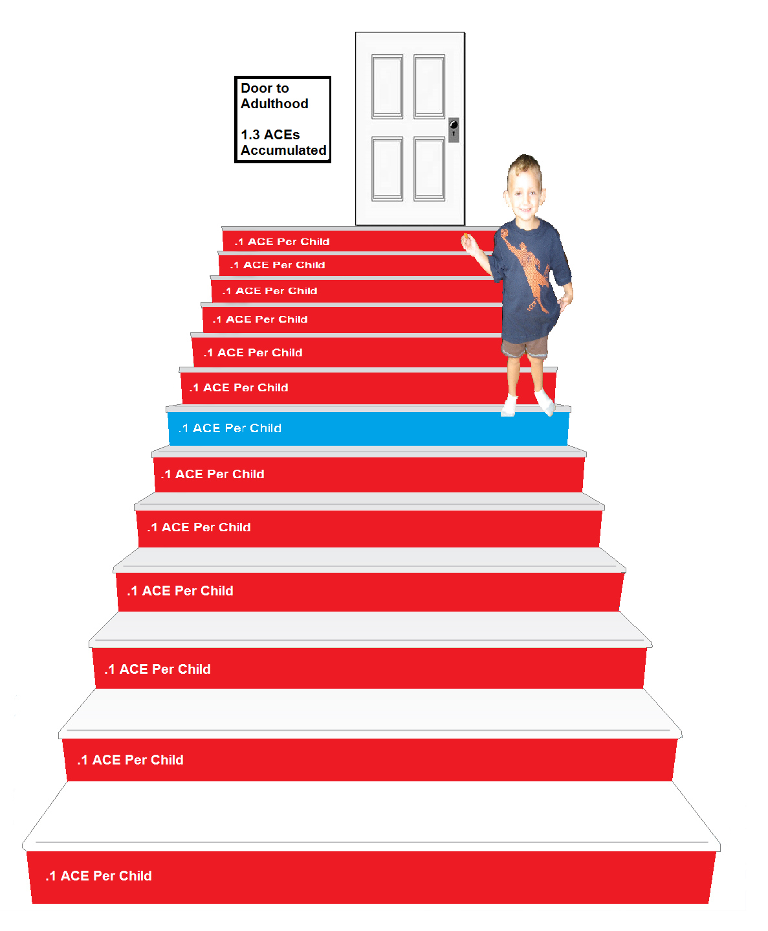
By age 17 Alaskan young people on average have 1.3 ACEs they have acquired
At what age do you think that
they are half-way to their total
ACEs?
Age 3
Source: Child and Adolescent Health Management Initiative (2012). “2011-2012 National Survey of Children’s Health (2012), U.S. Department of Health and Human Services, Health Resources and Services Administration. Graphics and analysis done by the Alaska Mental Health Board and Advisory Board on Alcoholism and Drug Abuse Staff

Slide 20
Source: Child and Adolescent Health Management Initiative (2012). “2011-2012 National Survey of Children’s Health (2012), U.S. Department of Health and Human Services, Health Resources and Services Administration. Graphics and analysis done by the Alaska Mental Health Board and Advisory Board on Alcoholism and Drug Abuse Staff

Slide 21
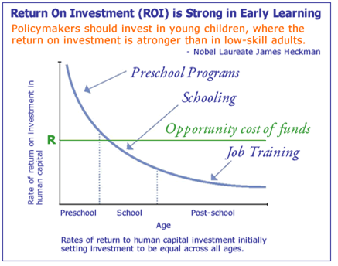
The Heckman Equation

