Slide 1
Fiscal Review of Alaska K-12 Investments
Review of Commonwealth North Fiscal Study Group Recommendations & Background Analysis
Review of School Facility Consolidation Incentives
Prepared by: Mark Foster, CWN Fiscal Study Group Member
Prepared for: Senate/House Joint Education Meeting
March 6, 2017

Slide 2
Overview
Preface
Commonwealth North Fiscal Study Group
Recommendations
State Fiscal Outlook Considerations
K-12 Investment & Performance
Review of School Consolidation Incentives

Slide 3
Preface
Commonwealth North Fiscal Study Group
Cochairs: Cheryl Frasca & Eric Wholforth
CWN Fiscal Study Group
Mark Foster, CWN Study Group Member, mafa@alaska.net
Former CFO, Anchorage School District (through April 2016)
Principal, Mark A Foster & Associates (MAFA)
Clients include public and private clients across energy, electric and natural gas utilities, information & telecommunications technology, health insurance & medical care sectors
No current or proposed K-12 engagements

Slide 4
Commonwealth North Fiscal Study Group Recommendations on K-12
Education funding needs to refocus on direct instruction that yields measureable improvements in student achievement. State K-12 funding should be reduced by 1 to 3% per year for four years, during which funding would have to be reallocated from administrative/operations [other than direct instruction] to maintain funding for direct instruction.
Prior to making investments in UA teacher training programs, teacher training programs both inside and outside Alaska should be evaluated to identify those that have produced high quality teachers who have generated high student achievement results.
Source: Commonwealth North, The State’s Operating Budget: Critical Crossroads,
Choices and Opportunities (Updated), A Commonwealth North Study Report,
Cheryl Frasca and Eric Wohlforth, Study Group Co-Chairs, January 2017
Jim Egan and Aaron Weddle, Staff

Slide 5
CWN Fiscal Study Group Recommendations Background: State Fiscal Outlook Considerations
Descriptions of State of Alaska Fiscal Gap (Alaska’s Future)
State of Alaska Fiscal Gap taking into consideration pension funding challenges (using Moody’s standard pension adjustments)
Notes:
Given the magnitude of the remaining structural deficit after taking into account the range of proposed contributions to the general fund from permanent fund earnings [maf note: especially after taking into account pension funding challenges as well the need to be mindful of the relative risk to overall economic output from taxes vs. modest budget reductions based on recent post 2008 economic research on the output differences between budget reductions and taxes] a budget reduction target of 1-3% per year for essential government investments in K-12 for four years appears modest.

Slide 6
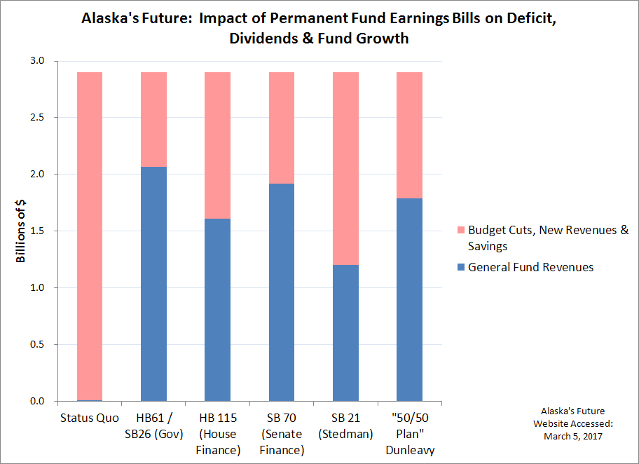
CWN Fiscal Study Group Recommendations Background: State Fiscal Outlook Considerations – Fiscal Gap
Notes:
On its face, a reconnaissance level analysis of the fiscal gap between expenditures and revenues remains daunting. Even with proposed contributions to the general fund from permanent fund earnings, a significant gap remains to be covered from a combination of budget cuts, new revenues and other savings sources.
In light of the magnitude of the gap that remains after given consideration to proposals to use permanent fund earnings, the Commonwealth North Fiscal Study Group has continued to look for ways to improve the efficiency and effectiveness of state expenditures and investments.
Given the magnitude of the remaining structural deficit after taking into account the range of proposed contributions to the general fund from permanent fund earnings and the need to be mindful of the relative risk to overall economic output from taxes vs. modest budget reductions, a budget reduction target of 1-3% per year for four years appears modest under the circumstances.

Slide 7
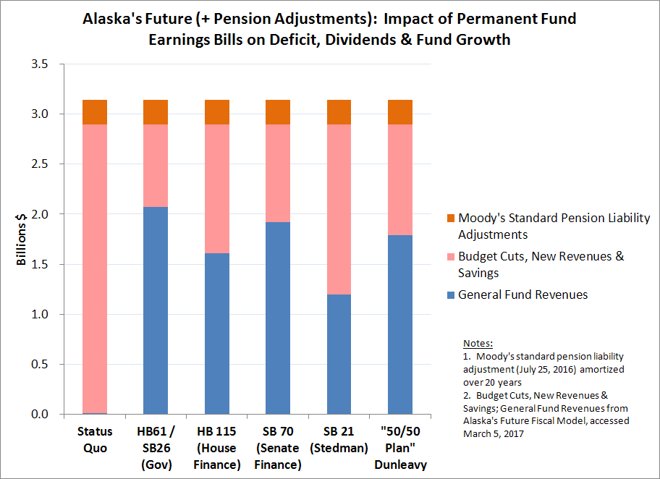
CWN Fiscal Study Group Recommendations Background: State Fiscal Outlook Considerations – Fiscal Gap including pension funding challenges
Notes:
The fiscal gap that remains after the proposed contributions to the general fund from permanent fund earnings should also consider the future pension payments (beyond the actuarial estimate) that are anticipated within what has become standard adjustments to state actuarial estimates for Moody’s and other credit analysts.
maf notes:
Recent economic research (November 2016) suggests that standard short term estimates of economic multipliers associated with public spending cuts and taxes may overestimate the relative economic impact of public sector spending cuts relative to new taxes. See for example, National Bureau of Economic Research, Working Paper #22863, “Is it the ‘how’ or the ‘when’ that matters in fiscal adjustments?”, Alesina, et al, (November 2016). “…when governments pursue contractionary policies, tax-based adjustments are costly in terms of output loses, while expenditure reductions have very low output costs. This difference appears to be independent of the business cycle.”
While state taxes have the potential to be a partial offset to federal taxes [which diminishes their potential impact on local economic output relative to the NBER sample in working paper 22863], the evidence from the NBER study suggests the dynamic negative impacts of taxes on output and the dynamic ability of the economy to adjust to public expenditure reductions warrant a fresh look at Alaska short term estimates of economic multipliers associated with public sector spending cuts relative to new taxes.

Slide 8
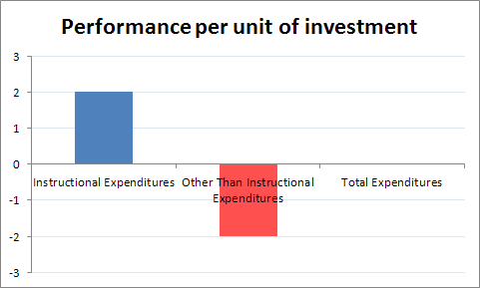
CWN Fiscal Study Group Recommendations Background: K-12 Investments & Performance APA Consulting, “Review of Alaska’s School Funding Program” (July 2015)
Relationship between Performance and Expenditures
APA’s regression analysis examining the relationship between instructional expenditures and district proficiency levels shows a positive relationship between spending and performance in both reading and math (p. xi)
Contrasted to instructional expenditure per pupil, the [regression] analysis indicated that there is no significant relationship between total district expenditure per pupil and district proficiency levels (p. xi)
maf annotation:
Notes:
The Commonwealth North Fiscal Study Group discussion continued to support the core government policy prescription that investments in essential government functions should be reviewed to ensure they remain efficient and effective.
The public record evidence regarding K-12 performance and expenditures includes a recent study (July 2015) for the Alaska Legislature which indicates that direct instructional expenditures correlate with performance while overall expenditure levels do not have an impact on performance. This suggests that expenditures outside of direct instruction are associated with a net negative impact on performance.

Slide 9
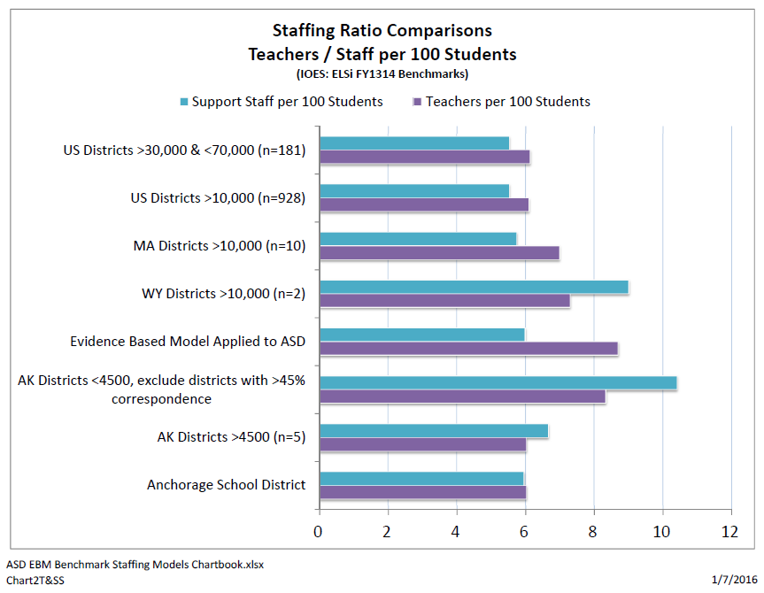
CWN Fiscal Study Group Recommendations Background: K-12 Investments & Performance (Anchorage School District Legislative Lunch Presentation, January 2016)
High performance districts (MA) and evidence based resource model feature more teachers than support staff (per student)
Other, often rural, districts feature more support staff than teachers (per student). Testimony provided to ASD Finance Committee suggest s that rural districts with teacher recruitment challenges may backfill empty teaching positions with support staff.

Slide 10
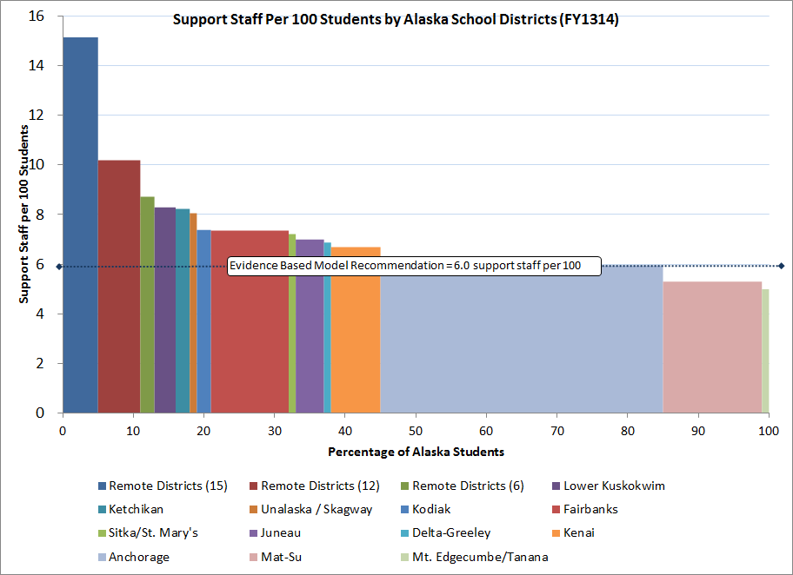
CWN Fiscal Study Group Recommendations Background: K-12 Investments & Performance Picus, et al., Evidence Based Resource Model (Anchorage School District Board Memo, April 4, 2016)
Given positive association between instruction investment and student performance & given negative association between support staff spending and student performance in AK, a shift in investment from support staff to teachers should be considered.
Mat-Su & Mt. Edgecumbe support staff ratios should be considered in the development of support staff ratios in a funding formula that prioritizes teachers / direct classroom instruction over support staff.
School districts and municipalities should explore support staff consolidation and efficiencies where ever possible.
<5-6

Slide 11
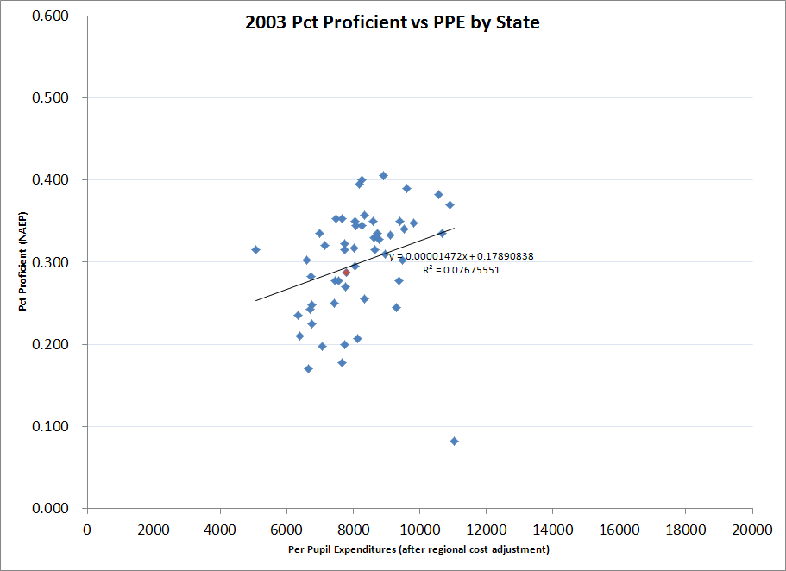
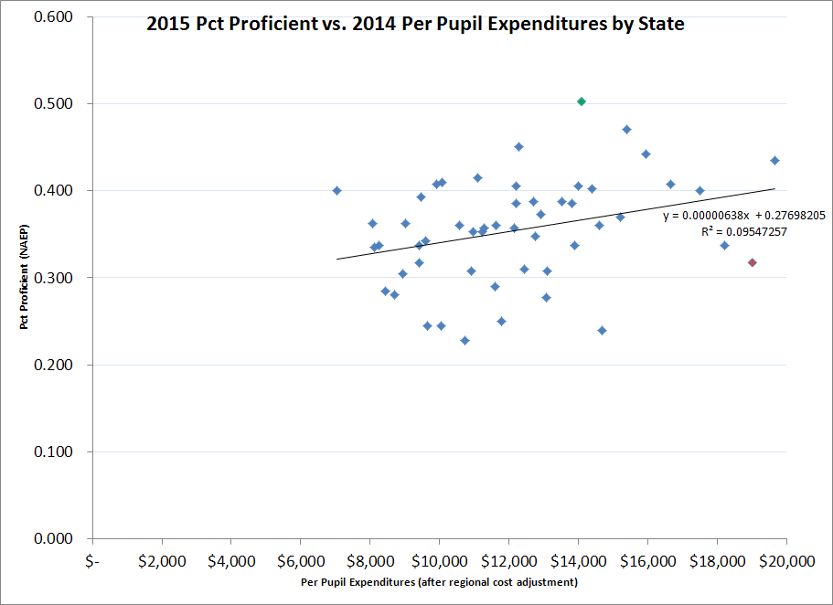
CWN Fiscal Study Group Recommendations Background: K-12 Investments & Performance January 2017 Update: What do we know about AK K-12 investment levels and performance compared to other states? (Source: Education Week Dec 30, 2016)
AK is red diamond
FY2003
FY2014 & FY2015
1. Spending and student performance is not well correlated at the State level
2. Alaska has migrated from “middle” of spending and performance toward high spending/low performance quadrant
Notes:
Source: Education Week Annual Reports on K-12 Performance & Finance, National Assessment of Education Progress (NAEP)

Slide 12
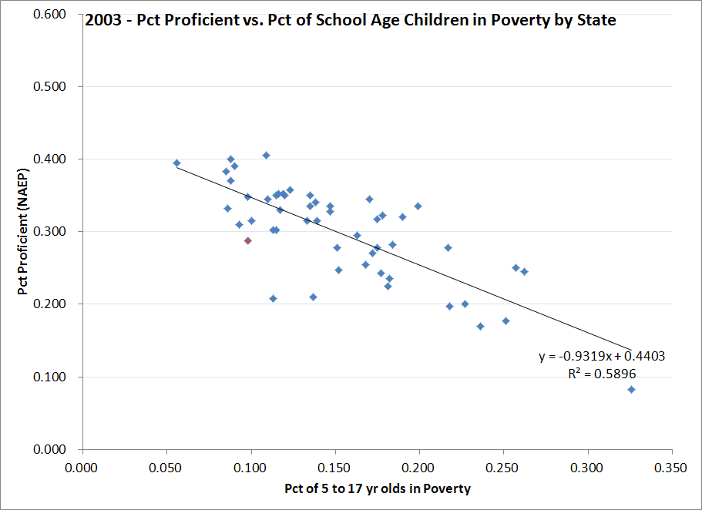
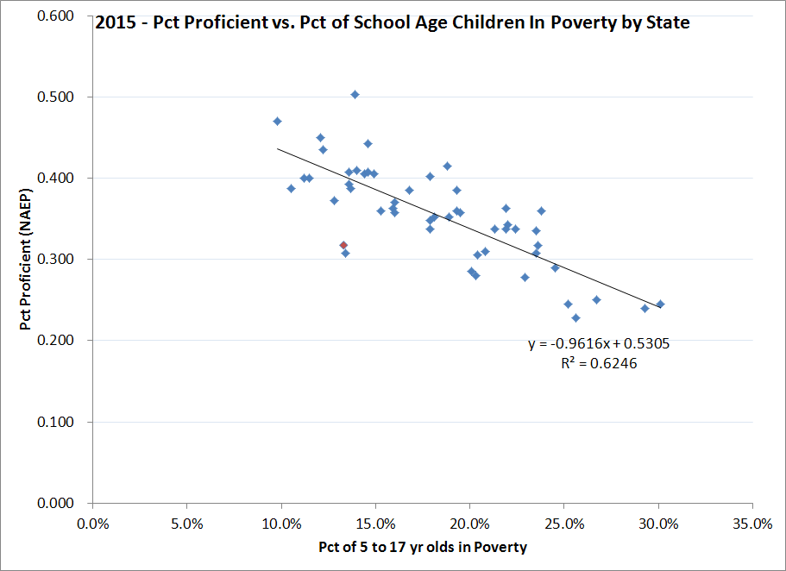
CWN Fiscal Study Group Recommendations Background: K-12 Investments & Performance January 2017 Update: What do we know about AK K-12 investment levels and performance compared to other states? (Source: Education Week Dec 30, 2016)
AK is red diamond
FY2003
FY2015
1. Student performance and percentage of school age children in poverty continues to be inversely correlated at the State level.
2. Alaska has made modest improvements in student performance, while other states have made more progress against the headwinds of poverty.
Notes:
Source: Education Week Annual Reports on K-12 Performance & Finance, National Association of Education Progress (NAEP), US Census Bureau (children in poverty)

Slide 13
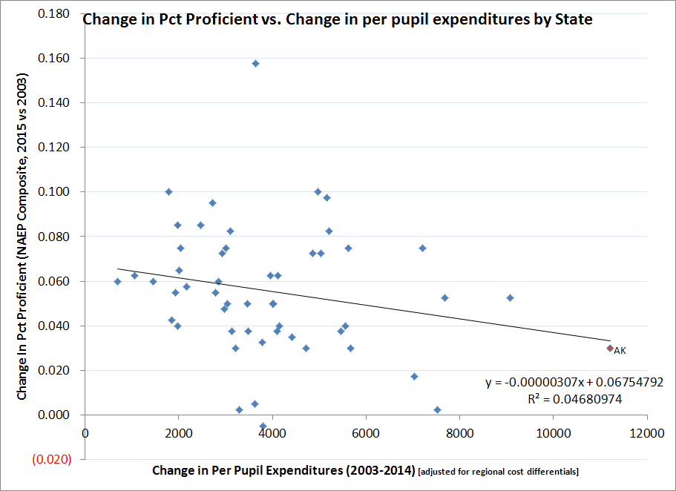
CWN Fiscal Study Group Recommendations Background: K-12 Investments & Performance January 2017 Update: What do we know about AK K-12 investment levels and performance compared to other states? (Source: Education Week Dec 30, 2016)
AK is red diamond
1. Alaska has made modest improvements in student performance with a large increase in spending per pupil, while most other states have made more progress on student performance with less investment. NB: This comparison does not take into account differences of poverty levels among states. See next chart for poverty normalized percentage proficient.
Notes:
Source: Education Week Annual Reports on K-12 Performance & Finance, National Assessment of Education Progress (NAEP)

Slide 14
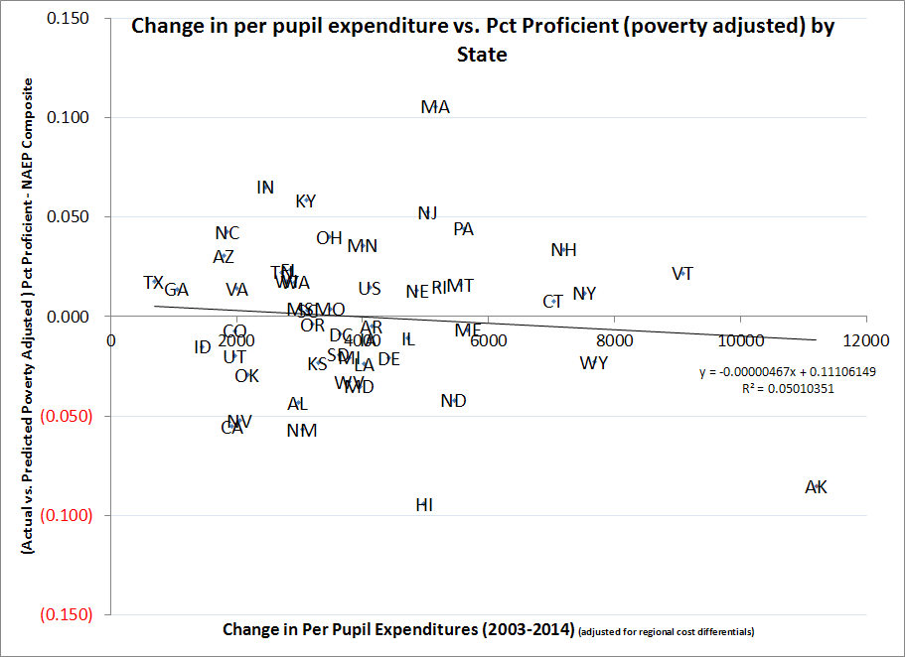
CWN Fiscal Study Group Recommendations Background: K-12 Investments & Performance January 2017 Update: What do we know about AK K-12 investment levels and performance compared to other states? (Source: Education Week Dec 30, 2016)
AK is red diamond
After adjusting for poverty, several states made significant progress in student performance with moderate increases in K-12 investment levels. Massachusetts student performance continues to outpace the rest of the States. Alaska and Hawaii are outliers – falling well below expected performance for their K-12 investment and child poverty levels.
Notes:
Source: Education Week Annual Reports on K-12 Performance & Finance, National Assessment of Education Progress (NAEP), US Census Bureau (children in poverty)

Slide 15
CWN Fiscal Study Group Recommendations Follow-up questions:
Strategies To Shift Resources toward Improved Performance (district level)
Prioritize classroom instruction; see for example Augenblick Study of AK Districts spending & performance (2015) linkage between spending on teachers with students (positive) and all spending (no linkage), which suggests spending on other stuff besides teachers with students is a net negative. Need to cut admin/overhead/support and focus on connecting quality educators with students.
Reduce expenditures outside of direct classroom instruction & limit teacher support to demonstrably high value valuable investments
Consider cost/benefit in the assessment of classroom support investments (curriculum, including software, etc.)
State Level Implementation Options & Considerations
Legislative intent language
Unallocated percentage reductions to allow administration and districts to allocate reductions
Foundation formula, transportation formula, school debt reimbursement
Restructure foundation formula around teacher:student ratios to ensure focus on direct classroom instruction; start formula discussion with evidence based resource model or top performers among comparable districts.

Slide 16
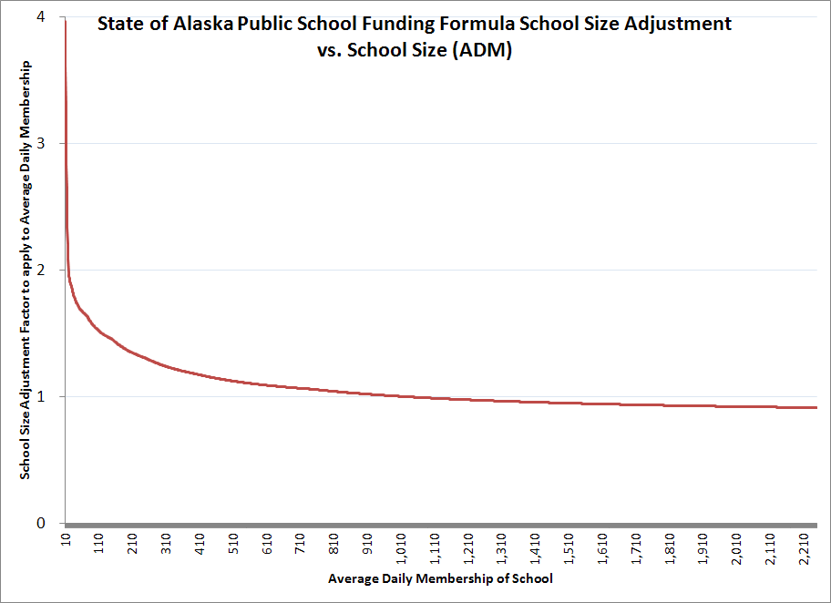
Review of School Facility Consolidation Incentives State, local and federal funding related to school facility consolidation incentives= State funding formula + transportation funding formula + school debt reimbursement program + federal support for school facilities, e.g., military impact funds
School Size Adjustment in Public School Foundation Formula tends to capture scale economies associated with consolidating schools - producing savings for state & local funding sources, but may not provide local district with any net financial benefit (and may be a financial risk, especially to central office and “fixed costs”) and district perceived financial risk is compounded by local challenges associated with closing schools and moving attendance boundaries.
Illustrative Example:
2 each X 200 ADM = 2 X 200 * 1.36 school size adjustment = 544.2 adjusted ADM * $10,000 / fully adjusted ADM = $5.442 million.
1 each X 400 ADM = 1 * 400 * 1.18 school size adjustment = 471.6 adjusted ADM * $10,000 / fully adjusted ADM = $4.716 million.
State + local taxpayers capture on the order of $726,000 in basic need formula savings; school district loses $726,000 in revenue and will be looking to capture as much or more in savings. Perceived risk that central office and other “fixed costs” may not be covered.
Notes:
Please note that most of the spare capacity in the Anchorage School District is associated with military base (JBER) student population fluctuations – including on-base, adjacent to, and along corridor serving civilian support as well as newly retired military population.

