Slide 1
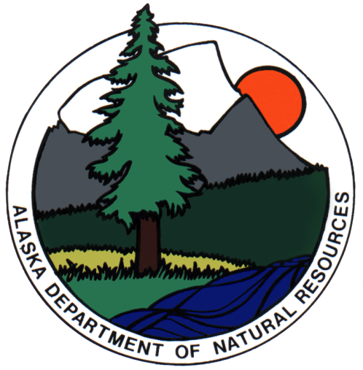
Alaska Department of Natural Resources
Senate Resources
FY12 Overview
January 24, 2011

Slide 2
Who We Are and What We Do
Article 8, Section 1 of the Alaska Constitution provides that “it is the policy of the State to encourage the settlement of its land and the development of its resources by making them available for maximum use consistent with the public interest.”
Article 8, Section 2 provides that the “legislature shall provide for the utilization, development, and conservation of all natural resources belonging to the State, including land and waters, for the maximum benefit of its people.”

Slide 3
Department Mission
Develop, conserve and enhance natural resources for present and future Alaskans

Slide 4
What We Do
DNR manages (1) the state’s land – approximately 100 million acres of uplands, 60 million acres of tidelands, shore lands, and submerged lands, and 40,000 miles of coastline – and (2) the state’s vast energy and natural resources
State land use and the natural resources developed from state land are the primary source of state revenue

Slide 5
What We Do
DNR also manages state parklands; conducts wildland fire suppression; and supports the agriculture and timber industries in Alaska
Another important function of DNR is obtaining and providing the geologic, hydrologic, land records, and other information needed to manage and utilize the state’s natural resources

Slide 6
Employees and Budget
DNR currently employs about 1,100 Alaskans in full-time and seasonal positions, with main offices in Anchorage, Juneau, Fairbanks and Palmer, and regional offices throughout the state
Our FY11 operating budget is $152.5 million, which includes funding for AGIA implementation
Our FY12 operating budget request is $153.7 million, made up of:
48% Unrestricted General Fund
17% Designated General Fund
23% Other funds including industry receipts
12% Federal

Slide 8
Divisions
Oil and Gas Kevin Banks, Director 105 full and part time budgeted positions 10.82% of DNR’s FY12 Operating Budget Request
$16,624.5 budget request (all sources)

Slide 9
Divisions
Mining, Land & Water Wyn Menefee, Acting Director 207 full and part time budgeted positions 15.27% of DNR’s FY12 Operating Budget Request
$23,481.2 budget request (all sources)

Slide 10
Divisions
Forestry Chris Maisch, Director 280 full and part time budgeted positions (does not include the hundreds of fire season crews) 25.38% of DNR’s FY12 Operating Budget Request
$38,988.6 budget request (all sources)

Slide 11
Divisions
Geological & Geophysical Surveys Bob Swenson, Director 48 full and part time budgeted positions 5.85% of DNR’s FY12 Operating Budget Request
$8,983.2 budget request (all sources)

Slide 12
Divisions
Coastal & Ocean Management Randy Bates, Director 33 full time budgeted positions 3.05% of DNR’s FY12 Operating Budget Request
$4,691.7 budget request (all sources)

Slide 13
Divisions
Agriculture Franci Havemeister, Director 46 full and part time budgeted positions 4.74% of DNR’s FY12 Operating Budget Request
$7,282.4 budget request (all sources)

Slide 14
Divisions
Parks & Outdoor Recreation Ben Ellis, Director 185 full and part time budgeted positions 10.09% of DNR’s FY12 Operating Budget Request
$15,495.5 budget request (all sources)

Slide 15
Divisions
Support Services Jean Davis, Director 130 full and part time budgeted positions 8.48% of DNR’s FY12 Operating Budget Request
$12,113.4 budget request (all sources)

Slide 16
Offices
State Pipeline Coordinator’s Office Mike Thompson, State Pipeline Coordinator 31 full and part time budgeted positions 5.07% of DNR’s FY12 Operating Budget Request
$7,789.2 budget request (all sources)

Slide 17
Offices
Project Management & Permitting Tom Crafford, Director 12 full time budgeted positions 2.75% of DNR’s FY12 Operating Budget Request
$4,223.9 budget request (all sources)

Slide 18
Offices
AGIA Coordinator’s Office 9 full and part time budgeted positions 2.32% of DNR’s FY12 Operating Budget Request
$3,563.3 budget request (all sources)

Slide 19
Offices
Mental Health Trust Lands Office Greg Jones, Executive Director
16 full and part time budgeted positions 1.88% of DNR’s FY12 Operating Budget Request
$2,892.7 budget request (all sources)

Slide 20
Offices
Office of the Commissioner Dan Sullivan, Commissioner 9 full time budgeted positions 0.79% of DNR’s FY12 Operating Budget Request
$1,221.1 budget request (all sources)

Slide 21
Boards and Commissions
Natural Resource Conservation & Development Board (NRCDB)
Citizen’s Advisory Commission on Federal Areas (CACFA)
Board of Agriculture and Conservation
Board of Forestry
Alaska Historical Commission
Alaska Royalty Oil and Gas Development Board
Seismic Hazards Safety Commission
Outdoor Recreation Trails Advisory Board

Slide 22
FY12 Operating Budget - $153,746.7

Slide 23
Engagement Tour
Meeting with key stakeholders
What I’m hearing, seeing, learning
Challenges
Opportunities
Need for partnership

Slide 24
Challenges
TAPS throughput
Aging infrastructure
High energy costs throughout the state
Gas pipeline
Cook Inlet energy
Permitting efficiencies

Slide 25
DNR Specific Challenges & Solutions
Permitting efficiencies & workload
Federal land conveyance
Litigation - defending permitting process
Forest management
Unlocking resources
Publicizing resources
Management challenges
Retention / Recruitment
Maintain budget & obtain increments
Improve coordination
Creative thinking & implementation

Slide 26
Opportunities – Alaska as a Storehouse
North Slope: world class energy basin
Massive mineral deposits
Vast amounts of renewable resources
New players looking to unlock our resource potential
Ongoing innovation

Slide 27
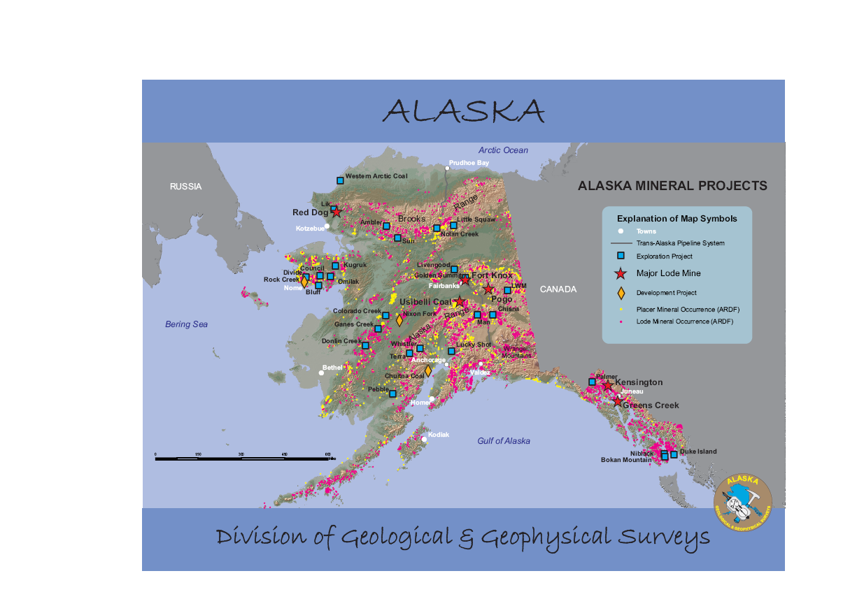

Slide 28
Alaska as a Storehouse
Oil: 43 billion barrels of undiscovered, technically recovery reserves; this does not include massive quantities of unconventionals (shale, heavy oil, etc.)
Gas: 236 trillion cubic feet of undiscovered, technically recoverable reserves
Coal: 17% of the world’s coal resources; 2nd most in the world
Copper: 6% of the world’s copper resources; 3rd most in the world
Lead: 2% of the world’s lead resources; 6th most in the world

Slide 29
Alaska as a Storehouse
Gold: 3% of the world’s gold resources; 7th most in the world
Zinc: 3% of the world’s zinc resources; 8th most in the world
Silver: 2% of the world’s silver resources; 8th most in the world
Rare earth elements: Alaska has over 150 occurrences, and one of N. America’s most significant deposits
Timber: Alaska has 17% of the nation’s forestland

Slide 30
Importance of Partnership
Stakeholders eager to form alliances
Partnership moves projects forward
Missing one key partner….

Slide 31
Federal Obstruction
Projects delayed or derailed
Opportunities foreclosed
Jobs lost and investment climate chilled
But we will redouble cooperation efforts

Slide 32
State at a Crossroads: Bright Future
TAPS decline arrested
OCS’s elephant fields placed on-line
ANWR and NPR-A open for development
Innovation leads to unconventional and heavy oil production
North Slope gas brought on-line
Mining production throughout the state
Cook Inlet resurgence
Renewable resources meet state’s growing energy needs
Rural Alaska: jobs up & energy costs down
New markets for our resources
Value added industries

Slide 33
State at a Crossroads: Bleak Future
TAPS throughput decline accelerates
Aging infrastructure failures hamper operations
Major energy companies leave the state
No gas pipeline
Existing mines exhausted and no new mines brought on-line
Crushing energy costs
Importation of LNG to meet Railbelt energy needs
Federal overreach transforms state into a national park
State population declines

